Slide 1
2019 NSF SMART AND CONNECTED COMMUNITIES PI MEETING
FY 2017 PG: S&CC Planning: Smart & Connected Rural Communities, NSF Award # 1737592
PI: Cajetan M. Akujuobi, P.E.
Co-PIs: Pamela Obiomon, Farrah Cambrice, Noel Estwick, Jerrel Moore
Senior Personnel: Shumon Alam, Suxia Cui
Students: Obinna Akujuobi, Fields Chastity
Community Partner: Mayor David Allen & City of Prairie View
AFFILIATION: Prairie View A&M University
http://www.pvamu.edu/cecstr/research-development/smart-connected-rural-communities/
Notes:
BRIEFLY INTRODUCE YOURSELF AND YOUR INVESTIGATORS (10 sec slide)

Slide 2
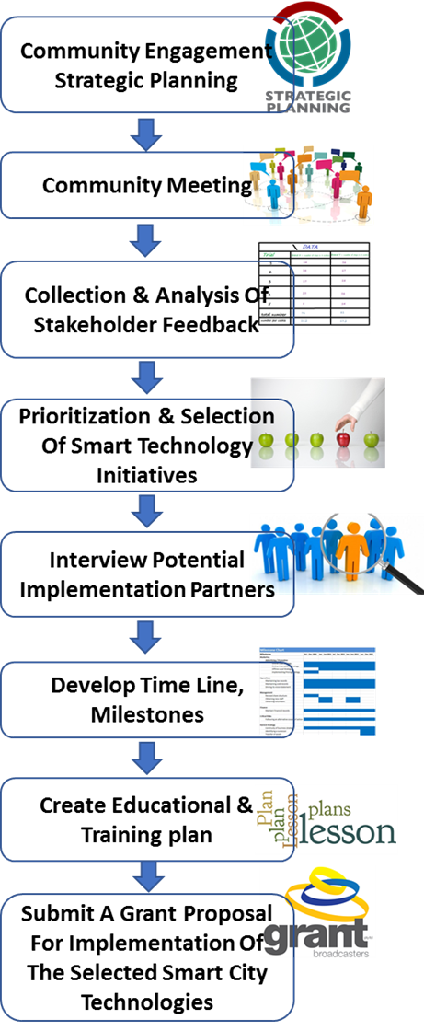
Project Aims
The primary goal of the Smart and Connected Rural Community planning grant is to explore how smart technologies can be used to enhance the lives of rural residents.
The City of Prairie View (CPV) was selected for this planning project for its distinctive rural nature. Rural Community's unique Challenges are Low Income, Aging population, and Aging Infrastructures.
To improve the quality of life, our researchers must assess the needs and desires of Prairie View Community (PVC) residents and tailor smart tools to meet those needs.
Since last year our team has been working closely with the Mayor, CPV residents and local government and engaging all the stockholders to assess the need of smart solutions.

Slide 3
Update of the Project since last PI meeting Community Engagement
The team has worked collaboratively to create an in depth survey instrument that was used to assess Prairie View City residents’ views on technology and some of their concerns regarding the implementation of SMART technologies.
Facilitated community meetings with the citizens of Prairie View City.
Administered in depth surveys with Stakeholders and then gathered qualitative feedback in an open forum on how technology should be implemented in the City of Prairie View.
Public safety, city council, a physician and two community health workers, longtime residents, Mayor of the City of Prairie View.
Had Focus Groups
SCC Team has completed Demographic Assessment, Assessment of Crime and Safety, Assessment of Health Services, and Assessment of Technology.
Notes:
.

Slide 4
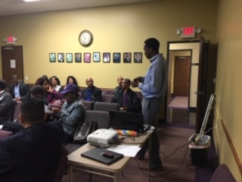
Update of the Project since last PI meeting What We Learned
In general, respondents were either strongly dissatisfied or dissatisfied with the healthcare services in the City of Prairie View.
Of the four sectors (healthcare services, communication technology, safety and emergency preparedness) under investigation, healthcare services or lack of healthcare services received the lowest satisfaction ratings from respondents. Therefore, healthcare services needed the most improvement.
Notes:
1. PVAMU and PVC have a fragmented relationship
2. Residents do not have the most experience with using technology but residents recognize the critical role technology is playing in society
3. The city of Prairie View is severely underserved in the area of health care services needed the most improvement

Slide 5
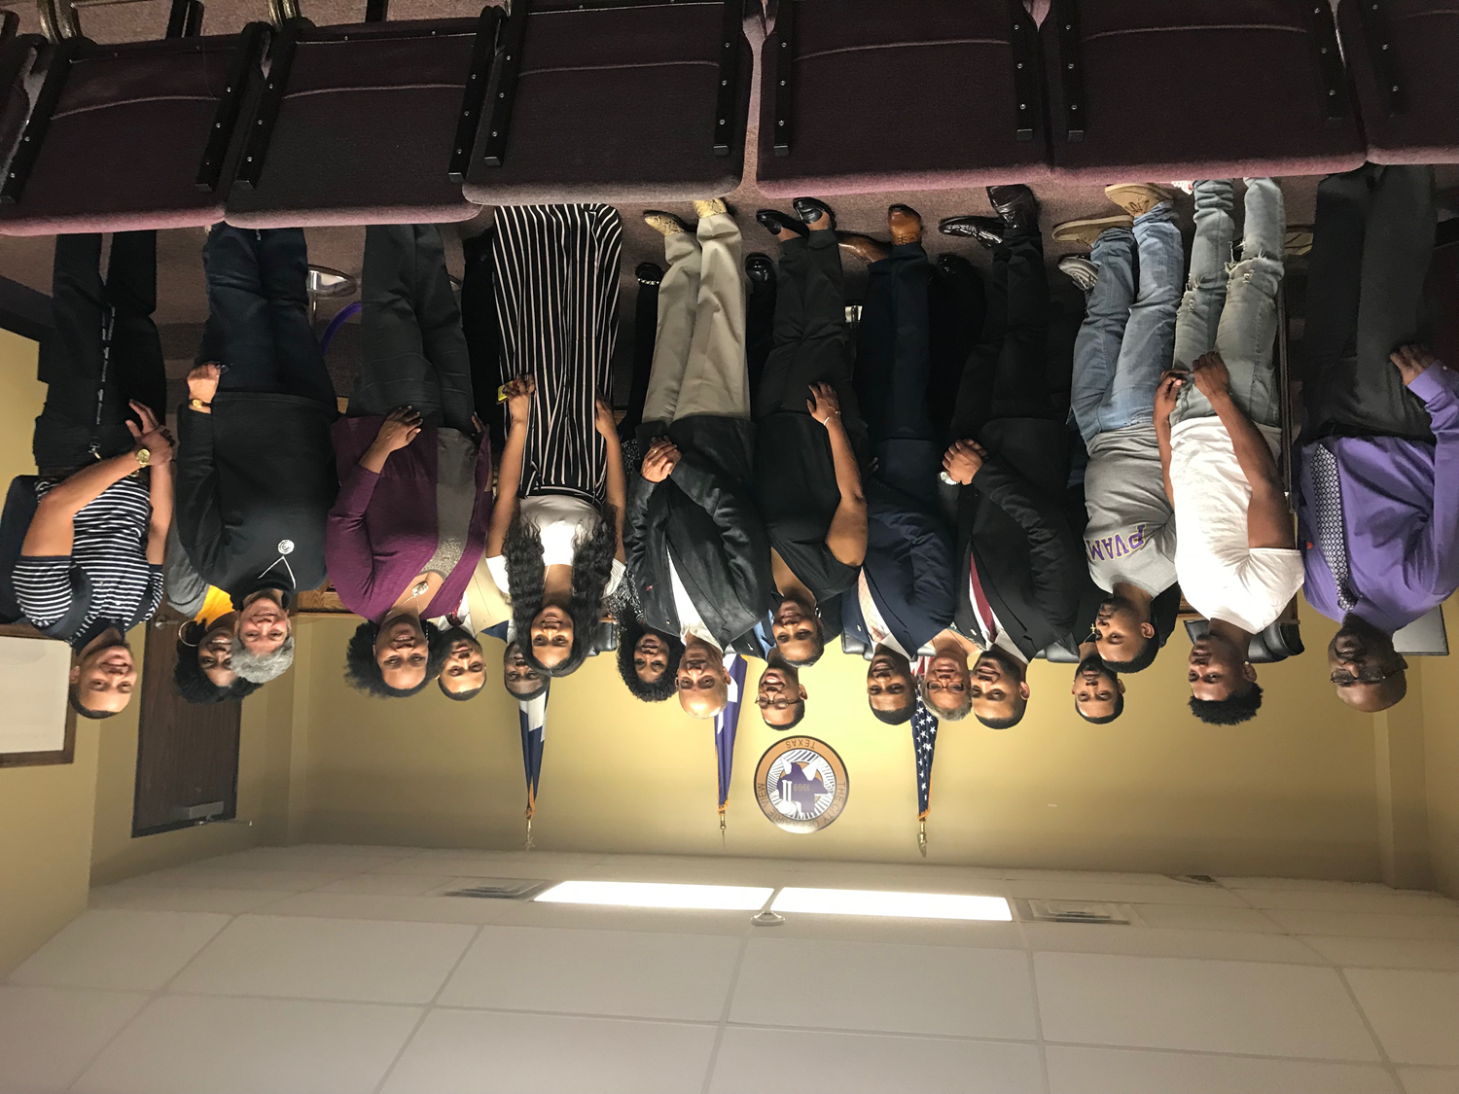
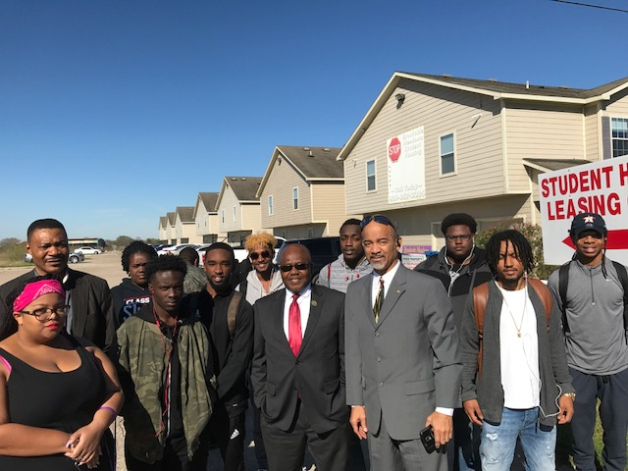
Planned Outcomes/Next Steps
Formation of a Community Advisory Board
Understand the need of Smart & Connected Rural Communities
Implement Smart technologies to telehealth in rural communities
Dissemination of knowledge to scientific community and stakeholders via publication and presentation
Develop educational and training plan involving smart technologies in telehealth.
Identified and selected Industrial Partners
Will submit a grant proposal to NSF for the implementation of the selected smart technologies for the Smart & Connected Rural Communities.
Notes:
A survey has been drafted to collect more data in the area of healthcare services. Community members had input in the creation of the items for the healthcare survey.
Community Advisory Board is being formed.

