Slide 1


2019 NSF SMART AND CONNECTED COMMUNITIES PI MEETING
FY 2017 RCN: MainStreet21, NSF Award GA11275
PI Ila Berman, co PI Karen Rheuban, Donna Cheng, Cai Qian, RCN Director Mona El Khafif, Advisor Tho Nguyen, IEN Tanya Denckla
UVA University of Virginia
http://www.mainstreet21.org/
Notes:
BRIEFLY INTRODUCE YOURSELF AND YOUR INVESTIGATORS (10 sec slide)

Slide 2
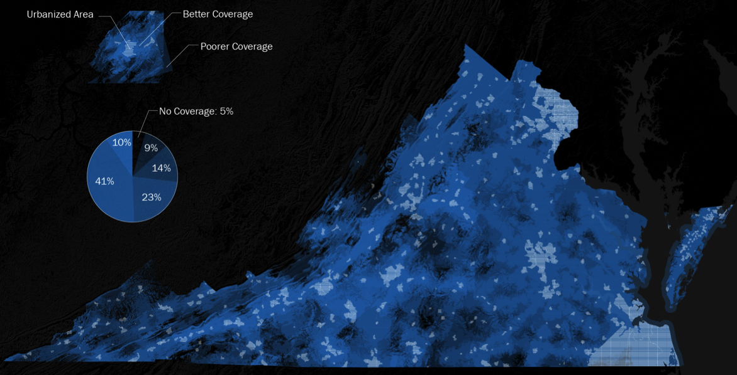
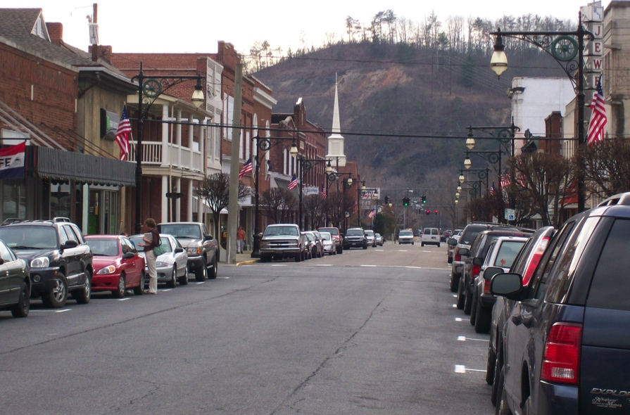
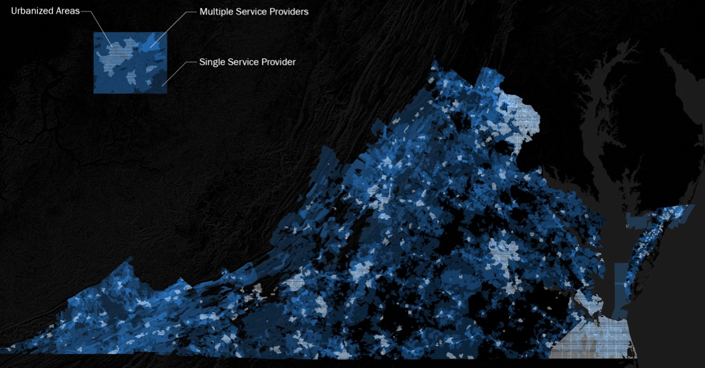
Project Aims VA MainStreet21
NSF19_Smart and Connected Communities PI Meeting Denver
Network
Exchange
Support
Pipelines
Establishment of Partner Network and Communities in the Commonwealth of Virginia
SCC Project support: evaluate proposed projects and activities, pipeline support from concept to implementation
Community Engagement: Annual partner workshop and community workshop
Education and training: web portal, visiting lectures, student involvement
MainStreet 21 Playbook: Publication best practice and pipeline strategies
Figure: [left] Downtown Covington, VA Main Street, steady decline since 1960 from 11,062 to 5518 residents, [right] VA Broadband Coverage
Dr. Mona El Khafif I University of Virginia
Notes:
A brief background: Please describe the problem you are addressing and why it is important (20sec slide)

Slide 3
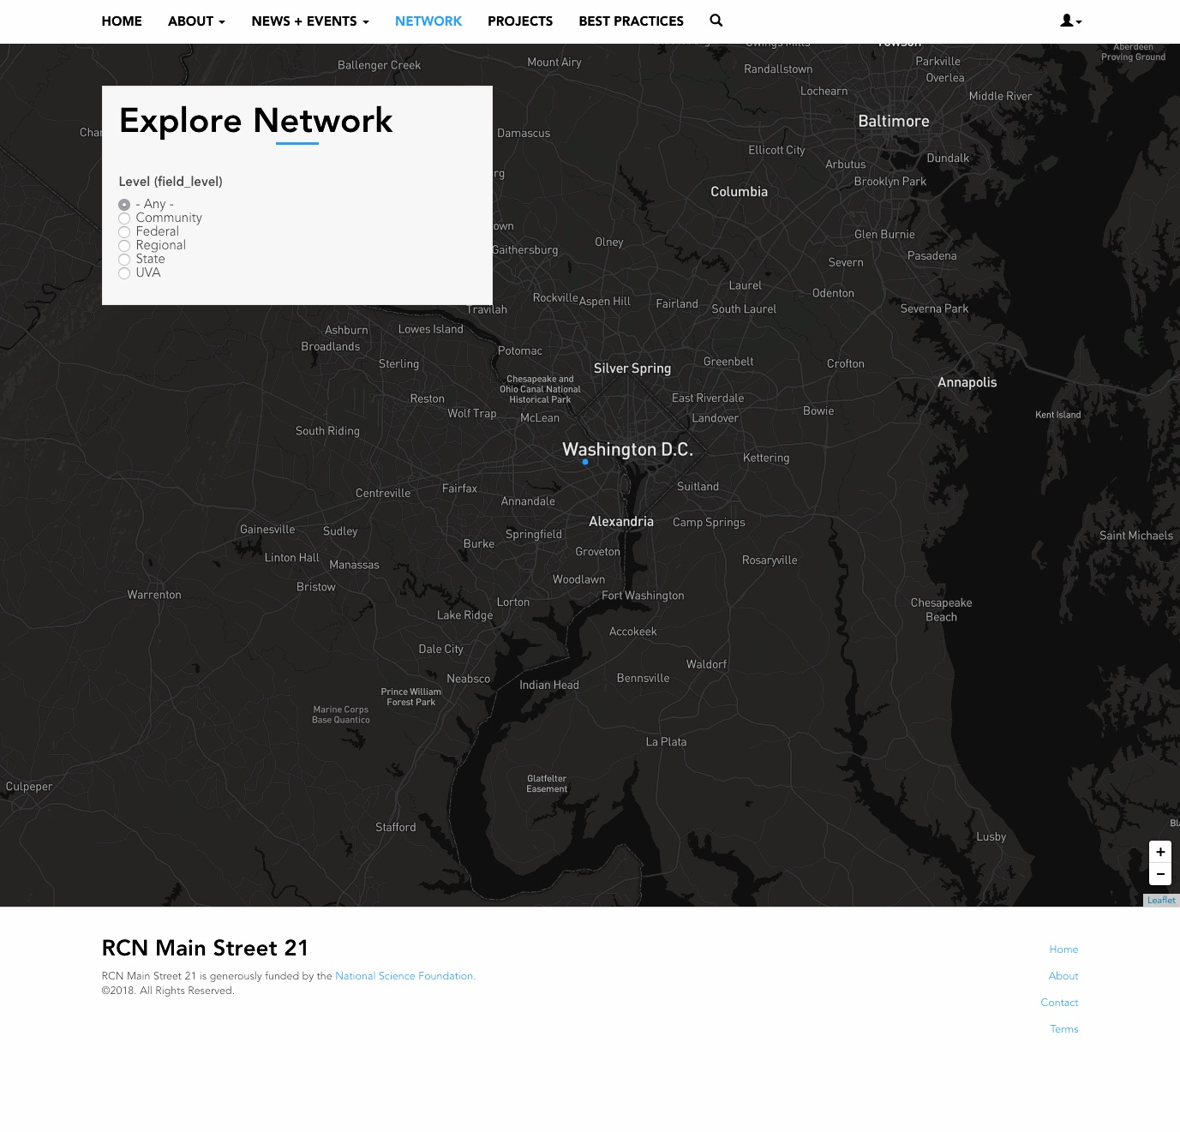
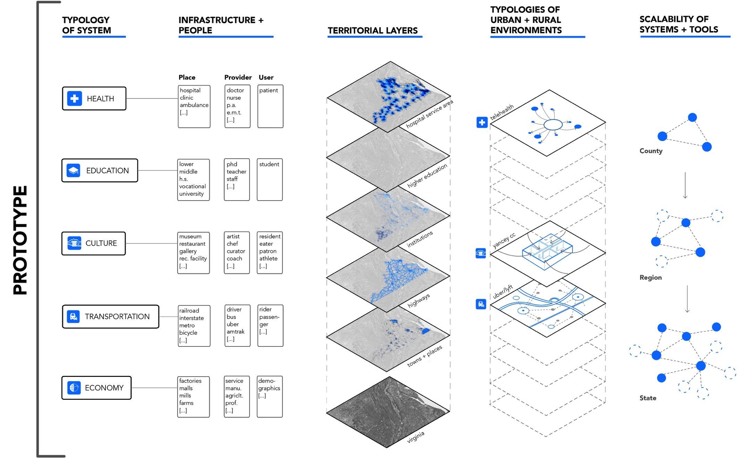
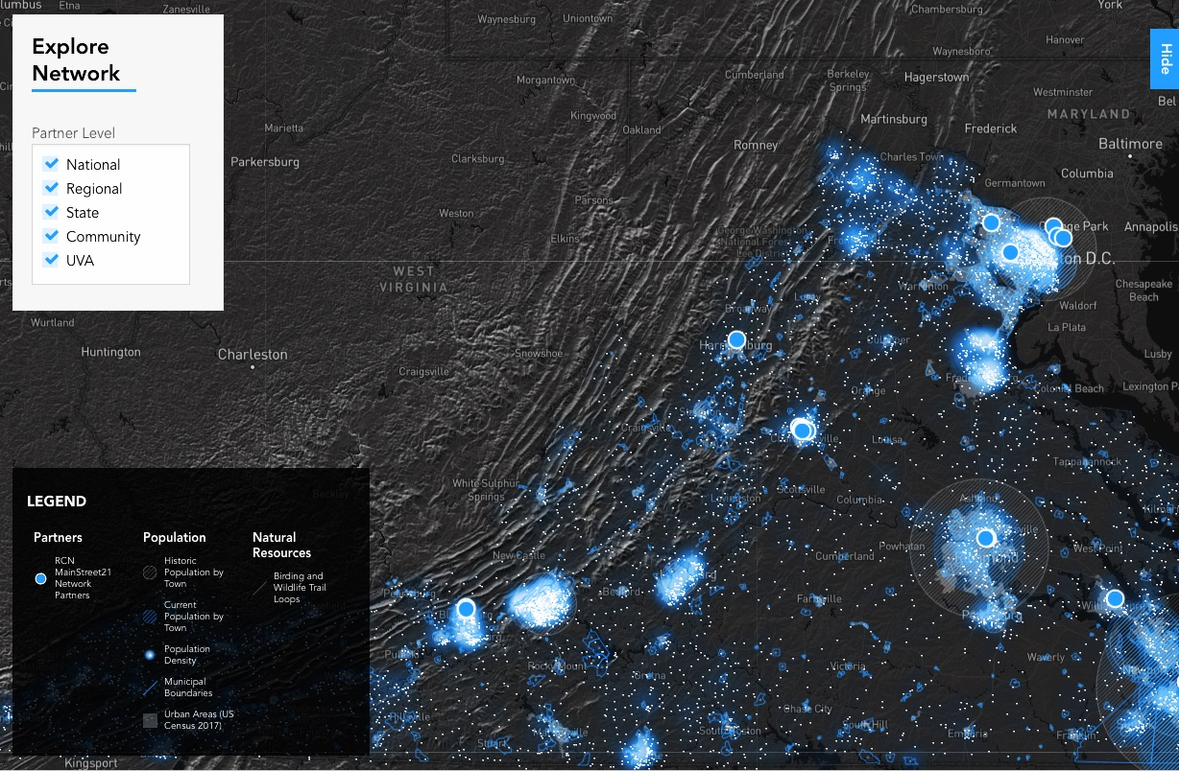
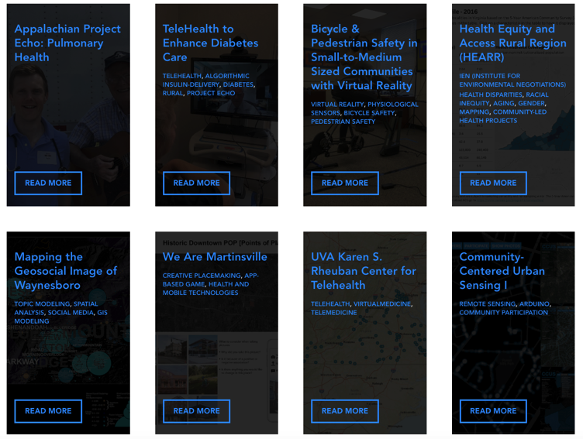
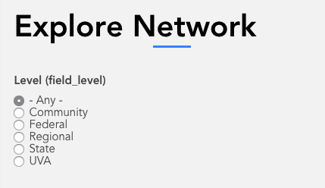
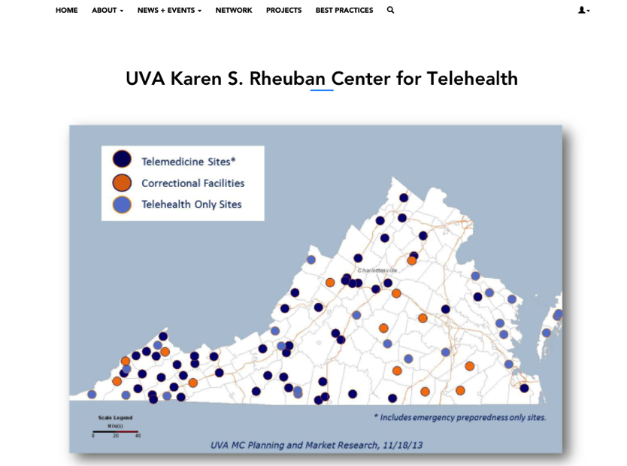
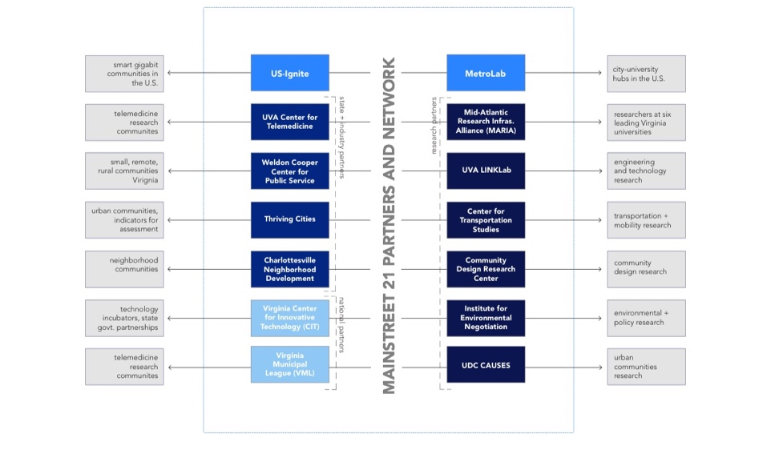
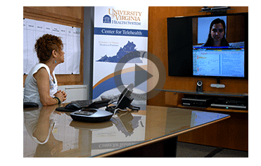
NSF19_Smart and Connected Communities PI Meeting Denver
RCN Website Tool
Website as a Networking and Publication Tool. www.mainstreet21.virginia.edu
Dr. Mona El Khafif I University of Virginia
Notes:
A brief background: Please describe the problem you are addressing and why it is important (20sec slide)

Slide 4
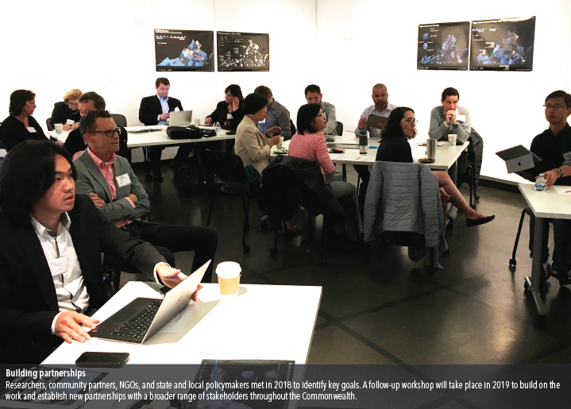
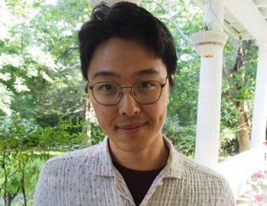
NSF19_Smart and Connected Communities PI Meeting Denver
Status of Project
April 18th first RCN Workshop with Partners
Presentation of MainStreet21 on several conferences nationally and internationally [Germany, 2018]
Participation in Tom Tom Founders Festival 2018
Jul 17th Website and Tool Launch
Nov Pipeline Support and call for Submissions
Development of major collaboration with Martinsville through WAM Health Game
Dec Database development best Practice
Launch of Playbook 2018 up-coming
Taro Matsuno
Research Assistant
UVa School of Architecture
Dr. Mona El Khafif I University of Virginia
Notes:
A brief background: Please describe the problem you are addressing and why it is important (20sec slide)

Slide 5
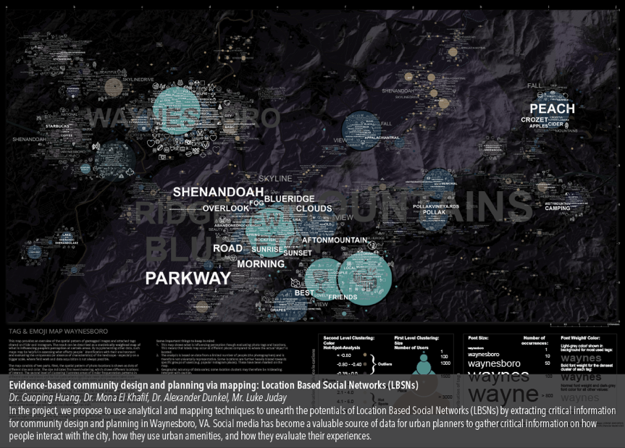
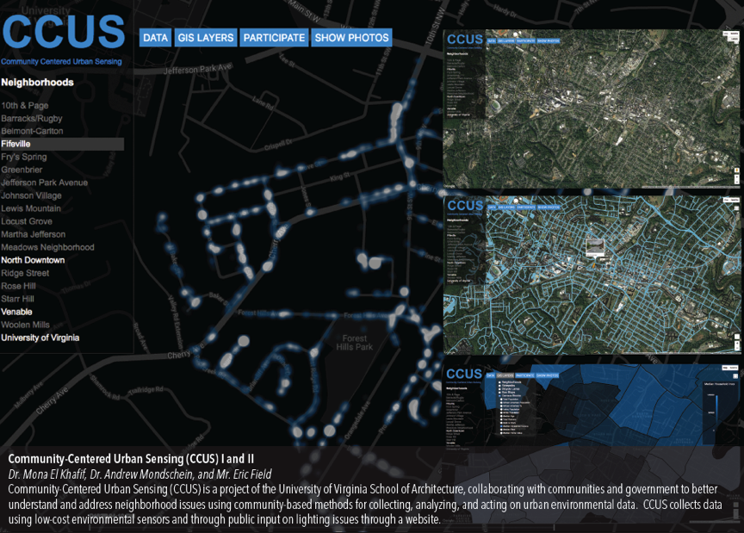
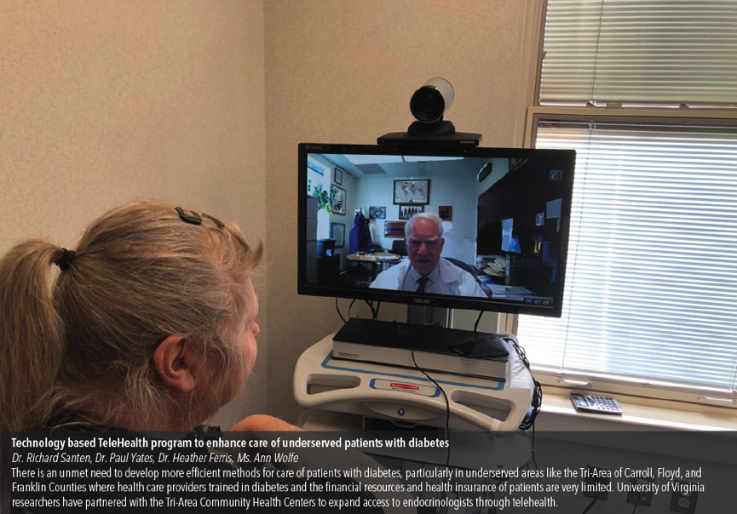
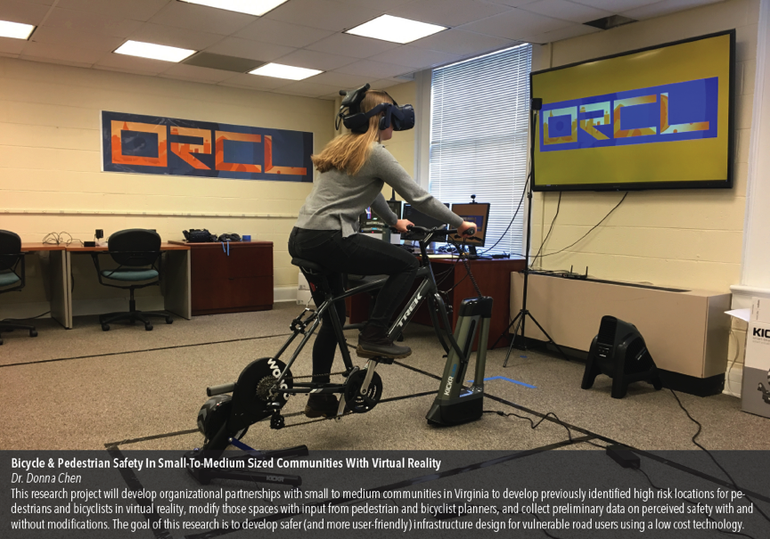
Update Sociotechnical Outcomes
NSF19_Smart and Connected Communities PI Meeting Denver
Pipeline projects 2018/19 and develop-ment of a technology-community-design integration model serving as a framework for the RCN’s seed projects:
Appalachian Project Echo: Pulmonary Health,
D. Harris, MD, UVA Karen S. Rheuban Center for
Telehealth, Stone Mountain Health Services, The
Health Wagon
TeleHealth To Enhance Diabetes Care,
Dr. R. Santen
Bicycle & Pedestrian Safety In Small-To-Medium Sized Communities With Virtual Reality,
Dr. D. Chen
Health Equity And Access Rural Region (HEARR), Frank Dukes IEN, HEARR Steering Committee
Mapping The Geosocial Image Of Waynesboro,
Dr. M. El Khafif, Dr. G. Huang, Dr. A. Dunkel,
Luke Juday Planning Director of Waynesboro
Community Centered Urban Sensing Virginia,
Dr. M. El Khafif, Dr. A. Mondschein, Eric Field
Figure: Funded Pipelines 2018/2019
Dr. Mona El Khafif I University of Virginia
Notes:
A brief background: Please describe the problem you are addressing and why it is important (20sec slide)

Slide 6
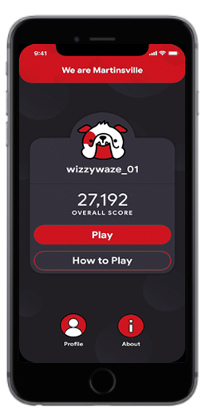
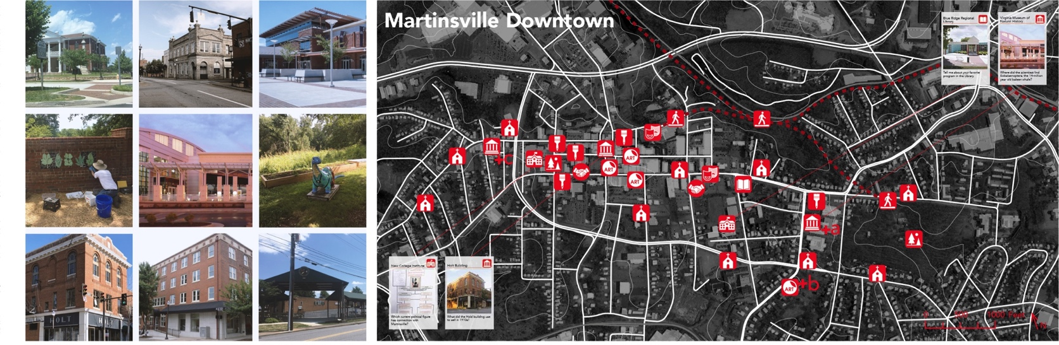
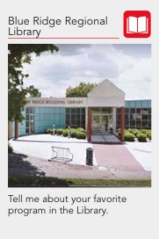
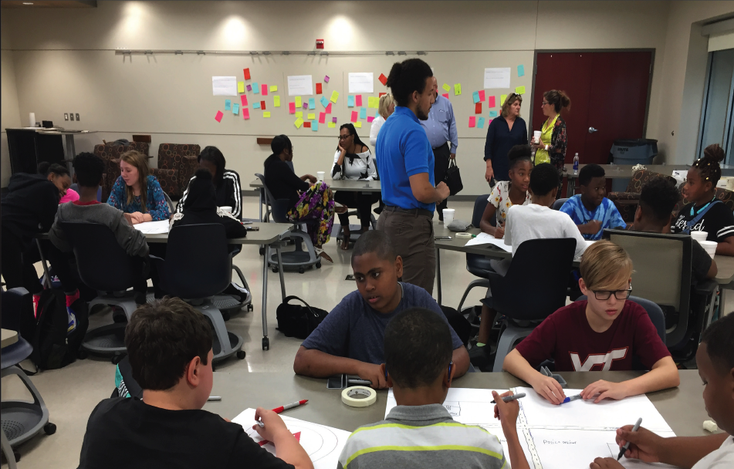
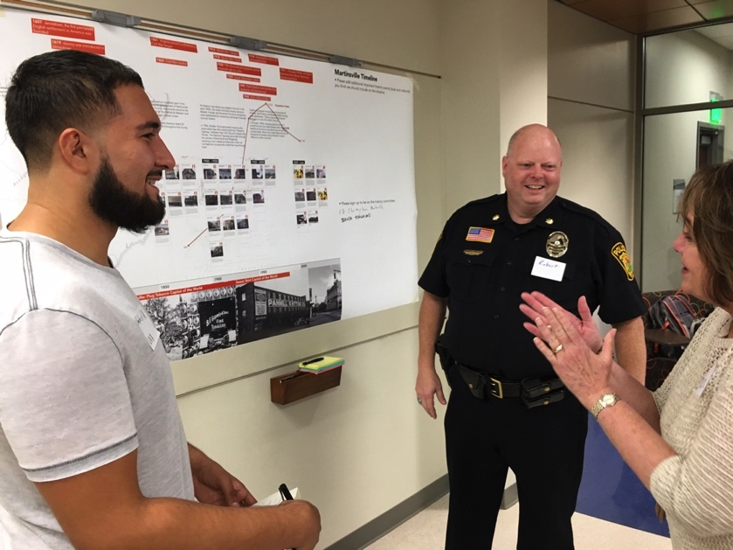
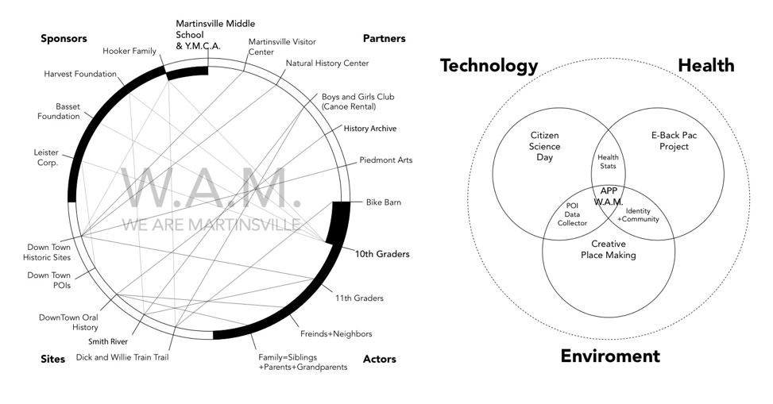
NSF19_Smart and Connected Communities PI Meeting Denver
Update Community Engagement Outcome
We Are Martinsville Health Game Collaboration between Community of Martinsville, UVA Telehealth, UVA Computer Science [DEVhub], UVA Architecture
Placemaking Strategy that successfully brings together Technology I Design I Community
CCUS Community Workshops with Neighborhood Associations
Further collaboration with Waynesboro, Hampton, Botetourt County, Orange County, Central Appalachia, Tri-Area of Carroll, Floyd, Franklin Counties, Albemarle, Buckingham-Fluvanna-Nelson County region through two new pipeline projects
Figure: WAM We Are Martinsville 2018/2019
Dr. Mona El Khafif I University of Virginia
Notes:
A brief background: Please describe the problem you are addressing and why it is important (20sec slide)

Slide 7
NSF19_Smart and Connected Communities PI Meeting Denver
Timeline and Deliverables 2019
Critical Outcomes 2019
Workshop with Partners and Communities
April 29, 2019, Hotel Roanoke. Goal is to expand collaboration
Digital Playbook 2018-2019
Test-drive of WAM We Are Martinsville and launch of replication
Continue with seed funds for pipeline projects 2019 / 2020 Virginia wide
Community Outreach Campaign
Contact
Mona El Khafif me9gn@virginia.edu
Tho Nguyen thn2c@virginia.edu
Dr. Mona El Khafif I University of Virginia
Notes:
A brief background: Please describe the problem you are addressing and why it is important (20sec slide)

