Slide 1
2019 NSF SMART AND CONNECTED COMMUNITIES PI MEETING
FY 2017 RCN: Developing an Informational Infrastructure for Building Smart Regional Foodsheds, NSF Award 1737573
University of California, Davis: Thomas Tomich (PI; Agricultural Sustainability Institute (ASI), Matthew Lange (co-PI; Food Science & Technology), Nina Amenta (Computer Science), Jim Quinn (Environmental Science & Policy), Nick Anderson (School of Medicine), Allan Hollander (ESP), Courtney Riggle (ASI), Patrick Huber (ASI)
The Ohio State University: Casey Hoy (co-PI; Initiative for Food & AgriCultural Transformation, InFACT), Ayaz Hyder (co-PI; Translational Data Analytics), Dorota Grejner-Brzezinska (Engineering), Jill Clark (Public Affairs) , Ingrid Adams (College of Medicine), Angela Latham (InFACT)
Other Institutions and Steering Committee Partners: Suzanna Lewis (co-PI; Lawrence Berkeley National Laboratory), Robyn Krock (Valley Vision), Matt Baker (Ecological Council of Sacramento), Daphne Miller (UC Berkeley/UC San Francisco), Brandi Braun (City of Columbus / Smart Columbus), Amrik Khalsa (Nationwide Children’s Hospital), Brian Estabrook (Franklin Co. Economic Development & Planning)
Notes:
This is the transition slide. The lightning talk moderator will announce the name of your project and the name of the lead PI. Expect to begin your presentation from the next slide.

Slide 2
RCN Project Aims:
Develop an informatics framework for understanding and optimizing regional food systems (“foodsheds”)
interrelated network relationships and material flows in the food system
information technologies to capture these relationships for information sharing and analysis
with stakeholders, strengthen regional, national, and international food system research and action

Slide 3
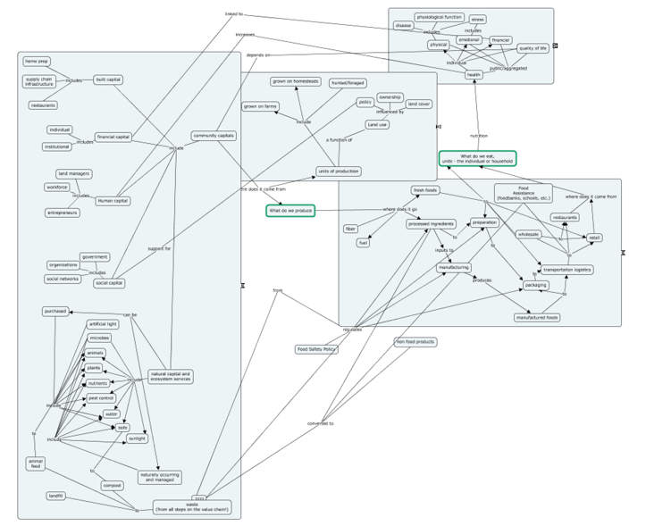
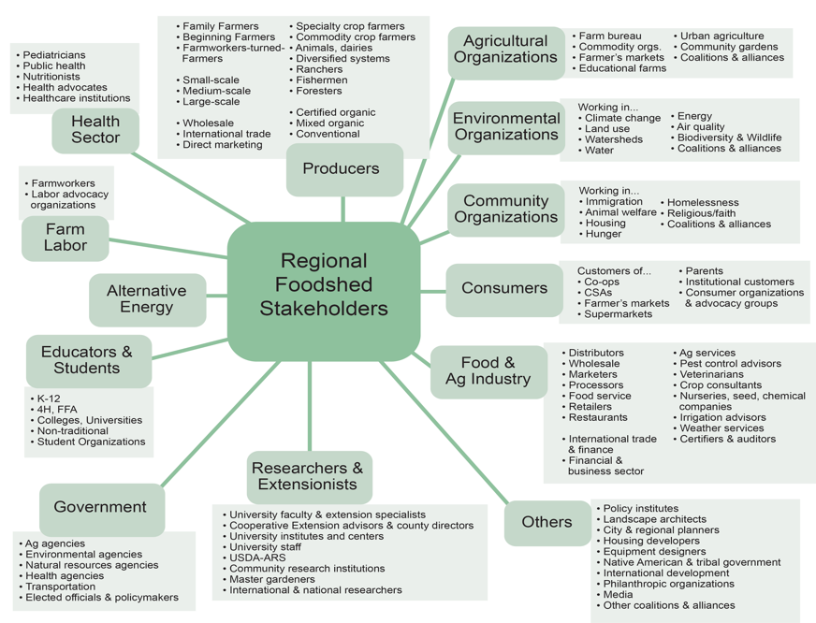
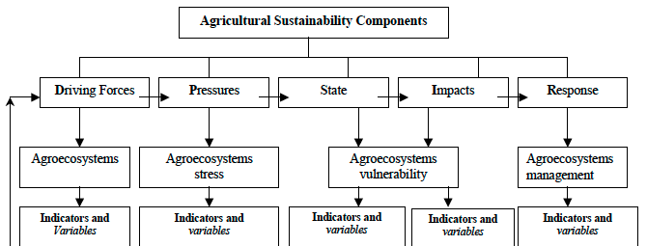
Update of the Project since last PI meeting
Food system mapping
Stakeholder mapping
Notes:
Scientific status of the project: Describe what you have done so far to advance your coordination network in terms of science (technical and social). Include activities from the past year (since the previous S&CC PI meeting). Also describe something unexpected that came about through your activities. Include photos and minimize text. Anecdotes are highly encouraged.

Slide 4
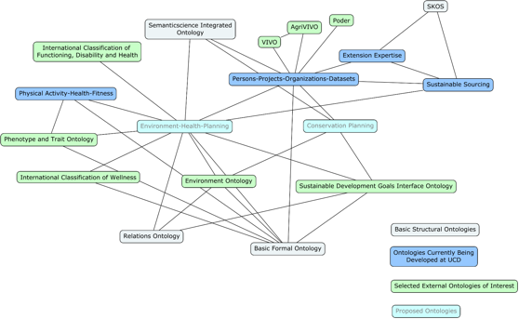
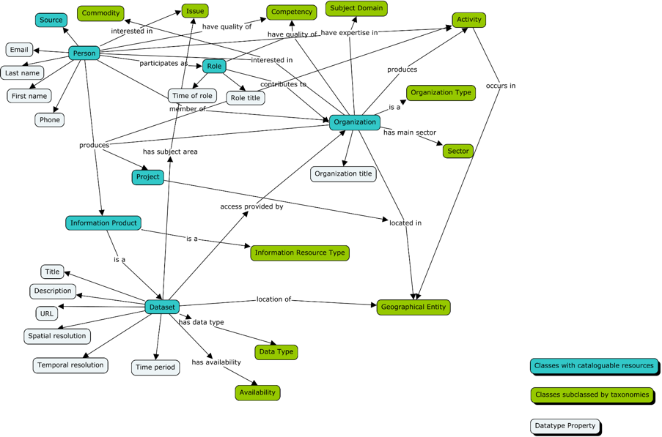
Update of the Project since last PI meeting
Multi-ontology framework
PPOD Ontology framework
Publication
Hollander et al. In revision. Towards smart foodsheds: using stakeholder engagement to improve informatics frameworks for regional food systems.
2020 Special Issue on Smart Spaces and Places, Annals of the American Association of Geographers.
Stakeholder Record
Notes:
Community engagement and capacity Status of the Project: Describe what you have done so far to advance your coordination network in terms of community engagement and capacity building. Also describe something unexpected about working with your community partners. Anecdotes are highly encouraged. Include photos.

Slide 5
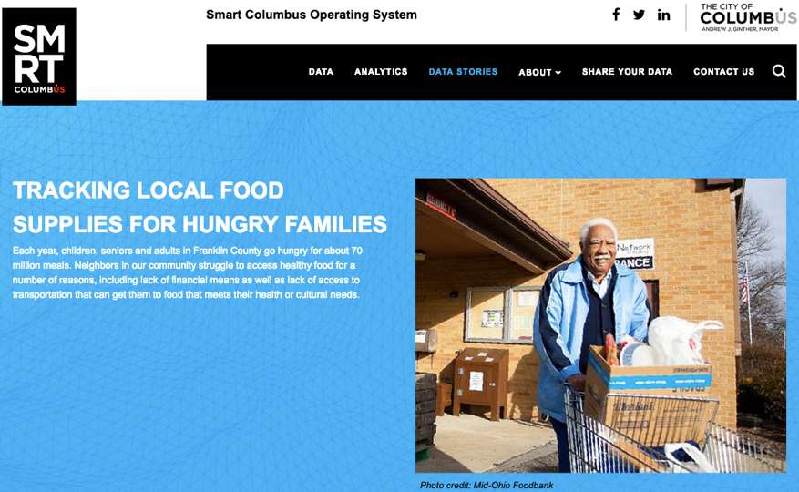
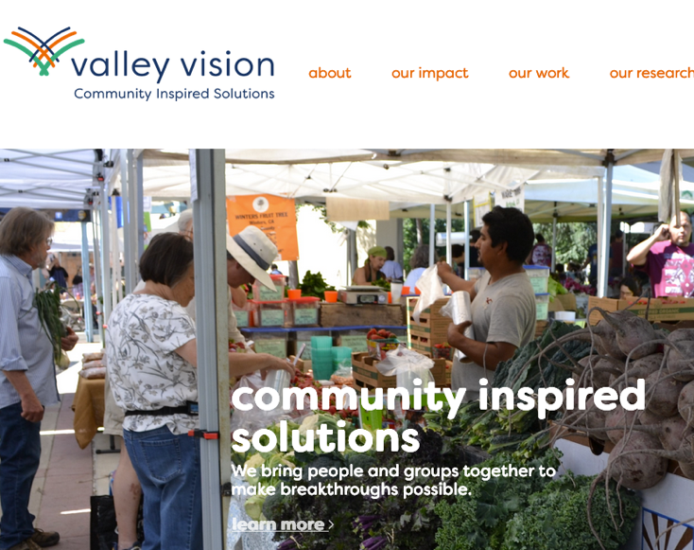
Anticipated outcomes and success measures in the next year
Meeting with stakeholders to develop use cases
Collecting and curating data resources
Coordinating between UCD and
OSU on use cases in four key areas:
Policy
Health
Supply chains
Production
Notes:
Describe at least two deliverables that you plan to accomplish over the next year that will significantly advance your project.

