Slide 1
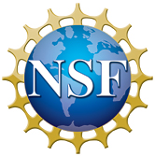
2019 NSF SMART AND CONNECTED COMMUNITIES PI MEETING
FY 2017 RCN: Smart Civic Engagement in Rapidly Urbanizing Regions, NSF Award #1737563
PI: Ross K. Meentemeyer¹ Co-PI: Helena Mitasova¹ Co-PI: Todd BenDor² Co-PI: Kevin Foy⁴ Co-PI: Emily Bernhardt³ Network Coordinator: Corey White¹
¹Center for Geospatial Analytics, North Carolina State University ²University of North Carolina at Chapel Hill ³Duke University ⁴North Carolina Central University
Community Partners: City of Raleigh Information Technology, Town of Chapel Hill Public Works, South Atlantic Landscape Conservation Cooperative, Water Resources Research Institute of UNC, UNC-Chapel Hill Energy Services
go.ncsu.edu/tomorrownow
Notes:
This is the transition slide. The lightning talk moderator will announce the name of your project and the name of the lead PI. Expect to begin your presentation from the next slide.

Slide 2
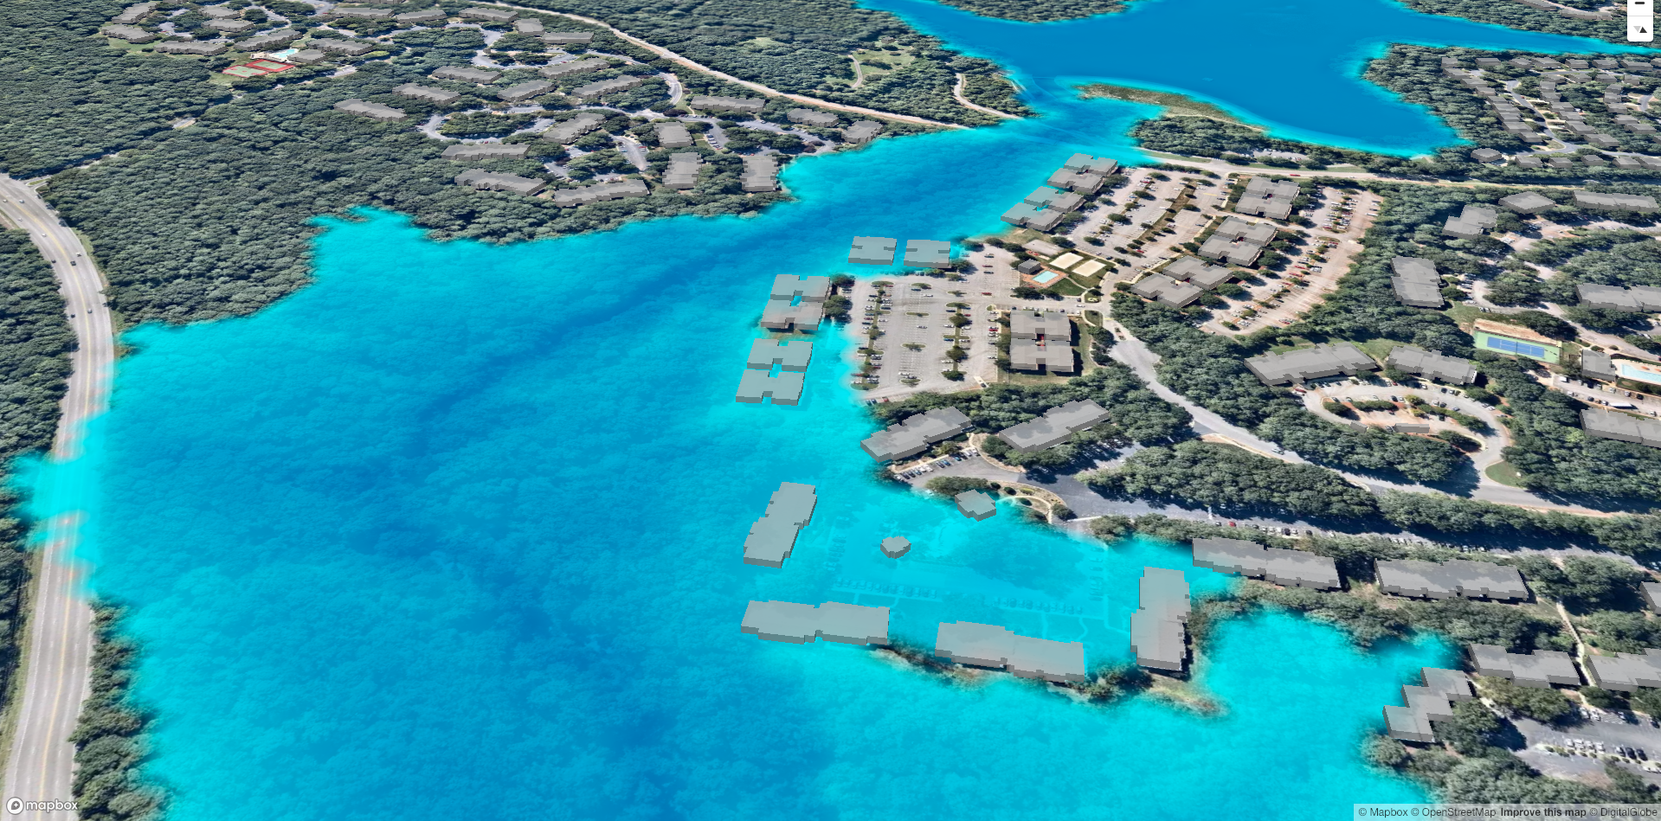
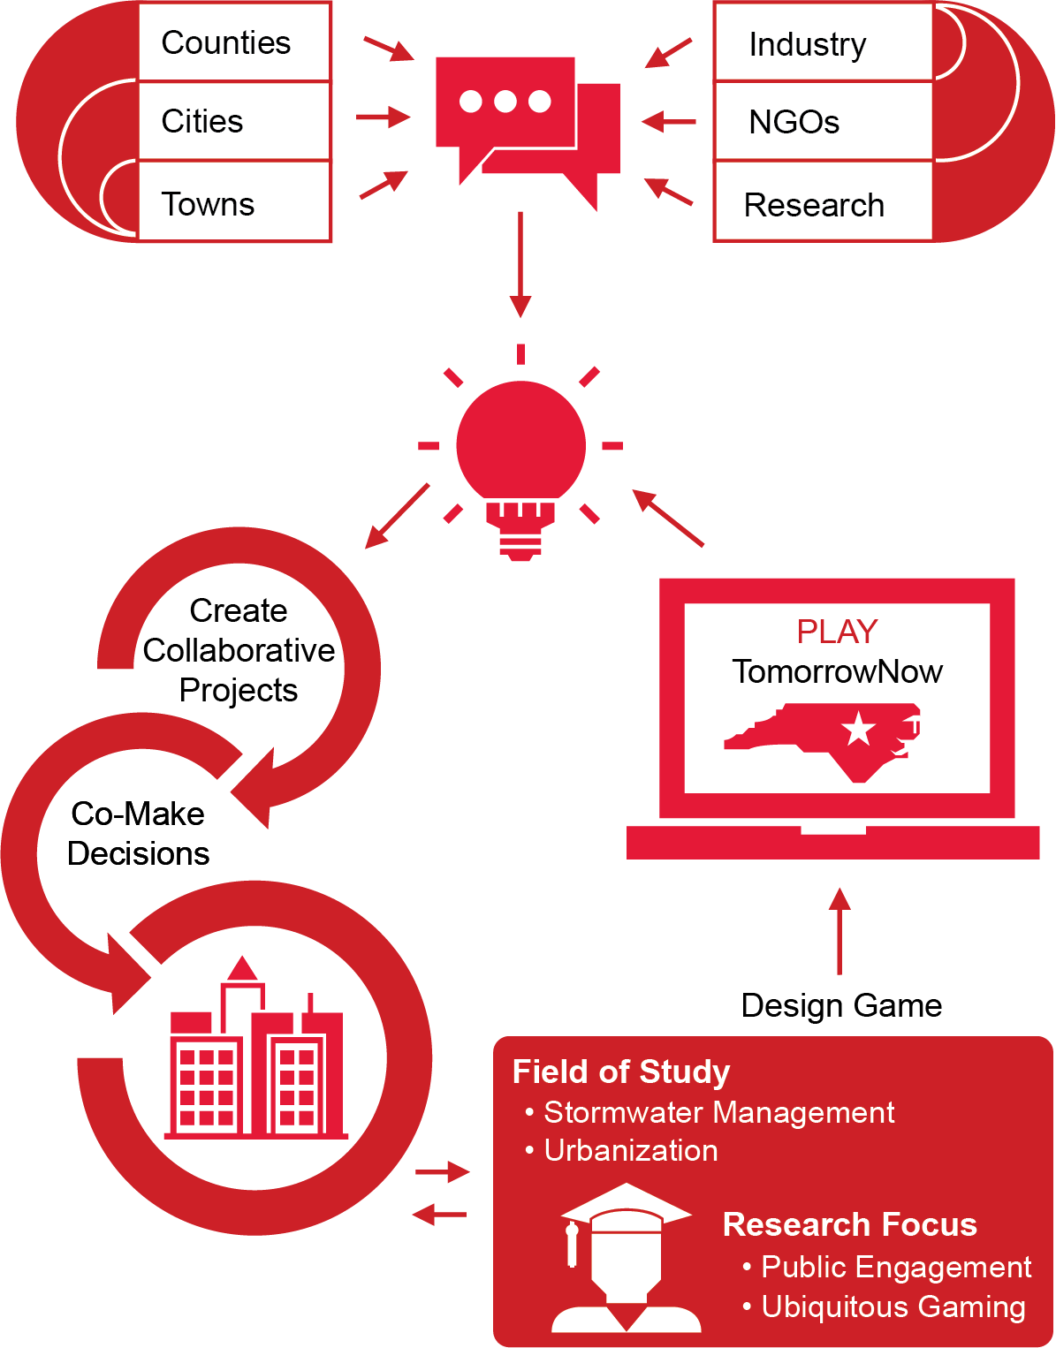
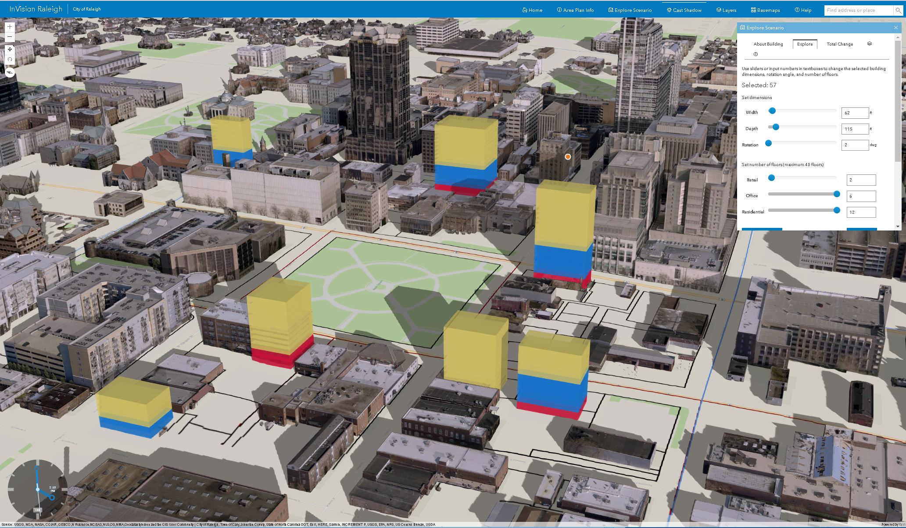
Project Aims
Context
Facilitating community engagement is hard, but necessary to develop tools and models of smart and connected communities.
Challenge
Can online serious games, using geospatial models & crowdsourced management scenarios, transform civic engagement and public policy decisions?
Example: Scenario of 5-m inundation used in TomorrowNow
Aim
Unite stakeholders in the Triangle to develop an online engagement system called TomorrowNow that will aid decision-making for stormwater management
Example: InVision Raleigh prototype for urban planning
This network will bridge technical research and social engagement through research about engagement with scientific models.
Notes:
Public engagement is hard!
People are busy, and for most, stormwater control or any other public utility is something that they just expect to work because (pause) you know taxes.
But managing stormwater is complicated and public input into how it is or is not working where they live is essential to the equitable development of smart and connected communities.
So, how can we improve public engagement?
Our work focuses on how to innovate citizen engagement through the use of serious games that use geospatial models, and crowdsource the design of management scenarios to improve decision-making in rapidly urbanizing regions. We see this as a way of getting a greater diversity of citizen input by essentially putting big data and sophisticated models into everyone’s hands and letting them “play” with alternative scenarios. Our initial focus for these games is urbanization and stormwater management . So, to develop this game – that we’re calling TomorrowNow – into something that will be useful and effective, we are uniting stakeholders and community leaders from around the Triangle region of North Carolina to co-create it.

Slide 3
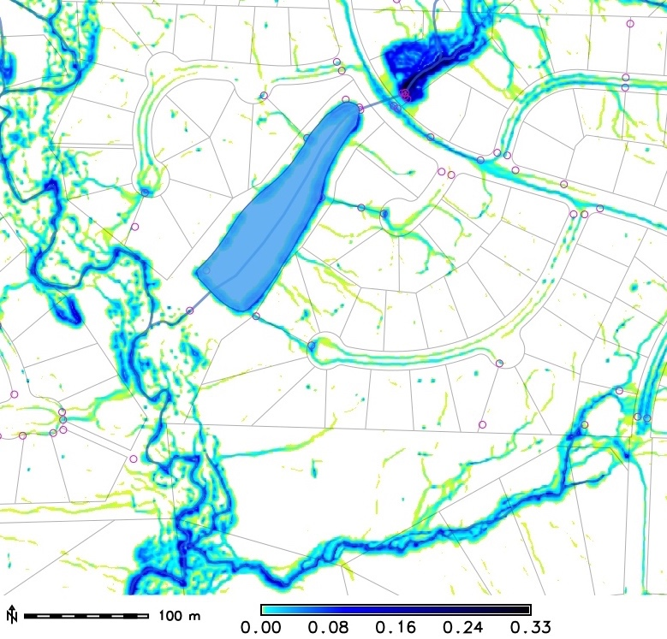
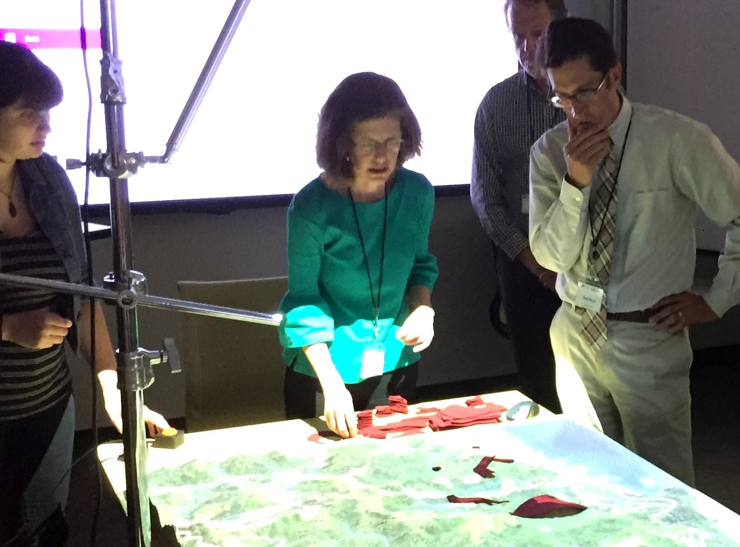
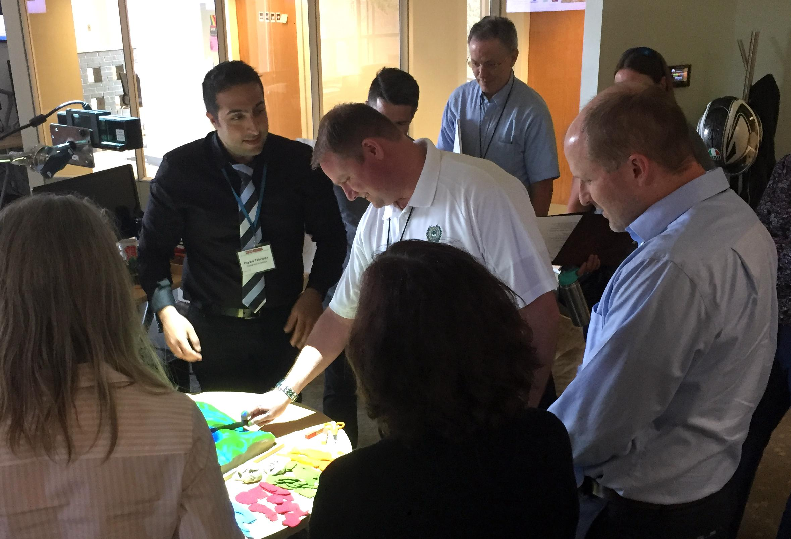
Update of the Project since last PI meeting
Coordination with the Town of Cary and City of Raleigh, demonstrating stormwater modeling applications.
Stakeholder Workshop with over 30 attendees, including members from the project’s Interdisciplinary Steering Committee and Stakeholder Advisory Board
“There’s a lot of exchange between city governments, but that does not mean collaboration for solutions. For Durham and Raleigh, the best collaboration comes when imposed by law.” –– Workshop Participant
Notes:
Last year we coordinated with the Town of Cary and City of Raleigh by demonstrating to them how some storm drains are not actually receiving the water they were designed to capture.
We did this by using 1m stormwater flow models to pinpoint how water flows over properties, streets, and other urban infrastructure.
We also hosted Workshop #1 our Goal-Defining Meeting!
During the workshop we were surprised by the creativity shown by participants when asked to imagine what TomorrowNow could look like. One participant imagined that TomorrowNow could work by having no way to win, so that people could gracefully learn to manage trade-offs that have no perfect solution. Ideas around spatial and temporal scales had a major impacts on which platforms, issues, and audiences the game could focus on --- do we need a “Homeowner Edition” or “City Planning” version or both?

Slide 4
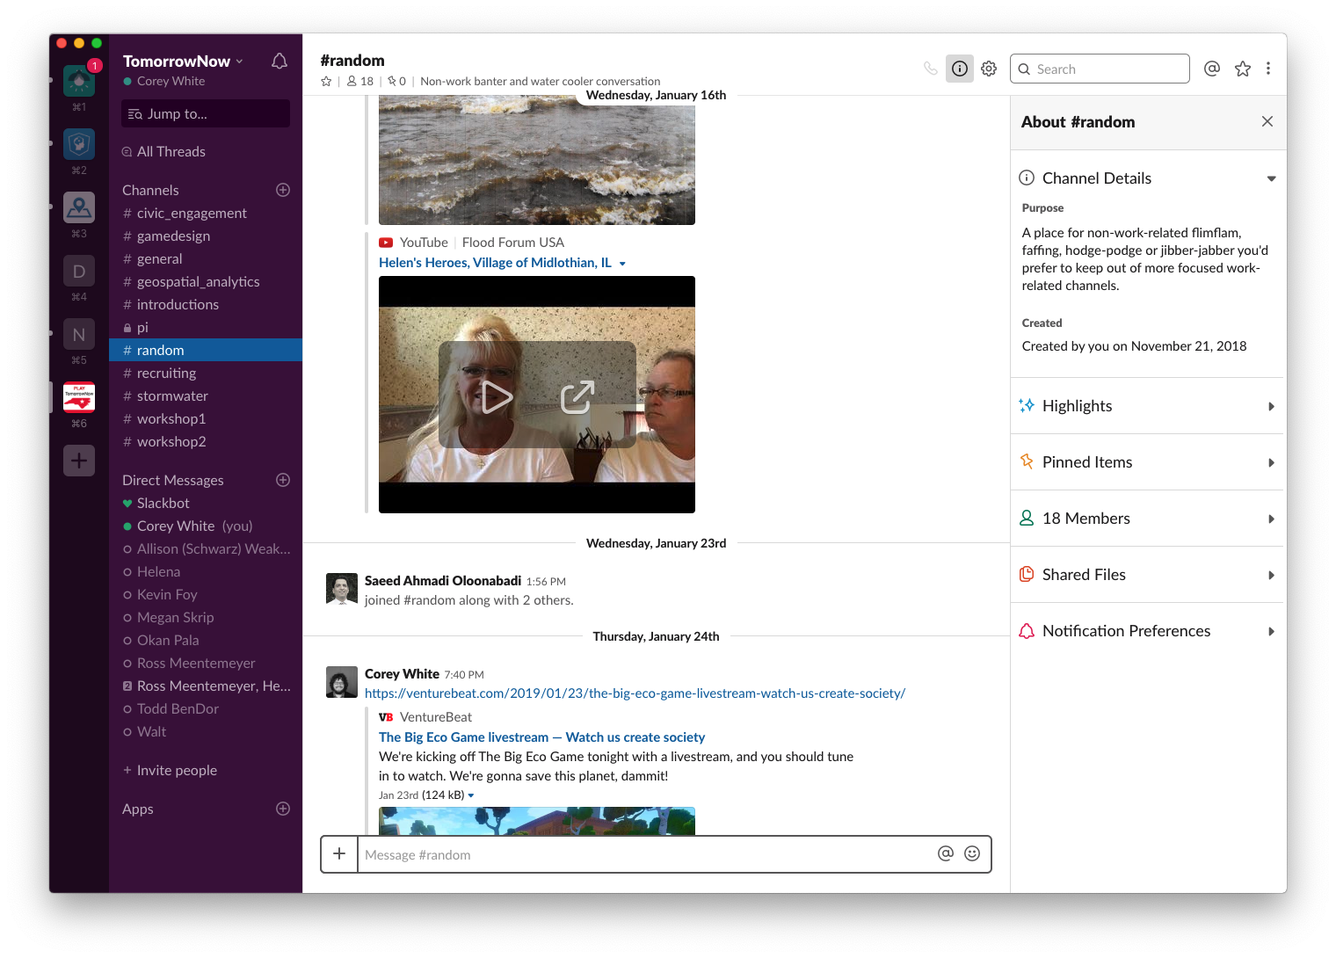
Update of the Project since last PI meeting
Slack
New Website
https://go.ncsu.edu/tomorrownow
Improved on-boarding to ease getting new stakeholders involved (Interdisciplinary Steering Committee and Stakeholder Advisory Board)
Community Updates
Growing Community of stakeholders
Notes:
Workshops and meetings are great for getting a lot of information at once, but once people leave they might not think about the issues again until they get another invite to the next event. In order to facilitate the co-development of TomorrowNow we set up a Slack community to foster ongoing dialog and transparency into the project.
We have also redesigned our website to make it easier to join the project and to make it easier for the community to catch up on what we are working on.

Slide 5
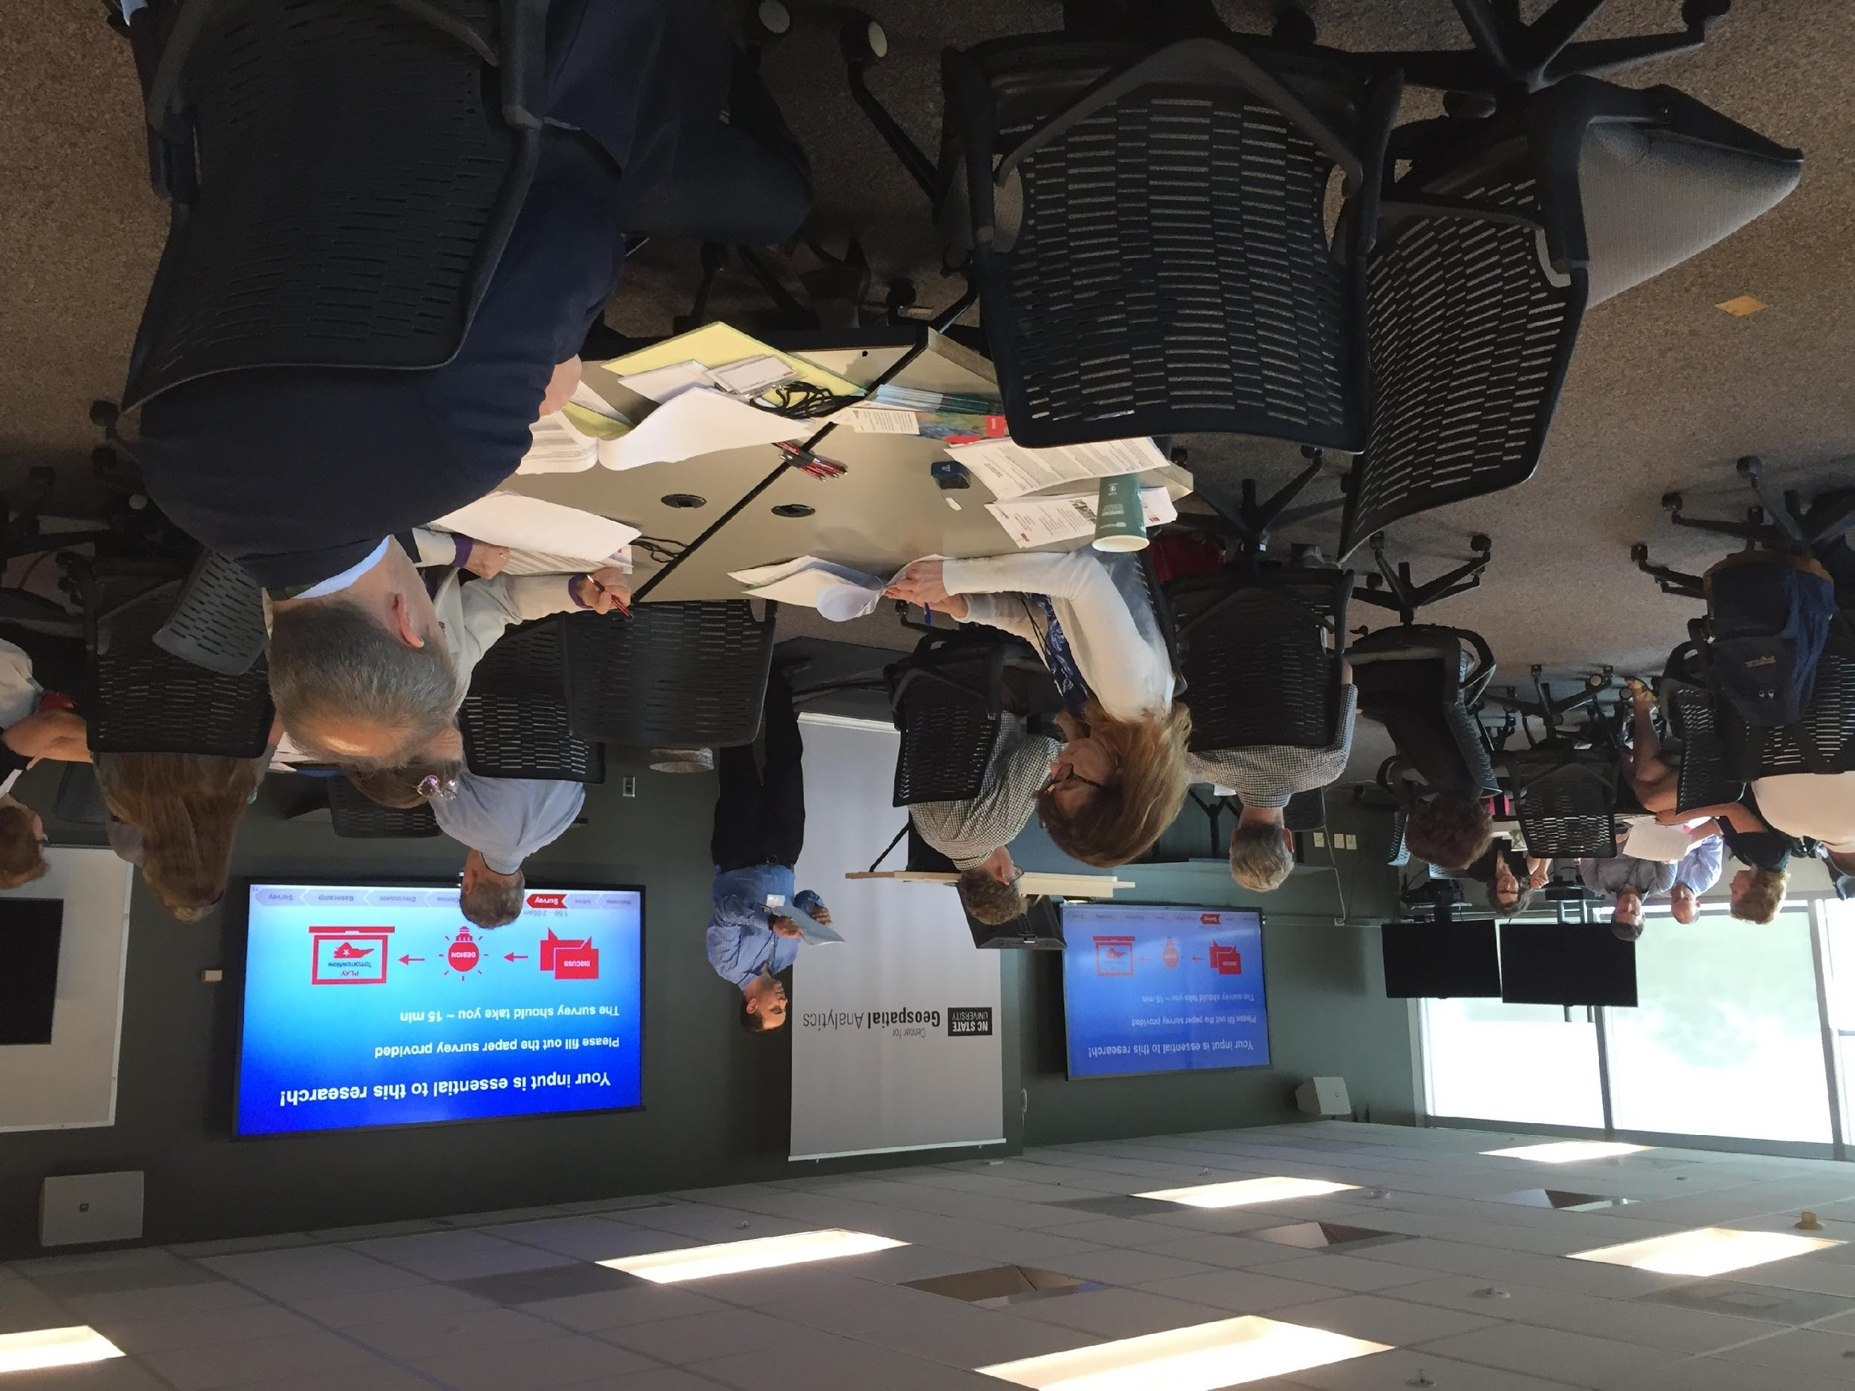
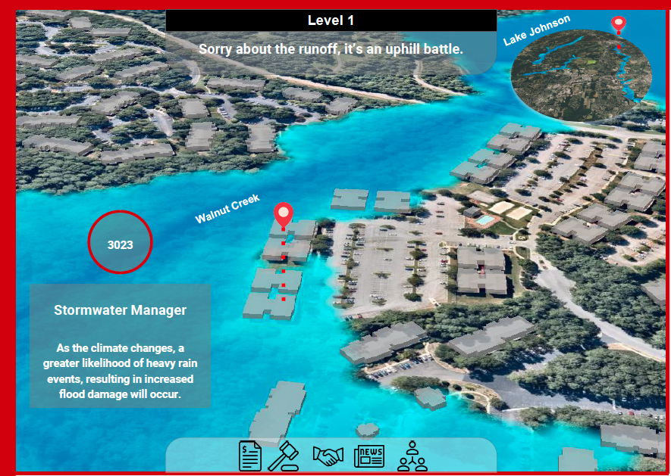
Anticipated outcomes and success measures in the next year
Workshops/Symposium/Interviews
Prototype
[Learn]
[Design]
[Build]
Notes:
Over the next year we plan to hold another workshop and a public symposium, interview members of our stakeholder advisory board, and develop an initial prototype of TomorrowNow. During our workshop we will develop a fuzzy cognitive map of stormwater issues in the Triangle and present stakeholders with various stormwater model outputs as discussion points centered around gamification. The public symposium will be designed to engage the public, informing them of our progress and to receive feedback. Interviewing members of our stakeholder advisory board will allow us gauge our lingering assumptions and finalize an idea for the development of an initial prototype. And finally, a prototype of TomorrowNow will be developed to test our assumptions by presenting it back to stakeholders and the public.
We hope that the success of this network –– and the initial game –– will eventually transform the way citizens participate in management decisions that affect where they live and work. Thanks for listening.

