Slide 1


2019 NSF SMART AND CONNECTED COMMUNITIES PI MEETING
RCN: One Bridge at a Time: Bridging the Digital Divide for the Well-Being of Aging Populations in Smart and Connected Communities (#1737483)
Project Team
Anil Yazici (PI), Assistant Professor, Civil Engineering, Stony Brook University, Email: Anil.Yazici@stonybrook.edu
Eren Erman Ozguven (Co-PI), Assistant Professor, Civil & Environmental Engineering, Florida A&M University-Florida State University College of Engineering, Email: eozguven@eng.famu.fsu.edu
David Eby (Co-PI), Research Professor, University of Michigan Transportation Research Institute, Email: eby@umich.edu
Jacqueline Mondros (Co-PI), Professor/Dean, School of Social Welfare, Stony Brook University, Email: jacqueline.mondros@stonybrook.edu
Walter Boot (Co-PI), Assistant Professor, Psychology, Florida State University, Email: boot@psy.fsu.edu
Project webpage: https://you.stonybrook.edu/agingpopulationrcn
Notes:
BRIEFLY INTRODUCE YOURSELF AND YOUR INVESTIGATORS (10 sec slide)

Slide 2
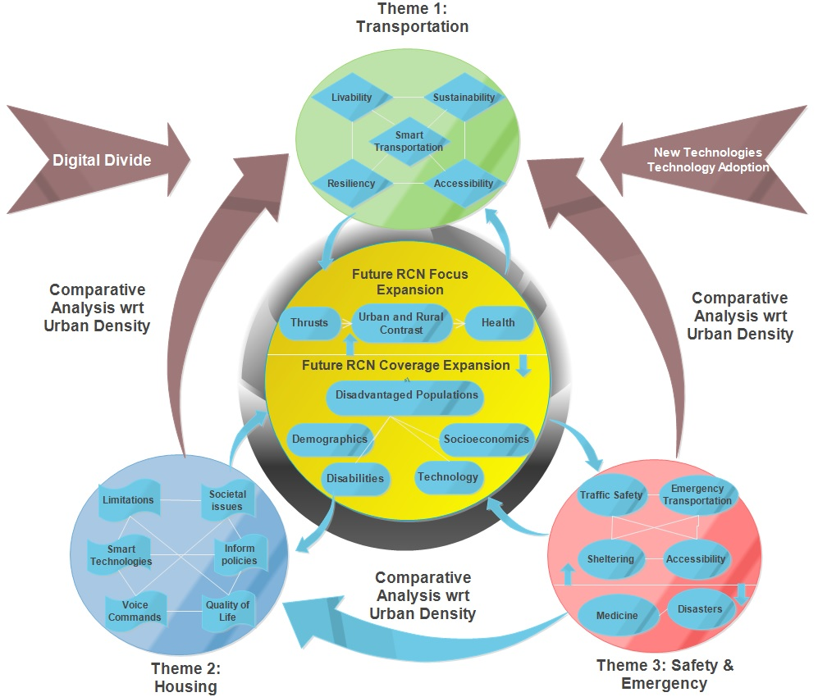
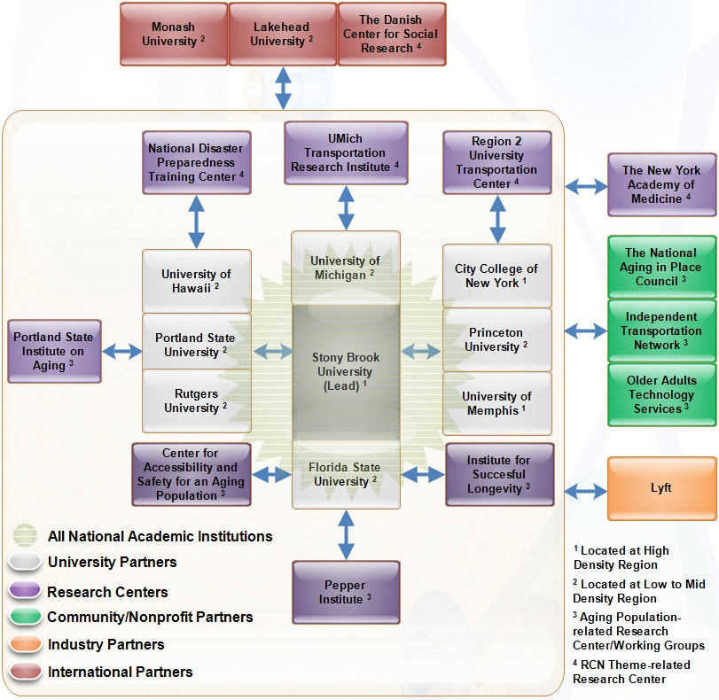
Project Scope and RCN Structure
Integrative Research:
A diverse group of researchers from 11 disciplines at 12 academic institutions, 5 community/non-profit/government organizations, and one industry partner as well as four international collaborators.
Workshops, special conference sessions and journal issues to promote, support, and strategize new directions in S&CC research
Notes:
A brief background: Please describe the problem you are addressing and why it is important (20sec slide)

Slide 3
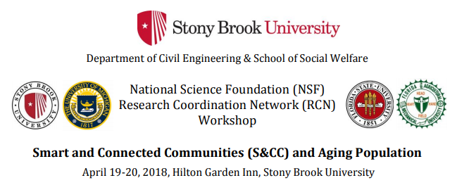
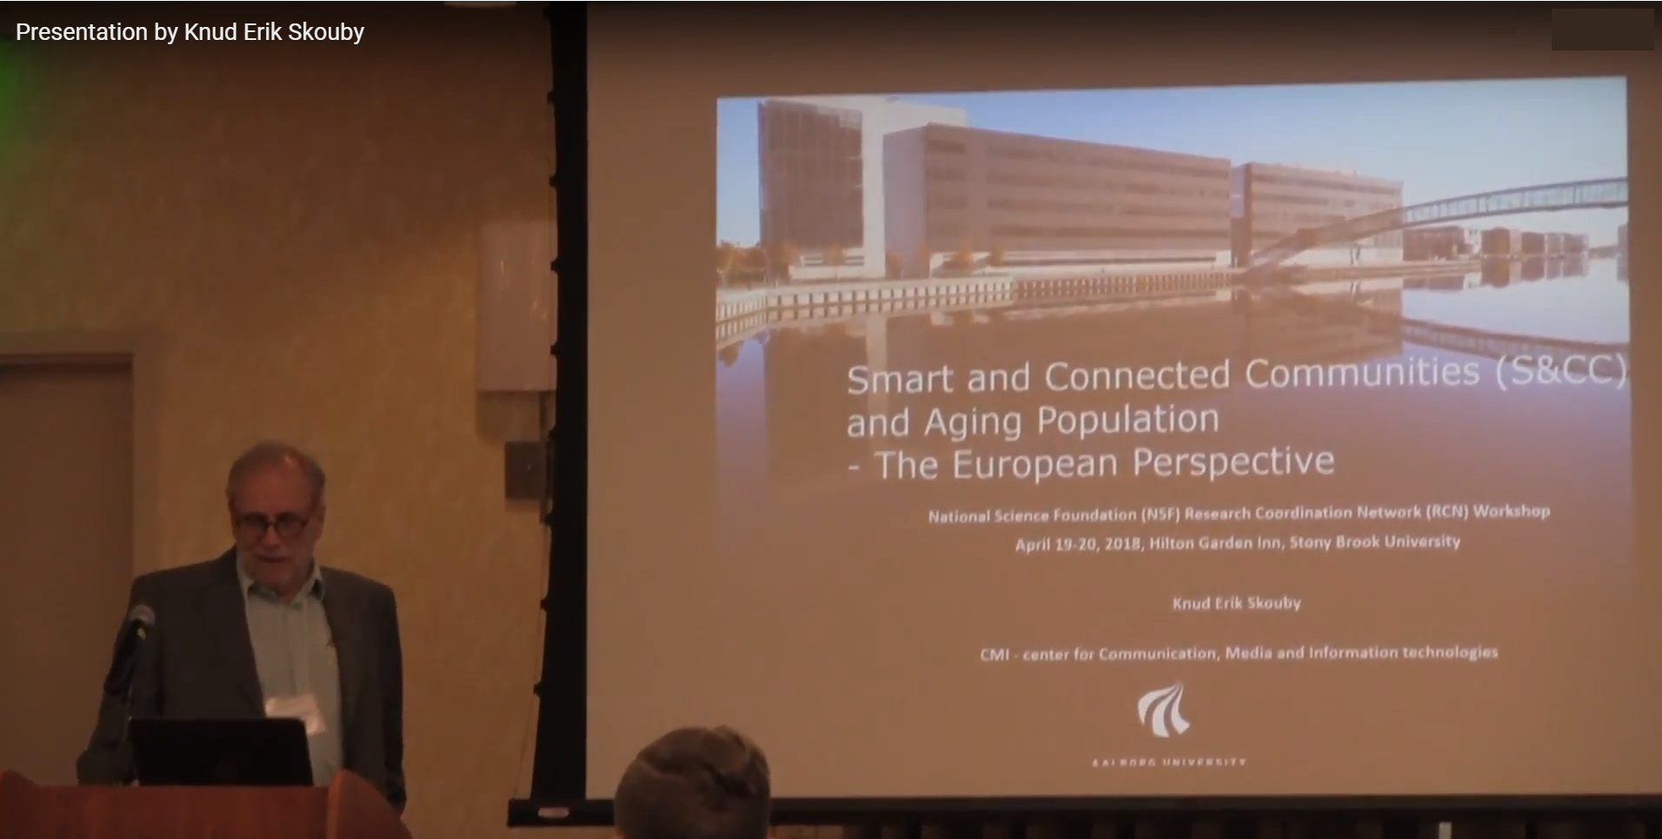
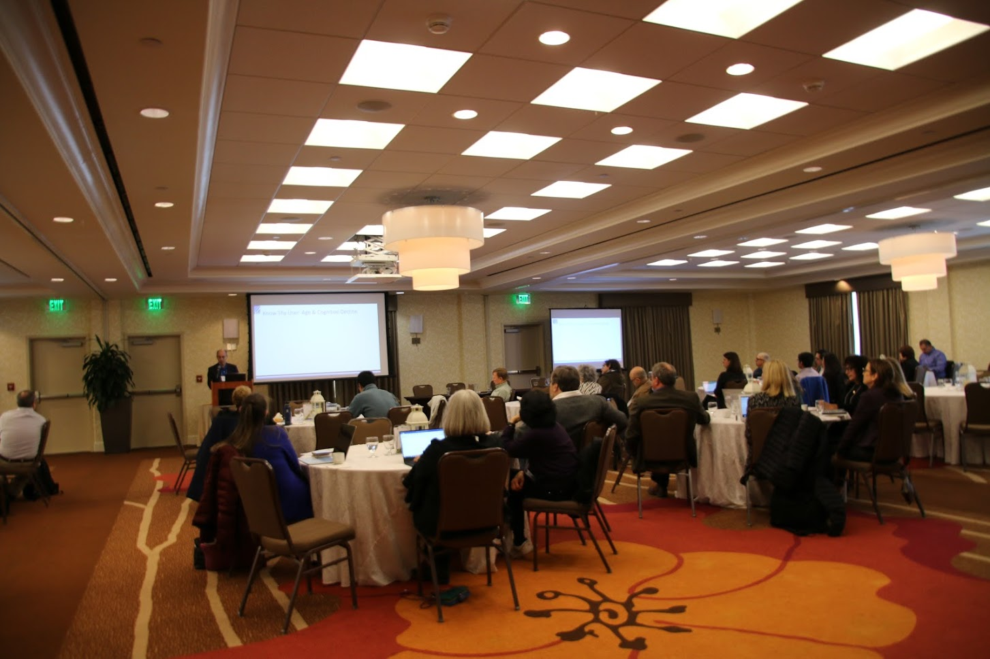
Update of the Project Since Last PI Meeting
First Workshop: More than 50 participants from academia, federal and state government agencies, non-profit organizations, practitioners, and community leaders.
Total of 21 presentations by researchers and non-profits across the U.S., including 4 presenters from Australia and Denmark.
Nine presenters were not in the original RCN and additional participants got connected through the workshop.
Presentation videos and event summary have been made available to the public at the RCN website.
Post-event survey was distributed for comments and suggestions.
A research needs statement was drafted.
Post-Event Feedback
Senior community appreciates looking into their challenges. Researchers emphasize the exposure to perspectives of different disciplines.
Suggestions to have more open discussions and roundtable exercises.
Limits on technical content not to alienate participants from communities and/or different disciplines.
“Speed-dating” research interest sharing to find suitable collaborators.
Teleconferencing or other ways to reach interested parties that cannot make it to the event in the future workshops.
Notes:
A brief background: Please describe the problem you are addressing and why it is important (20sec slide)

Slide 4
Update of the Project Since Last PI Meeting (cont’d)
Challenges
Including older adults in the loop while suffering from their limited mobility options to join the workshop.
Maintain and expand the created connections for further research collaborations and project partnership.
Research Needs
Studies on varying needs, challenges and solutions for urban and rural communities
The workshop included several presentations on the distinct challenges on urban and rural communities with different socioeconomic characteristics. The workshop consensus was the need for more studies covering different population density aspects of issues faced by aging adults and corresponding S&CC solutions.
Need for human centric design to overcome the digital divide for aging population
The workshop participants emphasized the importance of human centric design which yields custom-made
technology products for aging population, e.g. the need for educational programs which equip aging population with necessary skills to utilize existing technologies.
Need for interdisciplinary teams to tackle the issues faced by aging population
The general consensus among the participants was that forming multidisciplinary teams is not a choice but a necessity to address aging population’s challenges. The RCN’s role in facilitating such connections was stated as crucial.
Challenge of reaching out to aging population
The participants pointed out the difficulty of recruiting older adults for research purposes, particularly at rural communities. The workshop also suffered from the chicken-egg problem, i.e., reaching out to aging population and bringing them to the table to better understand their challenges. In this respect, closer collaboration with local institutions working with seniors was stated as an important aspect of research on aging population.
Notes:
A brief background: Please describe the problem you are addressing and why it is important (20sec slide)

Slide 5

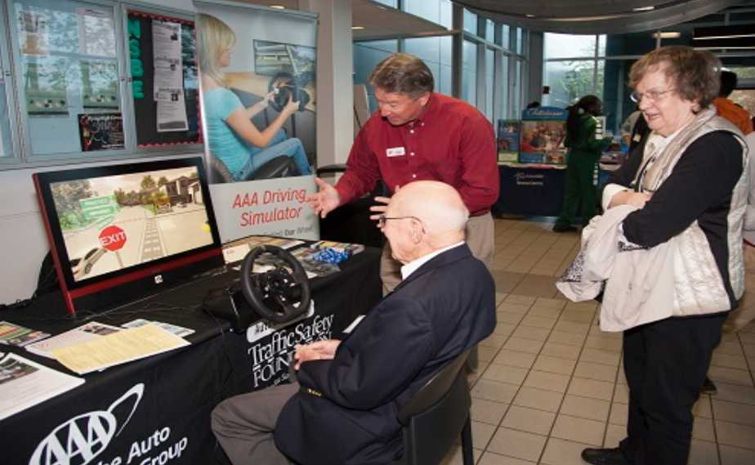
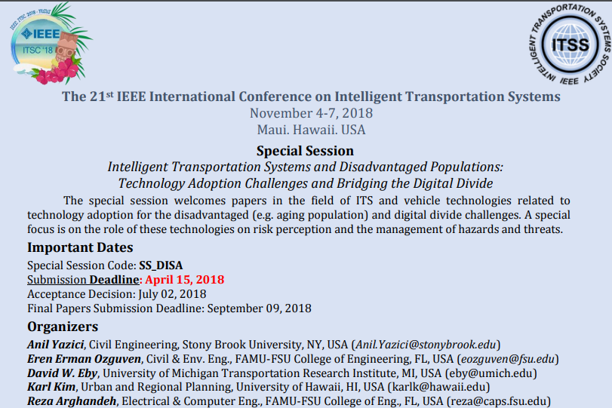
Update of the Project Since Last PI Meeting (cont’d)
Selfhelp Community Services, Community Meeting on Technology, May 18, 2019. As a follow up of the workshop connection, PI Yazici made a presentation on technology and older adults, with a follow-up Q&A including the RCN activities.
UTC Transportation Day, Center for Accessibility and Safety for an Aging Population, FAMU-FSU College of Engineering, November 30, 2018, Tallahassee, FL. RCN collaborator Selfhelp Services presented their pilot projects in NY with Uber and Lyft to community groups and researchers at FL. PI Ozguven also presented his research on the technology needs of older adults in the event of extreme events such as hurricanes in the State of Florida.
Following Hurricane Michael, meetings with Bay County EOC, Florida State Emergency Response Team, ARC, FEMA, DEP, EPA and volunteering organizations have been held. One focus item of discussion was how to disseminate vital information to seniors and other disadvantaged populations using technology.
Special Conference Sessions, Conference Presentations and Memberships
Intelligent Transportation Systems and Disadvantaged Populations: Technology Adoption Challenges and Bridging the Digital Divide (IEEE ITSC2018 Special Session, November 2018).
Transportation Research Board papers presented by RCN-involved students, related to the connected and automated vehicles with a focus on older adults (TRB, January 2019).
PI Ozguven joined the TRB Emerging Design and Construction Technologies Committee (AFH30), expanding the focus of the RCN towards new designs and technologies in roadway construction that can help older adults better understand and navigate the roadways.
Notes:
A brief background: Please describe the problem you are addressing and why it is important (20sec slide)

Slide 6


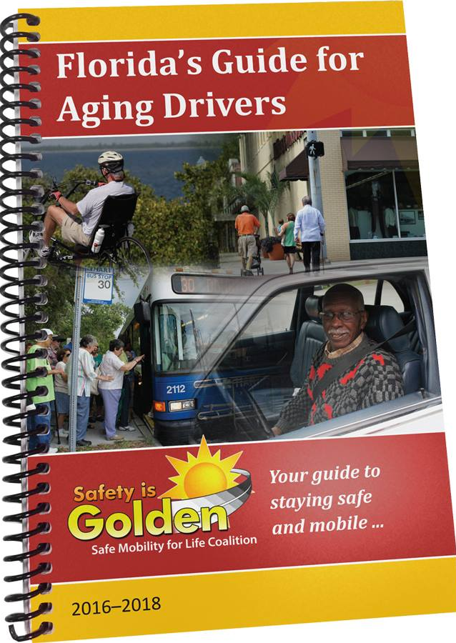

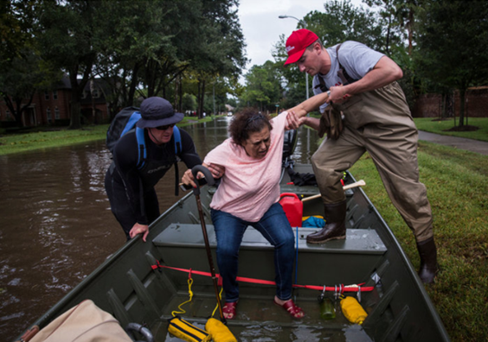
Anticipated outcomes and success measures in the next year
Second Workshop: The workshop will be organized by University of Michigan in Spring 2020. Measures of success will include:
  Participation of older adults community members
  Number of presentations/projects which were born through RCN connections and activities
  Number of theses and dissertations (completed or in progress) on SCC and seniors
New Transportation Research Interdisciplinary Perspectives Journal: SP Karl Kim, as the editor-in-chief, created a new journal.
  Special issue focusing on the technology adoption and older adults
    Number of manuscripts received, especially outside of RCN
    Coverage of RCN thrust areas and multidisciplinary authors profile
Planned Session and Presentations in the 2019 Gerontology Society of America Annual Scientific Meeting, November 2019, Austin, Texas, USA.
Presentation for Safe Mobility for Life Coalition of Florida to extend the reach of the RCN with the coalition in Fall 2019.
Specific focus on disasters and the needs of older adults given the extreme events (hurricanes, floods, wild fires, tornadoes, volcano eruptions) happening all around the U.S. as well as the world.
Notes:
A brief background: Please describe the problem you are addressing and why it is important (20sec slide)

