Slide 1
2019 NSF SMART AND CONNECTED COMMUNITIES PI MEETING: Research Coordination Network
1. Total Time = 3 minutes MAXIMUM for your content.
2. Must be a ppt/pptx file. Please rename the file SCC.RCN.[Award#].[PI_LastName].ppt/pptx
3. Slides must be uploaded at https://nsfsccpimeeting.ee.washington.edu/presentation/
4. Please address all the content in this template, but you may do so in more than five slides, if needed. Be sure to also read the additional instructions listed in the ”notes” section below the slides.
5. All slides must auto-advance (set under “Transitions”). We set a duration for these suggested template slides. You can change the duration on these slides, but the total must equal 3 minutes. If you do not use this template, be sure to set the duration for each slide and to make sure that the total presentation time is 3 minutes. Otherwise, we will set equal duration for each slide.
6. Other suggestions:
Keynote users, export to .pptx format; LaTeX users, make images to add to a .pptx; Please check your slides on a PC platform.
Animation should not be used
Use images for any content with special characters.
7. Please practice using the timing established here! The total time allotted is nonnegotiable.
8. DELETE THIS SLIDE WHEN YOU ARE DONE!

Slide 2
2019 NSF SMART AND CONNECTED COMMUNITIES PI MEETING
FY 2017 RCN: Mobility, Health, and Resilience in SCC: Building Capacities and Expanding Impact, NSF Award # 1736596
PIs: Radha Poovendran (UW), Scott Allard (UW), Jeff Ban (UW), Jeff Berman (UW), Sam Burden (UW), Cynthia Chen (UW), Andrew Clark (WPI), Sajal Das (Missouri S&T), Hedwig Lee (WUSTL), Sertac Karaman (MIT), Lillian Ratliff (UW), Thaisa Way (UW), Baosen Zhang (UW)
Community Partners: City of Seattle
Notes:
This is the transition slide. The lightning talk moderator will announce the name of your project and the name of the lead PI. Expect to begin your presentation from the next slide.

Slide 3
Project Aims
Research capacity-building centered on the challenges of mobility, health and well-being, and resilience in S&CC
Explore cross-cutting social issues affecting underserved communities: homeless, recently incarcerated, adolescents, urban poverty, and First Nations tribes
Community engagement through capacity-building workshops and education/outreach activities

Slide 4
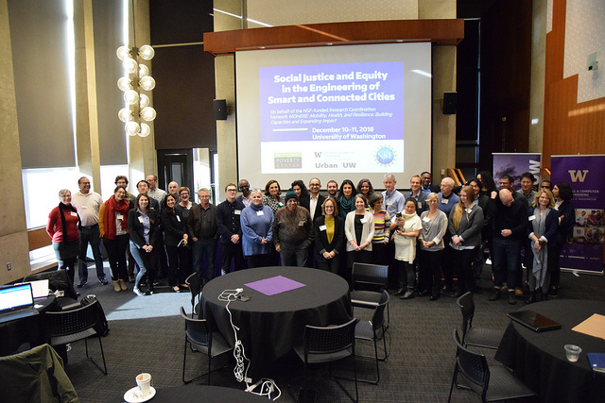
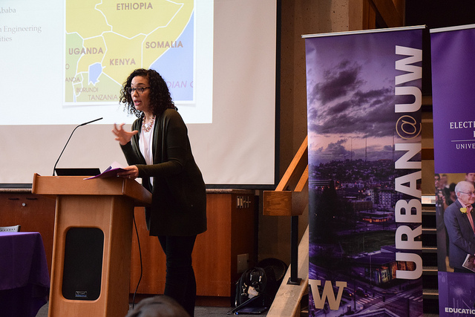
Update of the Project since last PI meeting
Capacity-building workshop on “Social Justice and Equity in the Engineering of Smart and Connected Communities” held in Seattle, WA, Dec 10-11, 2018
Sessions on: Environment, climate, and equity; mobility, equity, and health; and resilience and equity
Speakers and participants from academia, industry, local government, and international partners in Ireland, India, and Ethiopia
Notes:
Scientific status of the project: Describe what you have done so far to advance your coordination network in terms of science (technical and social). Include activities from the past year (since the previous S&CC PI meeting). Also describe something unexpected that came about through your activities. Include photos and minimize text. Anecdotes are highly encouraged.

Slide 5
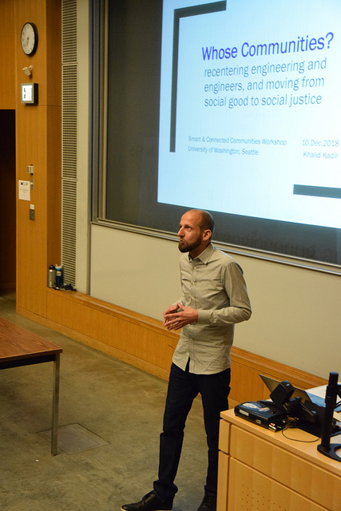
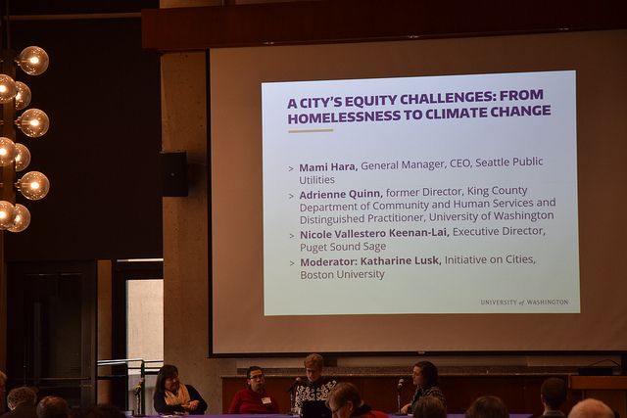
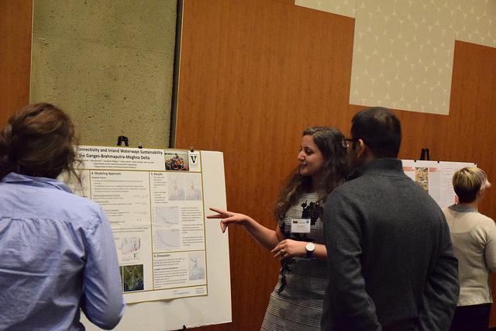
Update of the Project since last PI meeting
Representatives from City of Seattle, public utilities, and nonprofit groups in Seattle area attended workshop and participated in panel
Community partners provided insight into challenges of resilience, homelessness, sustainability, and environmental justice
Notes:
Community engagement and capacity Status of the Project: Describe what you have done so far to advance your coordination network in terms of community engagement and capacity building. Also describe something unexpected about working with your community partners. Anecdotes are highly encouraged. Include photos.

Slide 6
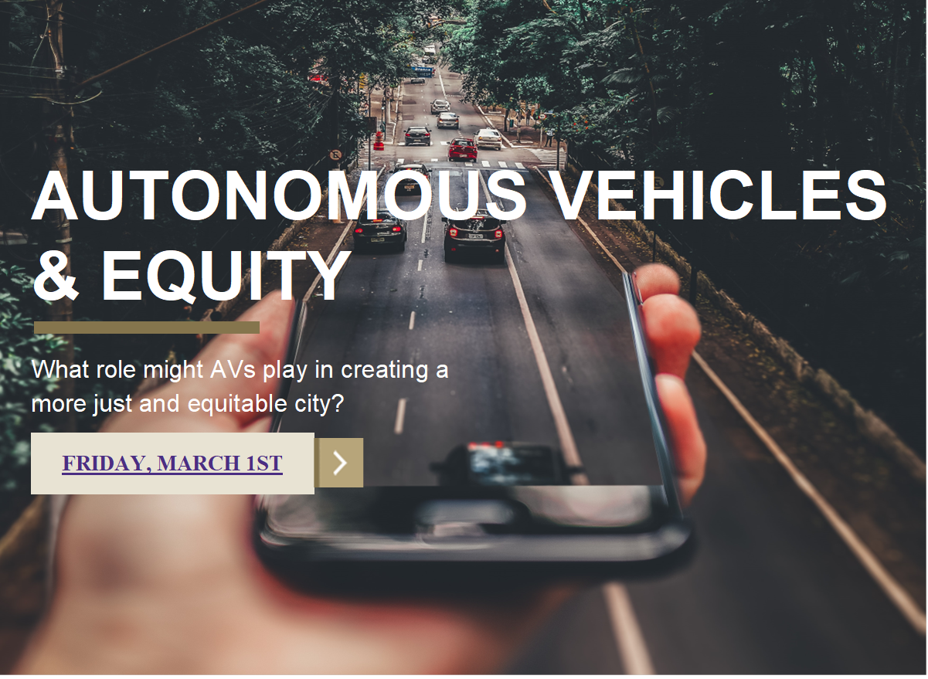
Anticipated outcomes and success measures in the next year
Disseminate white papers from workshop to broader community
Follow-up workshop on Autonomous Vehicles and Equity held in March 2019
Plan to organize additional workshop during 2019.
Notes:
Describe at least two deliverables that you plan to accomplish over the next year that will significantly advance your project.

