Slide 1
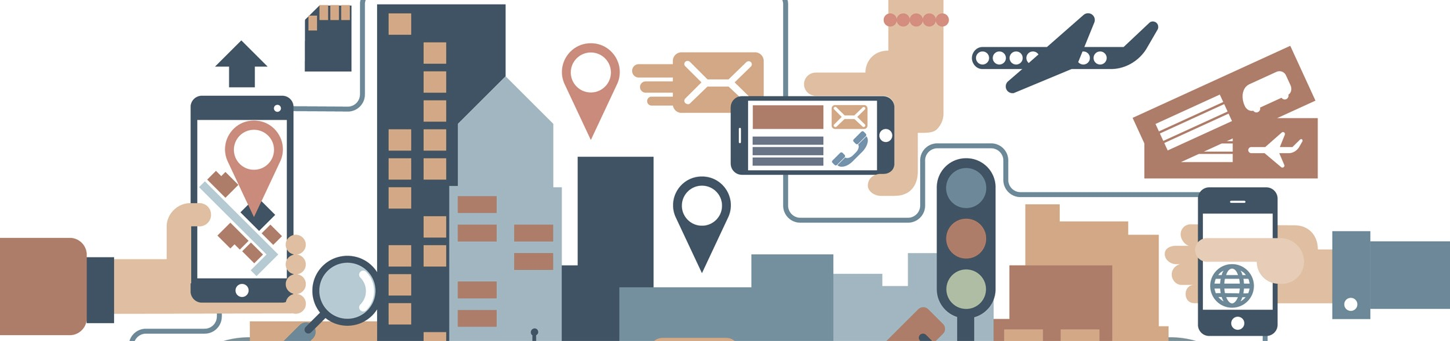

2019 NSF SMART AND CONNECTED COMMUNITIES PI MEETING
FY 2017 PG: SCC-Planning: Smart, Connected, Engaged Senior Communities, CNS#1737454
Team: Wu (PI), Knopf, Talmage, Mirchandani, Candan, O’Neill and Sazonov, Wen.
Affiliations: Arizona State University, Drexel University, University of Alabama
Community Partners: Westminster, Friendship Village, Vi at Silverstone, Royal Oaks.
Notes:
This is the transition slide. The lightning talk moderator will announce the name of your project and the name of the lead PI. Expect to begin your presentation from the next slide.

Slide 2
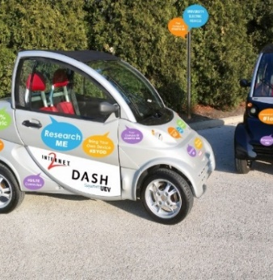

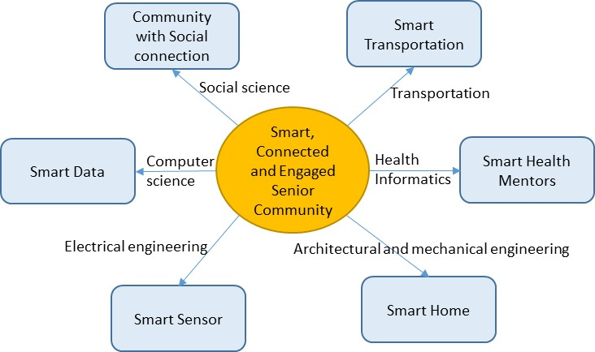
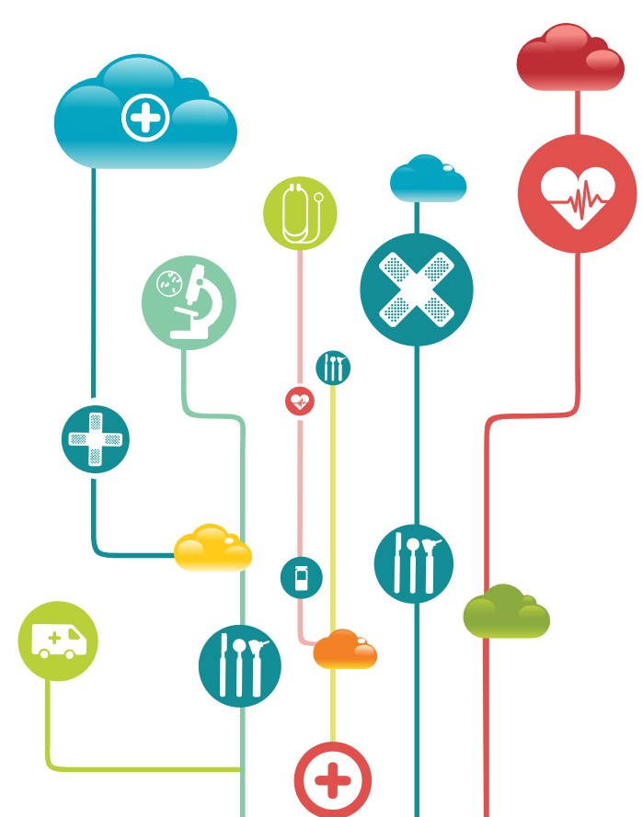

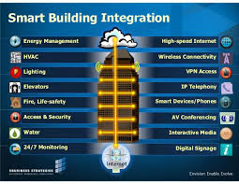
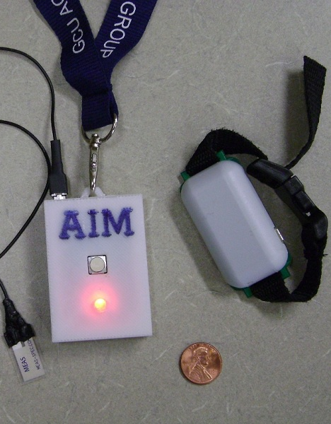
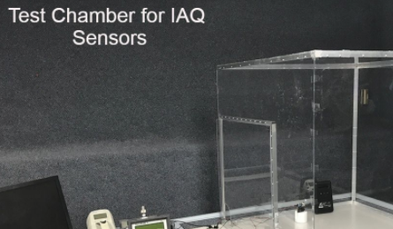
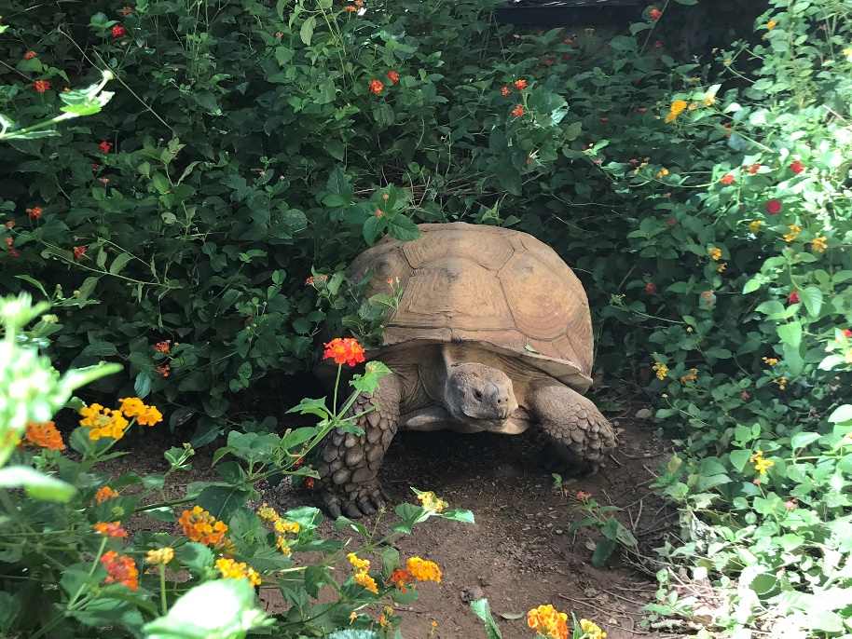
Project Aims
Understand challenges facing continuing care retirement facility residents
Understand facility guidelines incorporating multi-disciplinary progressive ideas
Explore technological solutions to be embedded into the community infrastructure
Notes:
A brief background: Please describe the problem you are addressing and why it is important (20sec slide)

Slide 3

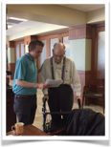
Update of the Project since last PI meeting
Selected 4 communities
Administered 33-item questionnaire (on-line and on-ground)
  Technology
  Individual and Community Well-being
  Mobility
  Health information Accessibility & Privacy
  Smart Building
Collected over 200+ questionnaires
Notes:
Describe at least one deliverable that you accomplished together with your community partners and at least one outcome in terms of capacity building. Also describe something unexpected about working with your community partners. Anecdotes are highly encouraged. Include photos.
Emphasize activities that have been carried out after last year's PI meeting and how these activities along with what was accomplished last year fits within the overall vision of your project.

Slide 4
Update of the Project since last PI meeting
Takeaway Point I:
Research. Loneliness cannot be broadly mitigated by the providing access to car and driver services; however, older adults who are lonely appear to demonstrate greater interest in those services.
Practice. Practitioners should identify individuals who are socially disconnected first and then introduce that particular population to car services.
58% of U.S. adults 65+
believe technology has a mostly positive impact on society
(Anderson & Perrin, 2017)
76% of U.S. adults 65+
go online daily (Anderson & Perrin, 2017)
42% of U.S. adults 65+
own smartphones; 80% own cellphones (Anderson & Perrin, 2017)
4% of U.S. adults 65+
have used ride-hailing services like Uber or Lyft (Smith, 2016)
Takeaway Point II:
Research. While Information and communication technology (ICT) does not substitute for human interaction (Anderson & Thayer, 2018), it can provide older adults with means to increase their interactions with others, which may in turn decrease loneliness and increase feelings of connectedness.
Practice. Practitioners should consider how older adults who are lonely can utilize ICT to increase quantity and quality of interactions with family, friends, and others.
Notes:
Describe at least one deliverable in terms of the science (technical and social). Why is this deliverable significant/what did it accomplish or what will it allow? Include photos.
Emphasize activities that have been carried out after last year's PI meeting and how these activities along with what was accomplished last year fits within the overall vision of your project. Inclusion of photos are encouraged.

Slide 5
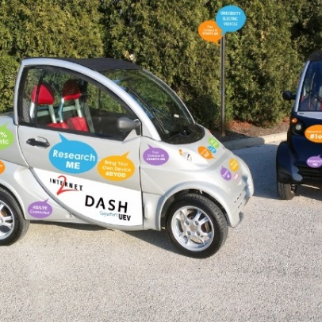
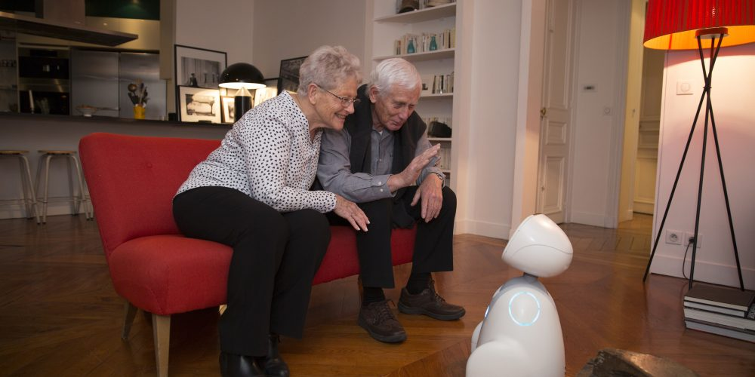
Planned Outcomes/Next Steps
Together, we build a DREAM Community

