Slide 1
2019 NSF SMART AND CONNECTED COMMUNITIES PI MEETING
FY 2017 PG: ZER0H: Zero Energy Ready Homes, 1737538
PI: Kavasseri, Co-PIs: Cao, Zhang, Srivastava, and Fischer, COMMUNITY: Native American Tribes in North Dakota (ND)
North Dakota State University, Fargo, ND
Notes:
This is the transition slide. The lightning talk moderator will announce the name of your project and the name of the lead PI. Expect to begin your presentation from the next slide.

Slide 2
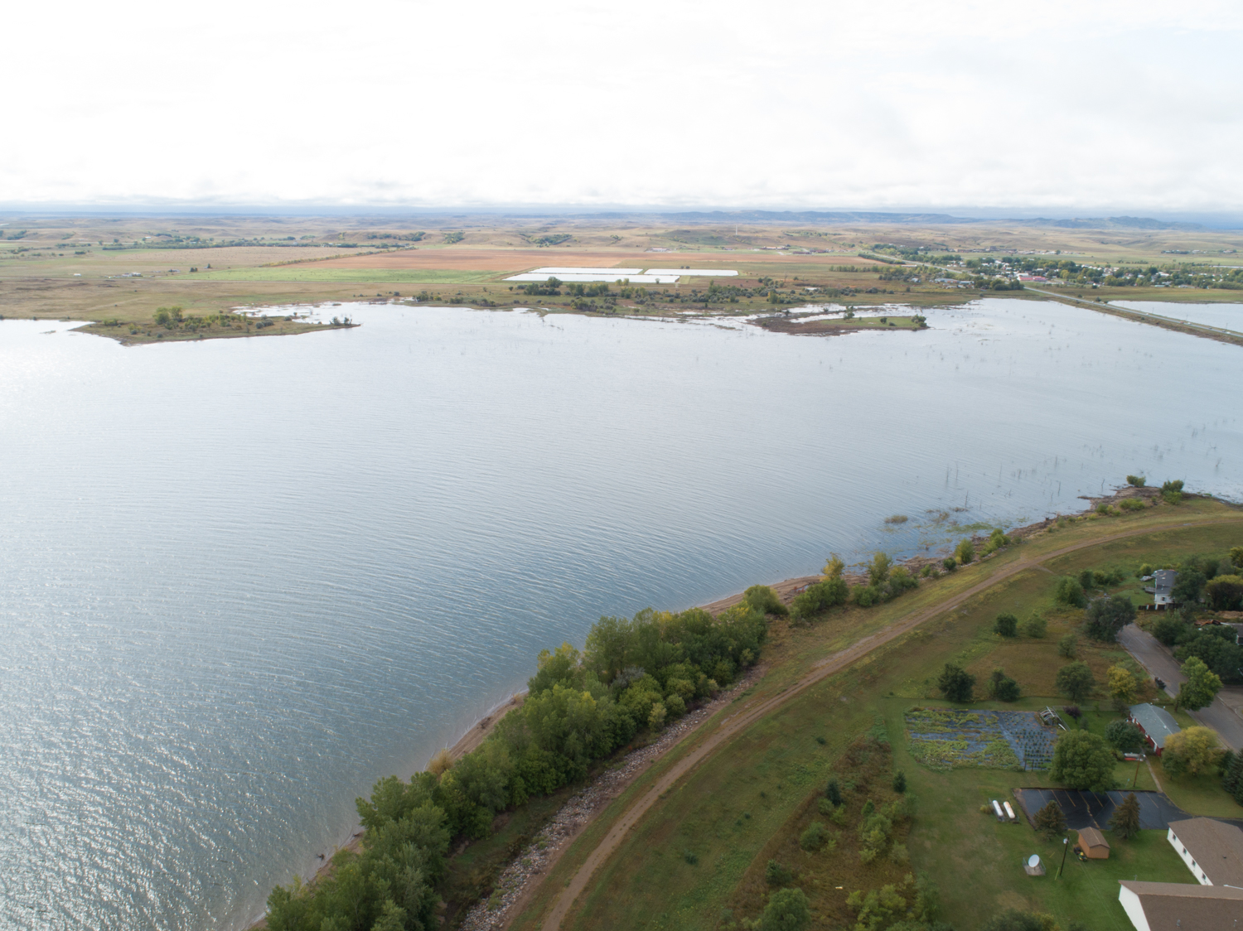
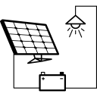
Project Aims
Exploit passive home design technologies to develop primarily DC energy delivery systems for residences;
Integrate photovoltaic and energy storage systems using next-generation earth-abundant materials;
Factor community inputs into (re)design of residential spaces;

Slide 3
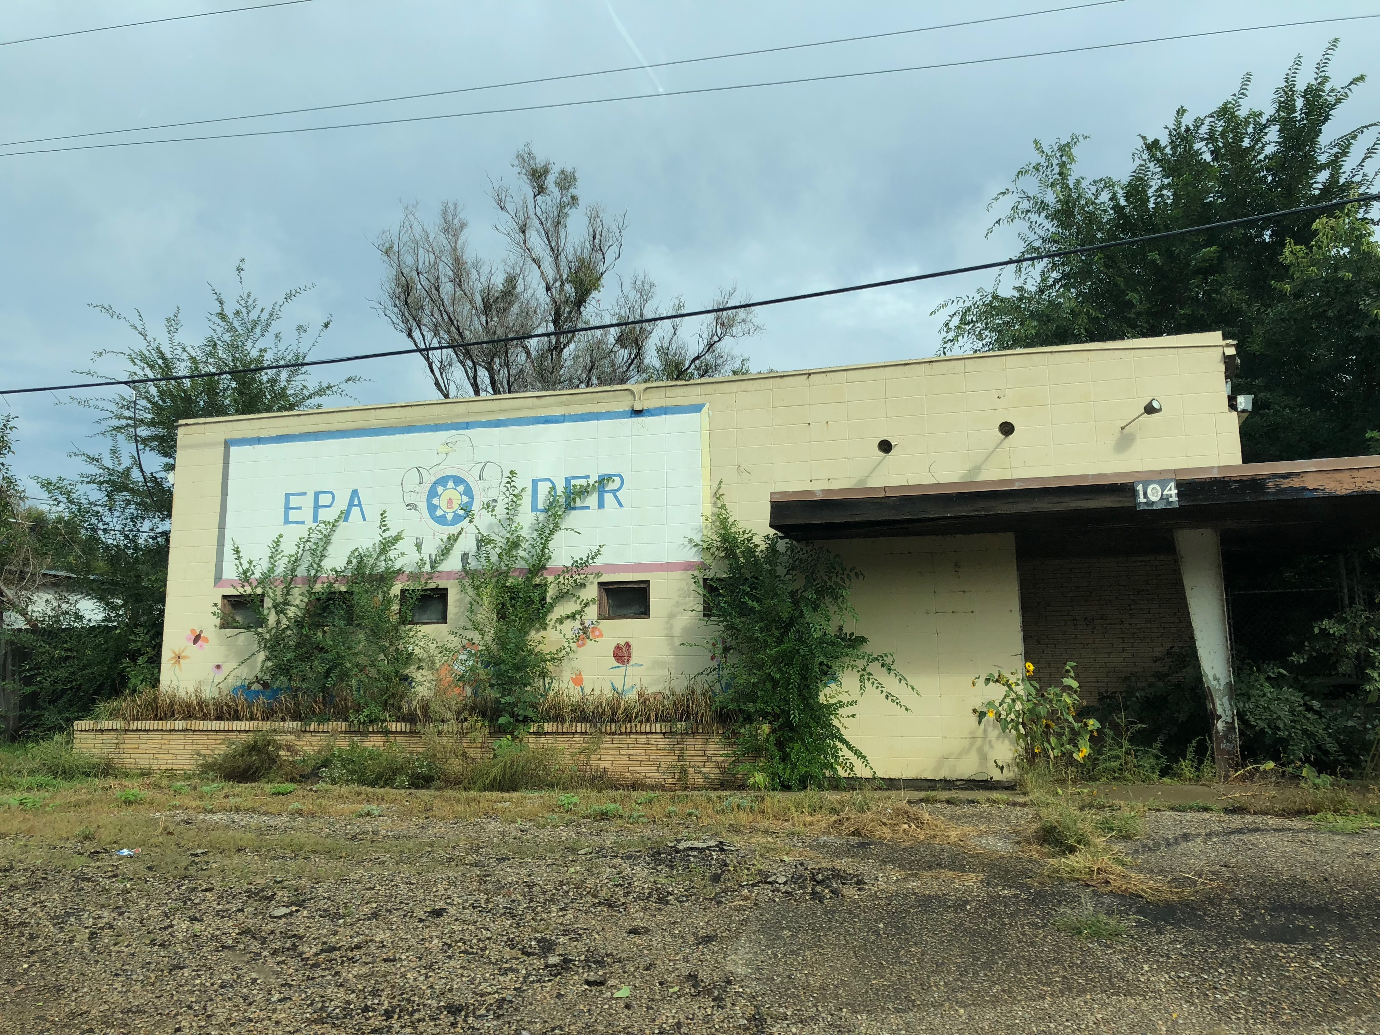
Update of the Project since last PI meeting
Community inputs provided insights into overlooked housing needs: including - A) access to home financing, major gaps in housing for single women, single mothers, and those with low-paying jobs, B) complexities of tribal land governance, and C) eagerness to live “off-grid”, but not in traditional town settings.
Engagement with Tribal housing authorities and the community helped us discovering many surprising land-use factors and understand cultural factors that bear on residential design.
Notes:
Describe at least one deliverable that you accomplished together with your community partners and at least one outcome in terms of capacity building. Also describe something unexpected about working with your community partners. Anecdotes are highly encouraged. Include photos.
Emphasize activities that have been carried out after last year's PI meeting and how these activities along with what was accomplished last year fits within the overall vision of your project.

Slide 4
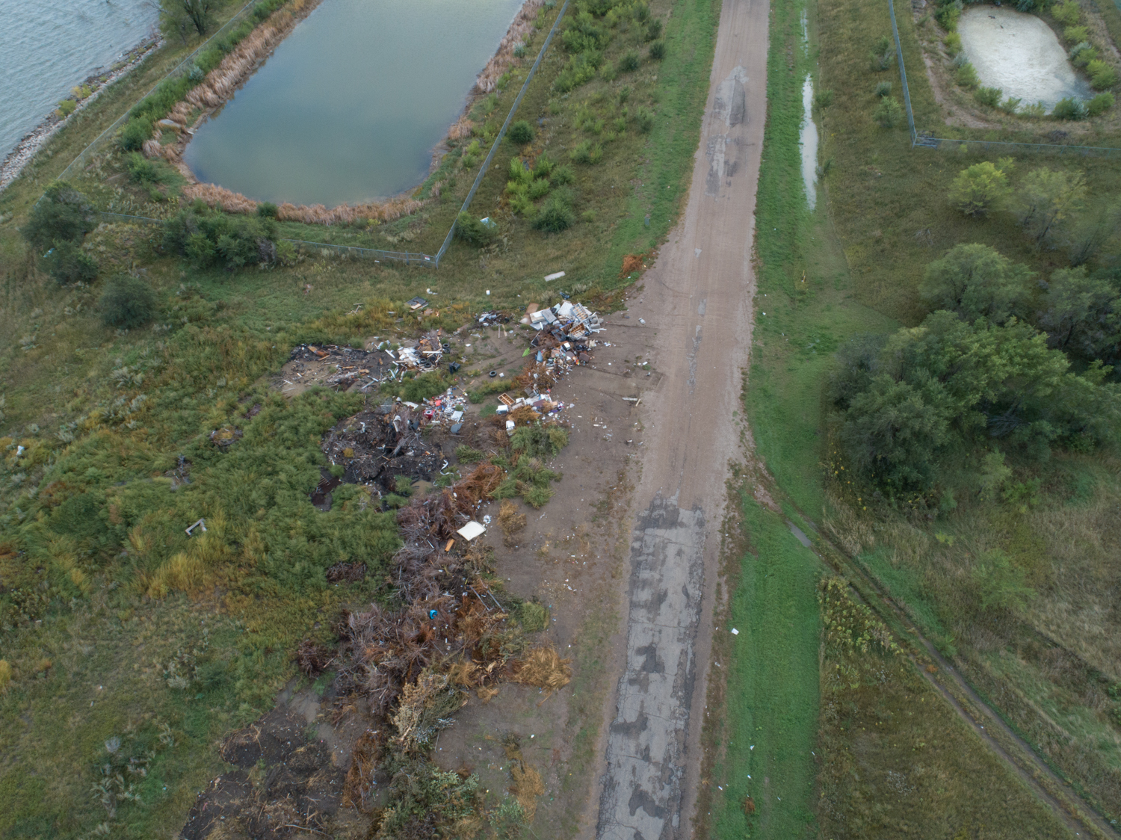
Update of the Project since last PI meeting
New concepts of Passive House home constructions with mobile, super-insulated wall systems designed as variable internal thermal boundaries;
The concept of “programmable spaces” that adjusts to variable occupancy with the use of mobile thermal boundaries can achieve optimal energy-efficiency
Collaboration with PassivHaus institute to develop building energy models with programmable spaces
Notes:
Describe at least one deliverable in terms of the science (technical and social). Why is this deliverable significant/what did it accomplish or what will it allow? Include photos.
Emphasize activities that have been carried out after last year's PI meeting and how these activities along with what was accomplished last year fits within the overall vision of your project. Inclusion of photos are encouraged.

Slide 5
Planned Outcomes/Next Steps
Evolve a new model for asynchronous, hierarchical partnerships between higher education (both tribal colleges and land-grant institutions), housing authorities, tribal leaders, federal agencies, private lenders and home owners in order to address the needs of all involved through symbiotic relationships that partially fulfills the goals of each entity’s charter while meeting the financial constraints.

