Slide 1
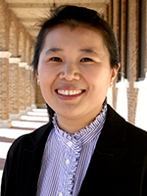
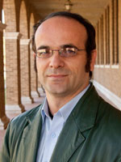
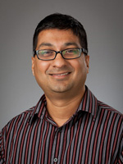
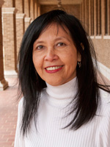
2019 NSF SMART AND CONNECTED COMMUNITIES PI MEETING
FY 2017 PG: SCC-Planning: Enhancing water resource management and infrastructure improvement through sensing, computation, and community engagement, NSF Award 1737634
Fang Jin, Akbar Namin, Venkatesh Uddameri, Rattikorn Hewett
Texas Tech University
http://myweb.ttu.edu/fjin/projects/water/
Notes:
This is the transition slide. The lightning talk moderator will announce the name of your project and the name of the lead PI. Expect to begin your presentation from the next slide.

Slide 2
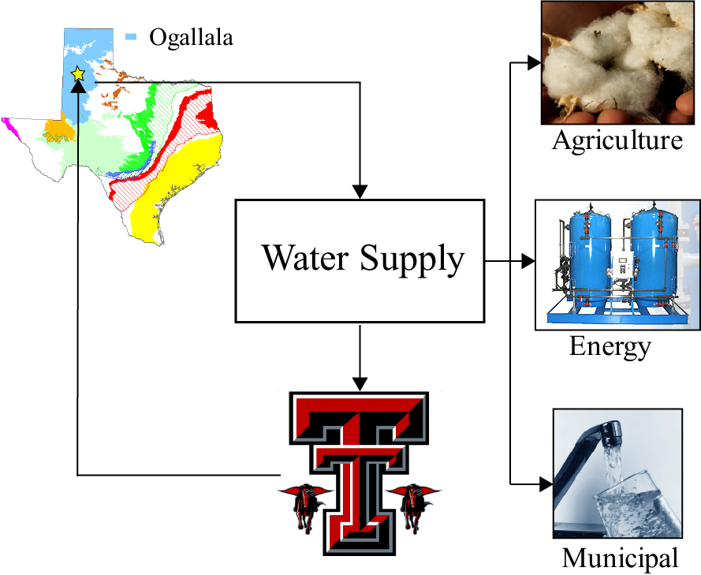
Project Aims
Investigate water resource management problems in three business sectors:
Agriculture,
Oil & Gas industries and
Water municipals.
Establish an interconnected community of water stakeholders, share experiences of modernizing water infrastructures across counties.
Identify the data and information needs for better water planning in rural communities

Slide 3
Community Partners
High Plains Underground Water Conservation District
Texas Alliance for Water Conservation
Saguaro petroleum
Apache Corporation
Pioneer Natural Resources
Anadarko Petroleum Corporation
City of Wolfforth, TX
Ransom Canyon, TX
City of Balls, TX
City of Crosbyton, TX
Saguaro petroleum

Slide 4
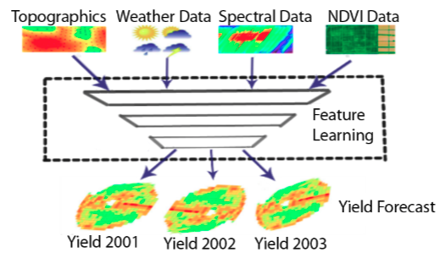
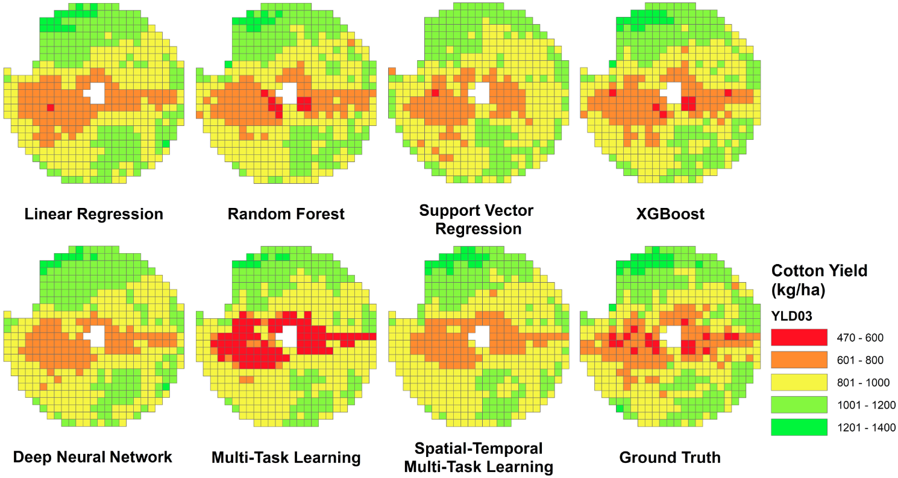
Update of the Project since last PI meeting
Major community outcomes.
- Collaborating with Texas Alliance for Water Conservation community, working on optimizing farming water usage, developed algorithms for Within-field Cotton Yield Prediction.
Long Nguyen, Jiazhen Zhu, Zhe Lin, Hanxiang Du, Zhou Yang, Wenxuan Guo, and Fang Jin. Spatial-temporal Multi-Task Learning for Within-field Cotton Yield Prediction., The 23rd Pacific-Asia conference on Knowledge Discovery and Data Mining (PAKDD). Accept rate 24.7%. April 14-17 2019.
Notes:
Describe at least one deliverable that you accomplished together with your community partners and at least one outcome in terms of capacity building. Also describe something unexpected about working with your community partners. Anecdotes are highly encouraged. Include photos.
Emphasize activities that have been carried out after last year's PI meeting and how these activities along with what was accomplished last year fits within the overall vision of your project.

Slide 5
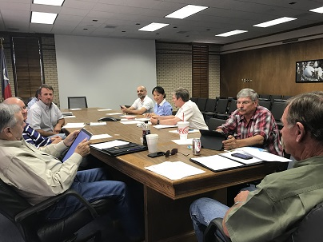
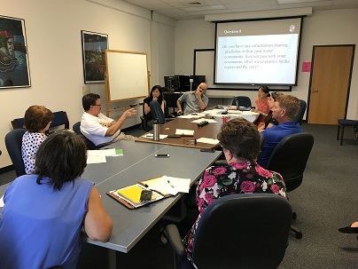
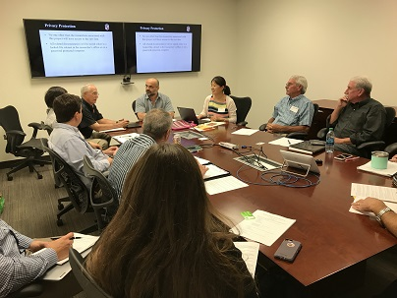
Update of the Project since last PI meeting
Major capacity outcomes.
Host three focus group discussion for farmers, municipal, and Oil & Gas industry;
Agriculture Municipal Oil & Gas industry
Notes:
Describe at least one deliverable that you accomplished together with your community partners and at least one outcome in terms of capacity building. Also describe something unexpected about working with your community partners. Anecdotes are highly encouraged. Include photos.
Emphasize activities that have been carried out after last year's PI meeting and how these activities along with what was accomplished last year fits within the overall vision of your project.

Slide 6
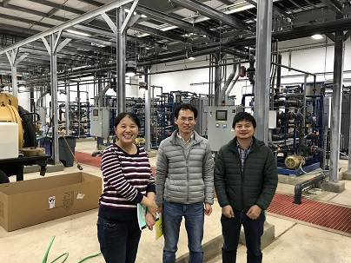
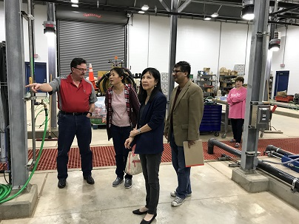
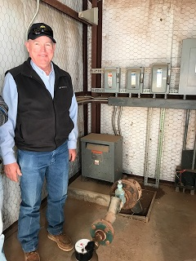
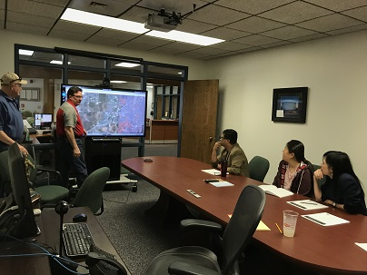
Update of the Project since last PI meeting
Major capacity outcomes.
Discuss with City of Wolfforth, working with them on water audit problem.
Tour Water Plant at Wolfforth, TX on April 6, 2018 & Nov 28, 2018.
Notes:
Describe at least one deliverable that you accomplished together with your community partners and at least one outcome in terms of capacity building. Also describe something unexpected about working with your community partners. Anecdotes are highly encouraged. Include photos.
Emphasize activities that have been carried out after last year's PI meeting and how these activities along with what was accomplished last year fits within the overall vision of your project.

Slide 7
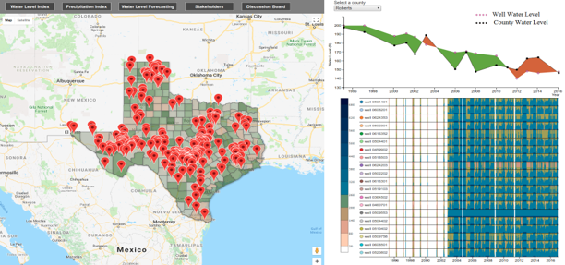
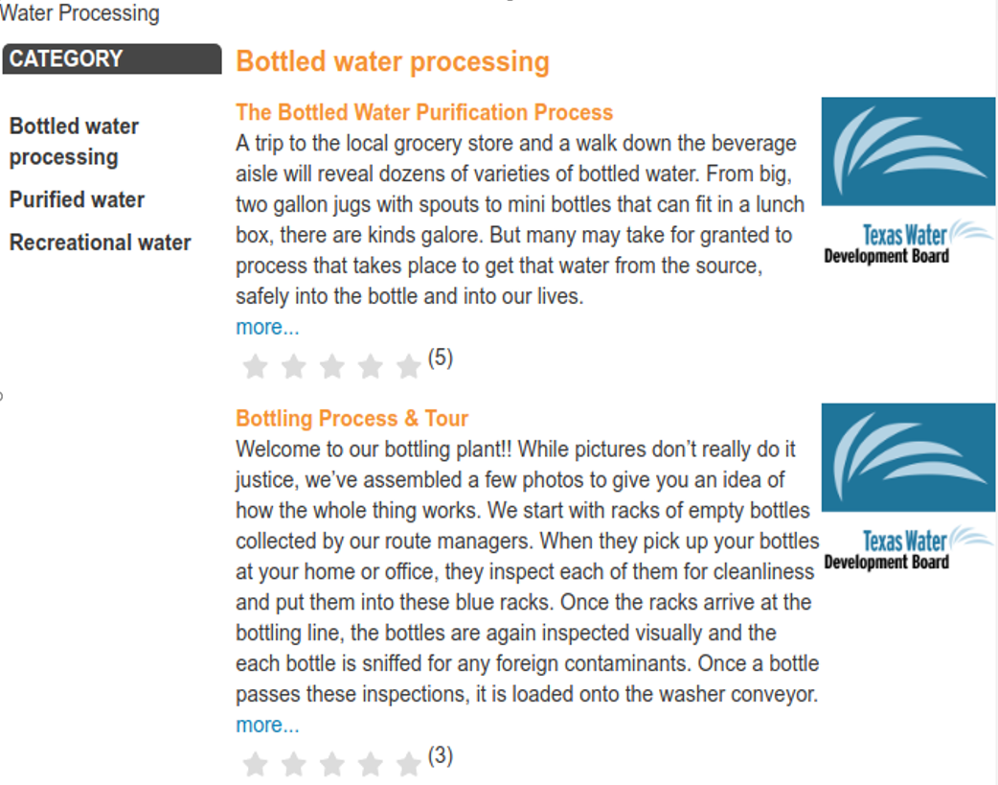
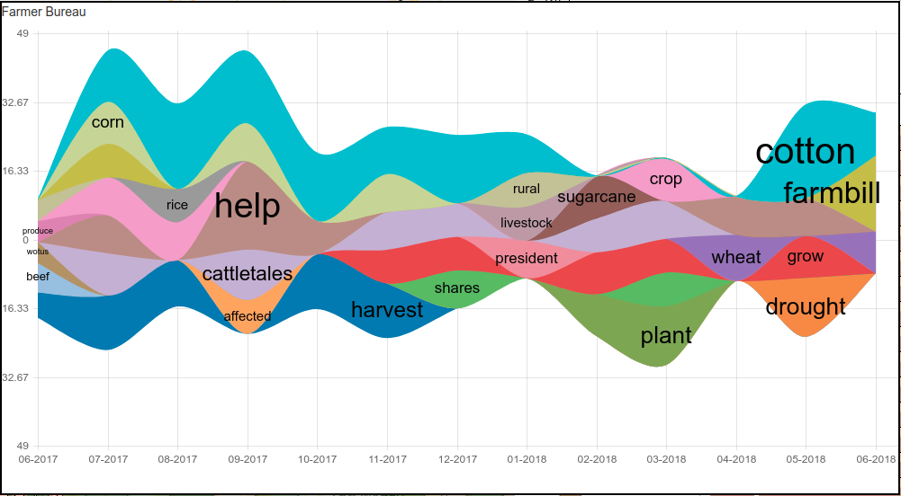
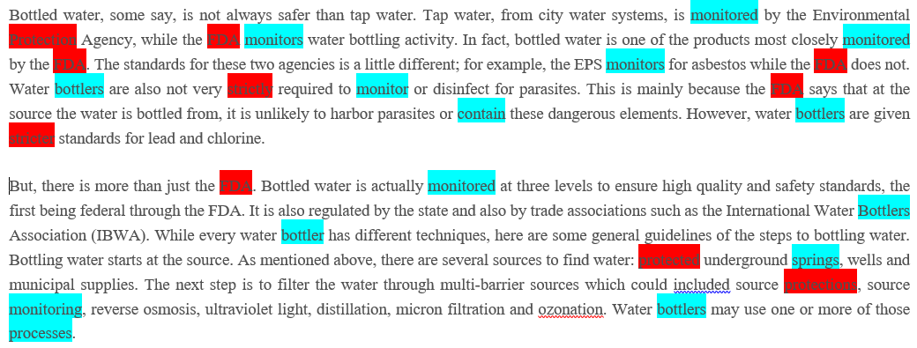
Update of the Project since last PI meeting
New socio-technical outcomes.
Developed an online water information sharing platform: WaterScope;
Extracted the concern flow from different water stakeholders in Texas;
Created an interconnected virtual community, improving water supply resilience.
Long H. Nguyen, Rattikorn Hewett, Akbar S. Namin, Nicholas Alvarez, Cristina Bradatan, and Fang Jin. Smart and Connected Water Resource Management via Social Media and Community Engagement, The 2018 IEEE/ACM International Conference on Advances in Social Networks Analysis and Mining (ASONAM 2018). Barcelona, Spain, 28-31 August, 2018.
Notes:
Describe at least one deliverable in terms of the science (technical and social). Why is this deliverable significant/what did it accomplish or what will it allow? Include photos.
Emphasize activities that have been carried out after last year's PI meeting and how these activities along with what was accomplished last year fits within the overall vision of your project. Inclusion of photos are encouraged.

Slide 8
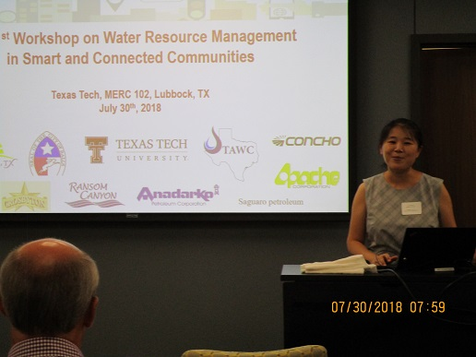
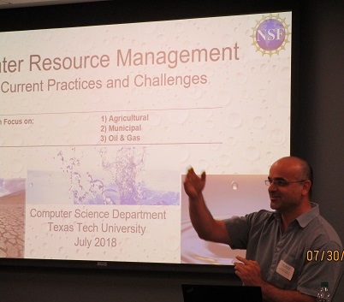
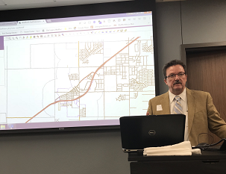
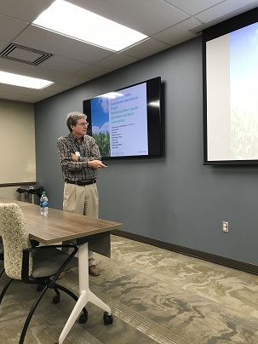
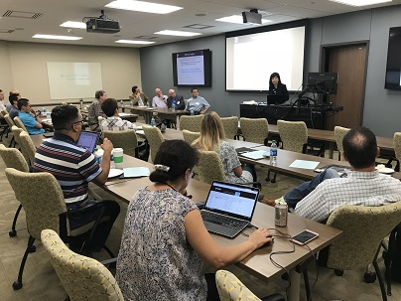
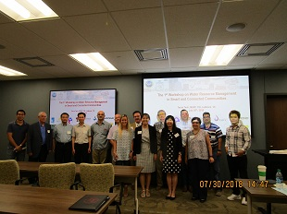
Update of the Project since last PI meeting
Activities for new sociotechnical outcomes
Host the Workshop on Water Resource Management in Smart and Connected Communities
Invited speakers from our community partners, water related researchers, industry, government, students, etc.
http://myweb.ttu.edu/fjin/projects/water/workshop.html
Notes:
Describe at least one deliverable in terms of the science (technical and social). Why is this deliverable significant/what did it accomplish or what will it allow? Include photos.
Emphasize activities that have been carried out after last year's PI meeting and how these activities along with what was accomplished last year fits within the overall vision of your project. Inclusion of photos are encouraged.

Slide 9
Update of the Project since last PI meeting
Major contribution to S&CC.
Enhanced this region’s community collaboration, by carefully considering issues specific to community members such as farmers, residents, and oil and gas industry professionals.
Built an online platform which connected water stakeholders share knowledge and expertise, whose conceptual solution can be applied to other domains that promote community engagement through multiple data sources.
Surveyed farmers and host discussions, increasing farmers’ knowledge about precision agriculture, encourage the deployment of smart meters, drone, soil probes, etc. aiming to optimize farming irrigation.
Notes:
Describe at least one deliverable in terms of the science (technical and social). Why is this deliverable significant/what did it accomplish or what will it allow? Include photos.
Emphasize activities that have been carried out after last year's PI meeting and how these activities along with what was accomplished last year fits within the overall vision of your project. Inclusion of photos are encouraged.

Slide 10
Planned Outcomes/Next Steps
Reach some municipal water community for another round of further discussion to help much better to formulate research questions and enhance the partnerships established.
Understand the complicated Agriculture farming irrigation water problem in West Texas, and investigate their current water solution techniques and identify missing/insufficient parts Big Data can plug in.
Discuss with collaborator communities, collect more data to test the solutions.

