Slide 1


2019 NSF SMART AND CONNECTED COMMUNITIES PI MEETING
FY 2017 PG: [Promoting Smart Technologies in
Public Safety and Transportation to Improve Social and Economic Outcomes in a US EDA-Designated Critical Manufacturing Region] , NSF Award [1737557]
PI: Seung-Jong Park and Co-PI: Judith Rhodes, Chester Wilmot, Kisung Lee, Jagannathan Ramanujam,
Community Partners: Baton Rouge Mayor’s office, District Attorney, BRPD, LA-DOTD, CPEX, Future Fund Project,
Louisiana State University
http://Smartcity.lsu.edu
Notes:
This is the transition slide. The lightning talk moderator will announce the name of your project and the name of the lead PI. Expect to begin your presentation from the next slide.

Slide 2
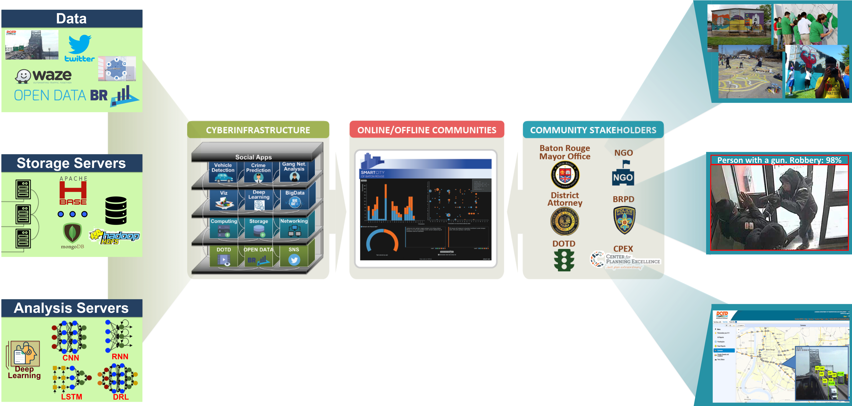
Project Aims
Integrative Research:
1) Build a community from LSU research groups, Baton Rouge public offices, NGOs through a web-portal (http://smartcity.lsu.edu/)
2) Apply Big Data technologies to collect and manage heterogeneous data using HPC cyber-infrastructure at LSU.
3) Analyze Deep Learning technologies for collaborative analyses and predictions.

Slide 3
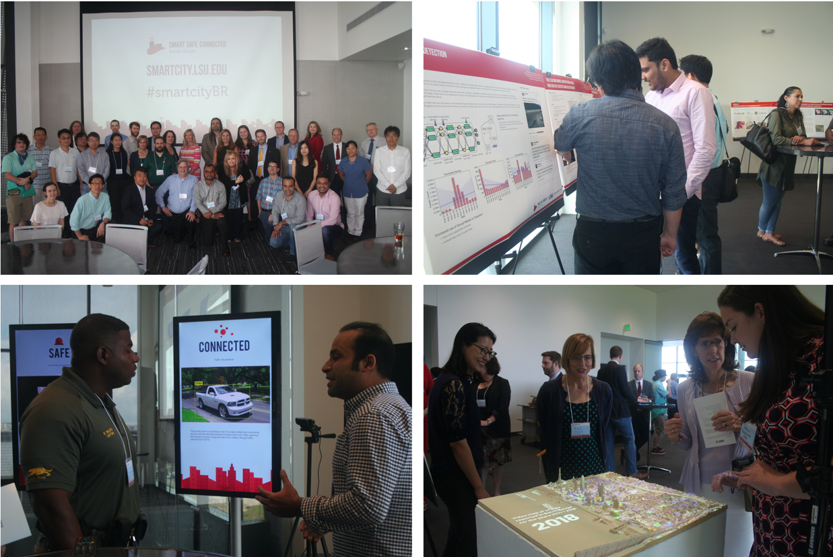
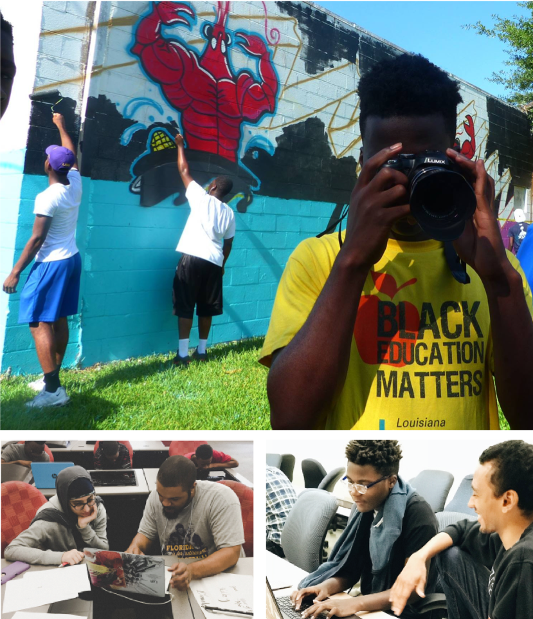
Update of the Project since last PI meeting
Capacity outcome:
  Building teams among Civil, Social, CS, Viz, and stakeholders (townhall meeting at Aug 2018)
Community outcome:
  Partnering with the Wall Projects (NGO, community reactivation organization)
Notes:
Describe at least one deliverable that you accomplished together with your community partners and at least one outcome in terms of capacity building. Also describe something unexpected about working with your community partners. Anecdotes are highly encouraged. Include photos.
Emphasize activities that have been carried out after last year's PI meeting and how these activities along with what was accomplished last year fits within the overall vision of your project.

Slide 4
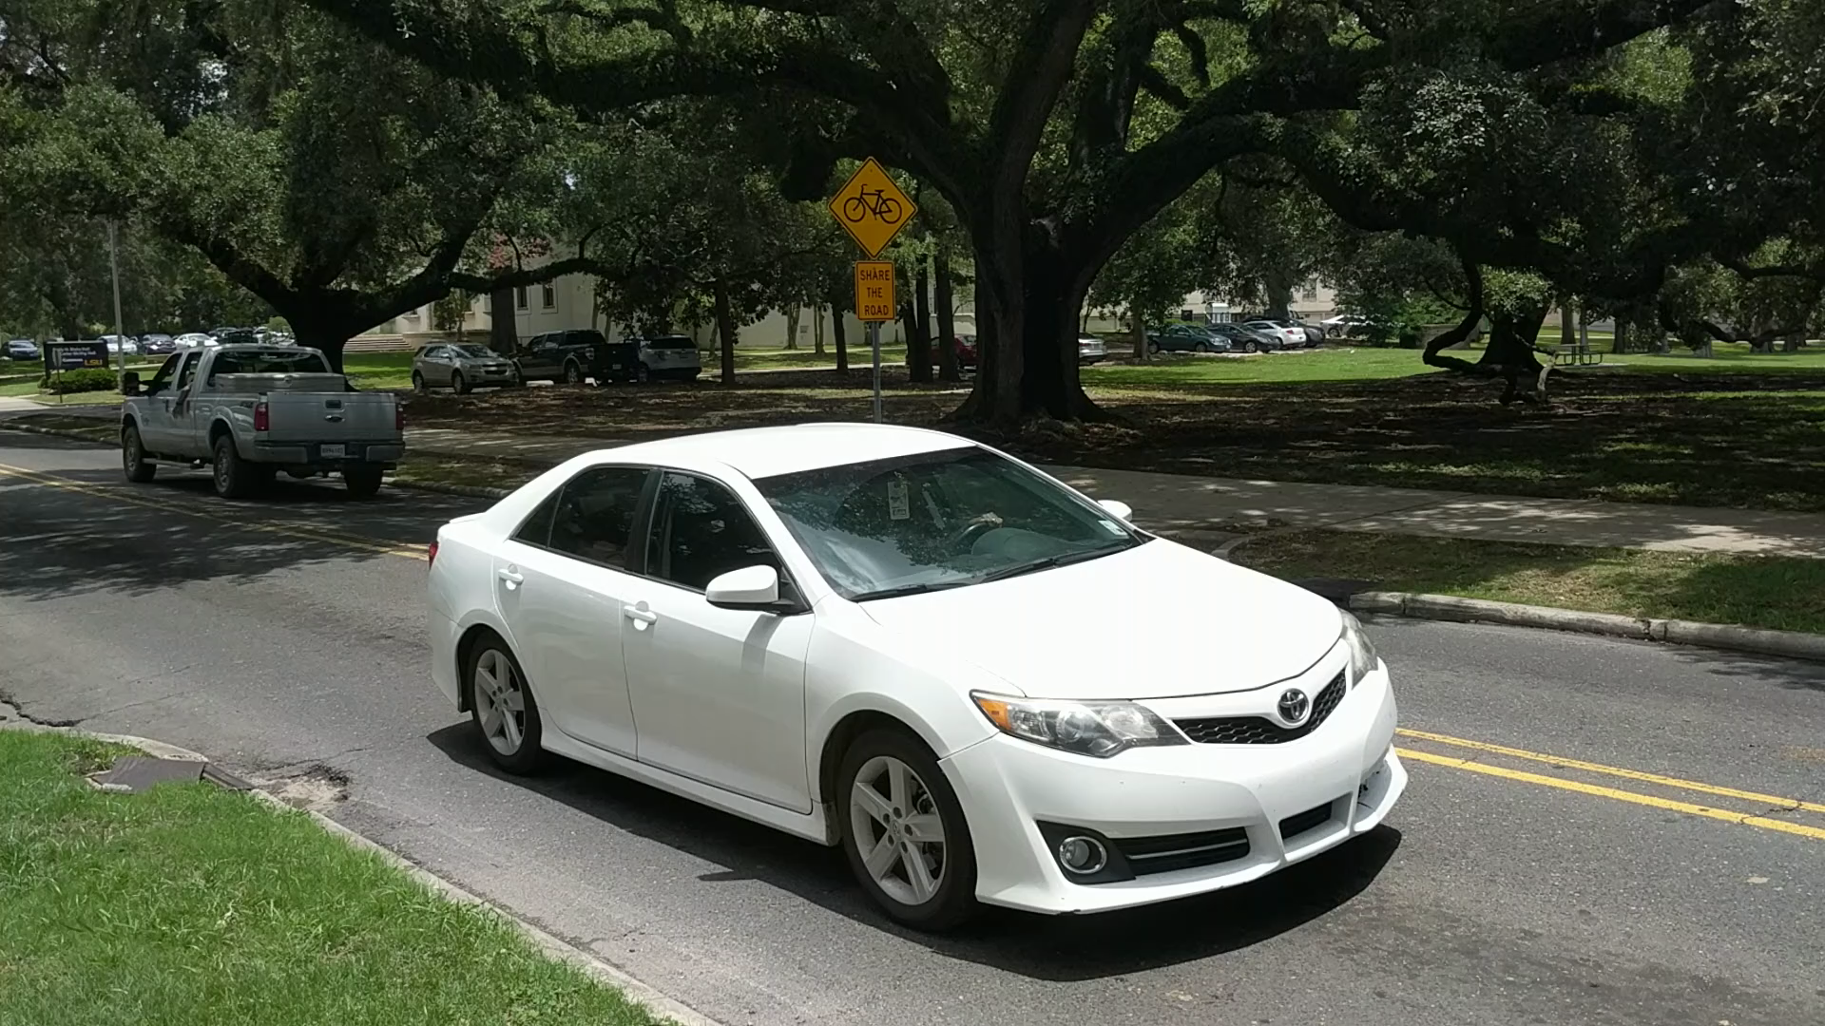
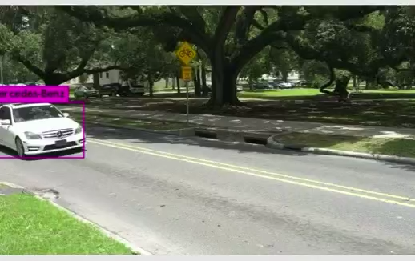
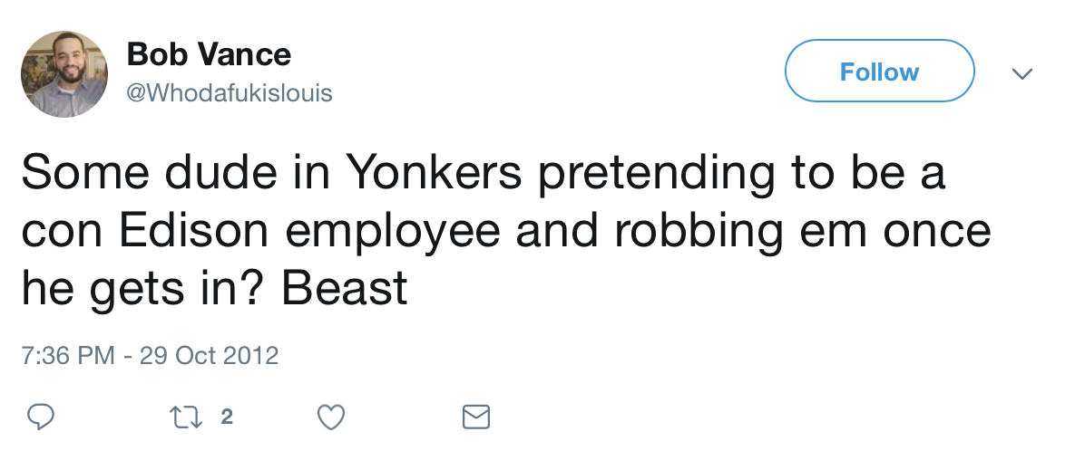
Update of the Project since last PI meeting
New sociotechnical outcomes:
  Developing fine-grained vehicle classi-fication (make, model, year)
Designing S/W to detect fake news and crime related twitters
1. Detect Cars
2. Detect Fine-grained Features
3. Classify Car Make/Model
Toyota Camry
Notes:
Describe at least one deliverable in terms of the science (technical and social). Why is this deliverable significant/what did it accomplish or what will it allow? Include photos.
Emphasize activities that have been carried out after last year's PI meeting and how these activities along with what was accomplished last year fits within the overall vision of your project. Inclusion of photos are encouraged.

Slide 5
Planned Outcomes/Next Steps
Next steps:
  Disseminate outcomes from collaborative teams (Civil, Social, CS, Visualization, etc.) through conferences, workshops and townhall meetings
  Developing new proposals for NSF SCC, CPS programs
  Continuing partnerships with stakeholders and NGOs (e.g., Future Funds Project)

