Slide 1
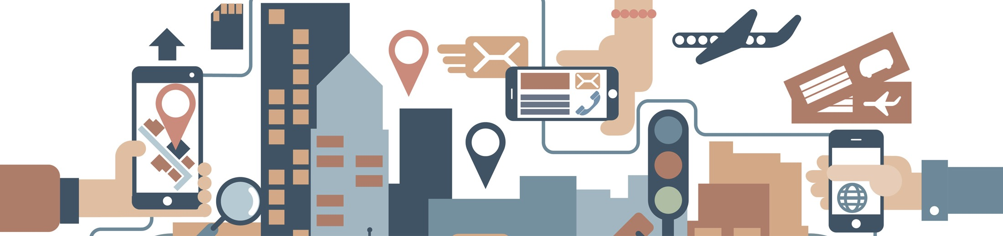

2019 NSF SMART AND CONNECTED COMMUNITIES PI MEETING
FY 2017 PG: SCC-Planning: CityGuide: Beacon-Based Community-Driven Inclusive Wayfinding, NSF Award 1737433
Vinod Namboodiri (PI, Wichita State U. or WSU); Rakesh Babu (Co-PI, Envision); Nils Hakansson (Co-PI, WSU) , Maryam Zahabi (Co-PI, WSU), Rui Ni (Co-PI, WSU), Guler Arsal (Envision), Mike Mayta (City of Wichita), Debbie Warren (City of Wichita), Siny Joseph (K-State), Scott Wituk, (Community Engagement institute, WSU)
https://www.wichita.edu/research/access-lab/cityguide.php
Notes:
This is the transition slide. The lightning talk moderator will announce the name of your project and the name of the lead PI. Expect to begin your presentation from the next slide.

Slide 2
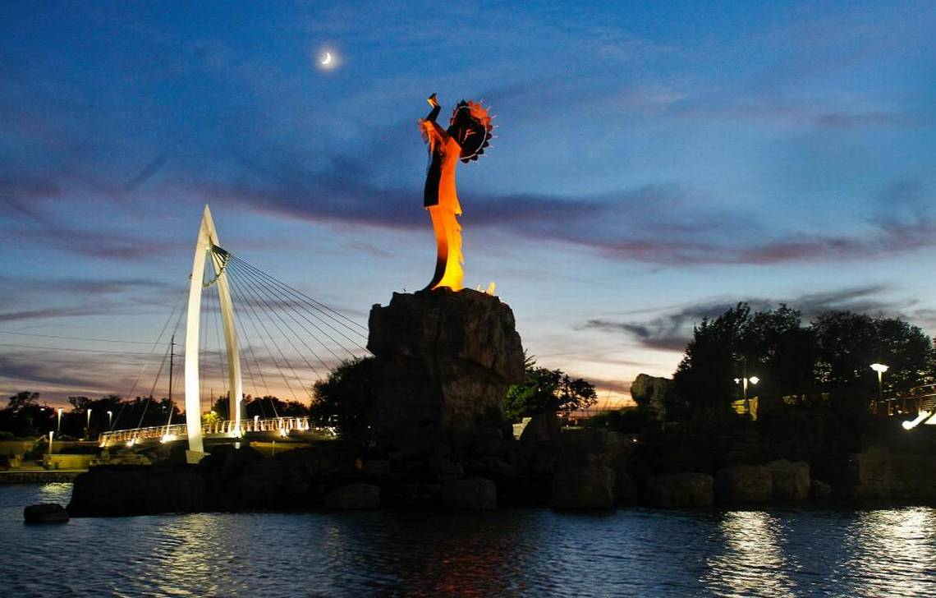

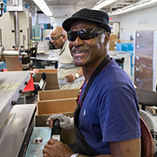

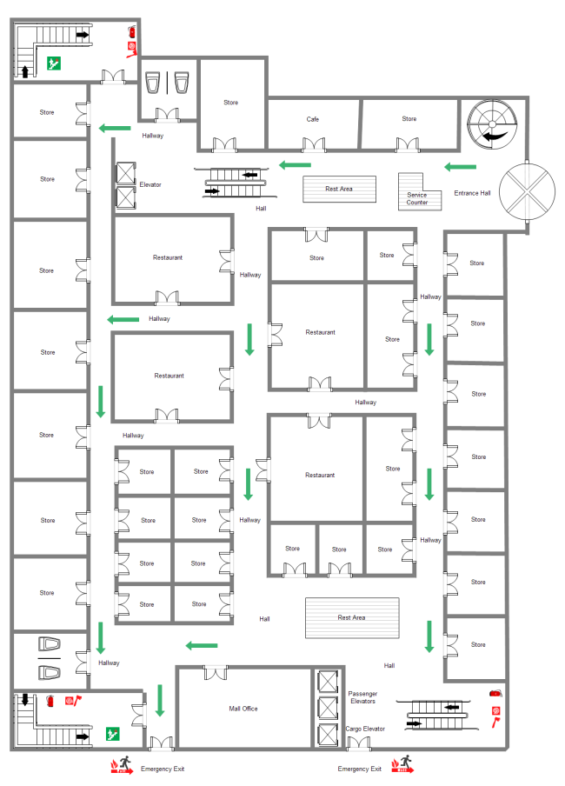

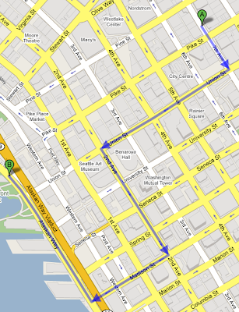
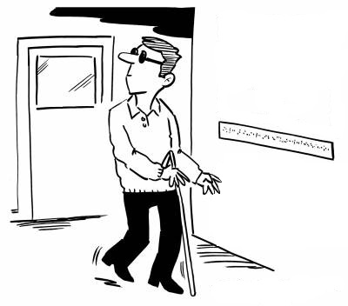
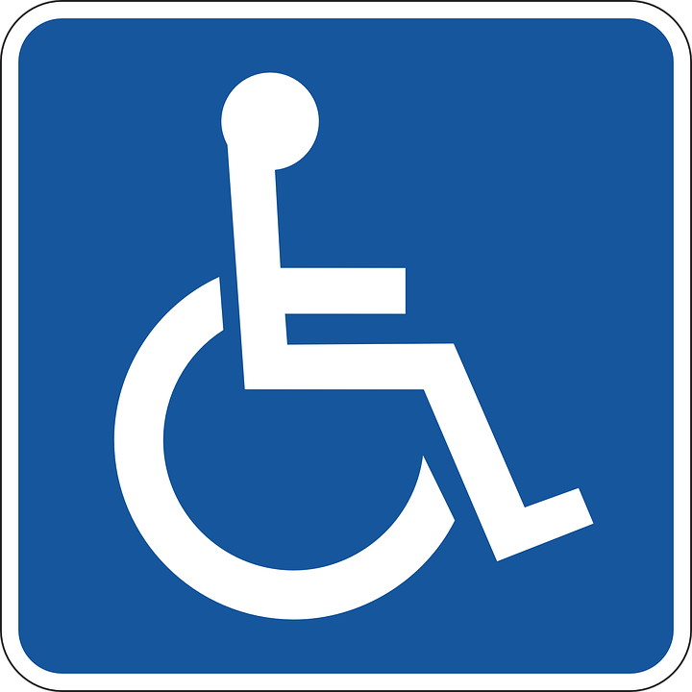
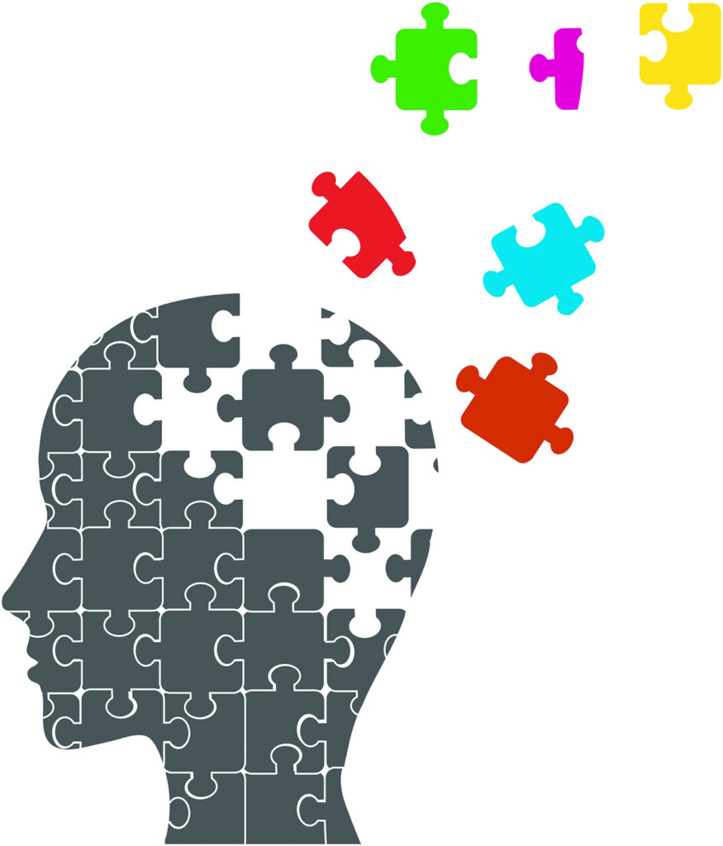
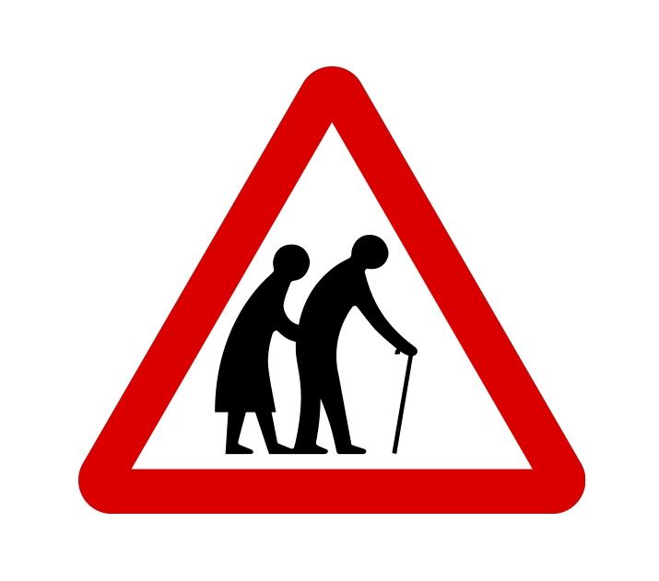
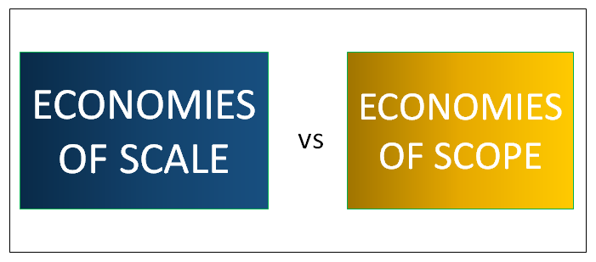
Project Aims
Scenario:
Need:
Opportunity:
This project is designing auxiliary location-based services (beyond GPS) in indoor and outdoor spaces for people with disabilities. Project goals include
identifying adequate informational cues,
enabling seamless indoor and outdoor wayfinding and other apps, and
the design of user interfaces that are usable by all but account for the constraints imposed by some.
Notes:
Scenario: Wichita is a medium-sized city and is home to Envision, Inc. one of the larger NIB-affiliated nonprofits serving people with visual impairments. The greater Wichita Community would like to address the needs of this population.
Need: Wayfinding remains a challenge for people with visual impairments where GPS –based navigation is limited or non-existent. Additional needs exist in accessing transportation services, signage information on various landmarks, and retail services.
Opportunity: Similar challenges exist for people with other disabilities and there lies an opportunity to achieve ``economies of scale” by utilizing a common technology infrastructure to meet the needs of people with a variety of disabilities, simultaneously.

Slide 3
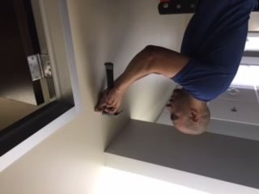
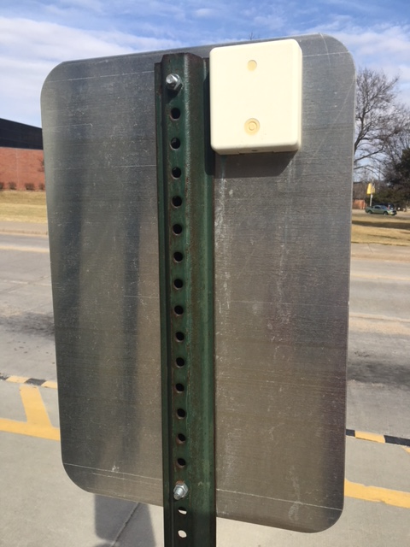
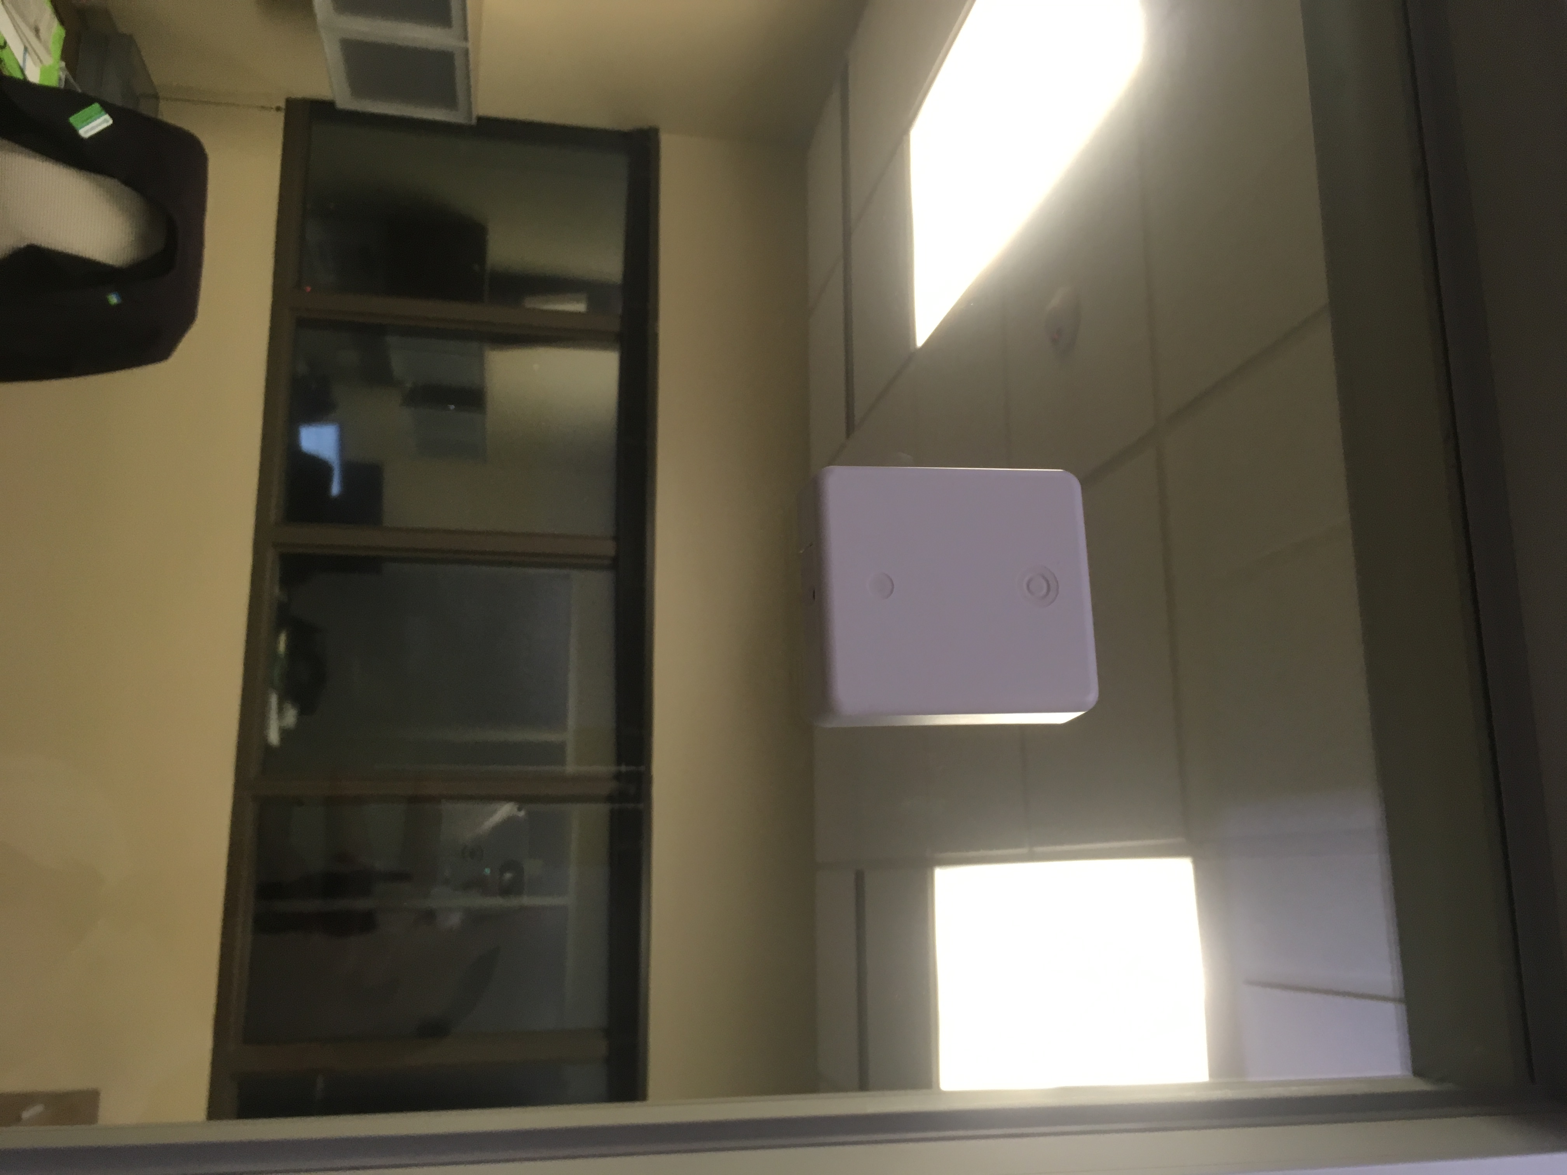
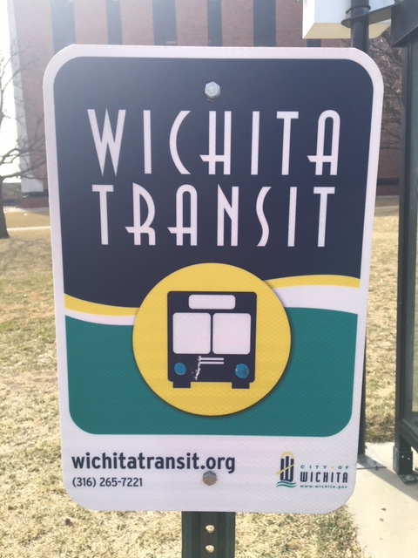
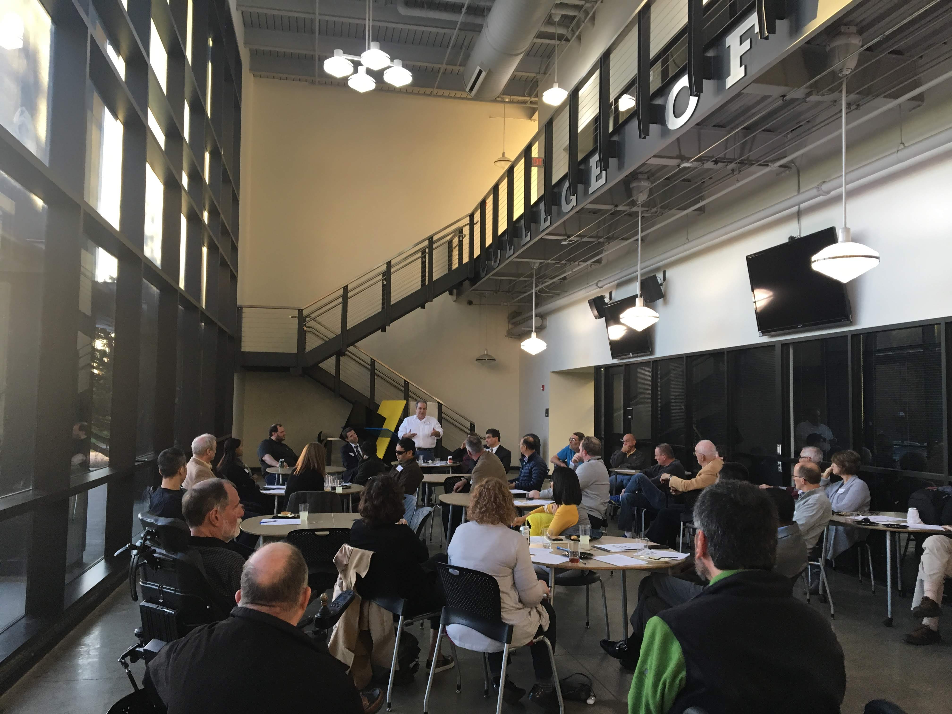
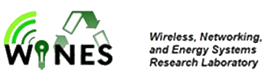
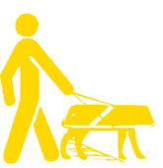
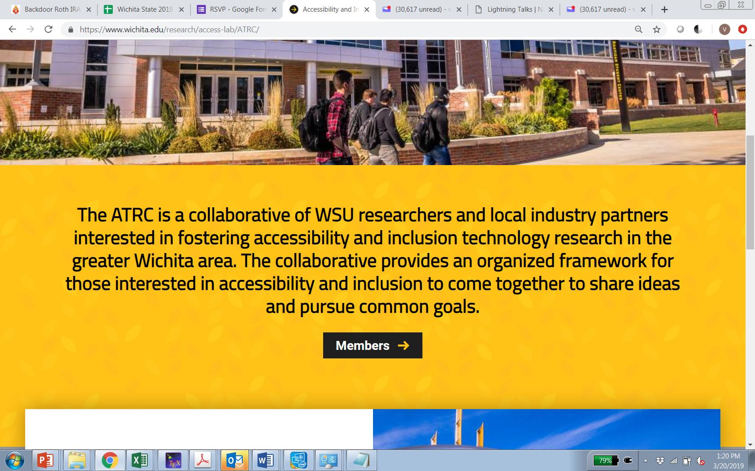
Update of the Project since last PI meeting
Beacons on all transit stops in Wichita; beacons on an entire floor of Envision’s HQ; next one at WSU’s Ulrich Museum of Art
Number of PIs and senior personnel involved increased from 5 to over 15!
2 offerings of a team-taught trans-disciplinary class on Accessible Computing
Establishment of the Accessibility and Inclusion Technology Research and Education Collaborative (ATRC)
The lab I direct changed from
Assistive and Accessible
Computing Research Lab
Challenge: Managing expectations of the community
“Heard you were building an app to direct blind folks to board the bus. I still cannot, please fix it. I will come to your office at 2PM today”
Notes:
Platform to showcase research and educational activities related to accessibility and inclusion
Over 50 attendees in first interest-gathering session!
Colloquium series on Accessibility and Inclusion starting April 5
Describe at least one deliverable that you accomplished together with your community partners and at least one outcome in terms of capacity building. Also describe something unexpected about working with your community partners. Anecdotes are highly encouraged. Include photos.
Emphasize activities that have been carried out after last year's PI meeting and how these activities along with what was accomplished last year fits within the overall vision of your project.

Slide 4
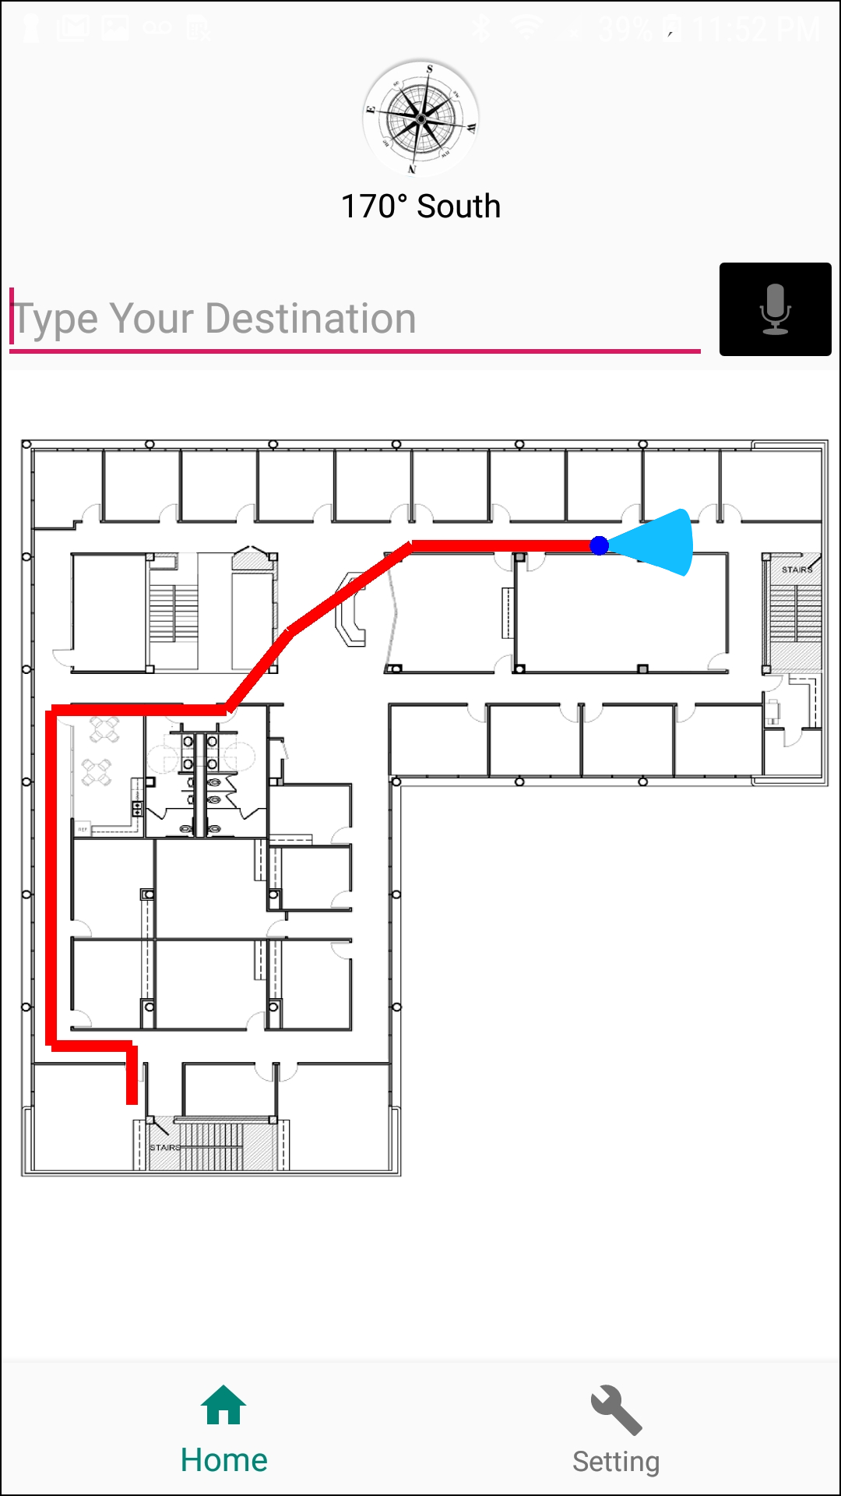
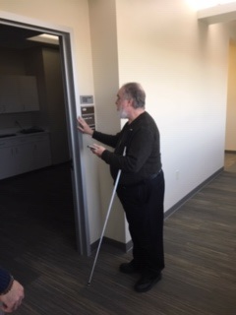
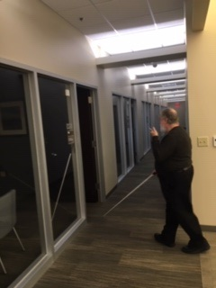
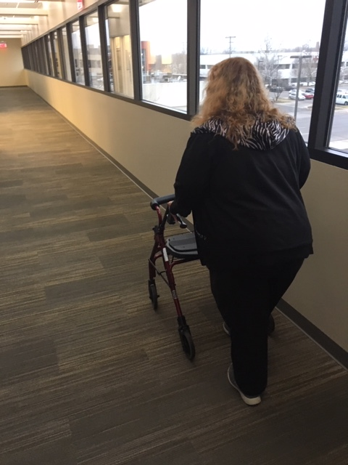
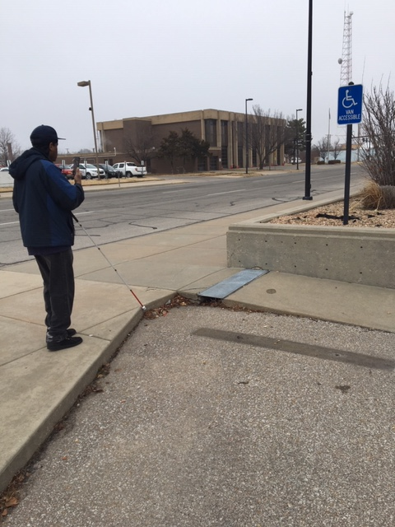
Update of the Project since last PI meeting
Sociotechnical contributions thus far:
GuideBeacon: Accurate indoor wayfinding and navigation enabling turn-by-turn directions within indoor spaces for people with visual and mobility impairments
SafeExit4All: Evacuation of people with disabilities from an unfamiliar indoor space independently
GuideCall: Timely remote human assistance for certain tasks
 | Vision | Mobility | Hearing | Cognitive | …….
Indoor Wayfinding | Tested | Tested
Evacuation | Tested | Tested | Tested
Indoor-Outdoor Wayfinding | Tested
Landmarks
Transit | Partial
Already provides a model for bringing the community together to solve some of the challenges with accessibility and inclusion for people with disabilities; just needs scaling up
Notes:
Three avenues of sociotechnical contributions for CityGuide:
A proof-of-concept of the navigation and wayfinding system called GuideBeacon enabling turn-by-turn directions from point A to point B within an indoor spaces
The emergency evacuation system SafeExit4All, built on top of GuideBeacon, becomes the second application enabled
Addition tool called GuideCall implemented to provide remote assistance through a video call
Provides a small-scale model for bringing the community together to solve some of the challenges with accessibility and inclusion for people with disabilities
Three avenues of sociotechnical contributions for CityGuide:
A proof-of-concept of the navigation and wayfinding system called GuideBeacon enabling turn-by-turn directions from point A to point B within an indoor spaces
The emergency evacuation system SafeExit4All, built on top of GuideBeacon, becomes the second application enabled
Addition tool called GuideCall implemented to provide remote assistance through a video call
Provides a small-scale model for bringing the community together to solve some of the challenges with accessibility and inclusion for people with disabilities
Describe at least one deliverable in terms of the science (technical and social). Why is this deliverable significant/what did it accomplish or what will it allow? Include photos.
Emphasize activities that have been carried out after last year's PI meeting and how these activities along with what was accomplished last year fits within the overall vision of your project. Inclusion of photos are encouraged.

Slide 5
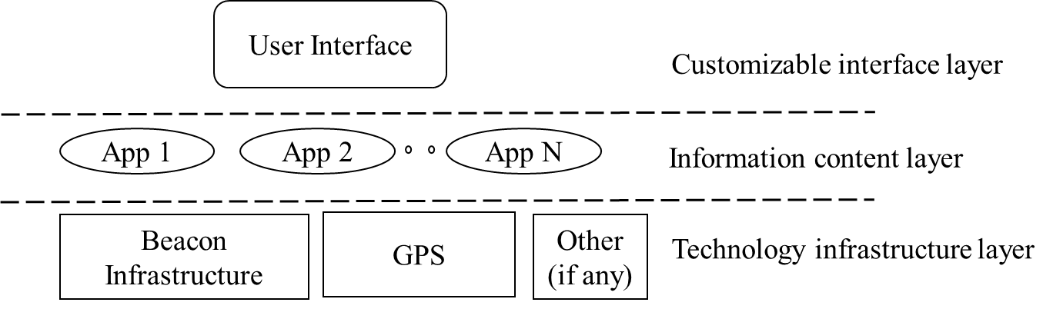


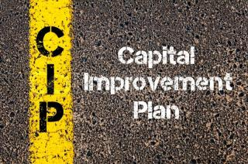

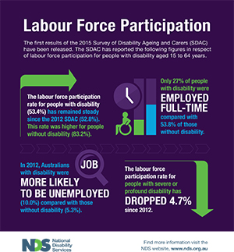

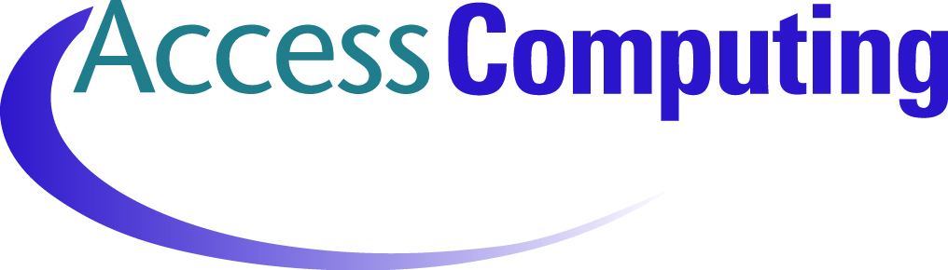

Planned Outcomes/Next Steps
Continue to add to technology portfolio, considering alternative technology infrastructure options at the lowest layer
  layered architecture allows swapping of underlying technology;
  upper layer contributions remain as fundamental contribution
Continue efforts to secure funding for the long-term sustainability of the project
Continue to utilize the community partnerships fostered through the S & CC program towards solving other challenges for PwD:
Notes:
Various NSF programs ranging from foundational research to partnerships for innovation
Programs at NIH and NIDLRR for development and rehabilitation
CIPs and other federal grants to support the city in infrastructure development
Increasing the rate of employment among people with disabilities
Increasing the rate of students with disabilities entering graduate school

