Slide 1
2019 NSF SMART AND CONNECTED COMMUNITIES PI MEETING
FY 2017 PG: A Data-Driven Framework for Smart Decision-Making in Small and Shrinking Communities, #1736718
KIMBERLY ZARECOR¹ (PI), SARA HAMIDEH¹ (CO-PI), DAVID PETERS¹ (CO-PI), MARWAN GHANDOUR² (CO-PI), ERIC ROZIER³ (CO-PI), ERIN MULLENIX⁴ (COMMUNITY PARTNER)
¹IOWA STATE UNIVERSITY, ²LOUISIANA STATE UNIVERSITY, ³INDUSTRY, & ⁴IOWA LEAGUE OF CITIES
HTTP://SCC.DESIGN.IASTATE.EDU
Notes:
This is the transition slide. The lightning talk moderator will announce the name of your project and the name of the lead PI. Expect to begin your presentation from the next slide.

Slide 2
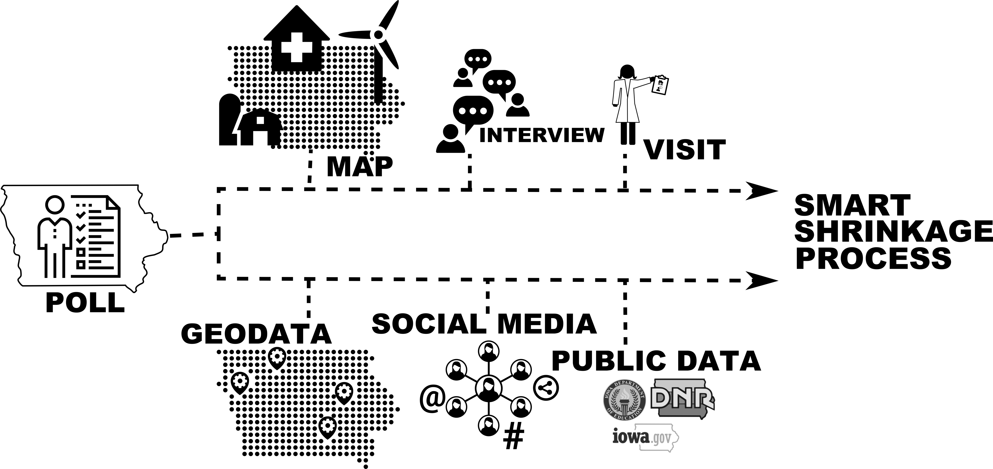
Project Aims
This project seeks to understand why perceptions of quality of life are stable or improving in some rural Iowa communities even as they lose population. We call this a process of smart shrinkage.
Tasks include identifying and verifying smart shrinkage through one-on-one interviews, focus groups, spatial analysis, mapping, and, in parallel, data-driven methodologies to search for proxy metrics to estimate longitudinal polling about quality of life that may predict smart shrinkage in other communities.

Slide 3
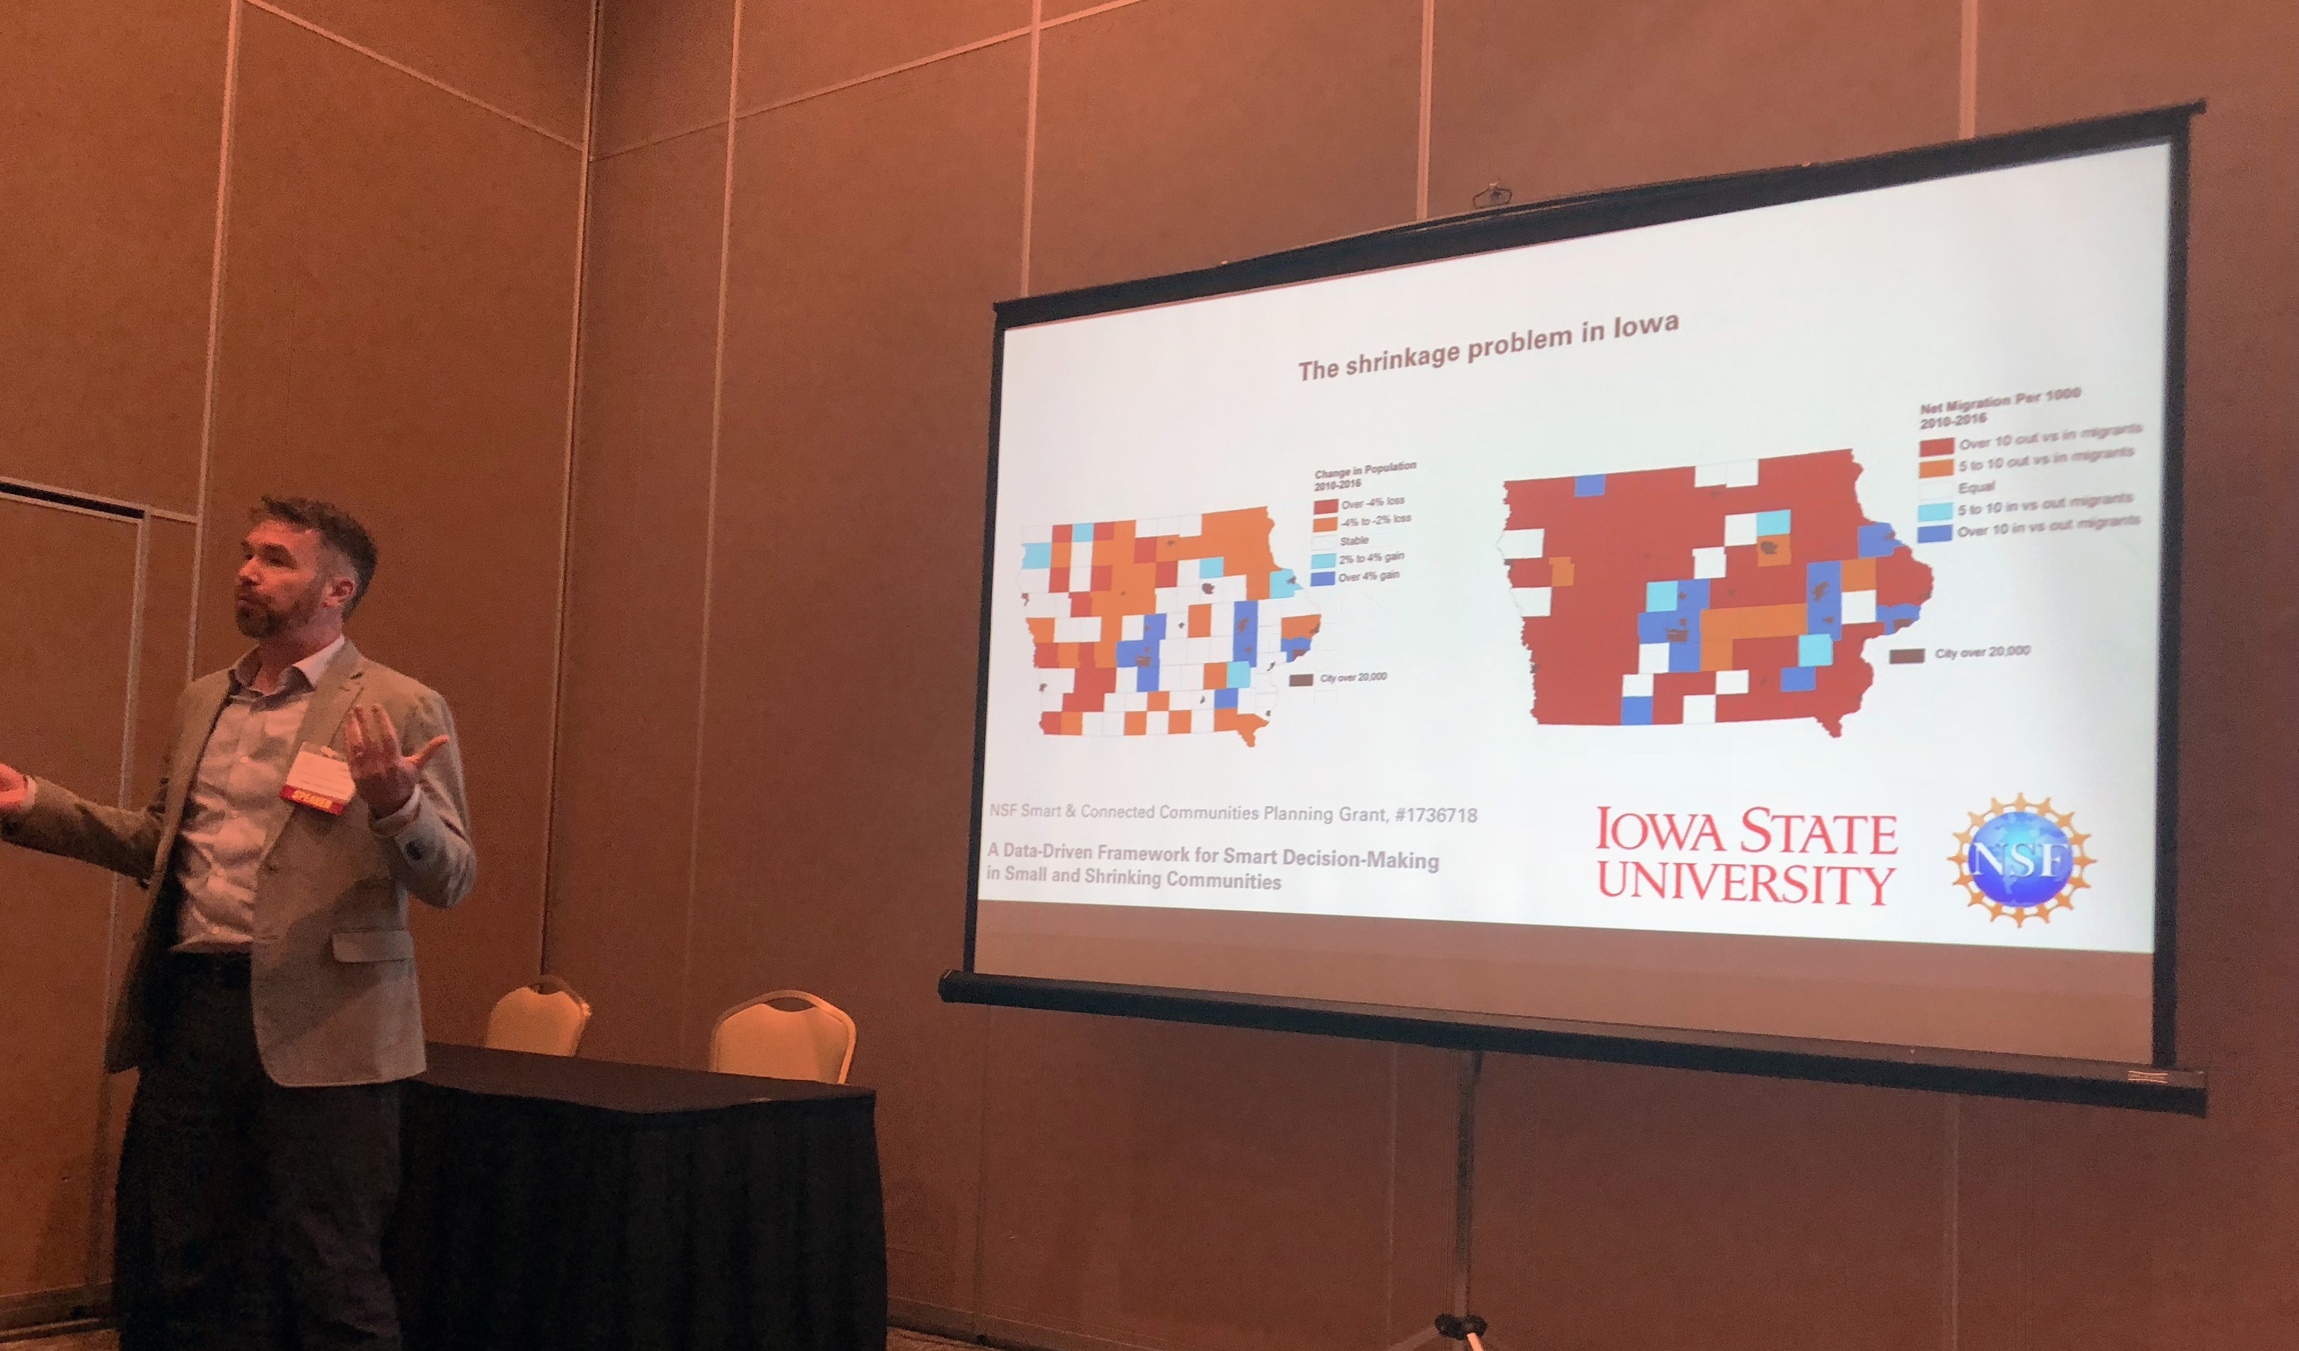
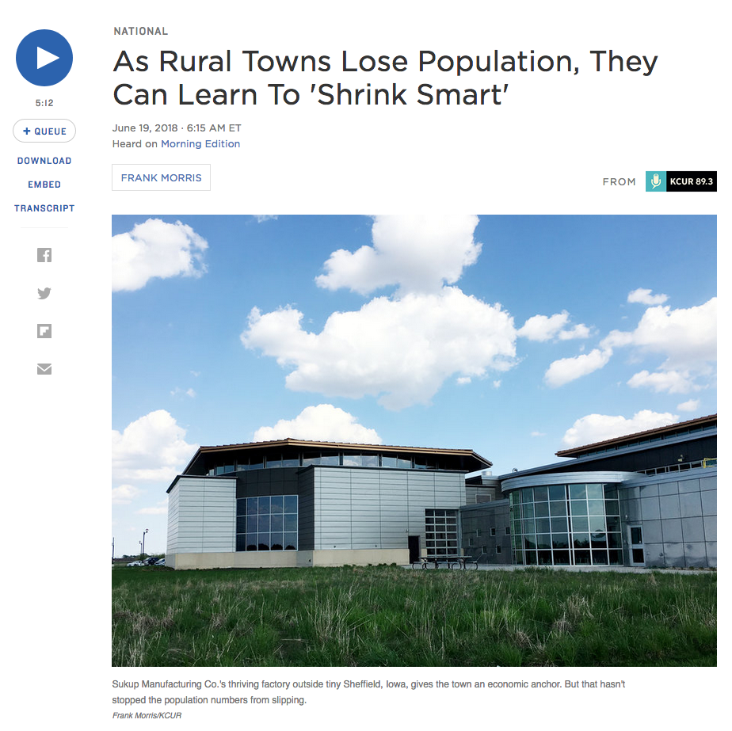
Update of the Project since last PI meeting
Workshop at the Annual Meeting of the Iowa League of Cities (Sept. 2018)
Media coverage on Iowa Public Radio, National Public Radio, and newspapers that featured towns in our study
NPR,
June 2018
Notes:
Describe at least one deliverable that you accomplished together with your community partners and at least one outcome in terms of capacity building. Also describe something unexpected about working with your community partners. Anecdotes are highly encouraged. Include photos.
Emphasize activities that have been carried out after last year's PI meeting and how these activities along with what was accomplished last year fits within the overall vision of your project.

Slide 4
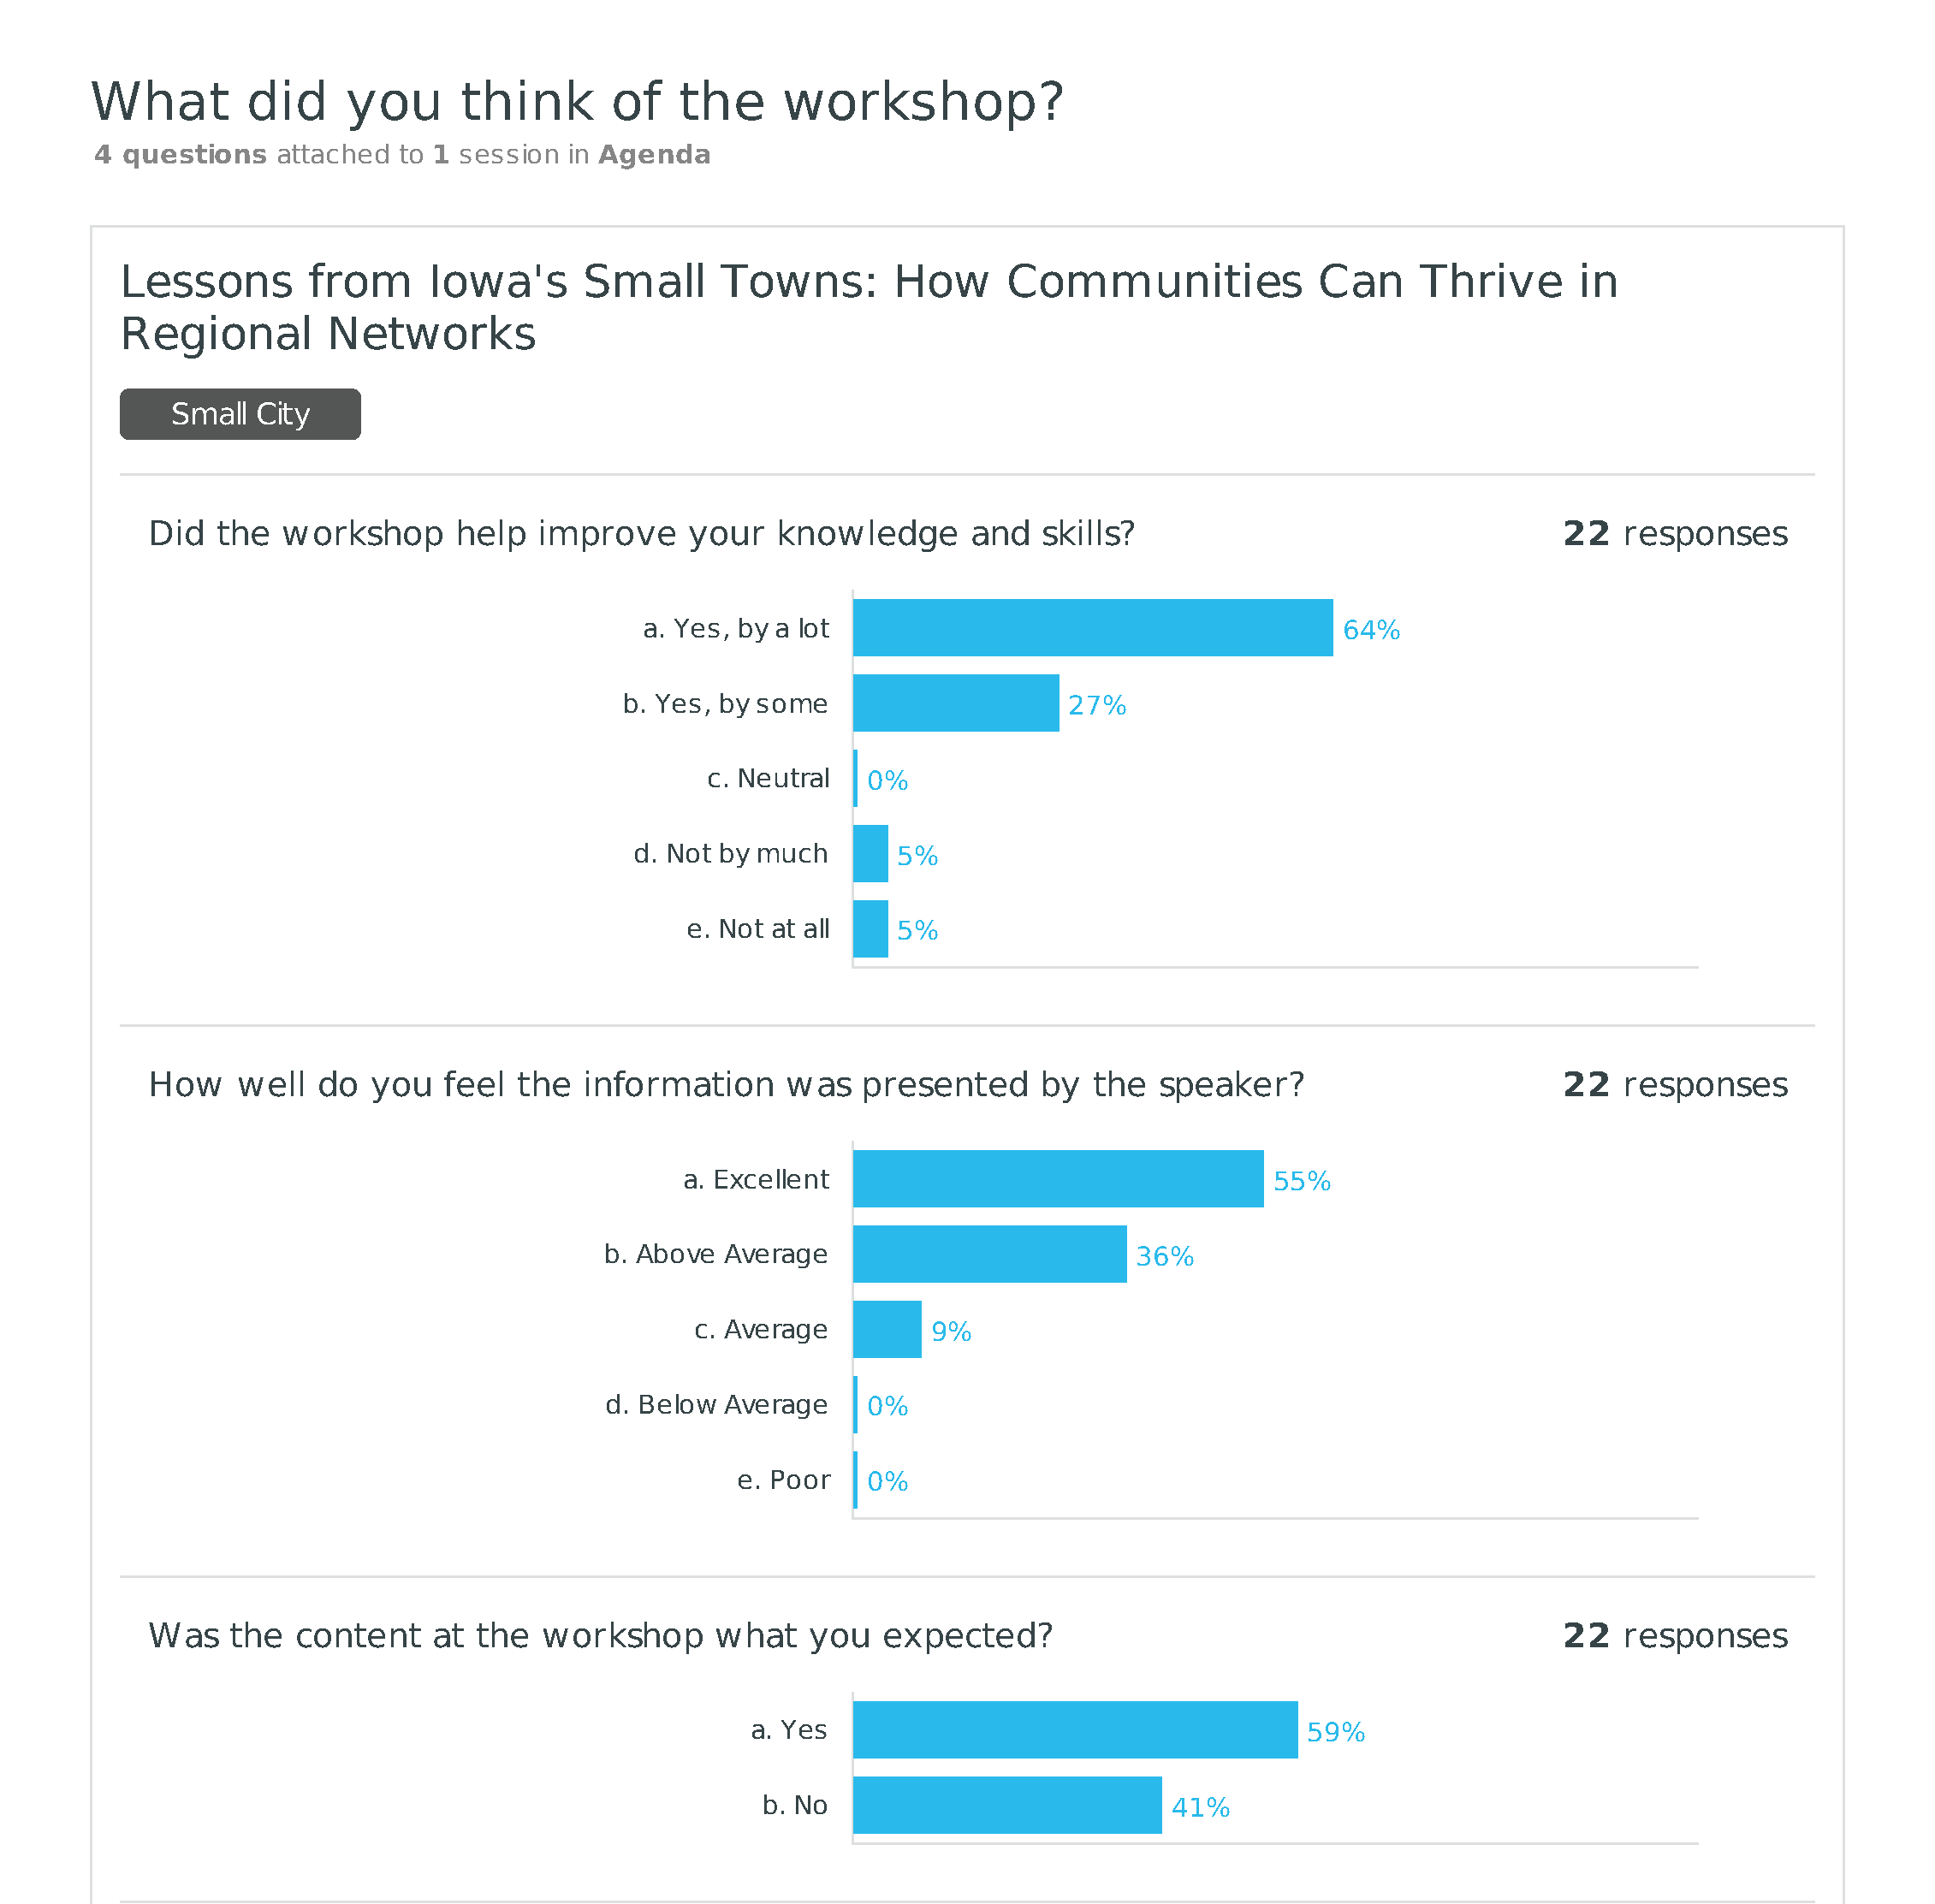
Workshop responses
(about 50% of attendees evaluated the session)
Some disappointed attendees expected us to have instructions for smart shrinkage
Notes:
Describe at least one deliverable that you accomplished together with your community partners and at least one outcome in terms of capacity building. Also describe something unexpected about working with your community partners. Anecdotes are highly encouraged. Include photos.
Emphasize activities that have been carried out after last year's PI meeting and how these activities along with what was accomplished last year fits within the overall vision of your project.

Slide 5
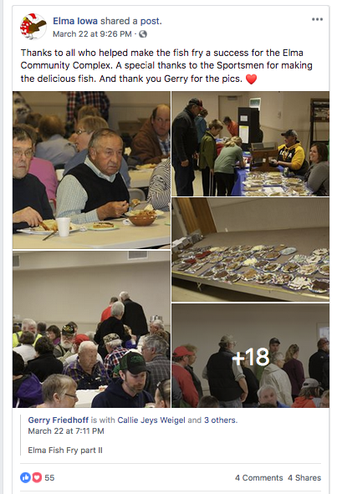
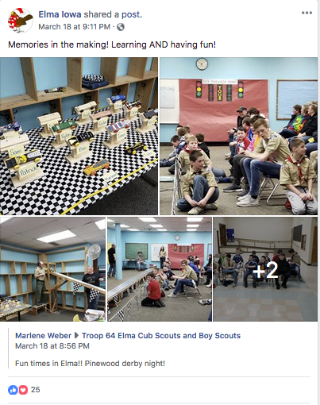
Update of the Project since last PI meeting
Verified smart shrinkage in 3 of 5 towns
(peer-reviewed publication on poll data analysis, 2 more on new qualitative data ready for review this spring)
Typology –
1) county seat
2) company town
3) home to local champions
Perceptions of quality of life are driven by social capital, openness to new people and ideas, and optimism about the future
Most unexpected type: home to local champions
Elma, Iowa (pop. 527)
Notes:
Describe at least one deliverable in terms of the science (technical and social). Why is this deliverable significant/what did it accomplish or what will it allow? Include photos.
Emphasize activities that have been carried out after last year's PI meeting and how these activities along with what was accomplished last year fits within the overall vision of your project. Inclusion of photos are encouraged.

Slide 6
Planned Outcomes/Next Steps
Transition data science tasks to new, larger team at a partner university
Continue dissemination through stakeholder organizations in the State of Iowa, including additional League of City events, sustainable cities meetings, and ISU Extension & Outreach
Develop larger public presence for the data and analysis including website with interactive interface
Publish additional peer-reviewed publications

