Slide 1
2019 NSF SMART AND CONNECTED COMMUNITIES PI MEETING
FY 2017 IRG Track 2: Building a Smart City Economy and Information Ecosystem to Motivate Pro-Social Transportation Behavior, NSF Award [CNS-1739413]
Alex Labrinidis (PI)
University of Pittsburgh
https://PittSmartLiving.org
Twitter: @PittSmartLiving
Notes:
This is the transition slide. The lightning talk moderator will announce the name of your project and the name of the lead PI. Expect to begin your presentation from the next slide.

Slide 2
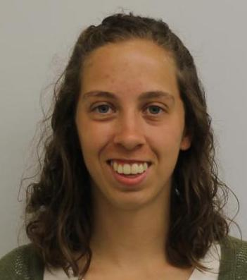
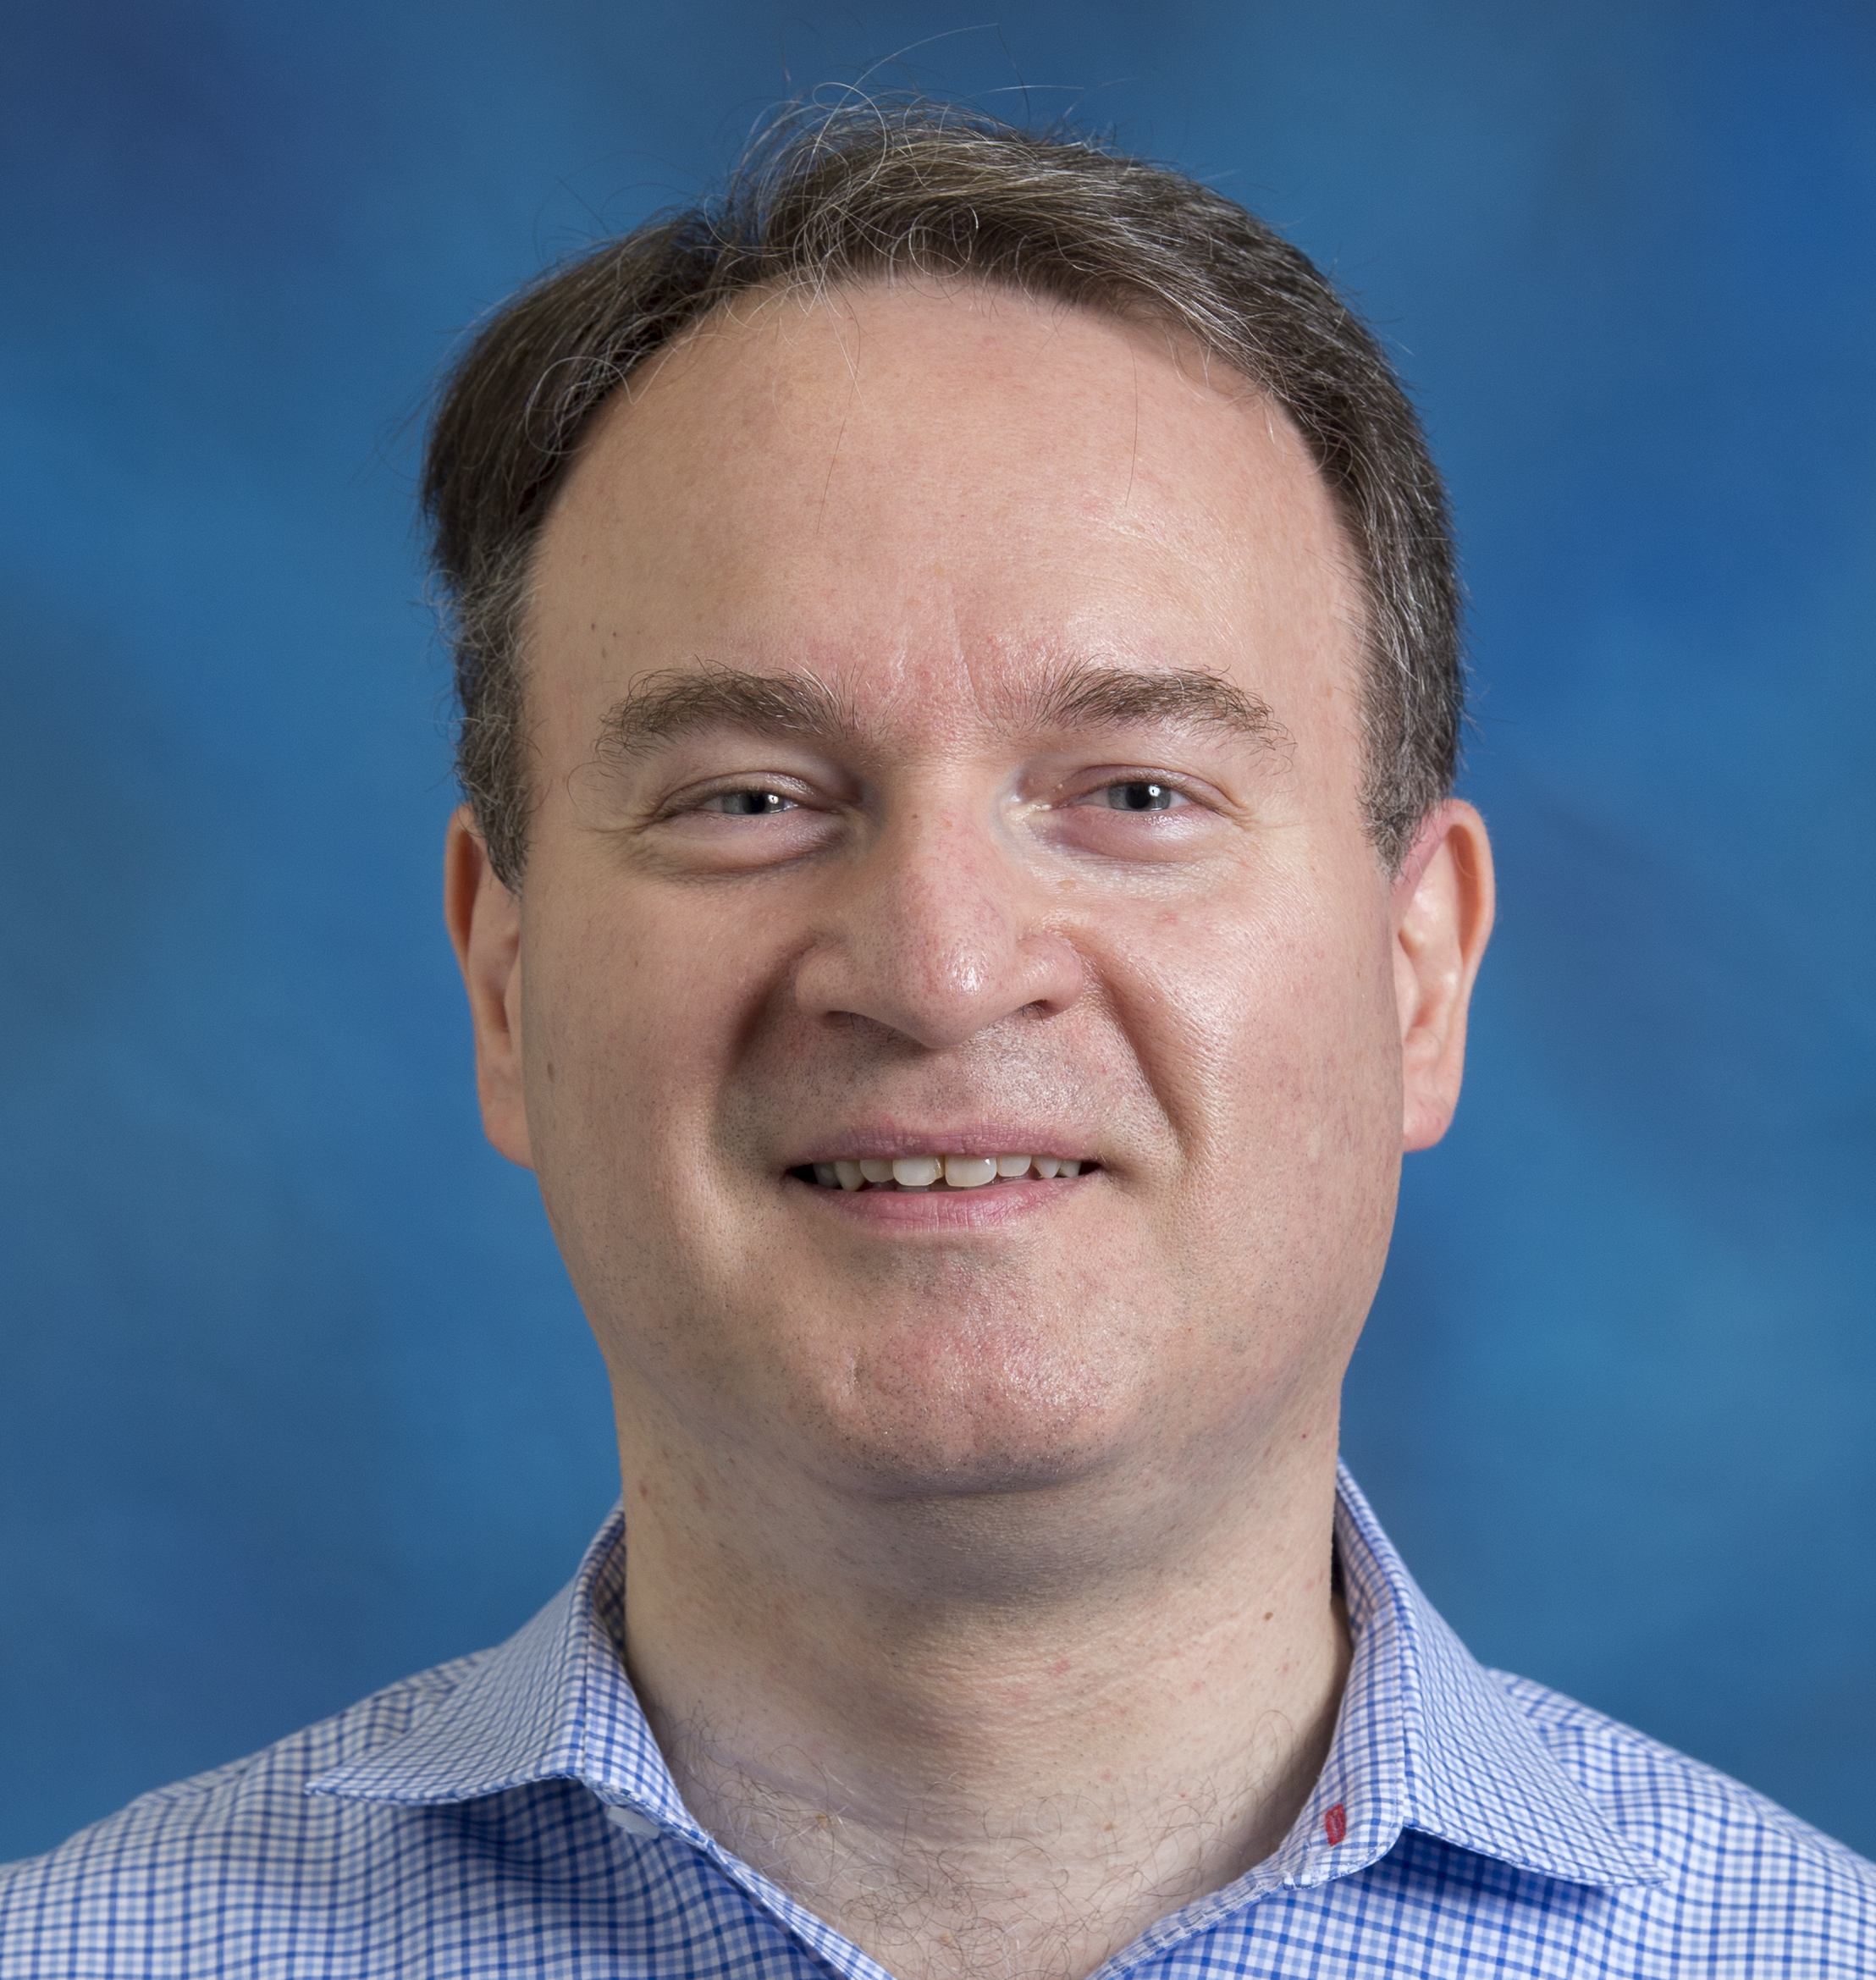
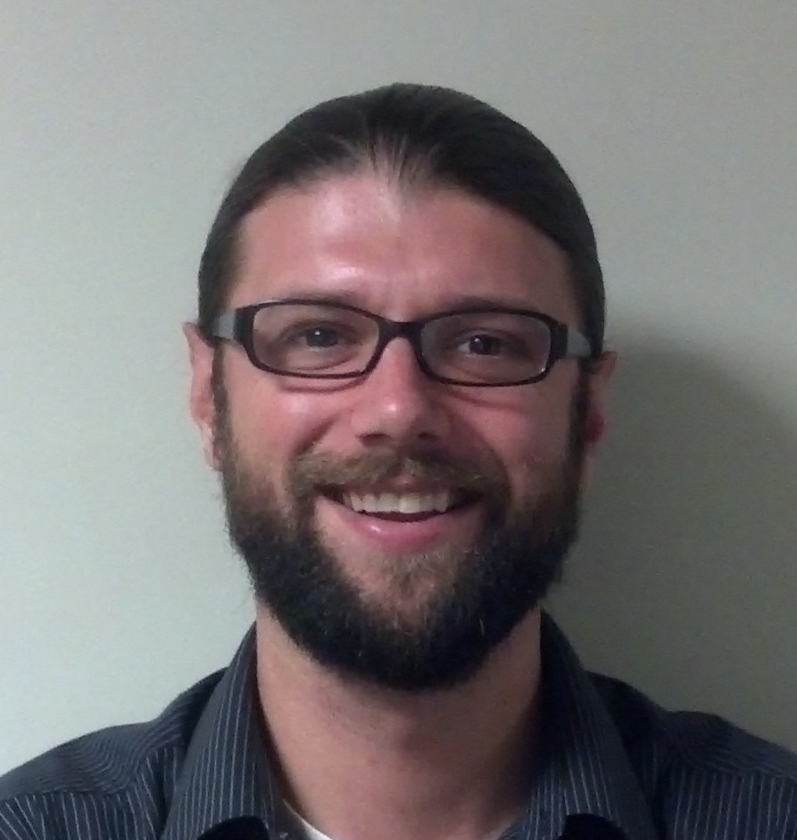
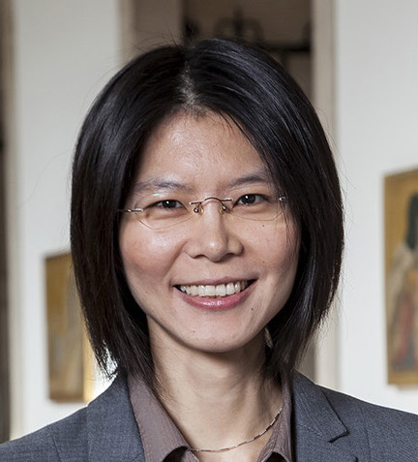
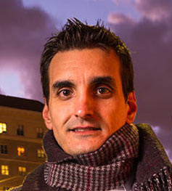
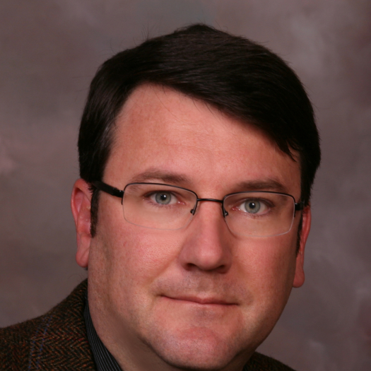
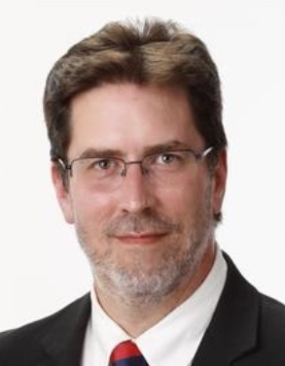
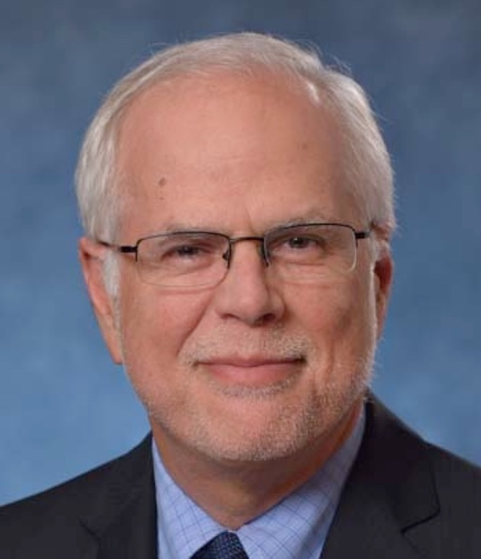
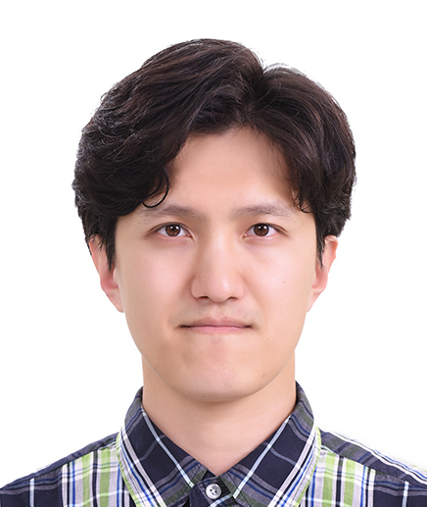
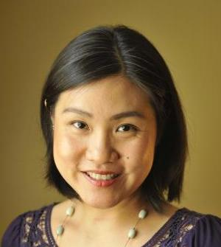
Team Members
School of Computing and Information (SCI)
Kristi Bushman
Alexandros Labrinidis (PI)
Adam Lee
Yu-Ru Lin
Konstantinos Pelechrinis
School of Engineering (SSOE)
GSPIA
Kent Harries
Keith Johnson
Mark Magalotti
Jinyong Jeong
Sera Linardi
Plus 8 Graduate Students And 7 Undergraduate Students (see https://pittsmartliving.org for full list)

Slide 3
Project Partners
Port Authority of Allegheny County
Healthy Ride Pittsburgh
City of Pittsburgh
Oakland Business Improvement District
Pittsburgh Downtown Partnership
Envision Downtown
Oakland Transportation Management Association
Pittsburgh 2030 District
Radius Networks
UPMC
Daniele Quercia, Bell Labs, Cambridge, UK
University of Pittsburgh – Department of Parking, Transportation & Services
University of Pittsburgh – Office of Community and Governmental Relations
University of Pittsburgh – Center for Social & Urban Research

Slide 4
Motivating Example
What if you knew how full your bus would be ahead of time?
What if you were given alternative options to waiting for the next bus?
What if you were given incentives for waiting for the next bus?
E.g., discount $3 off coffee from coffee-shop around the corner

Slide 5
The Big Picture
Mobility Providers
Travelers
Incentives
Pro-Social “rules” (e.g., reduce peak demand)
Realtime Information
Incentives
Better Quality of Life
Realtime Information
Marketplace for incentives
User Preferences
Historical Data
Predictive Models
Employers
Local Businesses
Sustainability Incentives
Redemption “rules” (e.g., verify carpooling)
Incentives
Redemption rules (e.g., no coupons before 5pm)

Slide 6
Deliverable: Deploying Infrastructure
@ Pittsburgh City Hall
@ new Port Authority Customer Service Center

Slide 7
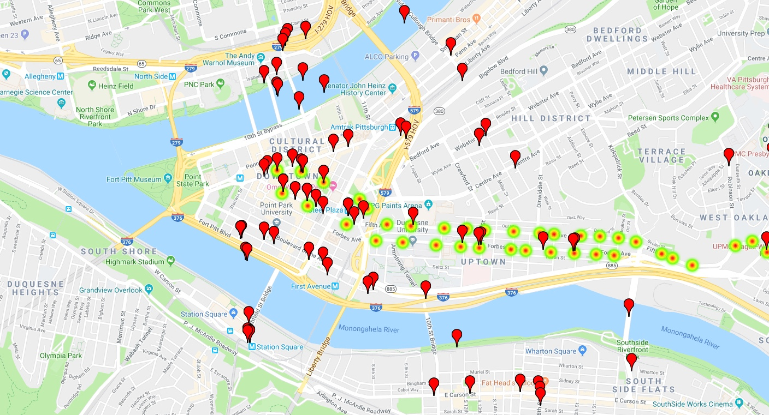
Deliverable: Understanding Real Data
Challenge: Real Data is DIRTY

Slide 8
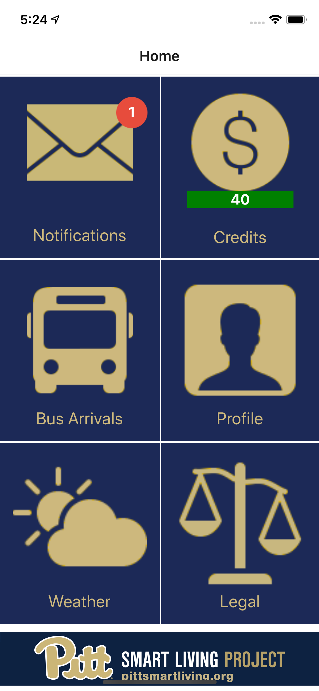
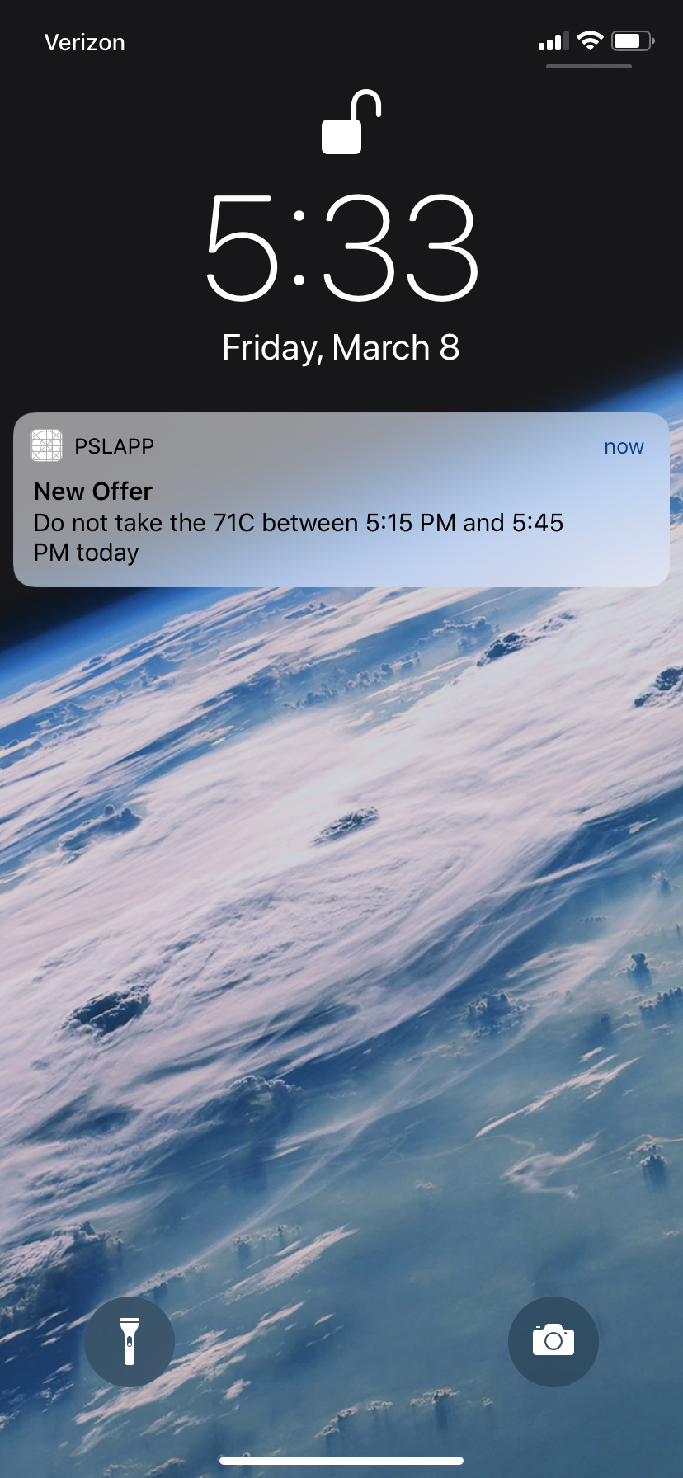
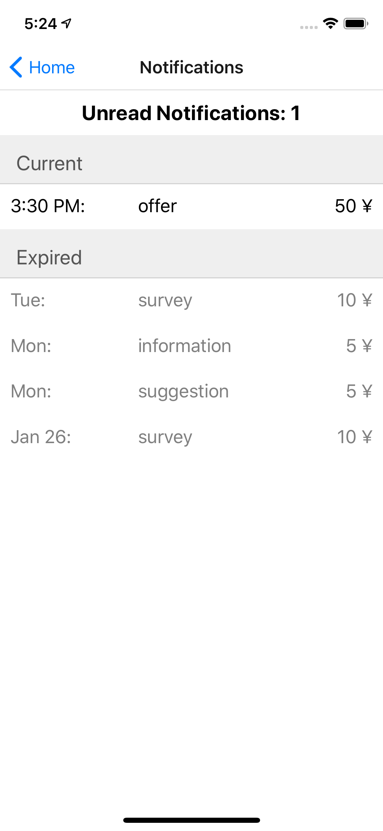
Deliverable: Mobile App for Field Experiment
Spring/Summer 2019

Slide 9
Anticipated outcomes and success measures in the next year
Data Modeling
Bus Capacity Prediction
Bus Delay Prediction
Screen Deployment
New Locations
Sophistication Level
Field Experiment
Participation Levels
Human Behavior Insights
Business Recruitment
Participation Levels

Slide 10
Alex Labrinidis
http://labrinidis.cs.pitt.edu
@labrinid
https://pittsmartliving.org
@pittsmartliving
Come to our booth on Tuesday!

