Slide 1


2019 NSF SMART AND CONNECTED COMMUNITIES PI MEETING
IRG Track 2: Real-time algorithms and software systems for heterogeneous data driven policing of social harm NSF Award # 1737585
Principal Investigators:
George Mohler, Jeremy Carter, and Rajeev Raje
Indiana University -
Purdue University Indianapolis
Community partners:
Indianapolis Police Department
Indianapolis Emergency Medical Services
http://cdash.cs.iupui.edu/
Notes:
This is the transition slide. The lightning talk moderator will announce the name of your project and the name of the lead PI. Expect to begin your presentation from the next slide.

Slide 2
Project Aims
Community Data Analytics for Social Harm
heterogeneous data integration
predictive modeling of social harm event dynamics
optimal control of space-time risk and dynamic resource allocation
matching the right people to place, time and social harm risk for targeted interventions

Slide 3
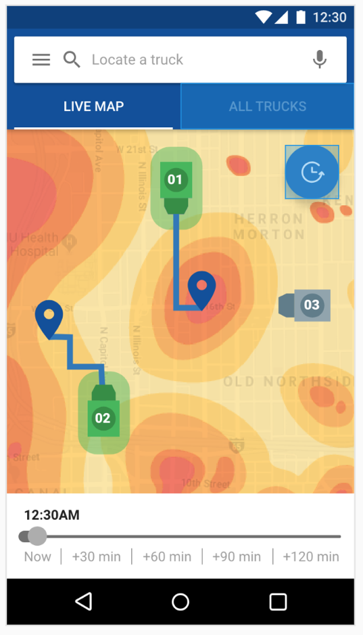
Update of the Project since last PI meeting
Most Significant Accomplishments
prototype software application for Indy Police and Emergency Medical Services
10 journal and conference publications on algorithms, service oriented software systems, and fairness
Toughest Challenge
bringing data pipe online and solving data integration challenges
Notes:
Most significant accomplishment: Describe at least one deliverable that you accomplished together with your community partner(s) in terms of capacity building and/or the science. Anecdotes and photos are highly encouraged.
Toughest challenge: Describe something challenging or unexpected about working with your community partners in terms of capacity building and/or the science (technical and/or social). How did you overcome this challenge? Anecdotes and photos are highly encouraged. Consider limiting your text.

Slide 4
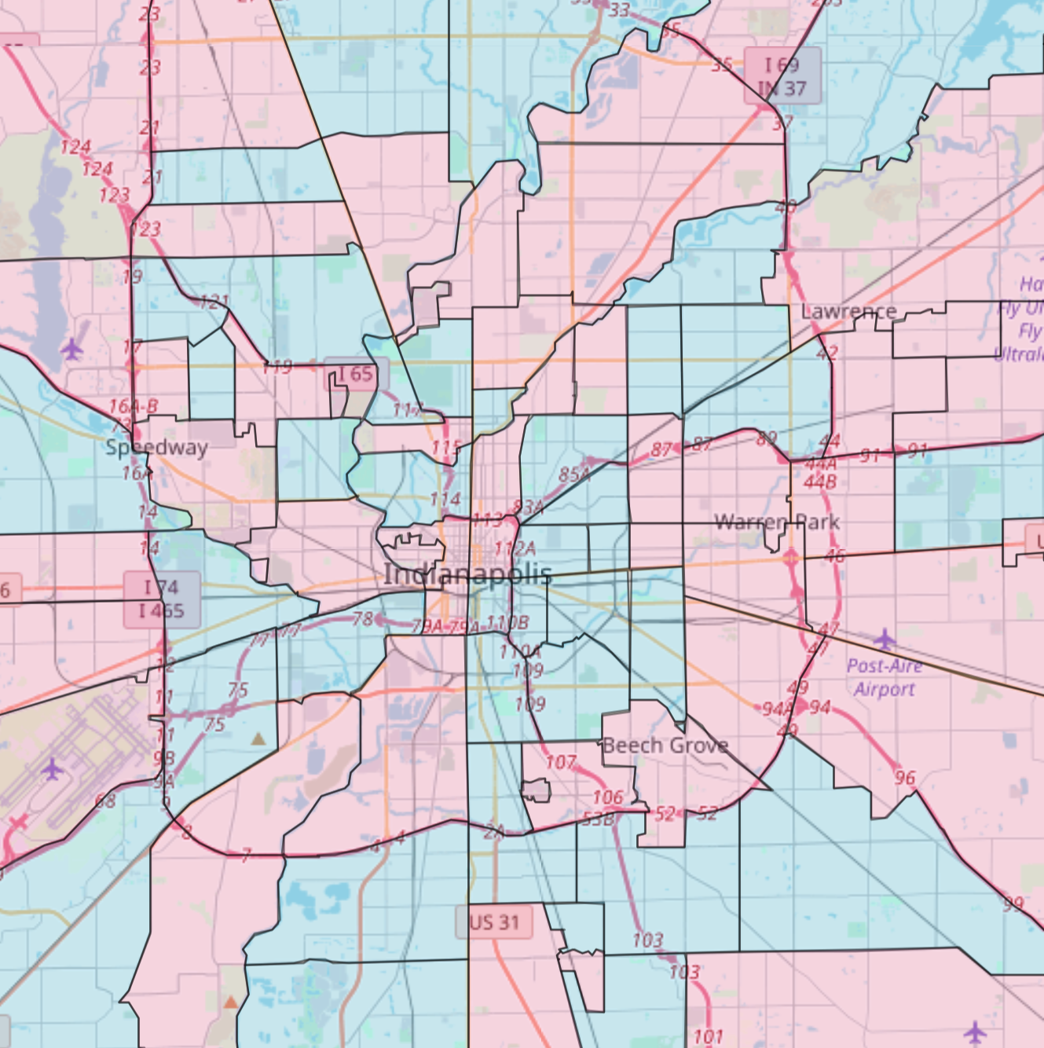
Anticipated outcomes and success measures in the next year
Randomized controlled trial of data-driven social harm policing May to July 2019
Pre/post community survey on trust in police, fear of crime, and views on predictive policing
Notes:
Describe at least two deliverables that you plan to accomplish over the next year that will significantly advance your project.

