Slide 1
2019 NSF SMART AND CONNECTED COMMUNITIES PI MEETING
FY 2017 IRG Track 2: Smart & Connected Kids for Sustainable Energy Communities, NSF Award #1737565
HILARY BOUDET (OREGON STATE UNIVERSITY), RAM RAJAGOPAL (STANFORD UNIVERSITY), MAHNOOSH ALIZADEH (UNIVERSITY OF CALIFORNIA, SANTA BARBARA)
COMMUNITY PARTNERS: RACHEL DIFRANCO (CITY OF FREMONT), JEAN FAHY (GIRL SCOUTS OF NORTHERN CALIFORNIA), OHLONE COMMUNITY COLLEGE
HTTPS://GLEE.STANFORD.EDU
Notes:
-Introduction slide.

Slide 2
Project Aims
Notes:
-In Fremont California we recruit kids and their families to participate in programs that teach them how to save energy in the home. Our goal is to help families save energy and money while improving community energy sustainability.
-Through engagement with novel mechanisms such as mobile apps, during periods of peak demand which is a time of the day, typically between 4-8pm, where the community is using the most power AND is most likely to draw this power from sources that produce greenhouse gas emissions. Reducing overall power consumed in peak demand periods makes it easier for communities to transition to cleaner energy sources and makes loads more predictable for utility providers.

Slide 3
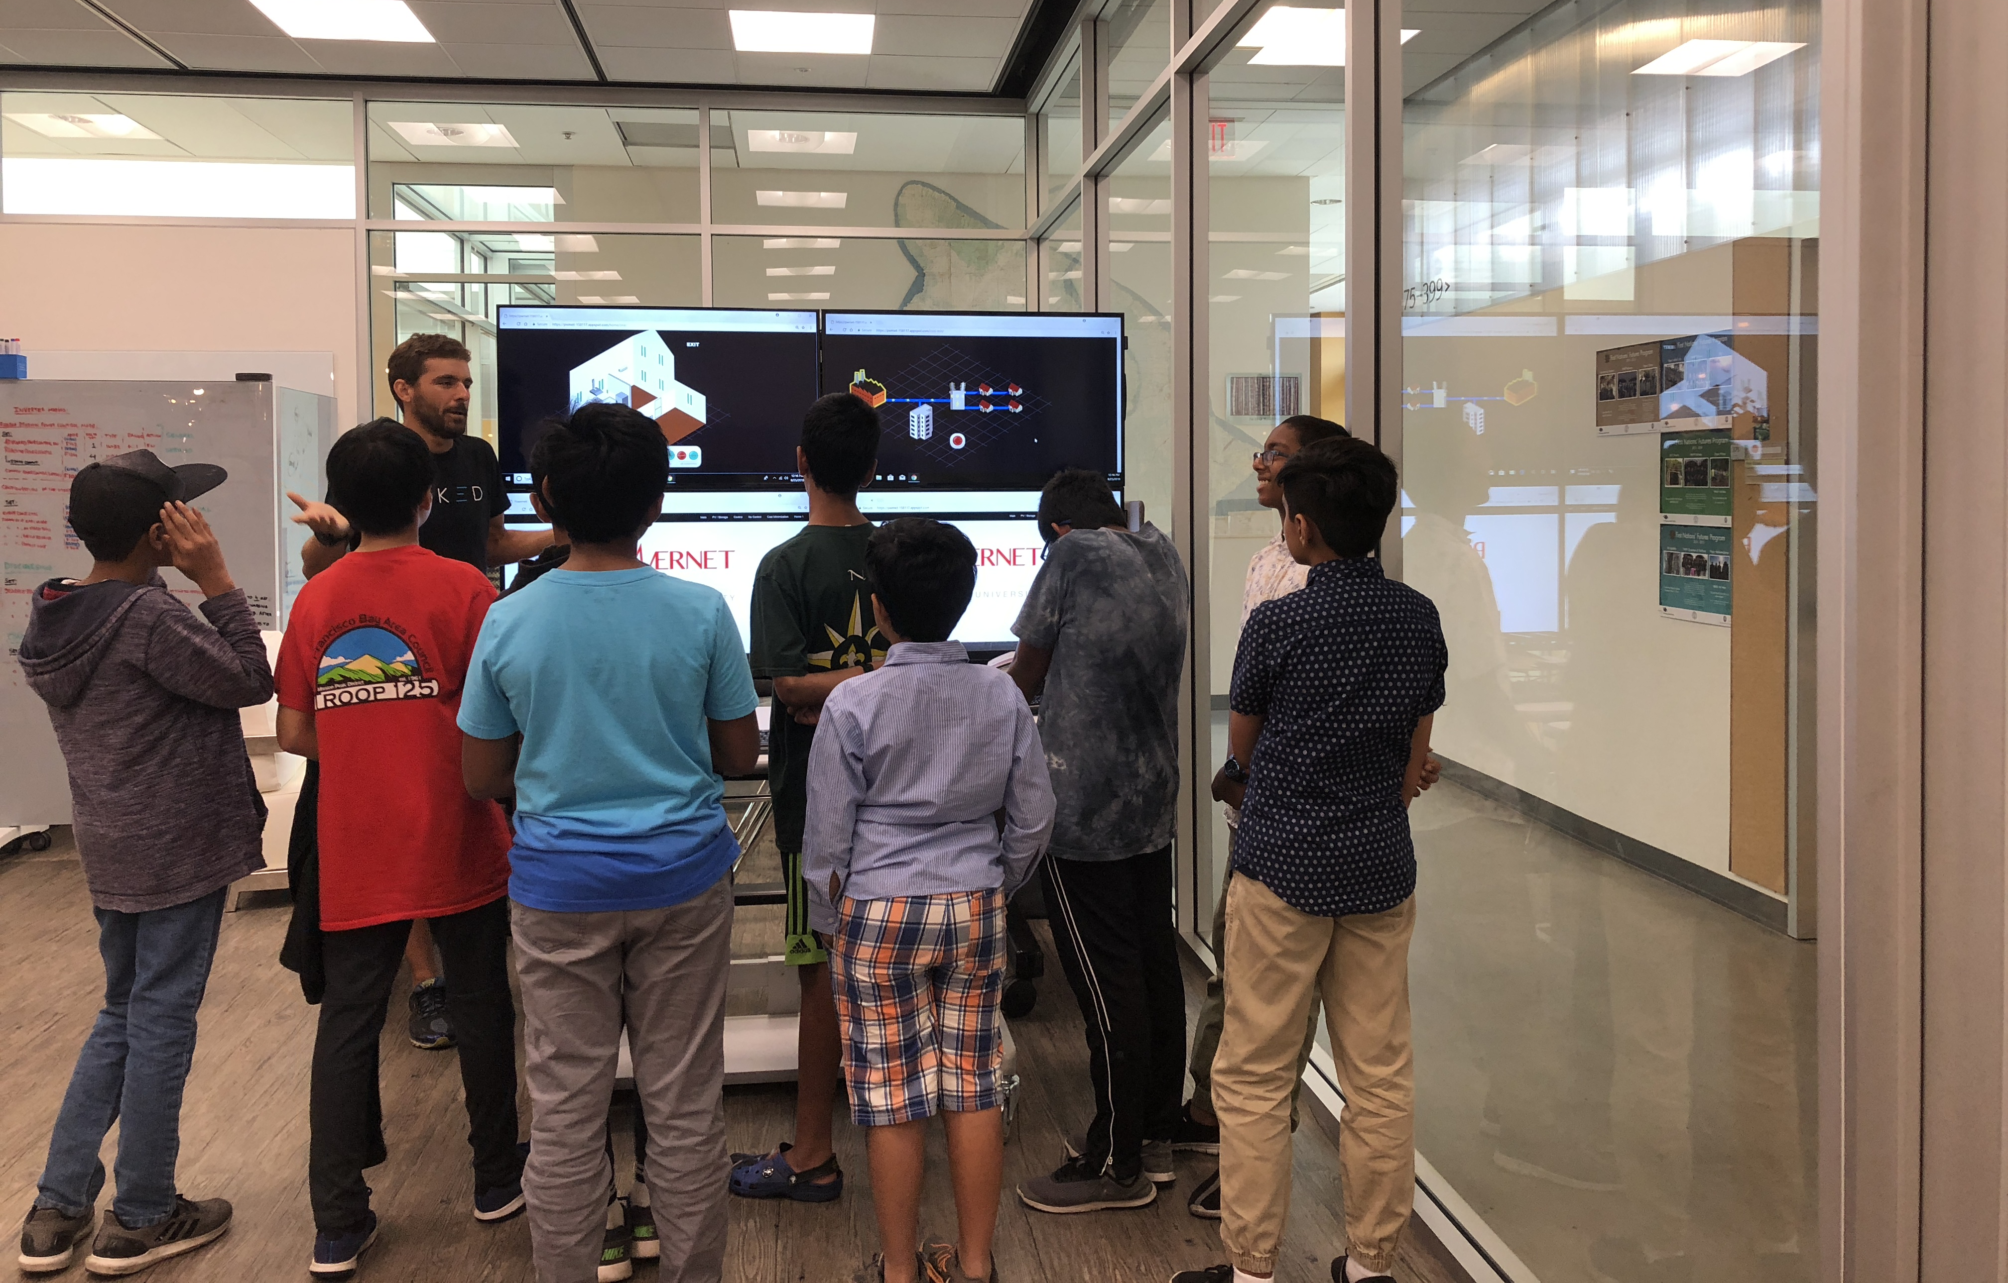
Update of the Project since last PI meeting
Most Significant Accomplishments
Gathered input from interviews, focus groups, community events, and surveys to develop and pilot two youth-focused energy programs, engaging 1,350+ community members in process.
Developing a mobile engagement mechanism to combine sparse activity journaling with real-time smart meter data to produce behavioral insights.
Toughest Challenge
Navigating constant obstacles with new and rapidly changing technologies.
Notes:
-After engaging the community through interviews and focus groups, community events, and surveys, we developed and successfully piloted two iterations of an energy education program where kids and their families learned about their energy use in the home and how to save energy through the: Design your sustainable life and Know Your Energy Numbers.
-Applied feedback from interviews and focus groups (n=68), community events (n=900), and household surveys (n=333) to create two workshop pilots: “Designing Your Energy Lifestyle” (n=28) and “Know Your Energy Numbers” (n=39).
-We are also developing novel activities to support this program, one of which is a mobile-based system for families to complete smartphone-based journal abouts real time energy use behaviors in the home. This mobile energy journal was implemented this month and we are starting to install our first real-time energy monitoring devices in pilot households towards the goal of building a repeatable data collection procedure that will allow us to build a large dataset of behavior+energy data on which to train algorithms that can provide feedback on reducing peak demand and improve energy literacy in families.
-One on-going challenge is navigating the very new and rapidly changing landscape of smart technologies. Many technical challenges still need be overcome and this introduces a new set of social challenges, such as deploying these technologies in homes and teaching participants about how to use of and privacy concerns surrounding these new technologies. An example of such a challenge that we personally faced was that one of our early technology partners (Chai Energy) folded in the middle of our initial deployments, c'est la vie.

Slide 4
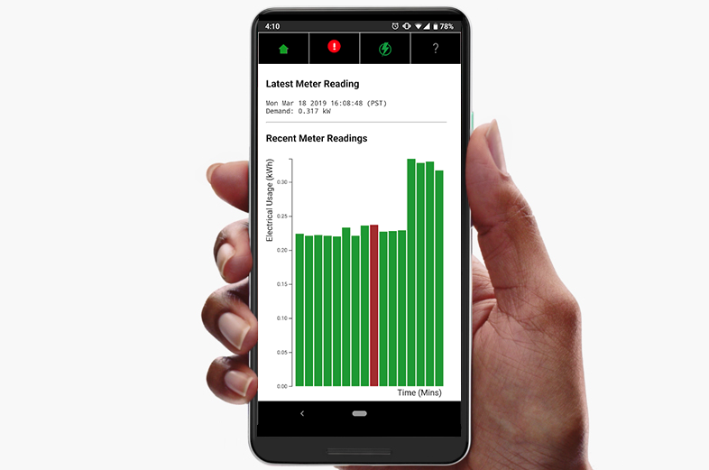
Anticipated outcomes and success measures in the next year
Complete and integrate mobile journaling and real-time energy feedback application into youth-focused energy program; test effectiveness in changing behavior.
Conduct four deliberative workshops with Fremont community members to understand public concerns and behavior in smart grid.
Prototype of real-time energy application
Connected Rainforest Automation EAGLE-200 (rev 2)
Notes:
-For next steps, we will finish piloting our programs and engage more youth, and their households, in mobile activity journaling. This will involve implementing our initial surveys through out technology partner, Expimetrics, to begin data collection while developing a custom application to support our energy programs. We will also be relying on energy hubs from Rainforest Automation to provide direct access to the smart meter data at deployment sites. Photos, right.
-We now have a better idea about the needs and aspirations of our community partners and we would like to build a set of strategies that can leverage resources within the community to better utilize existing sources of clean power, and begin conversations about how to implement their ideal clean energy solutions. To do this, we plan to conduct four deliberative workshops with approximately 15 participants each drawn from a representative sample of the community.

