Slide 1
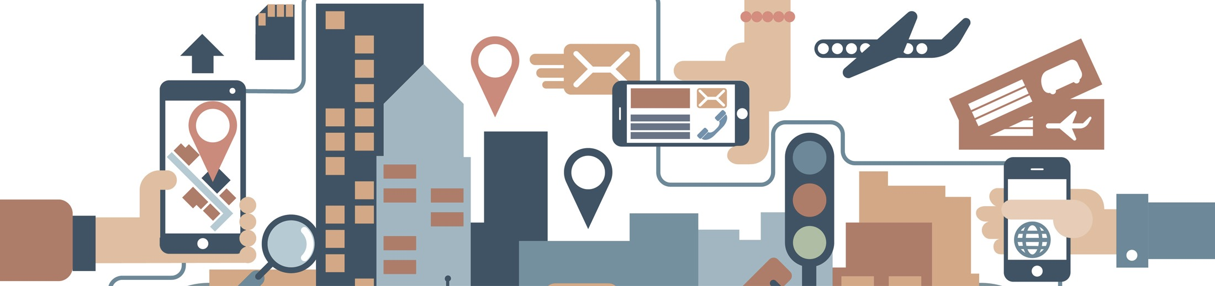

2019 NSF SMART AND CONNECTED COMMUNITIES PI MEETING
FY 2017 IRG Track 2: A Novel Architecture for Secure Energy Efficient Community-Edge-Clouds with Application in Harlem: SEEC Harlem, NSF Award #CNS-1737453
Dan Kilper¹ (Lead), Clayton Banks², Bryan Carter¹, Rider Foley³, Sheila Foster⁴, Bruce Lincoln², Olivier Sylvain⁵, Malathi Veeraraghavan³, Ron Williams³
¹University of Arizona (Lead), ²Silicon Harlem, ³University of Virginia, ⁴Georgetown University, ⁵Fordham University
http://cian-erc.uawebhost.arizona.edu/seec-harlem

Slide 2
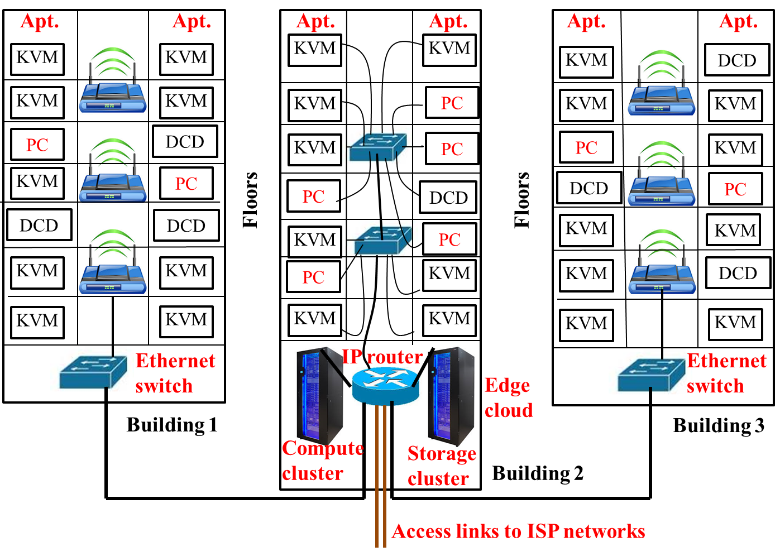
Zero Client Community Edge Clouds
Edge cloud to disaggregate hardware
  Low cost, secure user devices: KVM/Zero Client user interfaces, sensors, audio, VR/AR
  Shared, centralized IT management of high performance edge cloud
  Can this approach meet technology performance, ease of use, and cost?
Community network as digital constructed commons resource
  Develop groundbreaking model for distributed community governance of Internet resources: equitably provide benefits & transferrable to other communities
Technology
  Participatory technology assessments (pTA) on the highest priority criteria related to the community edge cloud and disaggregated devices
  Smart community education and engagement

Slide 3
Zero Client Trials
115 participants
Subjective & objective measurements
Defined new metric

Slide 4
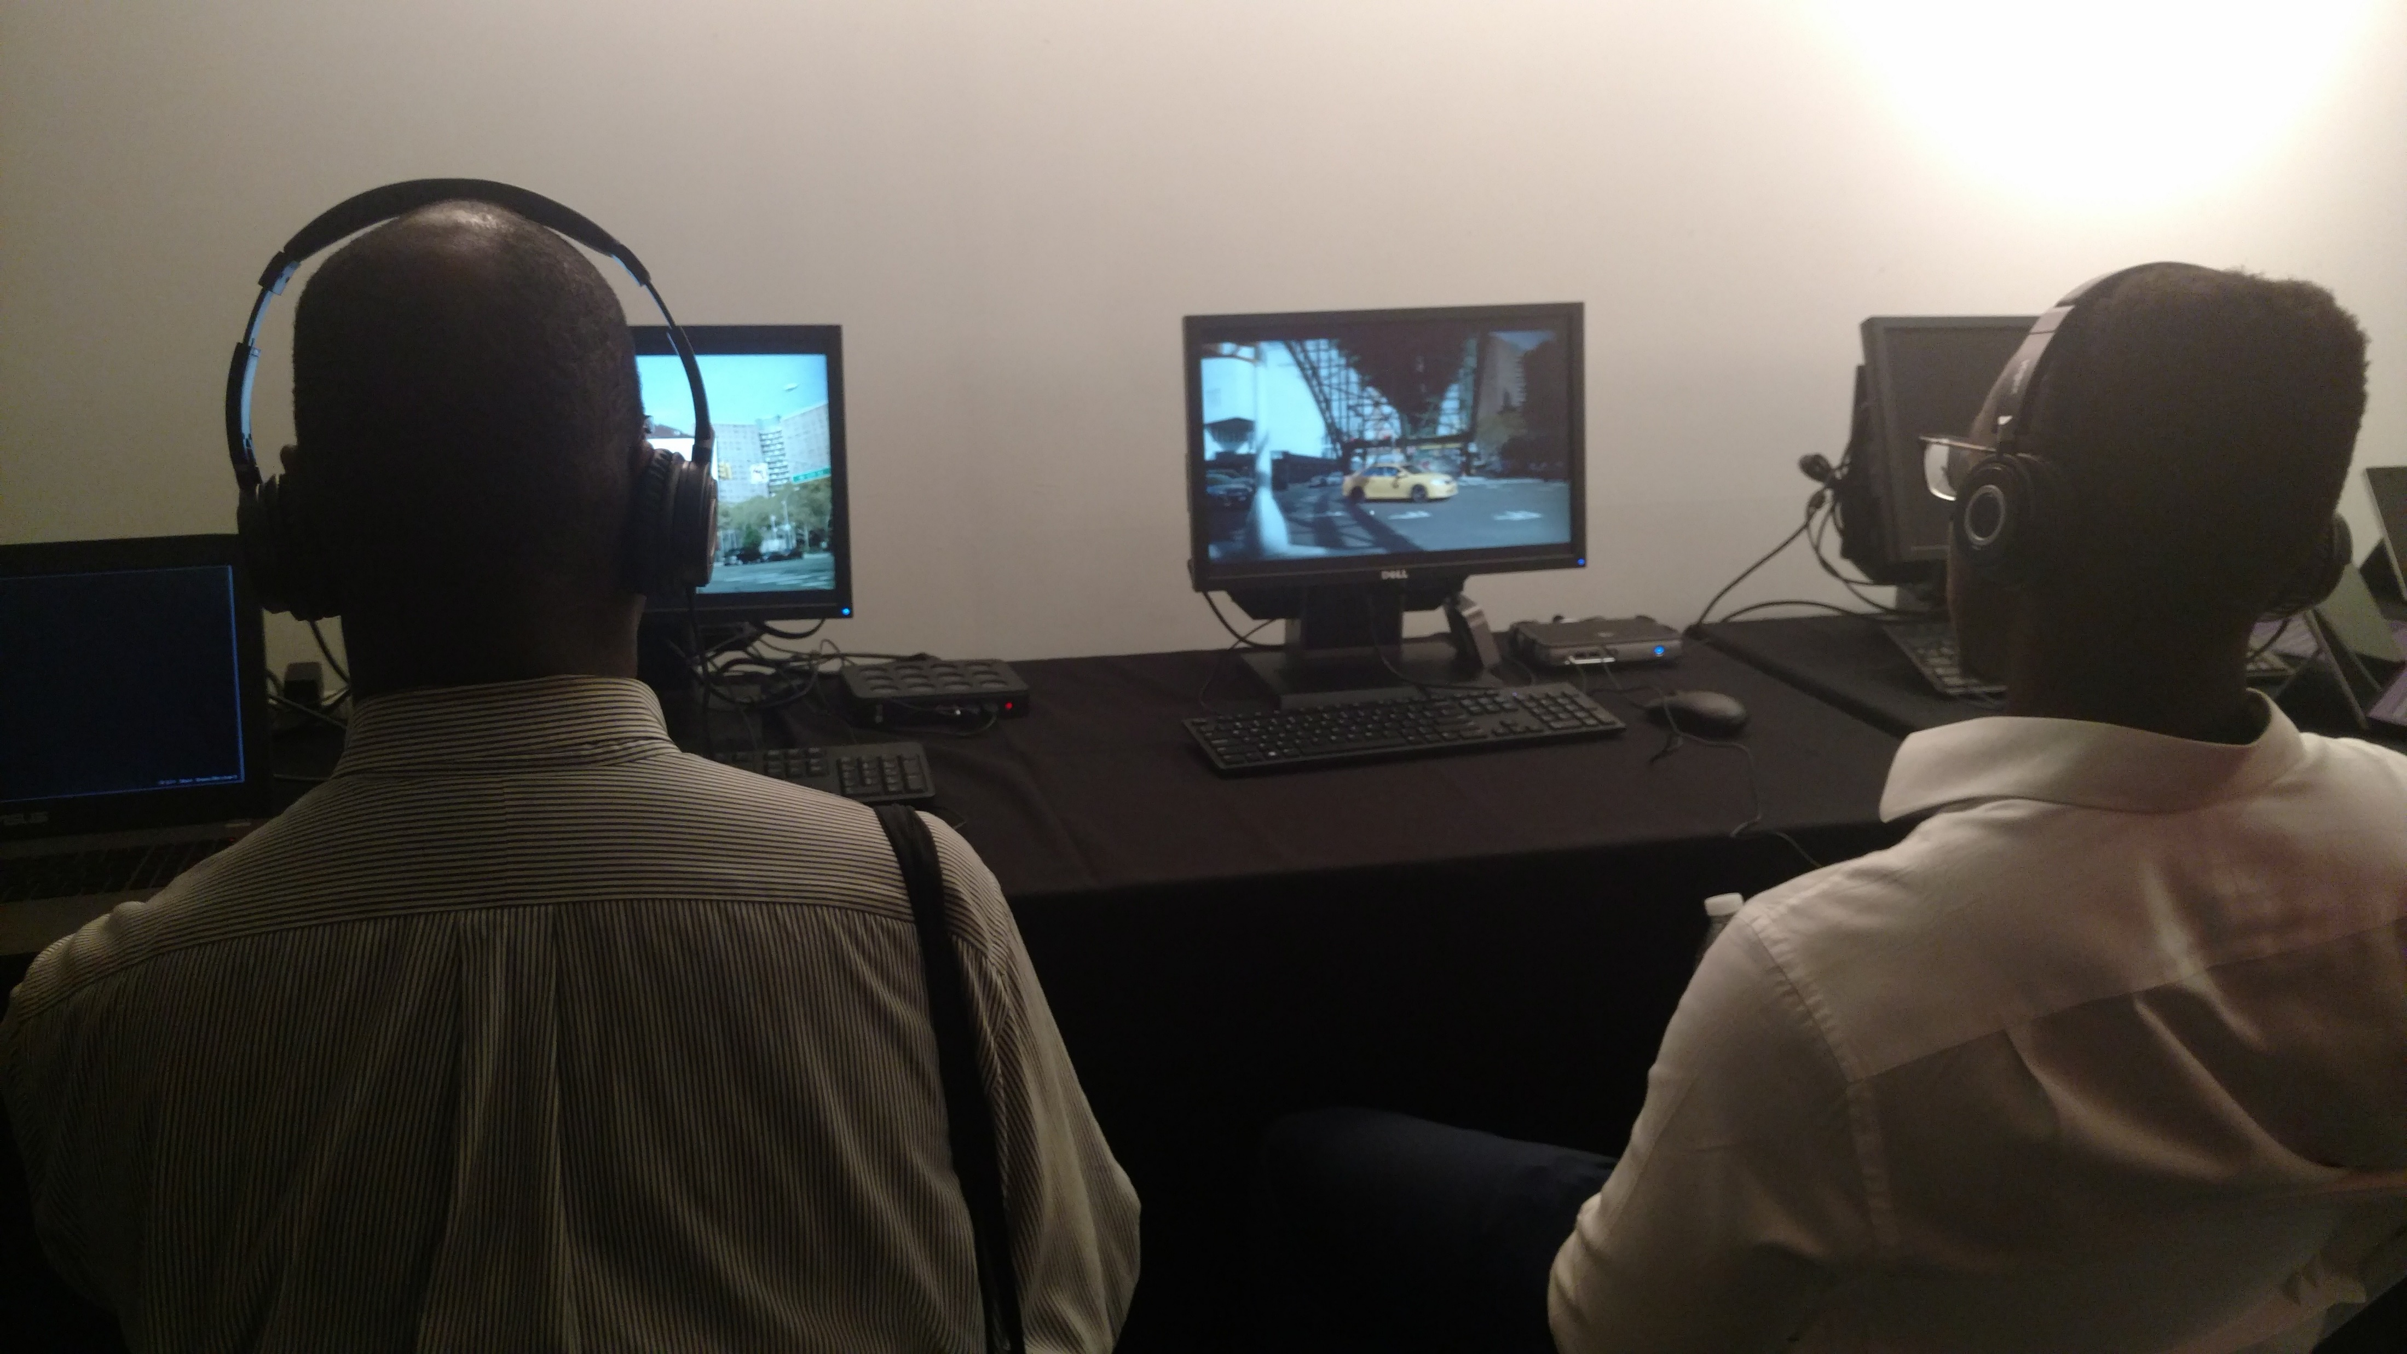
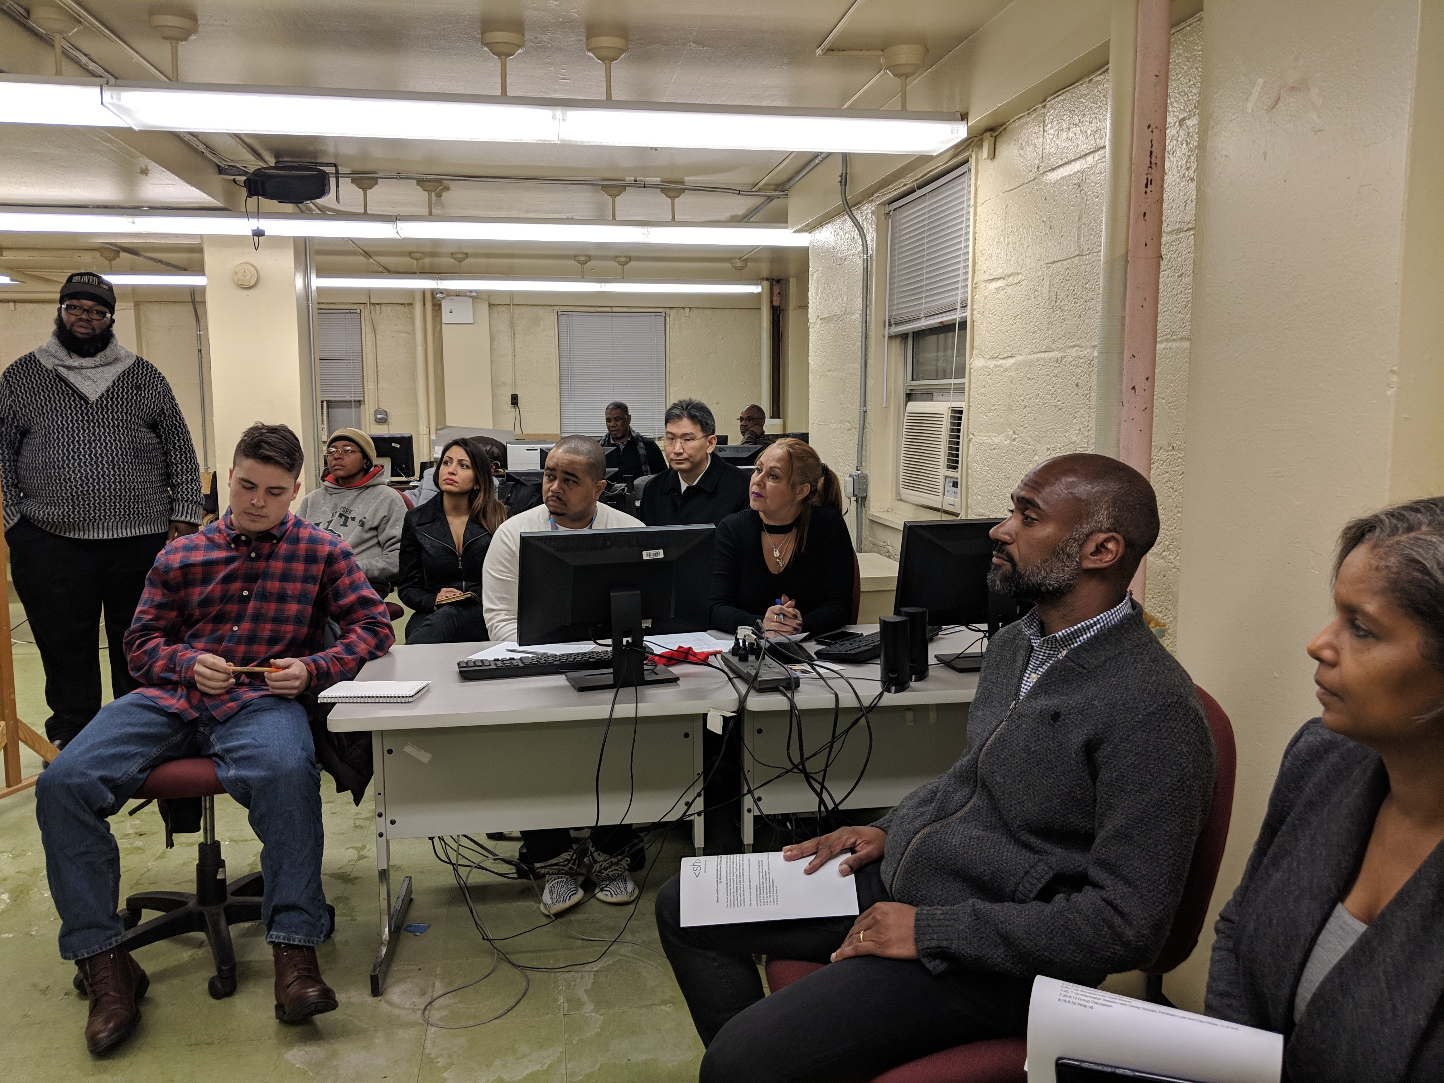
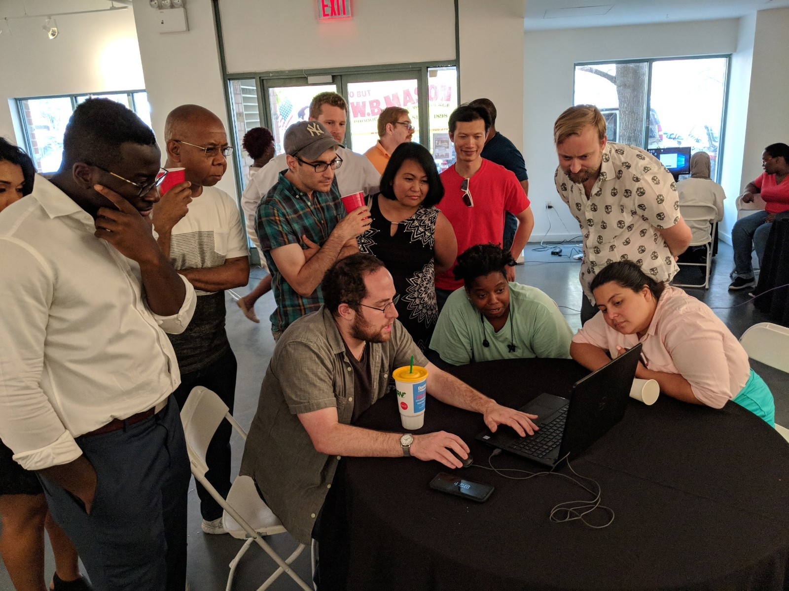
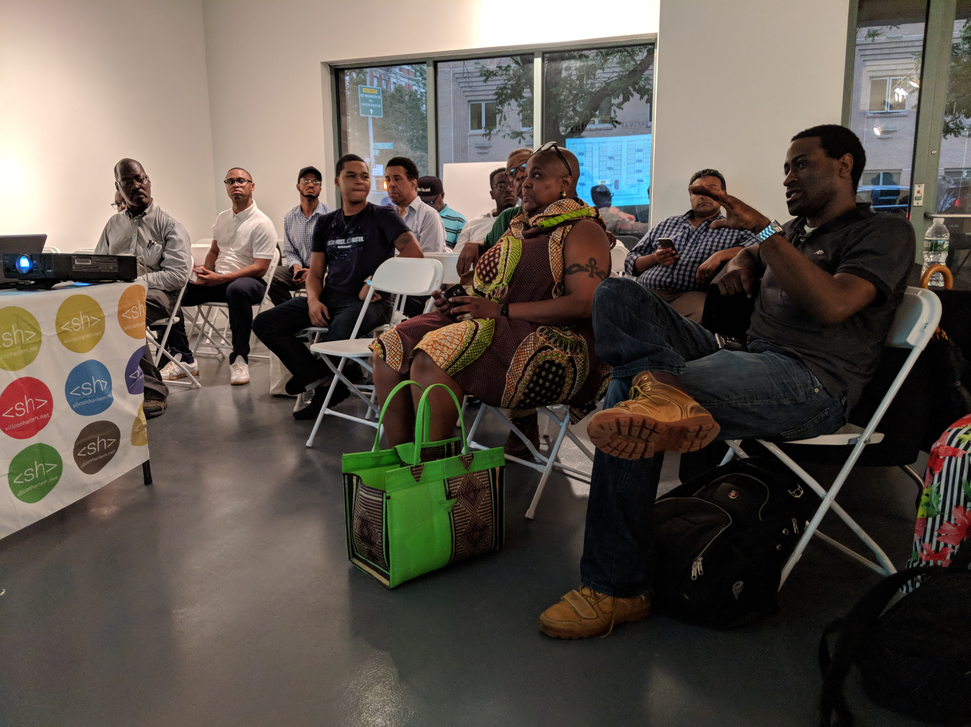
Harlem Week
300 survey responses collected in Harlem (confidence interval @ 95%)
50 hours of structured observation of public / semi-public forums
15 one-one interviews with key stakeholders and leaders in Harlem
50 people engaged in an initial round of technology trials
Reached over 2000 Harlem Week event attendees

Slide 5
Looking Ahead: Launching Edge Cloud
Launch Edge Cloud in Harlem
  Deploy equipment (shipping from Microsoft) and software
  Form community board
  Run workshops & trials
  Connect with COSMOS platform network
Subjective and objective measurements of network requirements using test and field configurations

