Slide 1




2019 NSF SMART AND CONNECTED COMMUNITIES PI MEETING
FY 2017 IRG Track 2: Community on Multimodality: Participatory Action, Service, and Support (COMPASS), NSF Award 1737443
Daphney–Stavroula Zois¹ (PI), Wonhyung Lee² (co–PI), Charalampos Chelmis³ (co–PI), Rushka Tcholakova⁴, Natasha Pernicka⁵, Brian Hawley⁶, Anthony Capece⁷, Nancy Chiarella⁸, Dahlia Herring⁹, Jill Peckenpaugh⁹, ¹⁰Lini Jacob, ¹¹Jonathan Hentrich, Jack C. Simeone¹²
¹Electrical and Computer Engineering Department, University at Albany, SUNY; ²School of Social Welfare, University at Albany, SUNY; ³Computer Science Department, University at Albany, SUNY; ⁴United Way of the Greater Capital Region; ⁵The Food Pantries for the Capital District; ⁶Neighborhood Engagement Unit, Albany Police Department; ⁷Central Avenue Business Improvement District; ⁸Capital Region Coalition to End Homelessness; ⁹U.S. Committee for Refugees and Immigrants;¹⁰Northeast New York Region 2-1-1; ¹¹ServeAlbany; ¹²Catholic Charities, Tri–County Services
https://www.albany.edu/~dz973423/projects/nsf-scc-2017/index.html

Slide 2
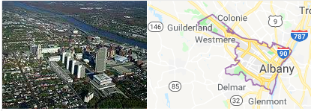
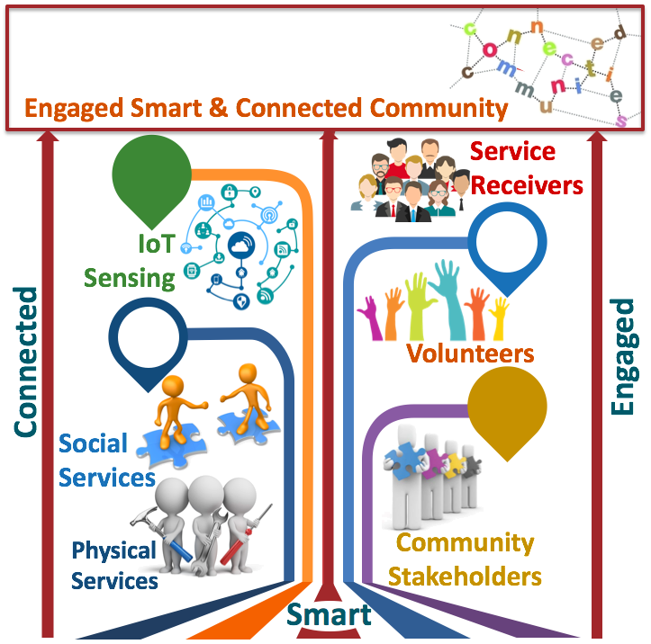





Project Aims
City of Albany, NY
Community Partners
Simplify discovery and use of services
Enable two–way communication between service seekers and service providers
Deploy resources more efficiently
Identify needs and challenges.
Share expertise and data.
Refine conceptual research framework.
Assist in evaluation of proposed approach.

Slide 3
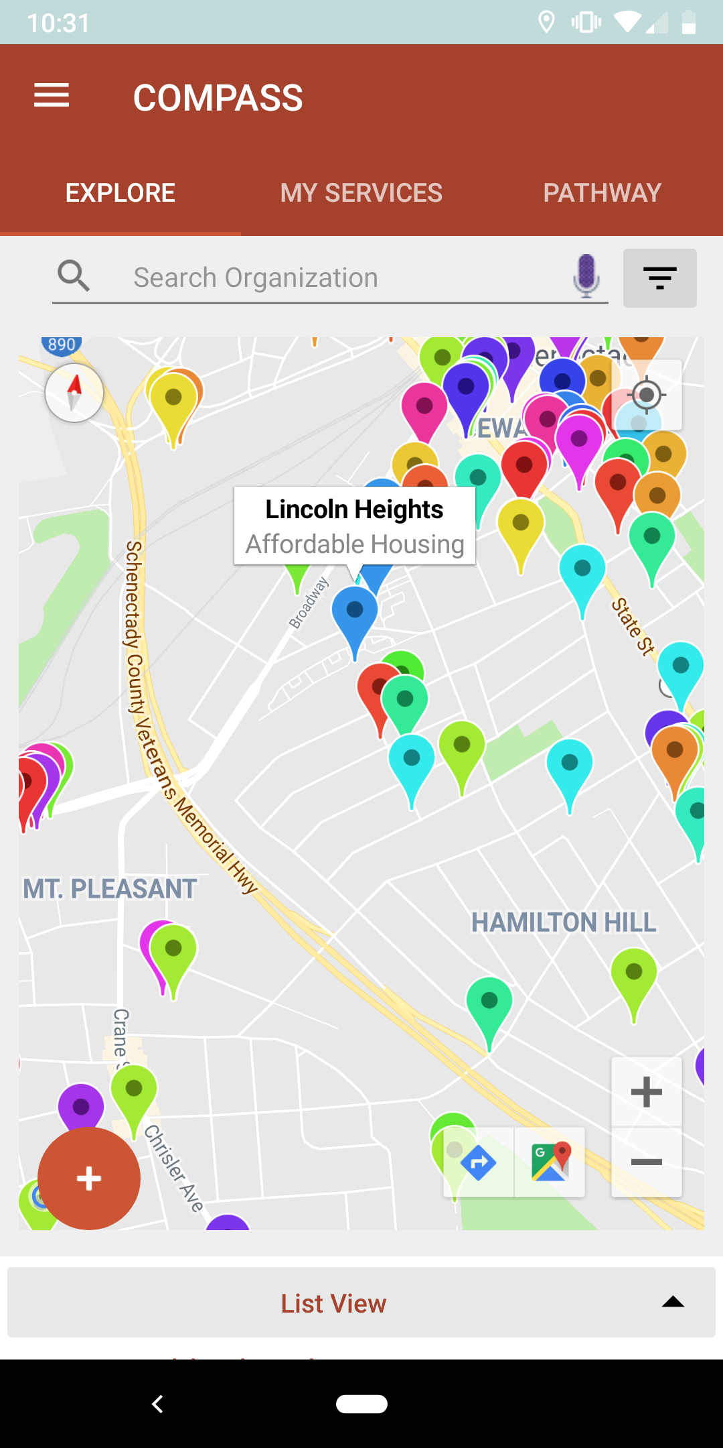
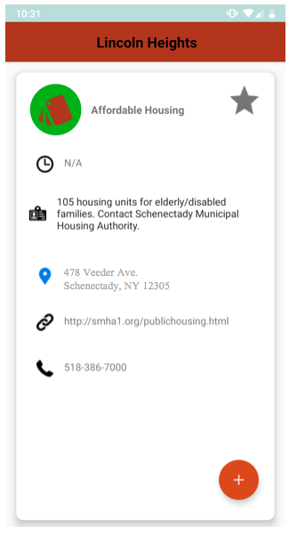

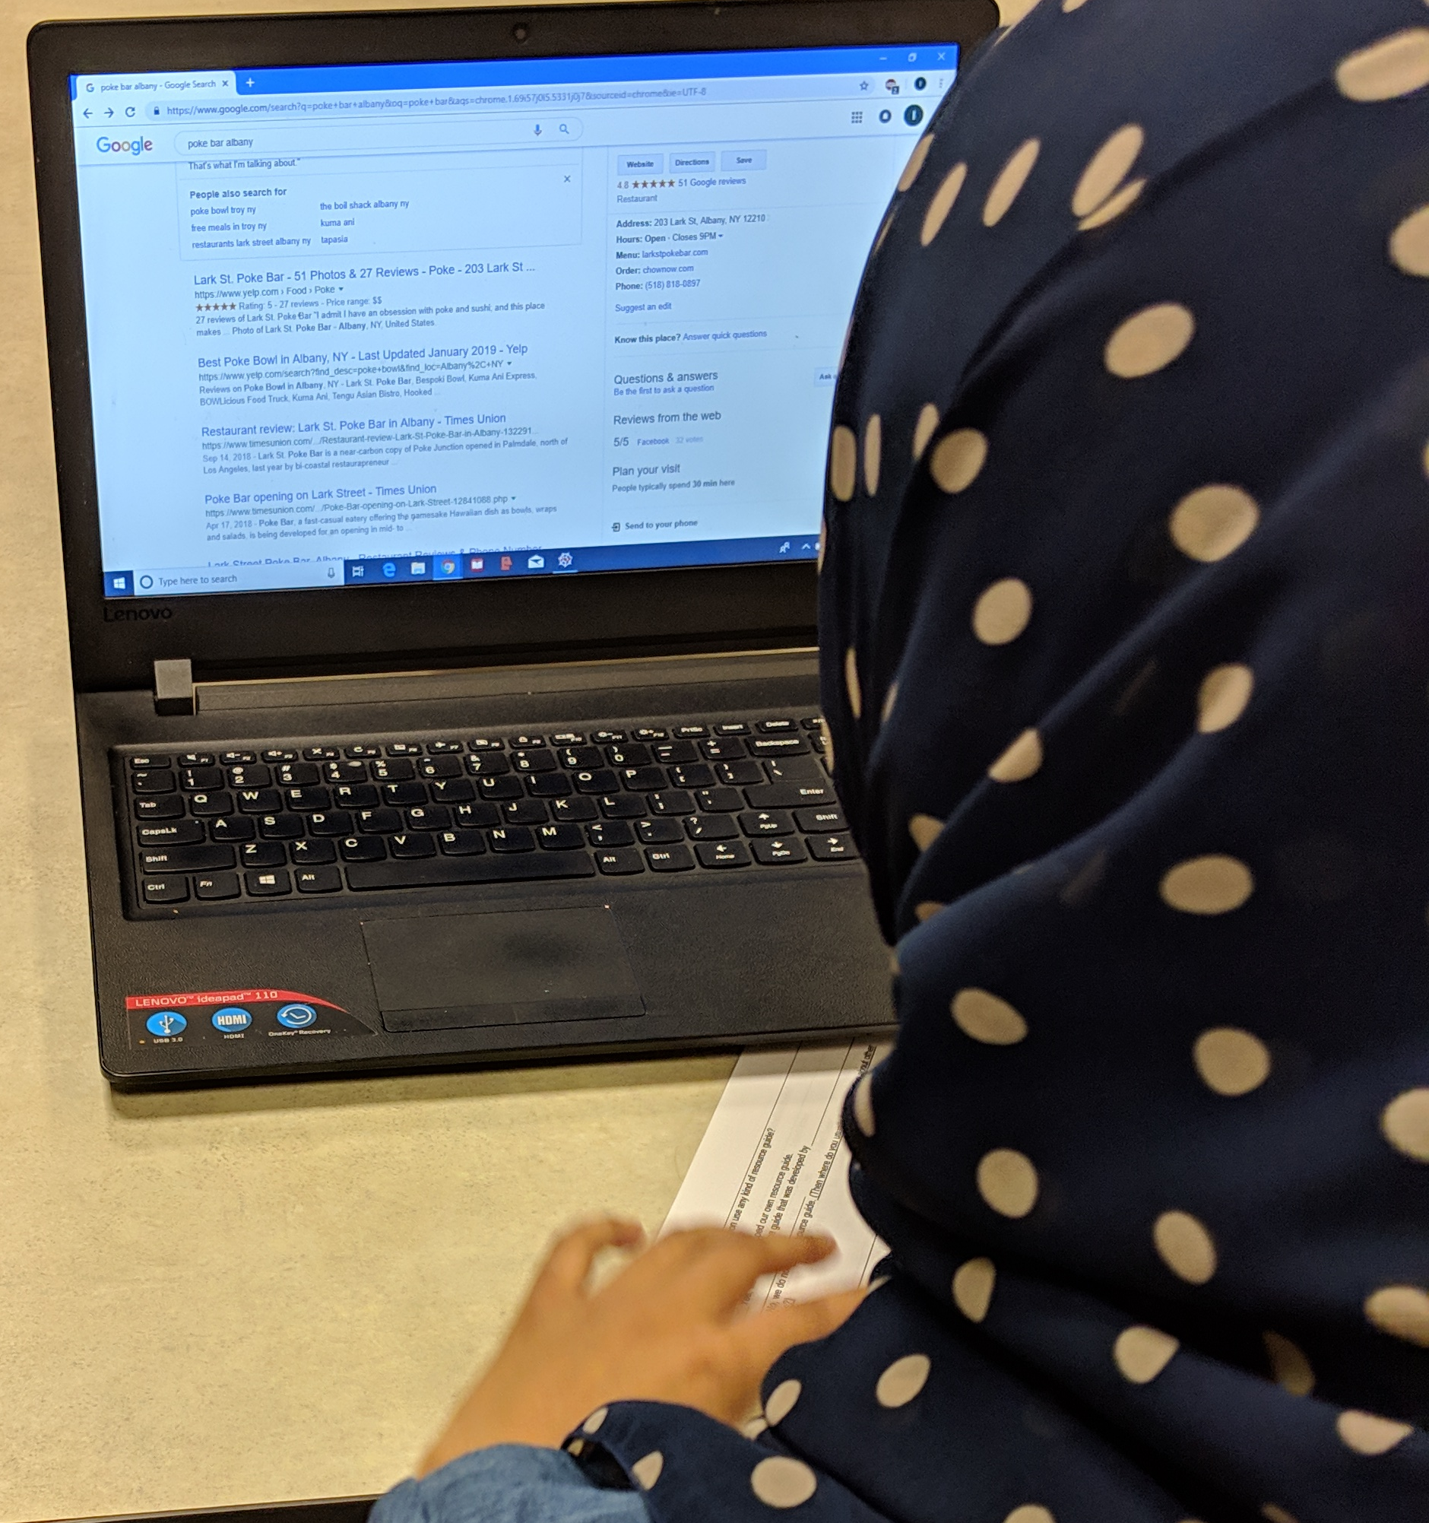
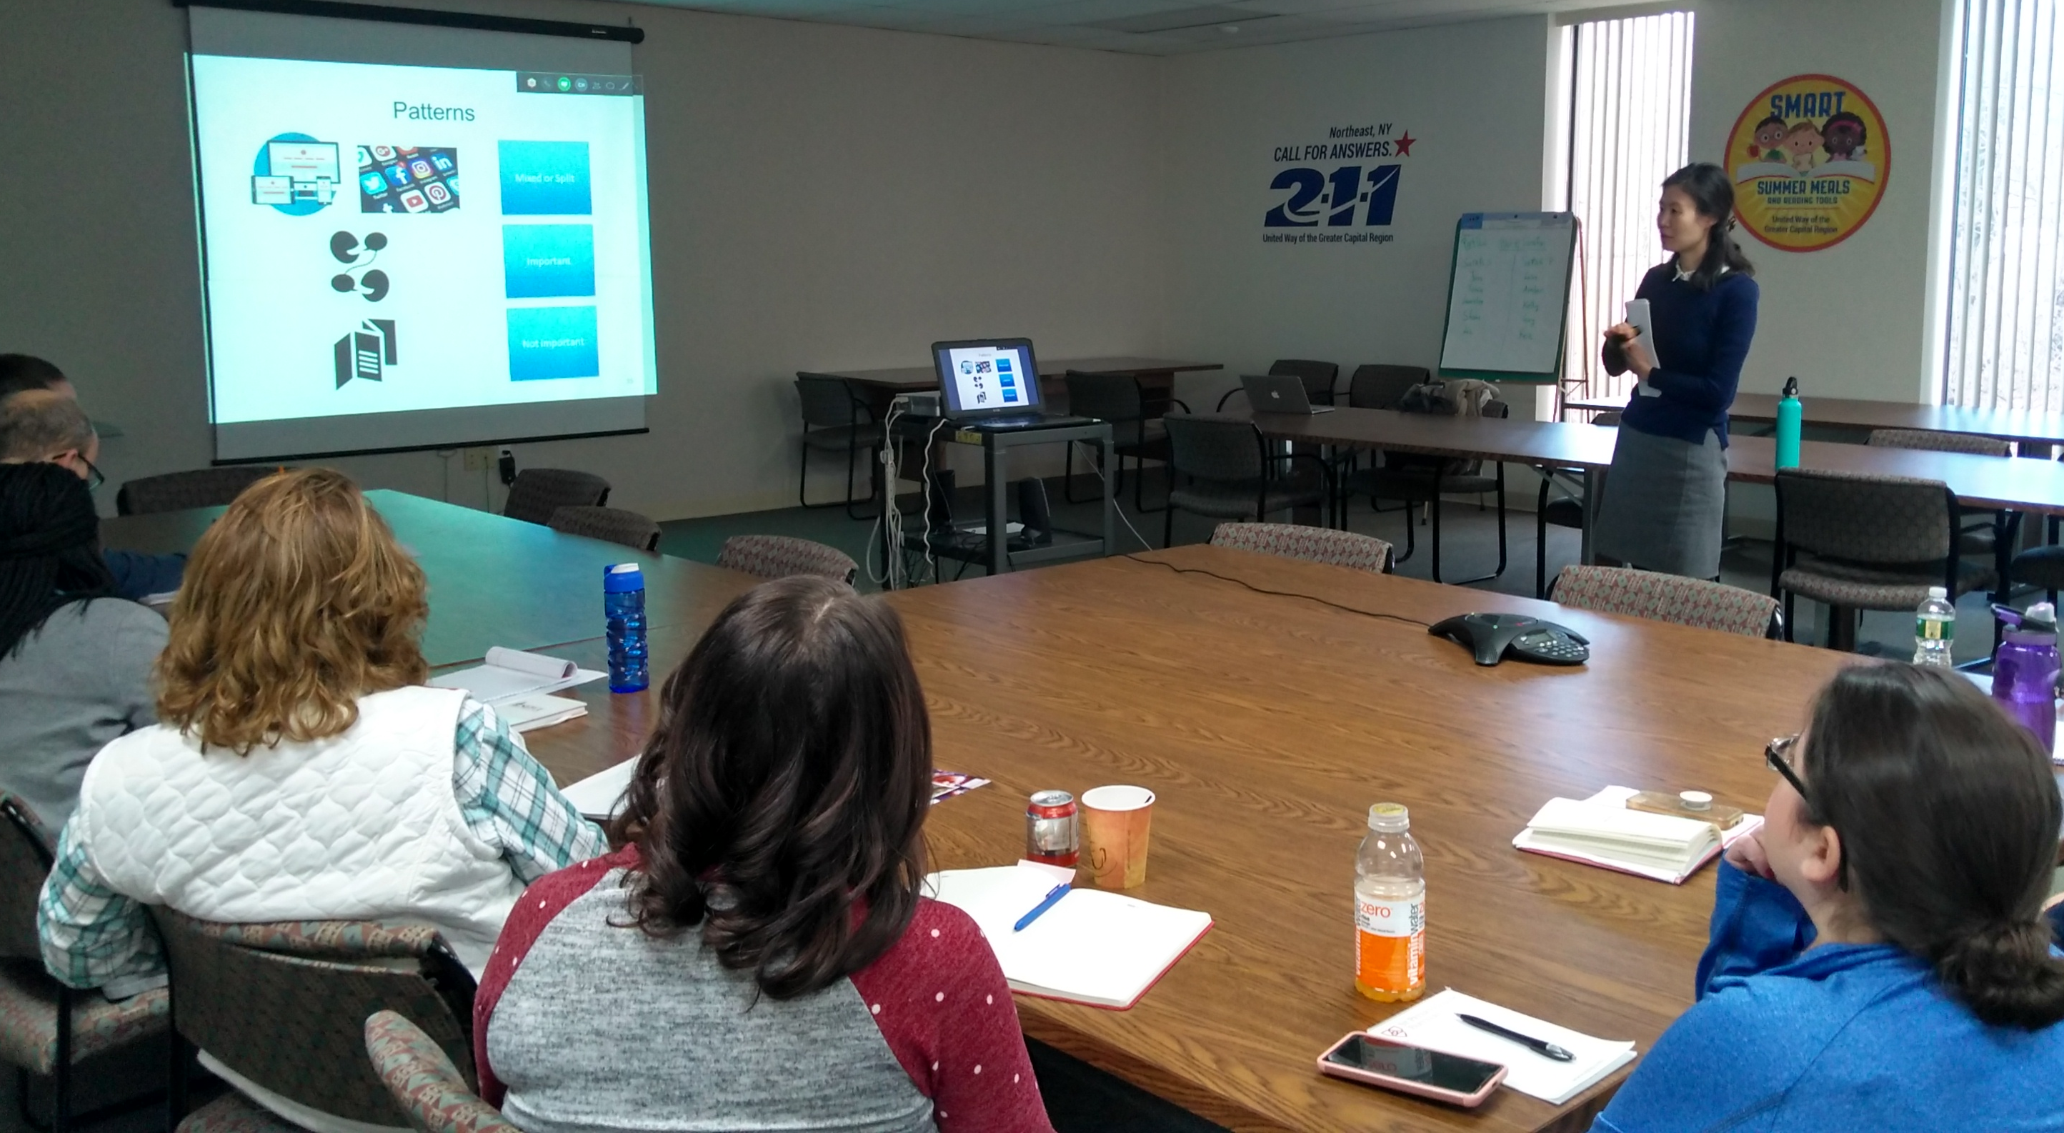

Update of the Project since last PI meeting
Most Significant Accomplishments
COMPASS mobile app
Interactive surveys: 94 individuals of the general public to identify issues with extant service–seeking process
Participatory design of mobile app: comprehensive resource and one - stop shop for services
Automatic identification of service need and importance: sequential feature selection methods for near–real–time classification and importance ranking
Toughest Challenge
Service coordination:
  What does service coordination mean?
  How can service coordination be achieved?
Surveys
Sharing findings & receiving feedback

Slide 4
Anticipated Outcomes and Success Measures in the Next Year
Anticipated Outcomes
Success Measures
Computational approach to match service needs to service providers:
  Graph–theoretic approach to characterize service–seeking behavior
  Adaptive recommendation strategies that consider service–seeking behavior
Enhanced mobile app:
  Participatory design through focus groups with the public
Informed community:
  Inform service providers about the results of interviews (providers’ point of view) and surveys (clients’ point of view)
of service seeker’s request being turned down
proposed technology
to address gaps

