Slide 1
2018 NSF SMART AND CONNECTED COMMUNITIES PI MEETING
2019 NSF SMART AND CONNECTED COMMUNITIES PI MEETING: FY 2017 IRG Track 2
IRG Track 2: Resilient Water Systems:
Integrating Environmental Sensor Networks and
Real-Time Forecasting to Adaptively Manage Water Quality and Build Social Trust, NSF Award 1737424
Cayelan Carey, François Birgand, Renato Figueiredo, John Little, Madeline Schreiber, Michael Sorice, Quinn Thomas, Western Virginia Water Authority
SmartReservoir.org
Notes:
Hello, my name is Cayelan Carey and I am excited to present our Track 2 project, which integrates ecosystem science, computer science, social science, and engineering to improve the resilience of drinking water systems for communities. To learn more about our project, I refer you to our website, SmartReservoir.Org

Slide 2
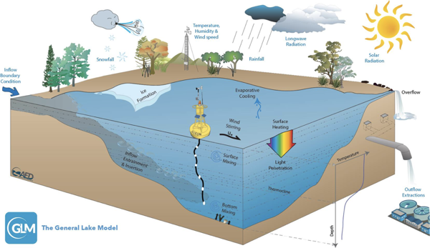
Sensored drinking water reservoir
Community system of water users
Building resilience in the water supply
Using forecasts to improve reservoir management
Educating the public on smart technology
Evaluating how technology changes social trust in water utilities
Novel sensors
and secure data
transfer and processing
in the cloud
Creating real-time water quality forecasts for decision-making
Mon
Tues
Weds
Thurs
0%
25%
75%
95%
Water quality model and forecasting system
Water utility management system
Notes:
Globally, the water quality of drinking supply lakes and reservoirs are threatened by land use change and climate change, resulting in toxic algal scums and contaminants. In response to this threat, our team has deployed novel water quality sensors in a drinking water reservoir in Roanoke, Virginia. The data from the sensors are being transmitted wirelessly and securely through virtual private networks to drive ecosystem models to create 16-day water quality forecasts, similar to weather forecasts. These forecasts are being co-developed with the managers so that they can integrate this information into their decision-making. We are studying how the managers use the forecasts to decide whether or not to treat the water in anticipation of predicted water quality impairment. Our forecasts will hopefully build resilience in the water supply, benefitting the overall community. We will then study how the public’s risk perceptions change in response to learning about the forecasting system via public surveys. Our overall goal is to use this technology to build social trust between the public and the water utility.

Slide 3
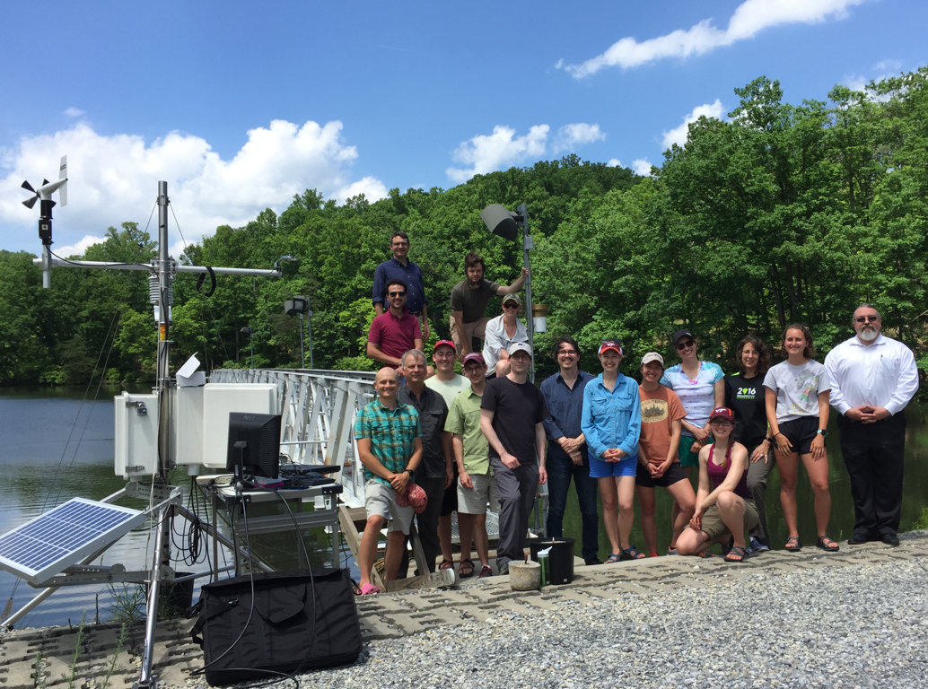
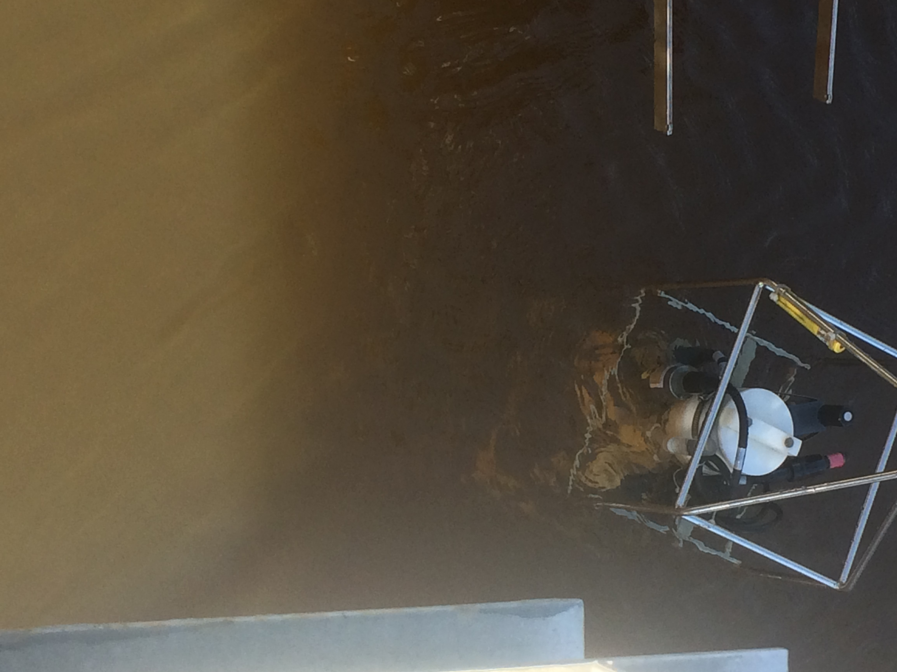
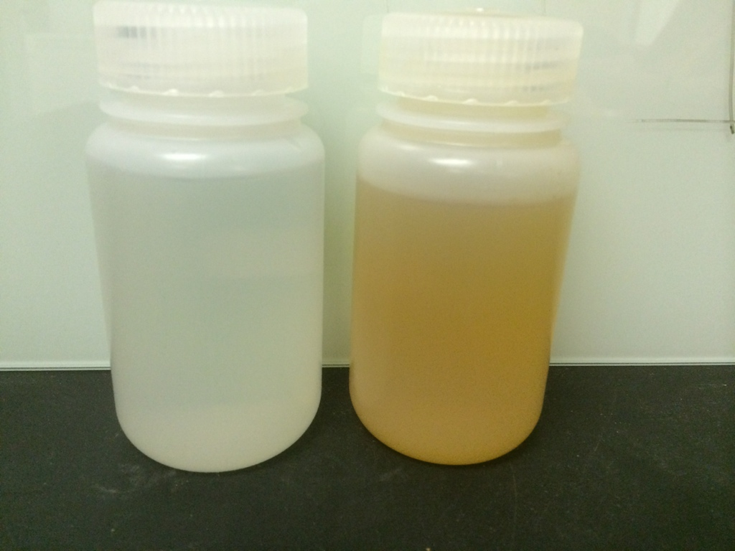
Project Updates
Most Significant Accomplishments:
End-to-end forecasting workflow with sensors, cyberinfrastructure, models, and managers is fully operational
We successfully predicted water quality impairment during fall 2018 more than one week in advance
Toughest Challenge
Data management → DOI publishing
Surface water temperature
30
20
Temperature (degrees C)
10
0
0
10
20
30
40
50
60
Time step (days)
Notes:
Our most significant update is that our project is now fully operational: we developed an end-to-end workflow that generates water quality forecasts every day for managers. I have worked with them weekly throughout the past year, and they are now using this system as part of their daily decision-making.
The most exciting update is that the system predicted a day with extremely high iron concentrations more than a week in advance last fall in the reservoir. The bottle on the left shows a water sample the day before the high iron, and the bottle on the right shows the sample on the day of high iron, so there is no way that the managers could have predicted the impairment without our forecasts. So I truly feel like our project is already having an impact.
Our toughest challenge thus far has been data management: we are collecting millions of both sensor and modeled observations per day. In response to this challenge, our team has partnered with the Environmental Data Initiative to publish our forecasts and sensor data daily with DOIs (a digital object identifier).

Slide 4
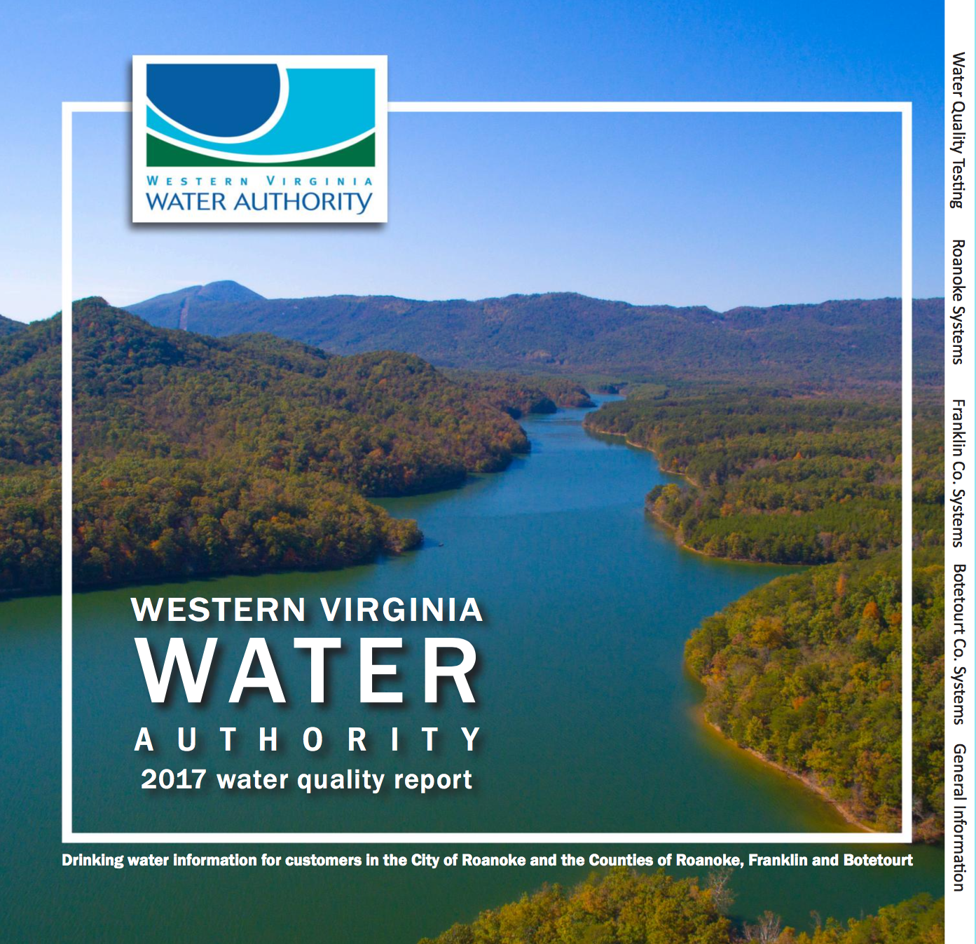
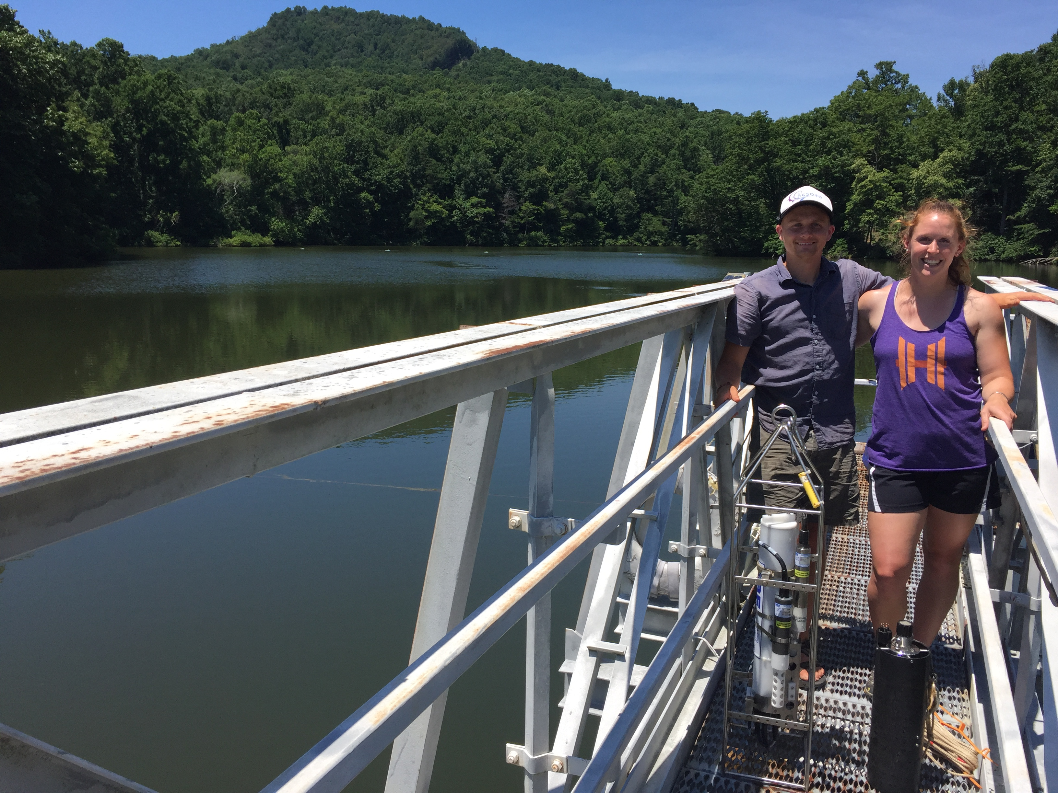
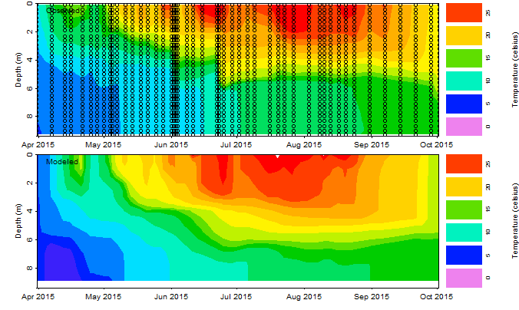
Next Steps
Survey of Roanoke residents to assess social trust in summer 2019
Begin forecasting algal blooms this upcoming summer
Iteratively co-develop new forecast visualizations for managers to study human-in-the-loop decision-making
Generalize our forecasting system for implementation in other lakes and reservoirs globally
Notes:
Now that our forecasting system is operational, we are conducting a full-scale survey of Roanoke residents this summer to assess their risk perceptions of the technology being used to manage their drinking water.
We will be deploying new sensors throughout the summer to begin forecasting algal blooms, and with the forecasts in hand, the social scientists on our team will be studying what visualizations are most useful for their decision-making.
Finally, we are working to generalize our tools so that our forecasting system can be implemented in other drinking water supply lakes and reservoirs around the globe.

