Slide 1


2019 NSF SMART AND CONNECTED COMMUNITIES PI MEETING
FY 2017 IRG Track 2: Data Informed Modeling and Correct-by-Design Control Protocols for Personal Mobility in Intelligent Urban Transportation Systems, NSF Award 1736582
Lillian Ratliff¹, Behcet Acikmese¹, Samuel Coogan², Juan Matute³
¹University of Washington, Seattle; ²Georgia Institute of Technology; ³University of California, Los Angeles
Community: SDOT, LADOT, and Business Improvement Areas in Seattle, LA, Santa Monica
Notes:
This is the transition slide. The lightning talk moderator will announce the name of your project and the name of the lead PI. Expect to begin your presentation from the next slide.

Slide 2
Project Aim: Unified Approach to Parking, Ride-Sharing, and Traffic Flow
Overview: Rich data streams available through collaborators are being leveraged to learn data-informed models and correct-by-design policies such as demand-based pricing for parking and traffic light control.
Data-informed stochastic dynamical system models of mobility including parking, ride-sharing, personal vehicles
Correct-by-design policy synthesis using formal methods, convex optimization, and certifiable learning algorithms
Formal verification and validation of algorithms via rigorous simulation and a series of living lab experiments.

Slide 3
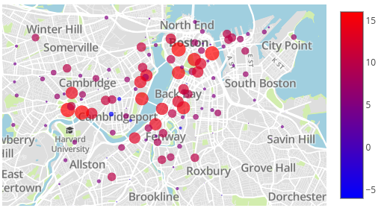
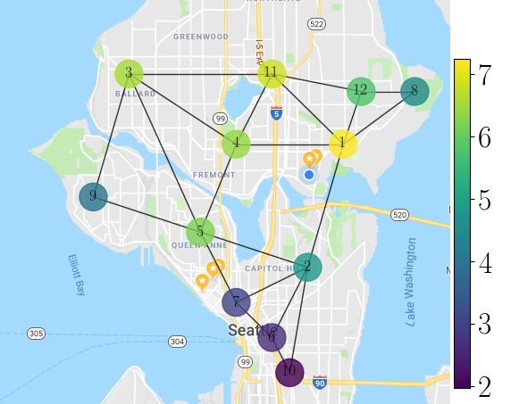
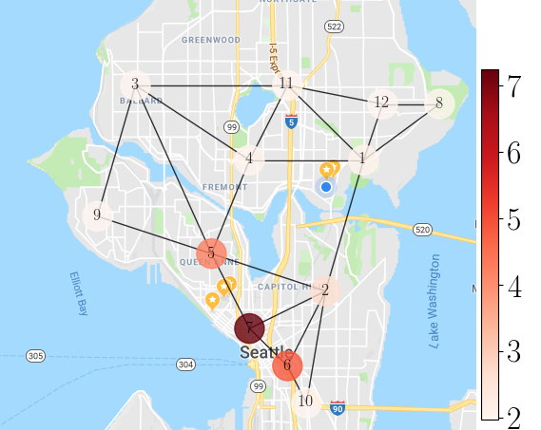
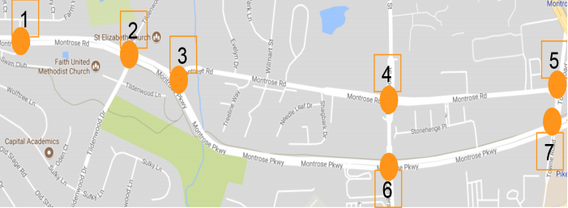

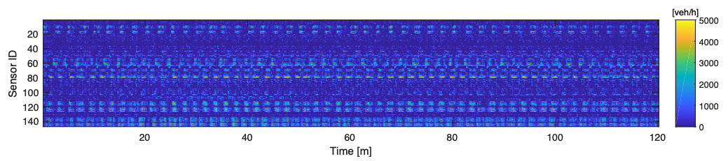
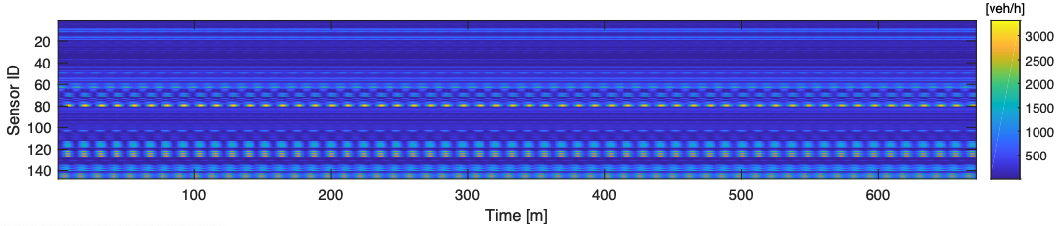
Project Update: Significant Accomplishments (Theory)
Certifiable algorithms for incentive and information dissemination
application: redistribution of bike-share
Optimization framework for synthesizing policies for stochastic games—e.g., demand-based tolls or variable ride-sharing pricing
application: redistribution of ride-share drivers
Reduction in rejections
Baseline equilibrium density
average increase in drivers
Development of Koopman/DMD tools for analysis of traffic flow data
application: traffic flow management
raw
low rank
Notes:
Most significant accomplishment: Describe at least one deliverable that you accomplished together with your community partner(s) in terms of capacity building and/or the science. Anecdotes and photos are highly encouraged.
Toughest challenge: Describe something challenging or unexpected about working with your community partners in terms of capacity building and/or the science (technical and/or social). How did you overcome this challenge? Anecdotes and photos are highly encouraged. Consider limiting your text.

Slide 4
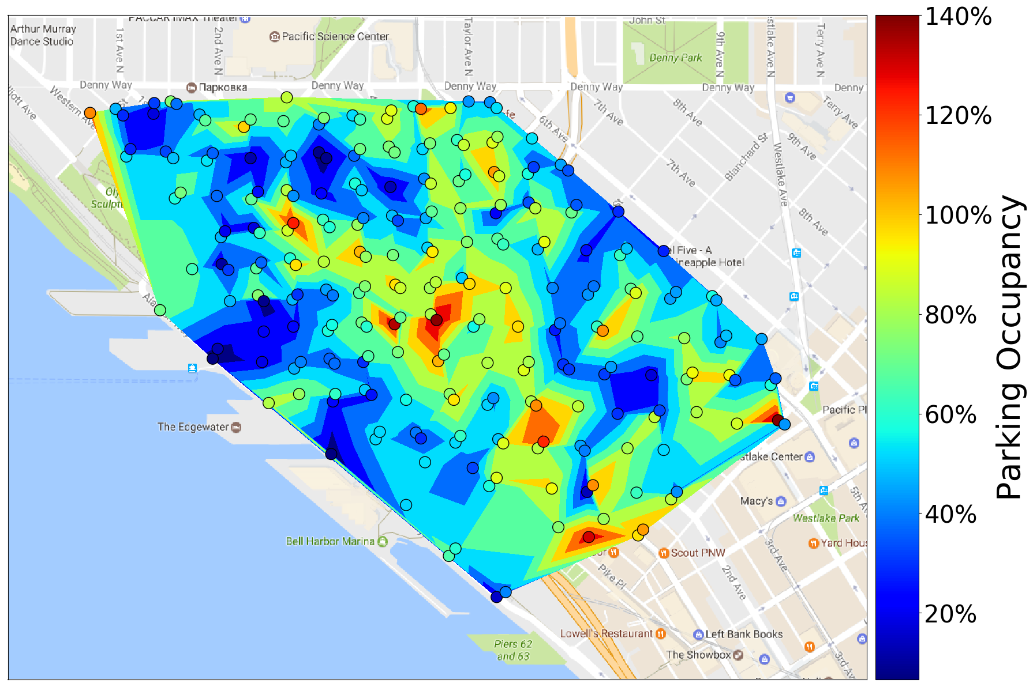
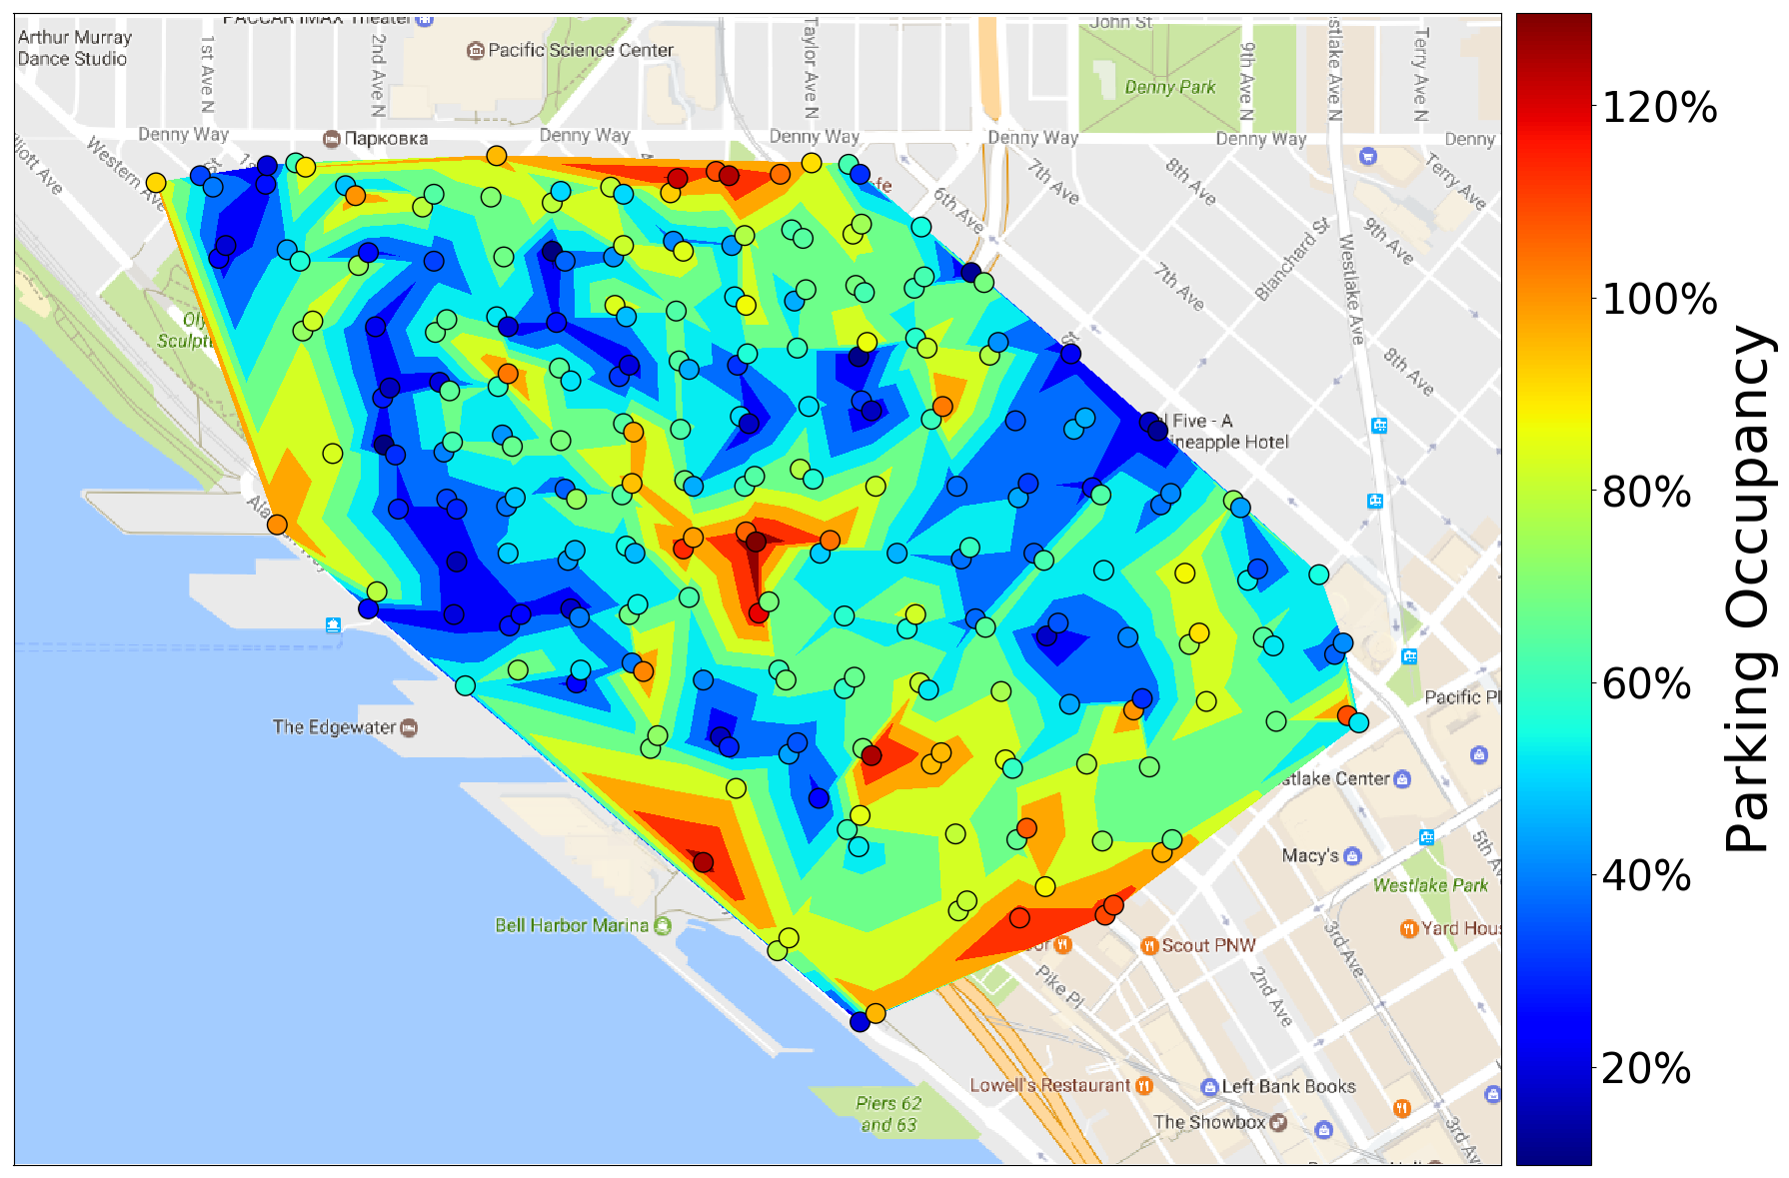
Project Update: Significant Accomplishments (Experimentation)
initial Pay-By-Phone (mobile payment) data analysis to identify `heavy hitters’ (frequent users) and peak demand locations
payment transaction spatio-temporal analysis
data analysis supports building priors and contextual models for incentive/ information schemes
rainy
Construction of a transportation data log of all available data and APIs
Toughest Challenges:
Changing laws (e.g., permits required for placing cameras) and coordinating industry, academia, and government
dry
Notes:
Most significant accomplishment: Describe at least one deliverable that you accomplished together with your community partner(s) in terms of capacity building and/or the science. Anecdotes and photos are highly encouraged.
Toughest challenge: Describe something challenging or unexpected about working with your community partners in terms of capacity building and/or the science (technical and/or social). How did you overcome this challenge? Anecdotes and photos are highly encouraged. Consider limiting your text.

Slide 5

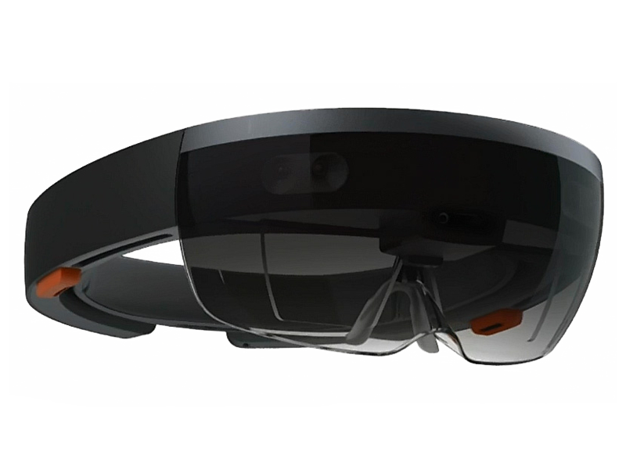
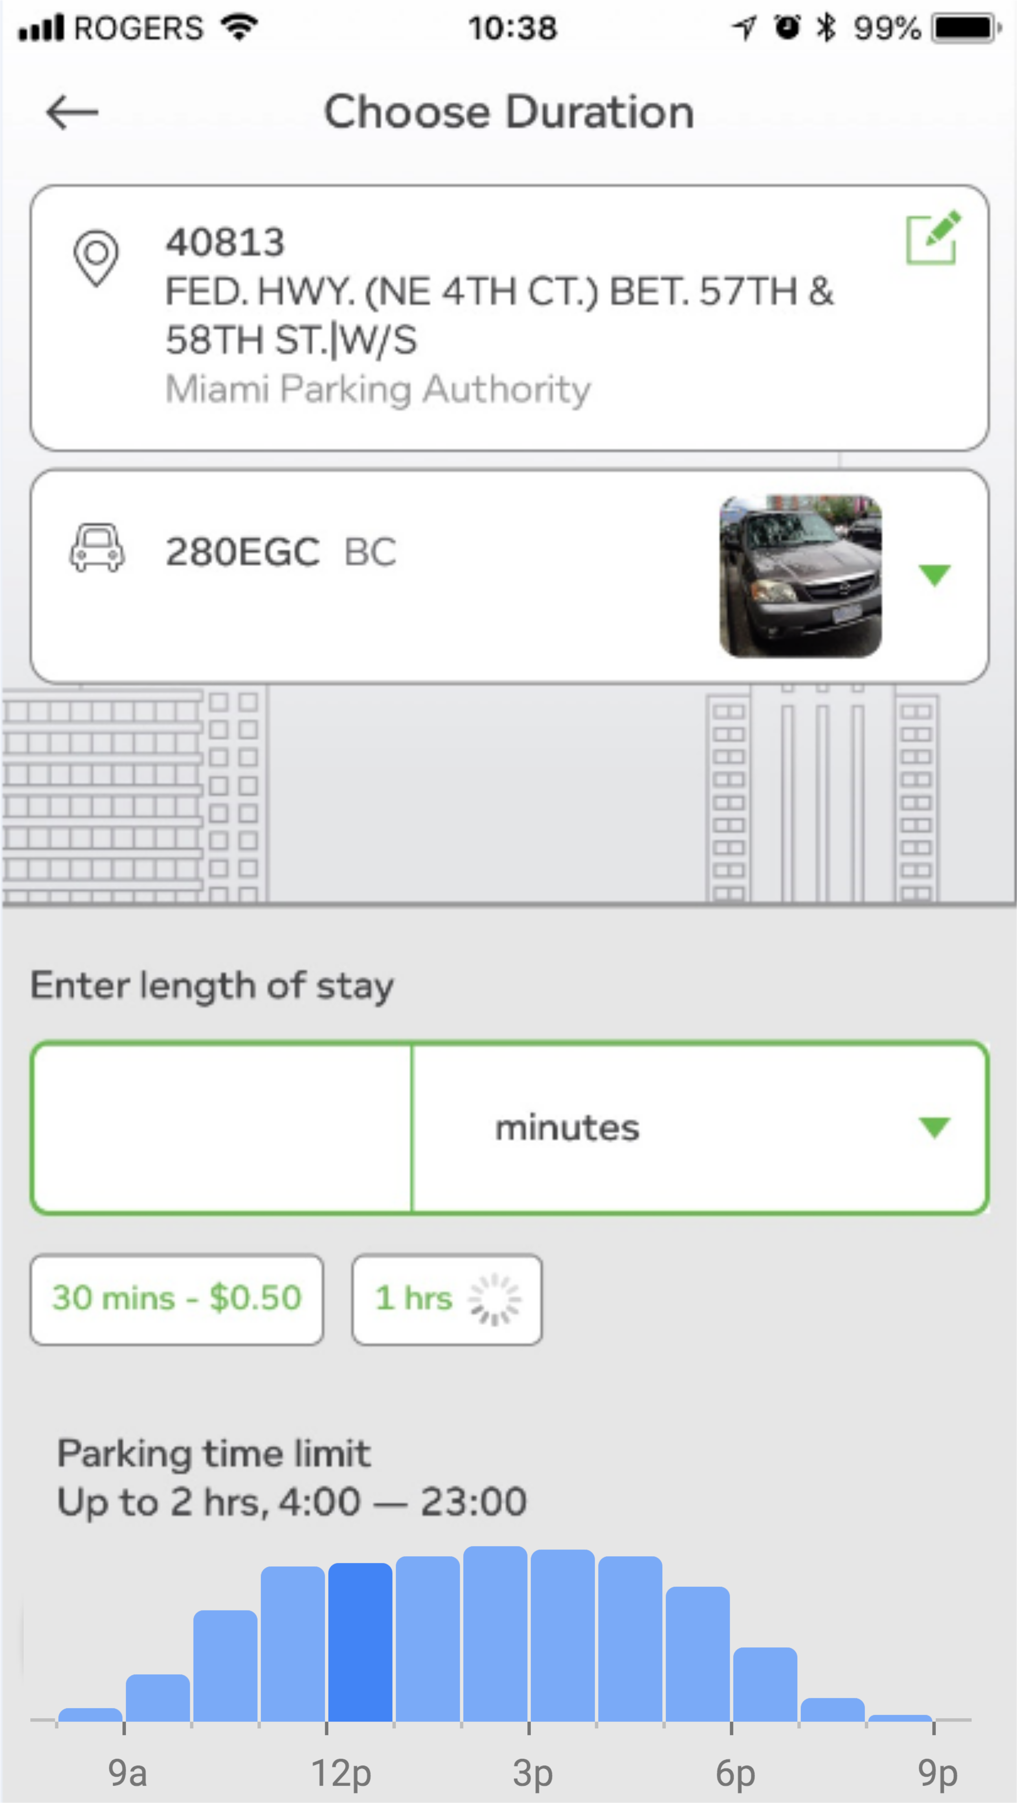
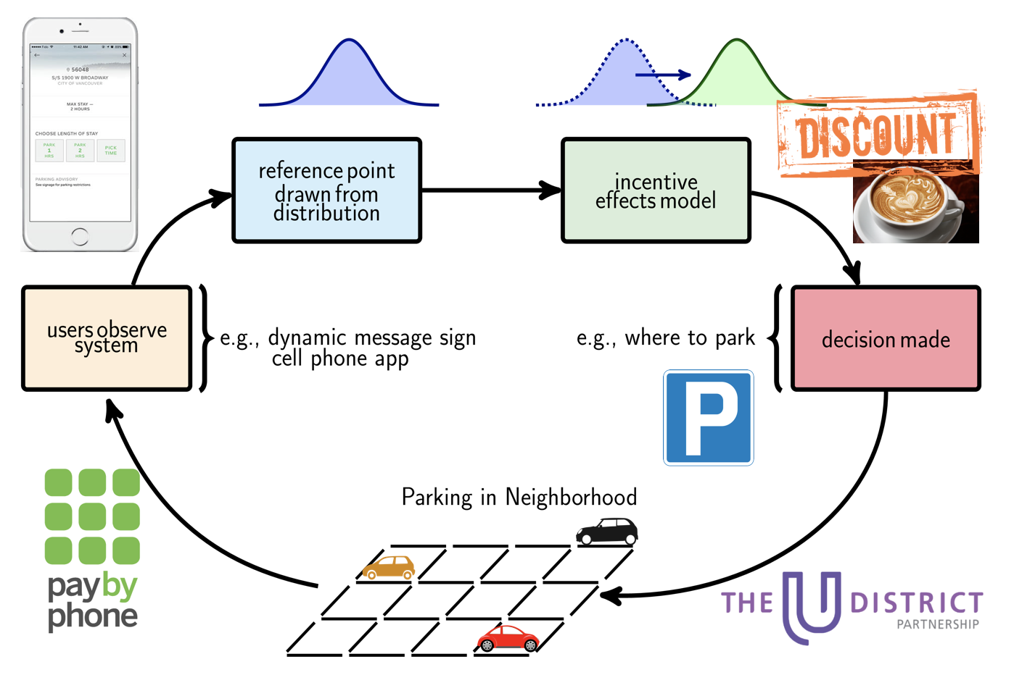
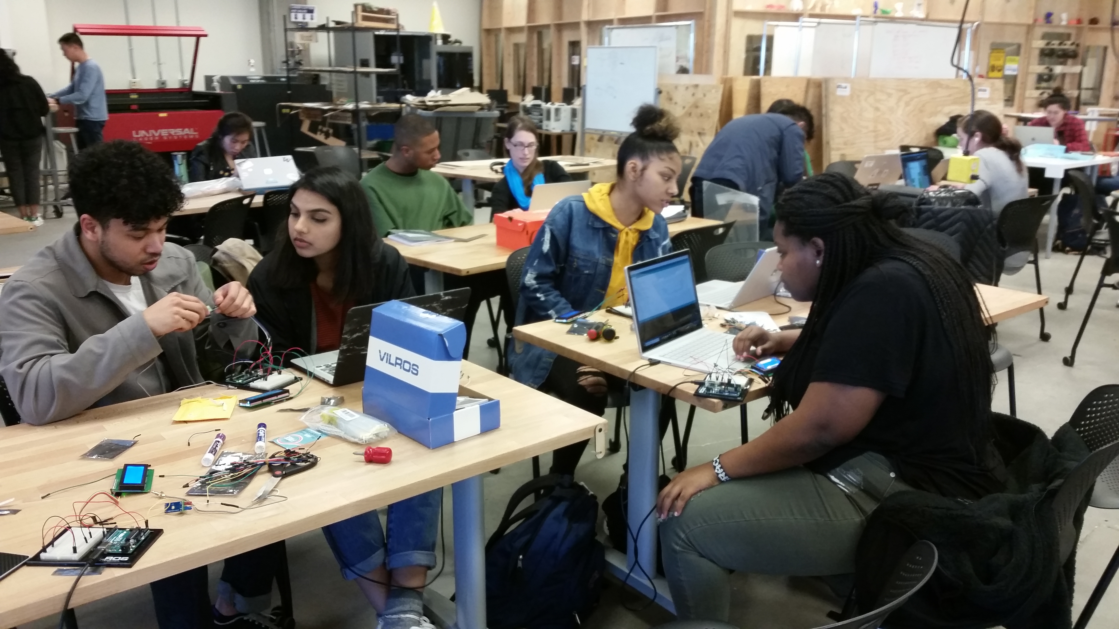
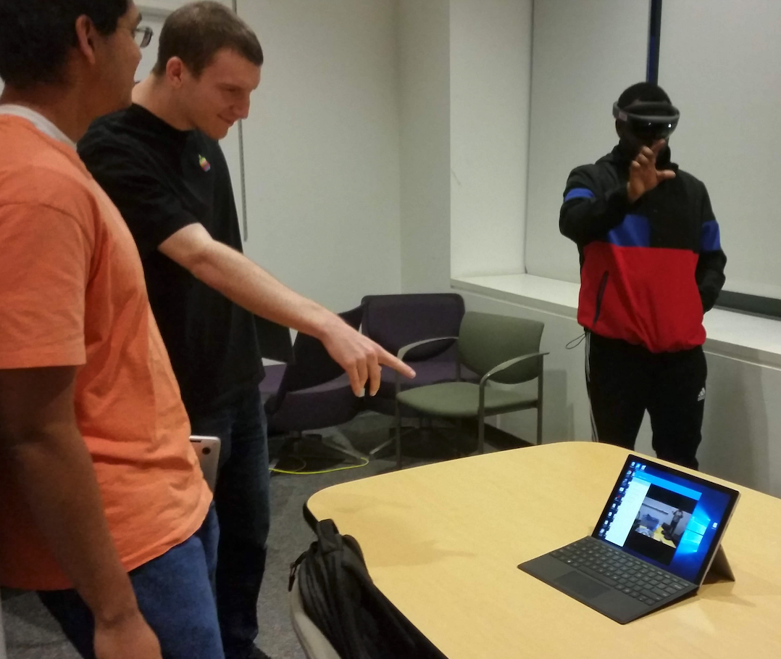
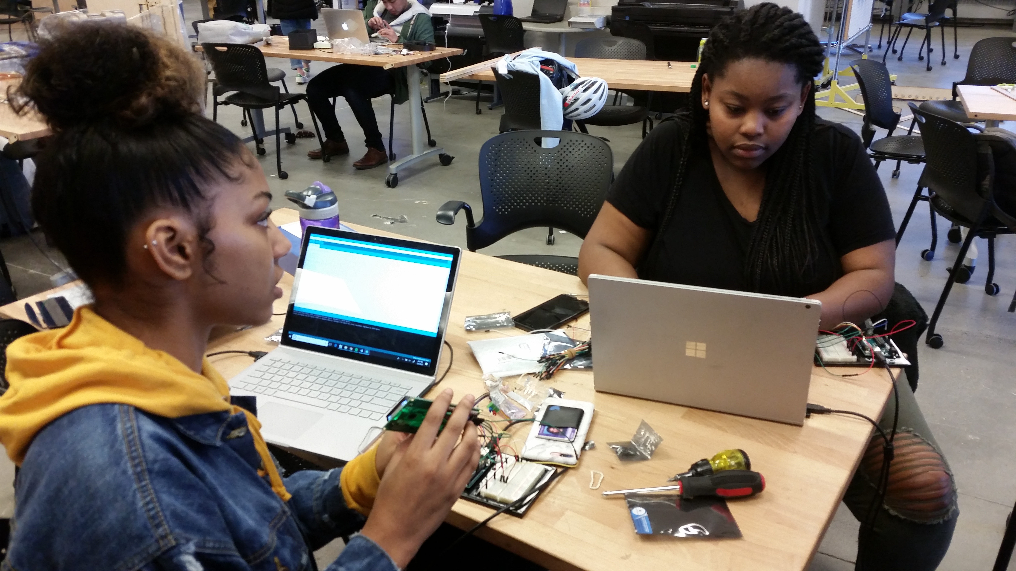

Anticipated outcomes and successes in the next year
Expected research outcomes:
Policies for traffic light control using DMD/Koopman analysis
Contextual bandits-based algorithms for incentive design leveraging initial Pay-By-Phone data analysis insights
Experiments with SDOT and Pay-By-Phone—i.e. user studies to learn how users respond to different information messages.
IRB approval for focus groups in Sum ’19 to identify politically and technically feasible traffic controls and curb management approaches
Broadening participation outcomes:
REU students developing augmented reality visualization tool
Planned mobility bootcamp

