Slide 1


2019 NSF SMART AND CONNECTED COMMUNITIES PI MEETING
IRG Track 1: Sociotechnical Systems to Enable Smart
& Connected Energy-Aware Residential Communities
#1737591
Purdue University
Panagiota Karava (PI)
Ilias Bilionis, James Braun, Sabine Brunswicker, Thanh Nguyen, Leigh Raymond, Julia Rayz, Torsten Reimer
State Government
Jacob Sipe, Indiana Housing and Community Development Authority (IHCDA)
Industry
Gary Hobbs, Rod Watts, BWI

Slide 2
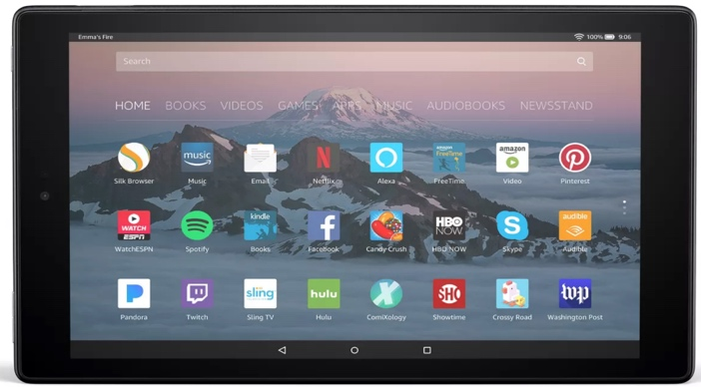
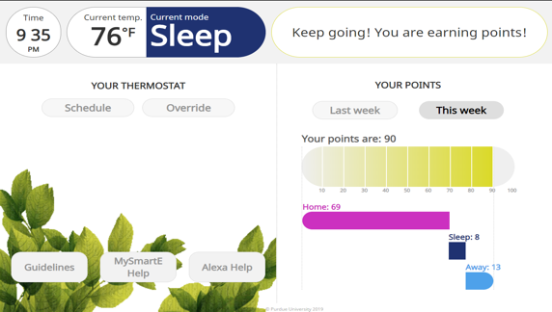

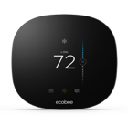




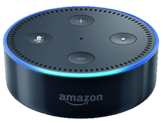




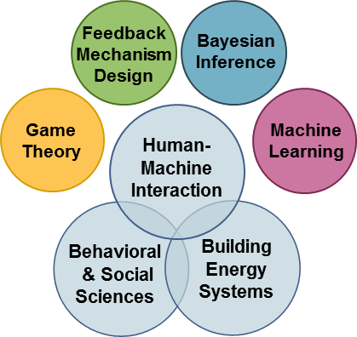
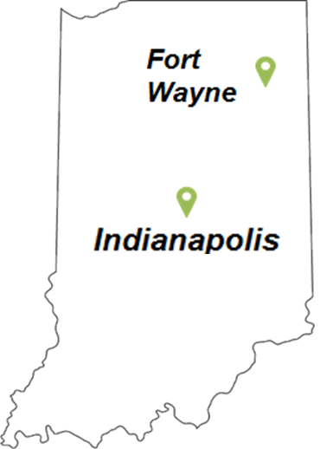

Project Aims
Cloud server
Foster energy-aware communities that can be scaled across the U.S based on data analytics and predictive modeling.
Demonstrate user-interactive devices and feedback mechanisms that optimize and incentivize energy management.
API
Sensors
Visual Interface
API
App
Cloud
Database
Voice Interface
Integrative Research
Community Engagement
Partner with IHCDA, industry, and affordable housing residents to demonstrate S&C energy-aware communities in different cities across Indiana

Slide 3
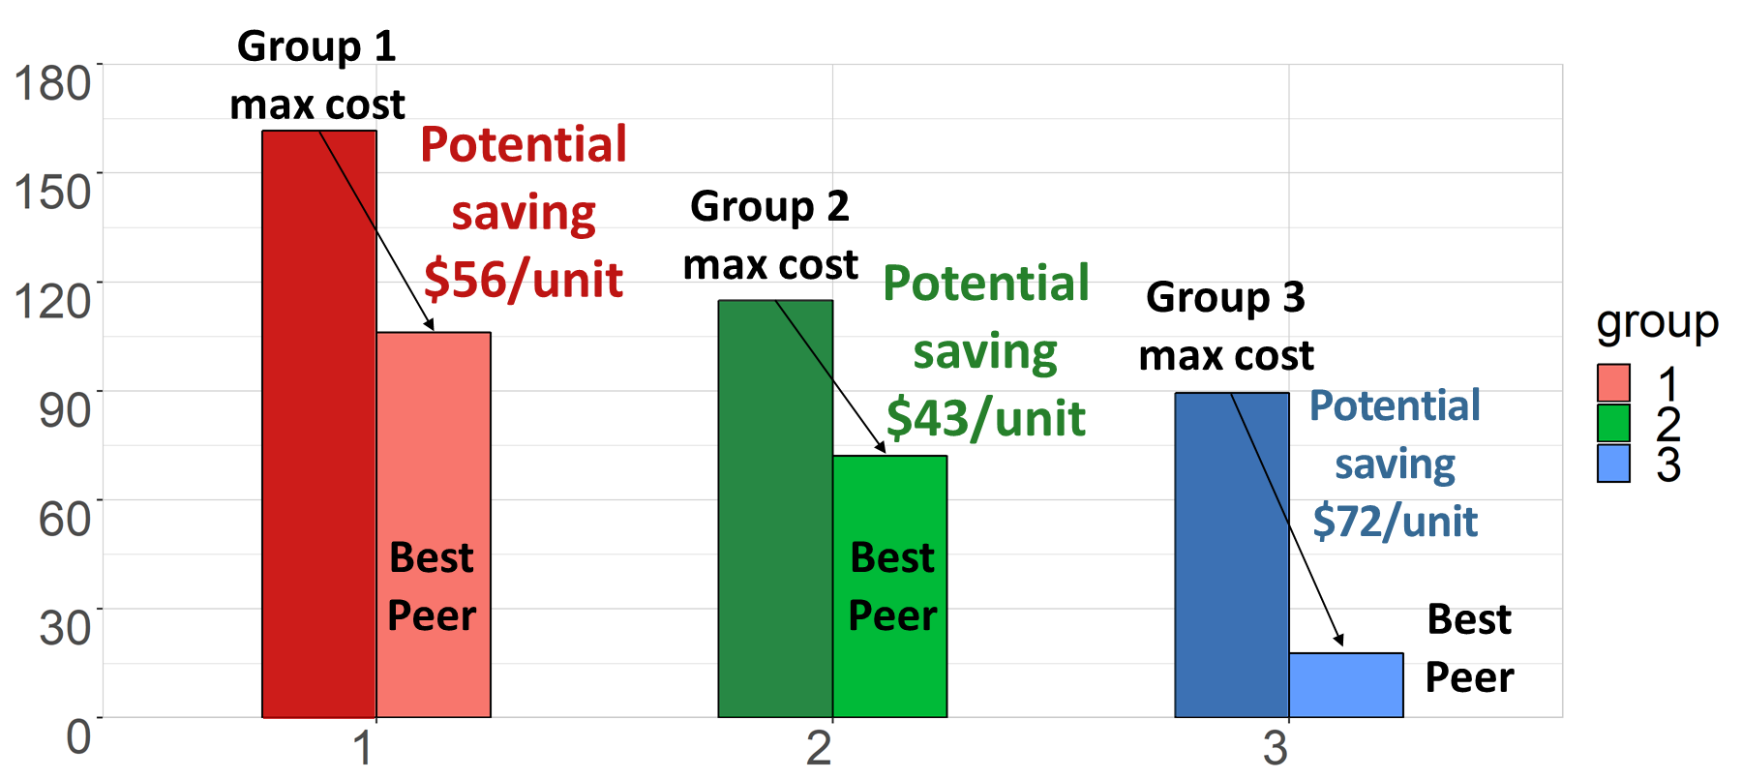
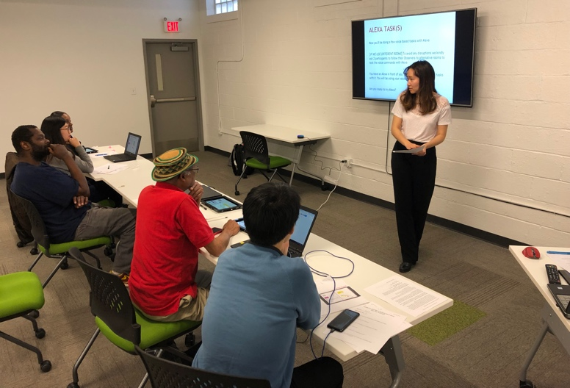
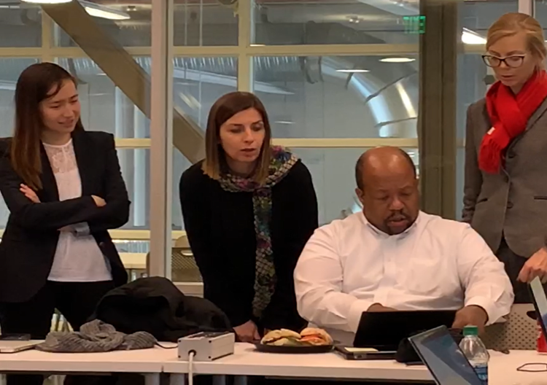
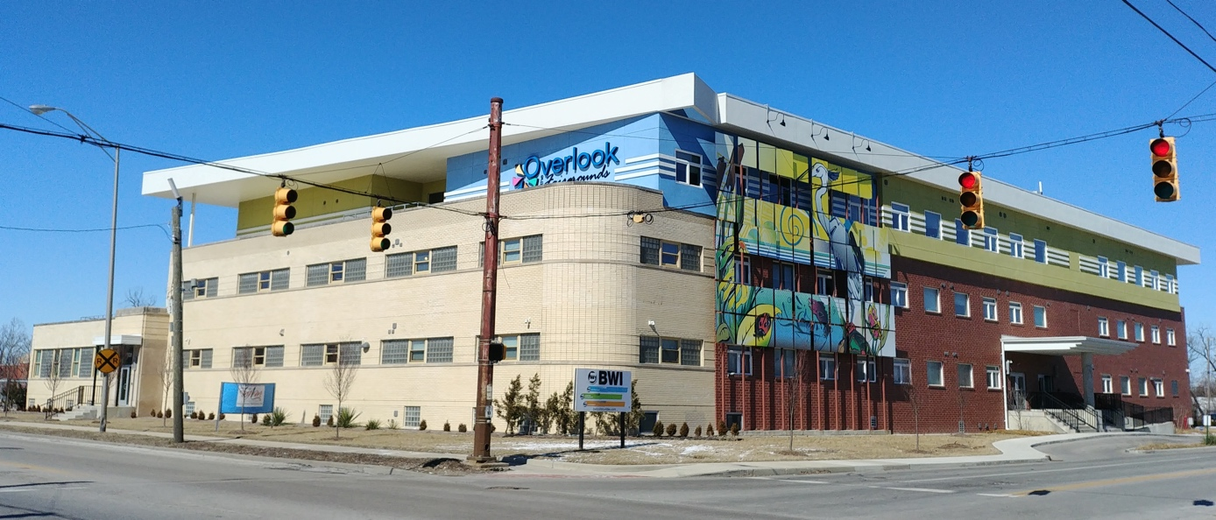
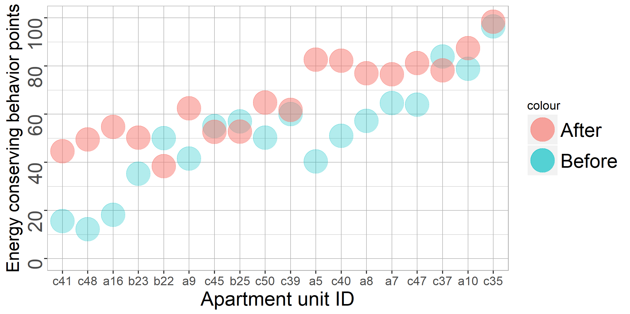
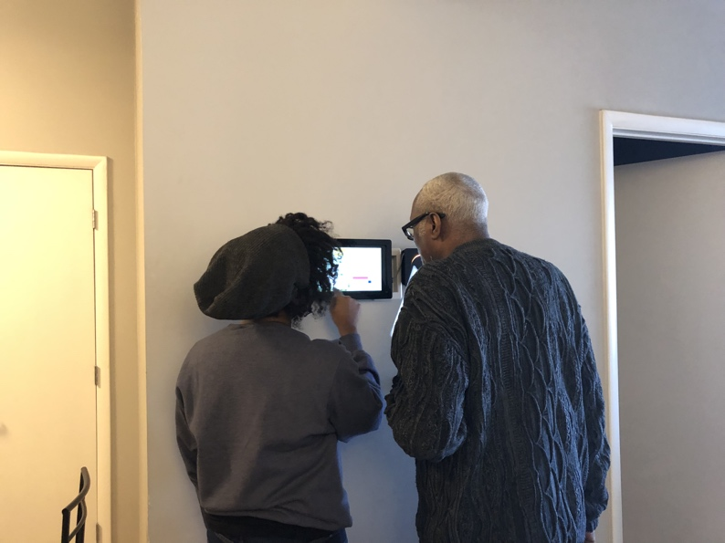
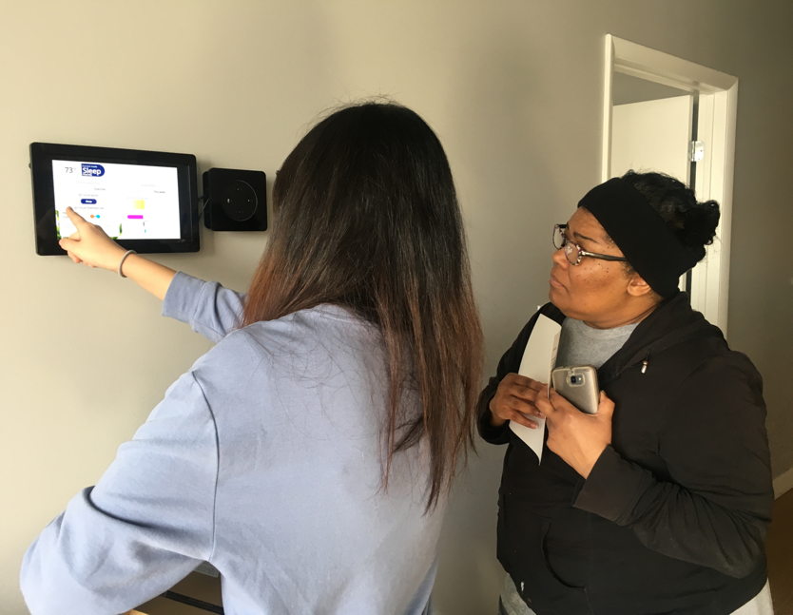
Update of the Project since last PI meeting – Major Community Outcomes at Overlook (50 Households)
MySmart-E App and Alexa skill usability tests with BWI Engineers and residents (Dec 2018 and Jan 2019)
Baseline monthly energy use (Jan-Feb 2018)
Monthly Energy Bill [$/Month]
Group
Potential cost savings from behavior change
ECB points improvements (Feb-Mar 2019)
Implementation of energy use feedback devices (Feb. 2019)

Slide 4
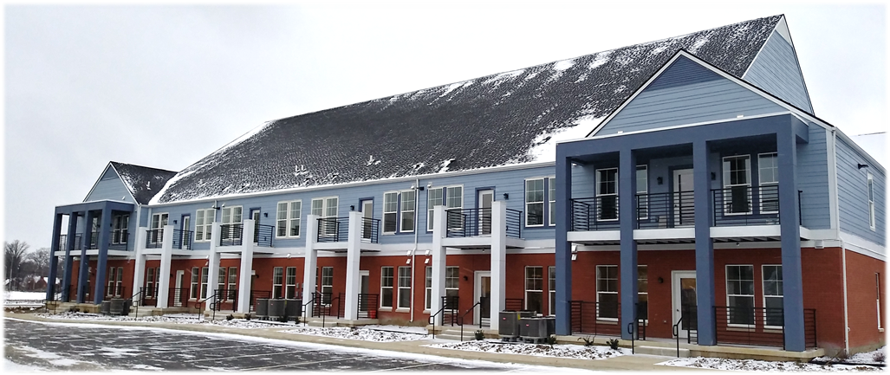
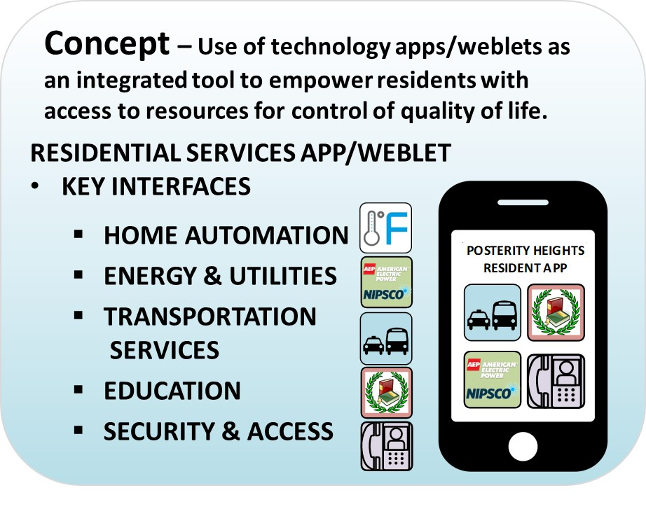
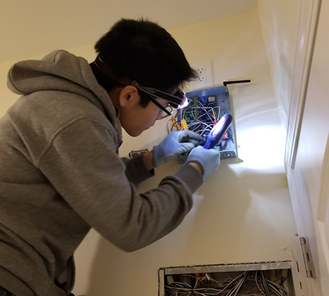
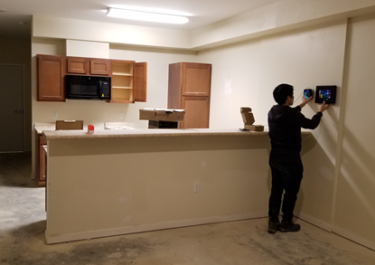
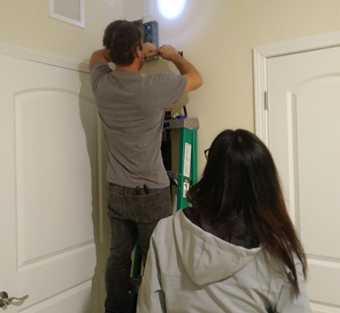
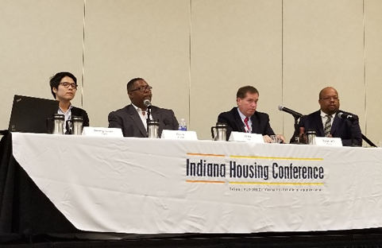

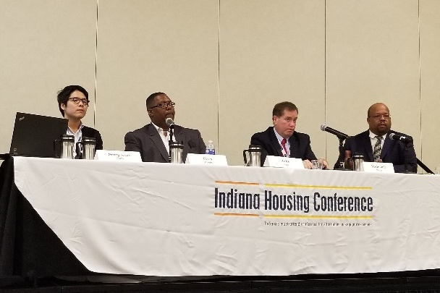

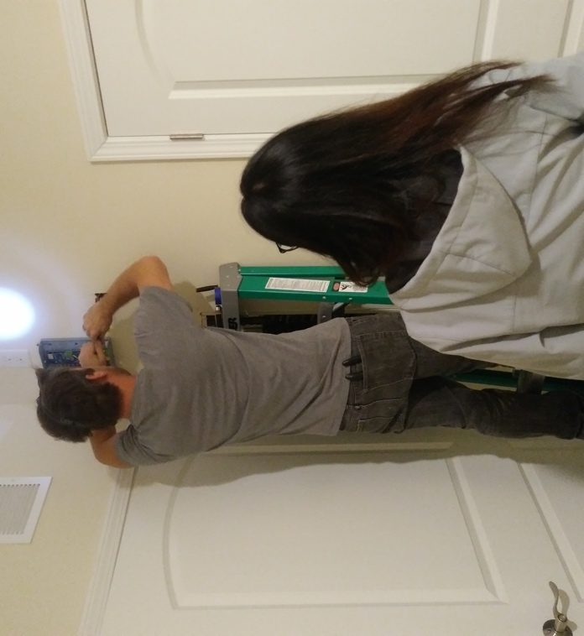
Update of the Project since last PI meeting – Major Capacity Outcomes at Posterity Heights (44 Households)
500 kW Solar Array and Battery Storage
Three Electric Vehicles with Charging Stations

Slide 5
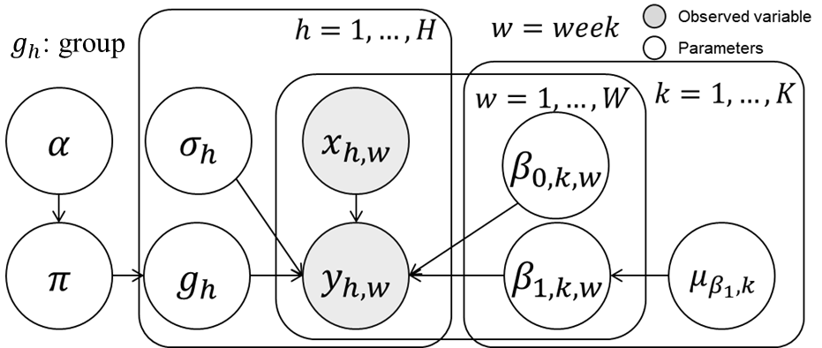
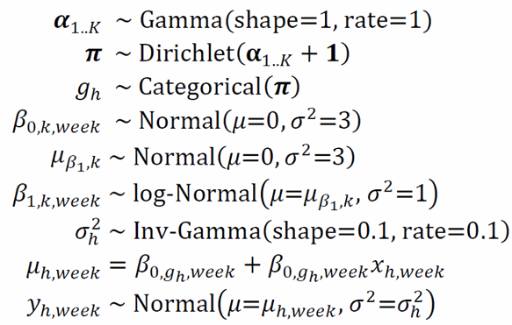
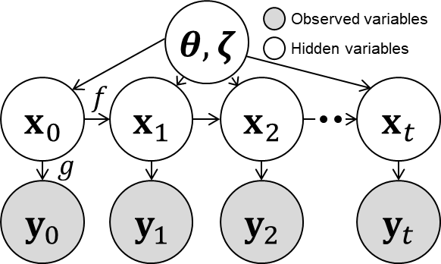
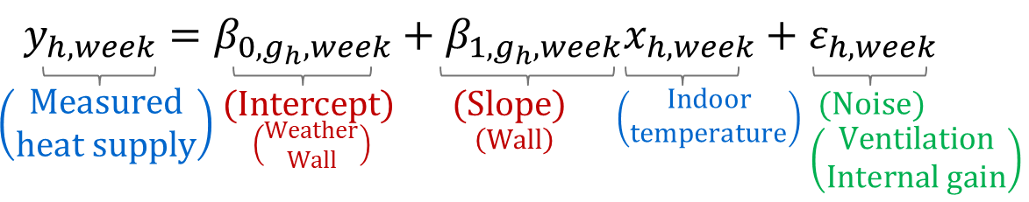
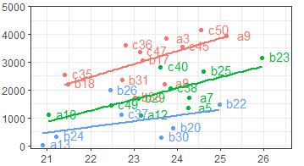
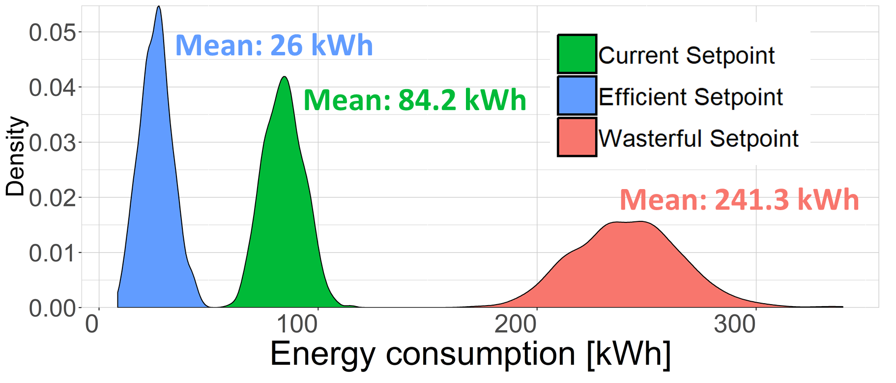

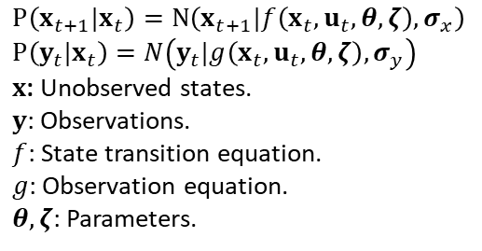
Update of the Project since last PI meeting – New Sociotechnical Outcomes
Identify peer groups and potential savings
Predict future energy use given behavior changes
Model structure – Mixture of linear regression
Online physics-informed machine learning model
$$P\left(x_{t+1}|x_{t}\right)=N\left(x_{t+1}|f\left(x_{t},u_{t},θ,ζ\right),σ_{x}\right) \\ P\left(y_{t}|x_{t}\right)=N\left(y_{t}|g\left(x_{t},u_{t},θ,ζ\right),σ_{y}\right)$$
$x$: Unobserved states.
$y$: Observations.
$f$: State transition equation.
$g$: Observation equation.
$θ,ζ$: Parameters.
Weekly average heating [W]
Weekly average temperature[F]
3 normalized (peer) groups w.r.t building characteristics for behavior comparison.
Filtering and stochastic simulation to quantify uncertainty

Slide 6
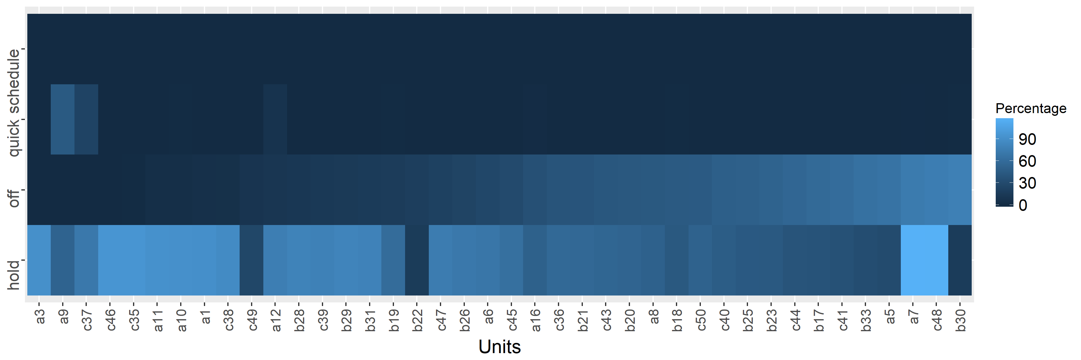











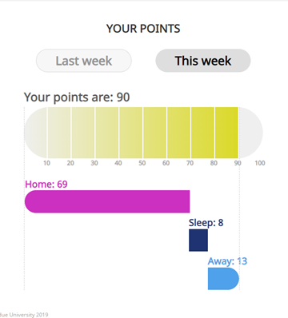
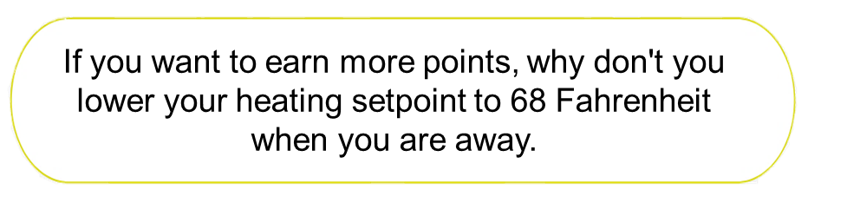
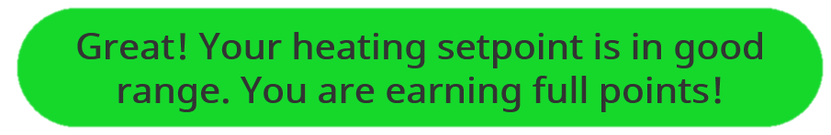
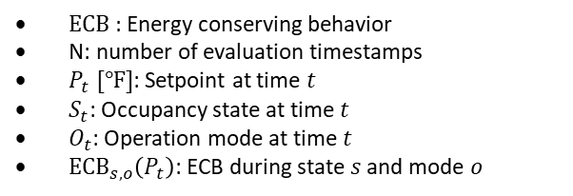

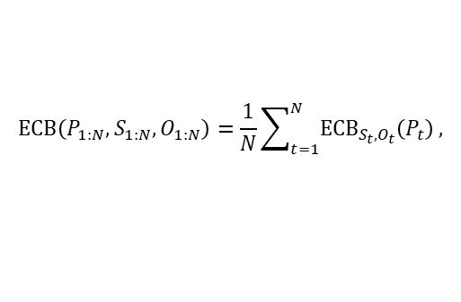
Update of the Project since last PI meeting – New Sociotechnical Outcomes
Learning-based feedback mechanism design
Observations from the baseline data
Psychometric measures
Thermostat settings (Jan – Oct 2018)
Energy Literacy
Numeracy Score
Reported Ecological Behaviors
Schedule
.45**
.22**
Percentage
Quick
Off
-.08
-.02
.26**
.29**
Perceived Difficulty of Sustainable Behaviors
.28**
Energy Usage Estimate Accuracy
Hold
Apartment unit ID
No usage of programmable schedule function
Correlations among knowledge, attitude, and behavior
1. Model of energy conserving behavior (ECB) points
2. Personalized feedback based on ECB points
ECB Definitions
General messages suggest the best way to improve the points
$$ECB\left(P_{1:N}, S_{1:N}, O_{1:N}\right)=\frac{1}{N}\sum_{t=1}^{N}{{ECB}_{S_{t},O_{t}}\left(P_{t}\right)},$$
$${ECB}_{s,o}\left(P\right)=\operatorname{sigm}\left(a_{s,o}+β_{s,o}P\right)=\frac{1}{1+\exp\left\{a_{s,o}+β_{s,o}P\right\}}$$
ECB : Energy conserving behavior
N: number of evaluation timestamps
$P_{t} [℉]$: Setpoint at time $t$
$S_{t}$: Occupancy state at time $t$
$O_{t}$: Operation mode at time $t$
${ECB}_{s,o}\left(P_{t}\right)$: ECB during state $s$ and mode $o$
Action messages inform how current action affects the points

Slide 7



























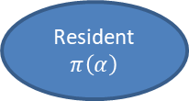



Update of the Project since last PI meeting – Major Contribution to S&CC
Community-based feedback mechanism design
Behavioral model to predict energy conserving behavior before and after feedback
Probabilistic graphical model of occupants’ behavior
Causal relationships that affect 𝜷∗
Resident
$$π\left(α\right)$$
Feeling: $f\left(α\right)$
Utility Bill: $b\left(α\right)$
Effort Cost: $c\left(α\right)$
$$ed$$
Created survey applicable to community population for l
$$f0$$
$$f$$
$$p$$
$$age$$
$$l$$
$$ls$$
$$h0$$
$$c0$$
$$c$$
$$β∗$$
$π\left(α\right)=f\left(α\right)−b\left(α\right)$ $− c\left(α\right)$
$$α0$$
$$Cluster$$
$$type$$
Lottery Framework based on ECB
$$em$$
$$E0$$
Energy Savings
Lottery Pool
Legend:
ECB_{w=1}
ECB_{w=2}
ECB_{w=n}
$$E1$$
…
⍺₃
⍺₃
⍺₂
$$ppl$$
$$Tavg$$
Demographic data
⍺₁
Winner
Model Parameters
⍺₂
…
⍺₂
⍺₃
⍺₃
Node is Observable
⍺₁
Node is Not Observable
⍺₃
…
⍺₁
⍺₂
⍺₃
Possible Causal Relationship
…

Slide 8
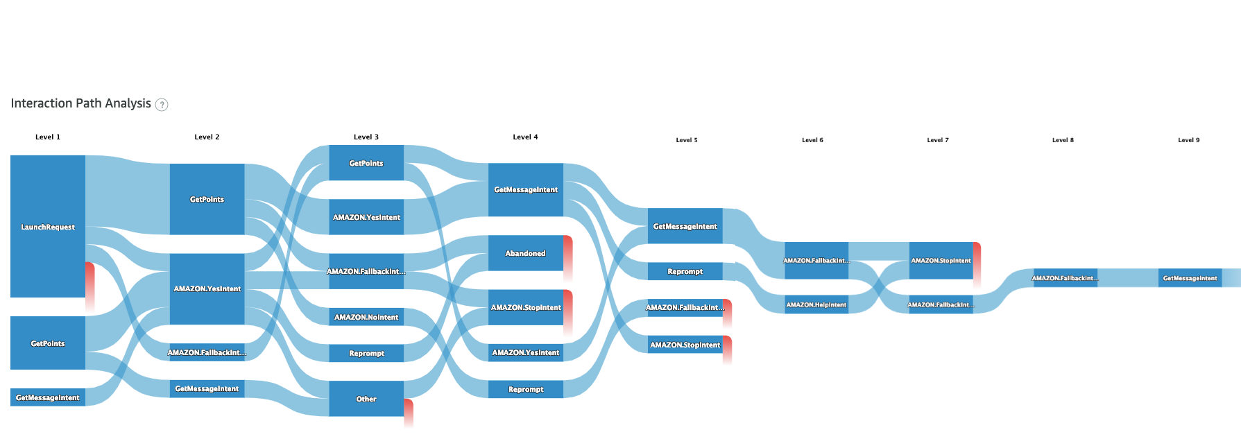

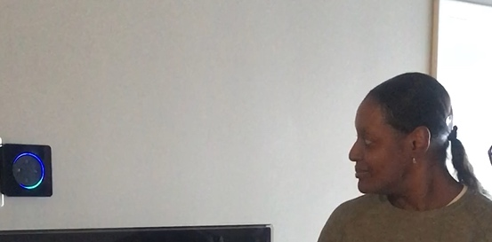
Update of the Project since last PI meeting – Major Contribution to S&CC
Alexa, ask energy saver
What are my energy points?
Hello Jeremy, I am here to help you to save energy. You can ask me: what are my points?
You have approximately 57 points for Home mode, 5 points for away mode, 9 points for sleep mode for this week. You may also ask me how to save energy or ask what the modes mean?
Yes, please
Alexa, ask energy saver what are my points?
You have approximately 71 points in total for this week. Would you like to know the breakdown of your points when you are away from home or at home during the day or at night?
Okay, if you want to earn more points, why don’t you move your heating setpoint closer to 68 Fahrenheit when you are away. What else I can do for you?
Alexa, ask energy saver what is my message?

Slide 9
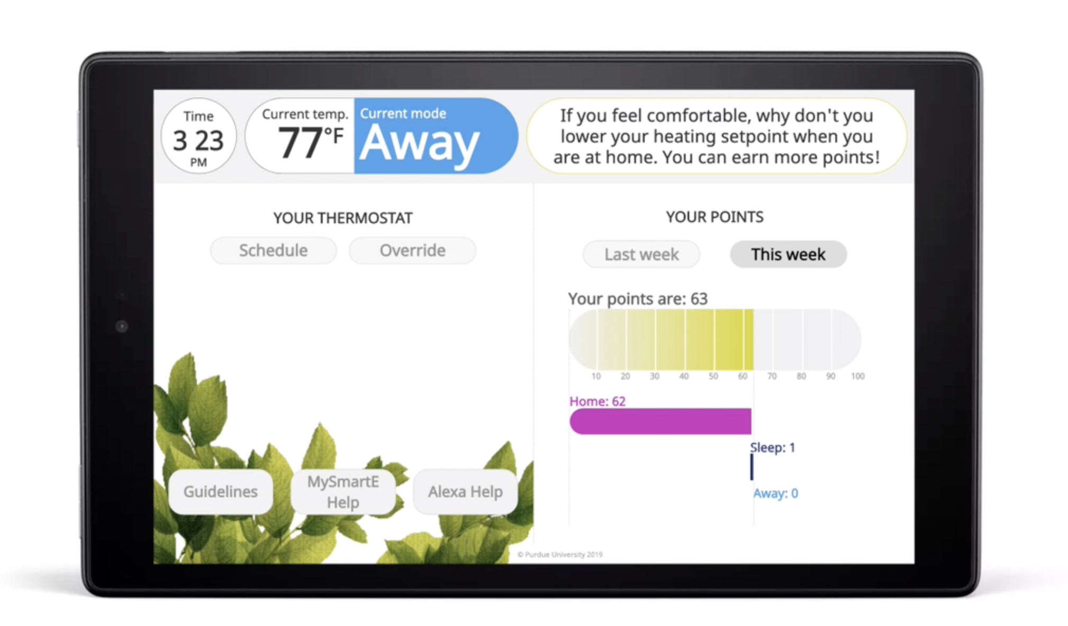
Update of the Project since last PI meeting – Major Contribution to S&CC
MySmart-E App:
HEADER:
Status
& advice
CONTROL
PANEL
USER’s
ENERGY
POINTS:
Total & break down.
HELP
VIDEOS

Slide 10
Anticipated Outcomes and Success Measures in the Next Year
Outcome 1: Community-based feedback and incentive mechanism design with lottery (game theoretic) framework implemented in 2 S&CC
Outcome 2. Integrated audio-visual interactions customized based on user knowledge and motivation

