Slide 1
2019 NSF SMART AND CONNECTED COMMUNITIES PI MEETING
FY 2019 Smart Privacy for Smart Cities:
A Research Collaborative to Protect Privacy and Use Data Responsibly,
NSF Award 1761795
Jules Polonetsky and Kelsey Finch
Future of Privacy Forum
https://fpf.org/
Notes:
This is the transition slide. The lightning talk moderator will announce the name of your project and the name of the lead PI. Expect to begin your presentation from the next slide.

Slide 2
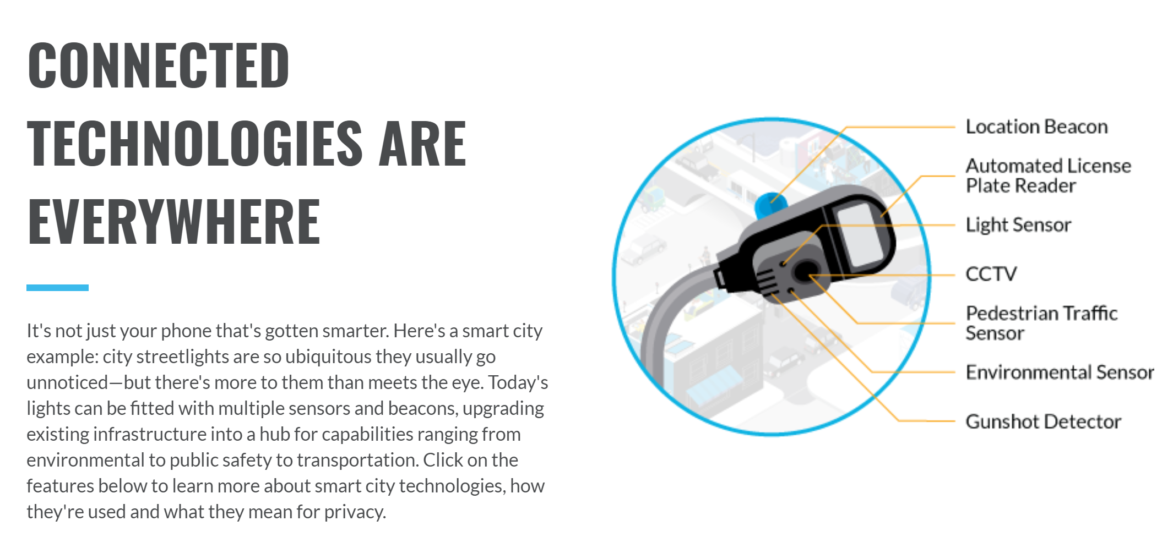
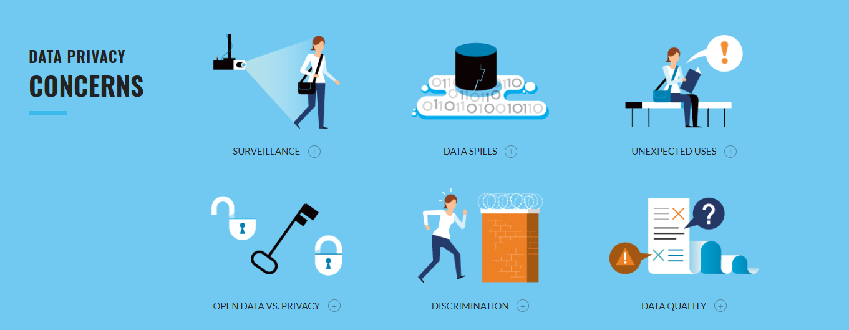
Project Aims
Help municipal leaders strengthen their ability to collect, use, and share data in a responsible manner, by creating peer networks, best practices, and practical tools for privacy
Grow privacy-preserving innovations across application and geographic boundaries for the public good, by supporting academic partnerships and privacy-protective data sharing, with support of partner organization MetroLab Network
Increase public knowledge, understanding and engagement with privacy-related concerns, and ultimately promote the public's trust in smart city technologies and in local government, through strong community engagement and education on responsible data practices

Slide 3
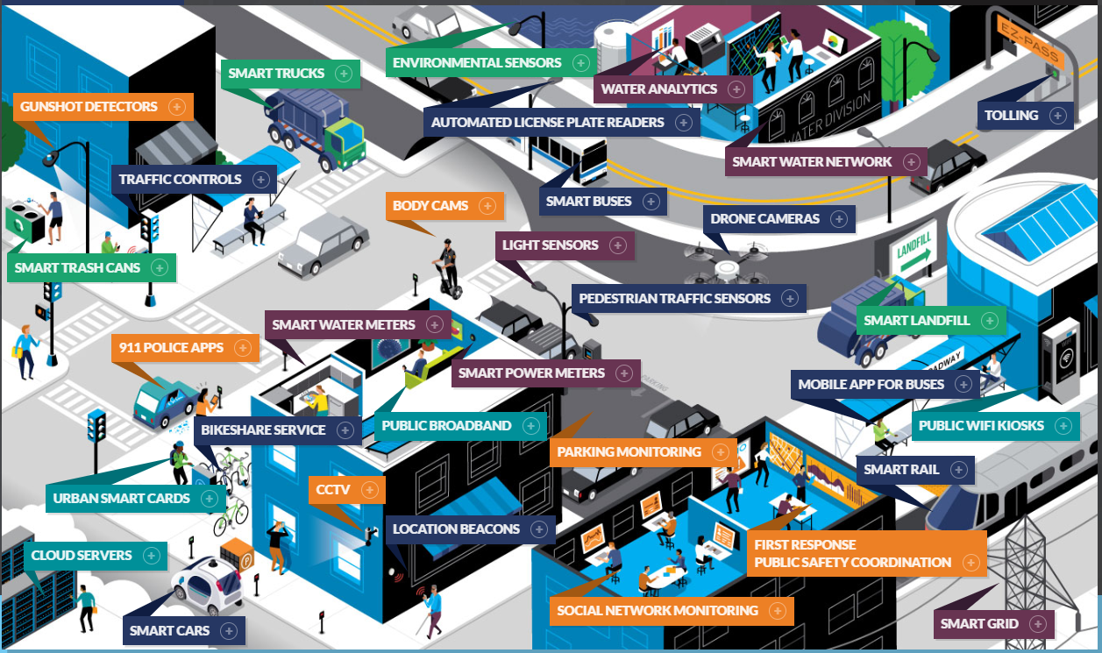
Update of the Project
Established a Civic Data Privacy Leaders Network: a peer network of local gov’t officials focusing on data privacy to collaboratively:
Navigate emerging privacy issues
Share practical guidance, and
Promote fair and transparent data practices.
Developed initial framework for a comprehensive Privacy Risk Assessment that smart and connected communities can use to evaluate new technologies and data flows:
Reviewed PIA best practices from local, state, federal, and int’l organizations
Developed framework to evaluate and weigh prospective benefits as well as prospective risks
Incorporated issues beyond “data protection” - ethics, equity, & engagement
Notes:
Describe what you have done so far in terms of the science (technical and social), community engagement, and capacity building. You do not need to be exhaustive and anecdotes are highly encouraged.
Representatives from 10+ major municipalities
Key issues identified: internal (continuity, culture, cost, consistency); external (community engagement, equity, ethics, emerging technologies)

Slide 4
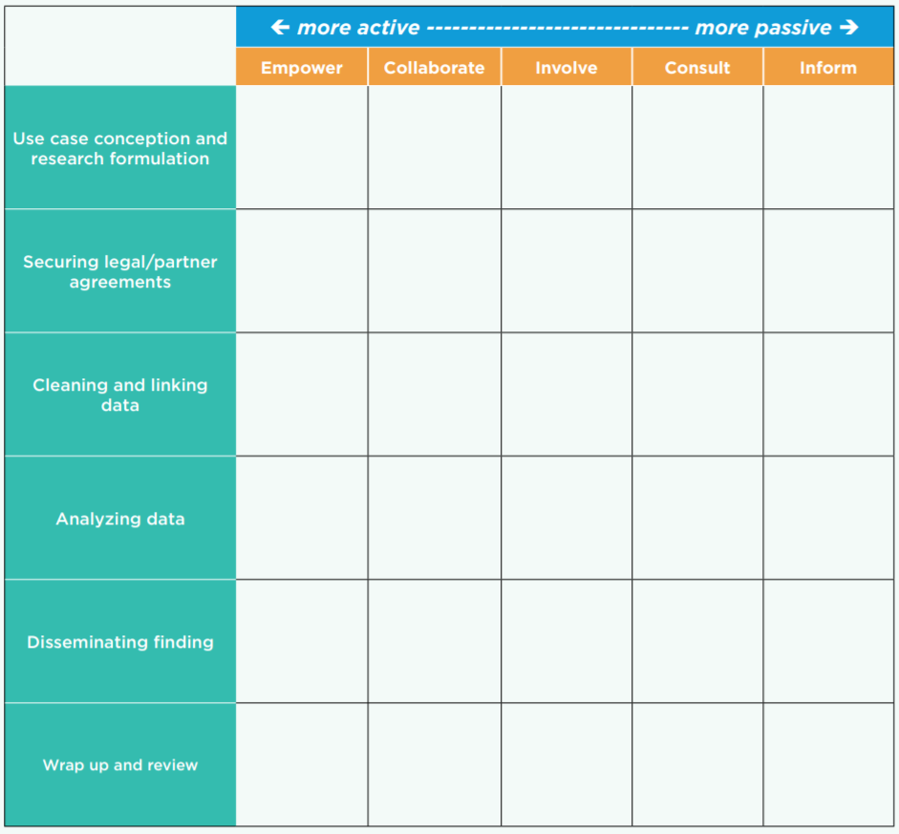
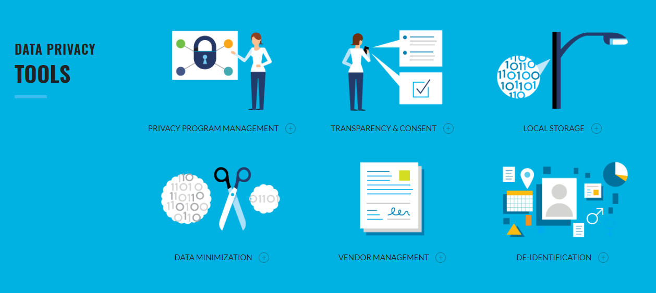
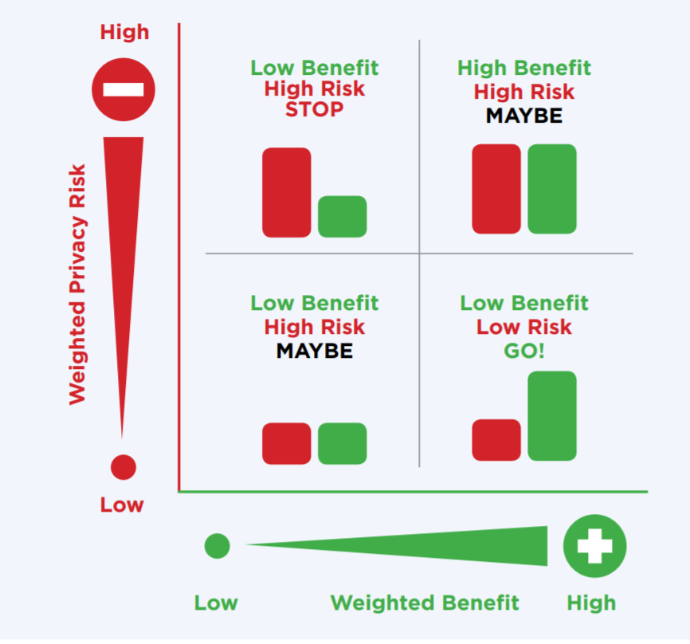
Anticipated outcomes and success measures in the next year
Expand the Civic Data Privacy Leaders Network and create a resource repository
Socialize and publish a comprehensive Privacy Risk Assessment for Smart & Connected Community Projects, providing guidance to local governments and technology providers
Host workshops in conjunction with MetroLab Network, the South Big Data Hub – & you!
Notes:
Describe at least two deliverables that you plan to accomplish over the next year that will significantly advance your project.

