Slide 1
2019 NSF SMART AND CONNECTED COMMUNITIES PI MEETING
FY 2018 IRG: UNITE: Smart, Connected, and Coordinated Maternal Care for Underserved Communities NSF Award CNS-1831918
Team: Nikil Dutt¹ (Lead PI), Yuqing Guo², Marco Levorato¹, Amir Rahmani^{1,2}, Margaret Schneider³, Stephanie Reich⁴, Pamela Pimentel⁵
Affiliations: ¹ Dept. of Computer Science, University of California at Irvine
² Dept. of Nursing, University of California at Irvine
³ Dept. of Social Ecology, University of California at Irvine
⁴ Dept. of Education, University of California at Irvine
⁵ MOMS Orange County
Website: https://www.unite.ics.uci.edu
Notes:
This is the transition slide. The lightning talk moderator will announce the name of your project and the name of the lead PI. Expect to begin your presentation from the next slide.

Slide 2
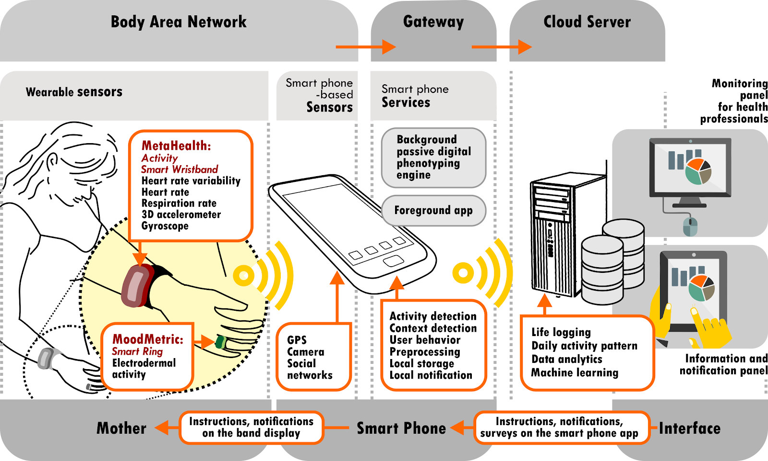
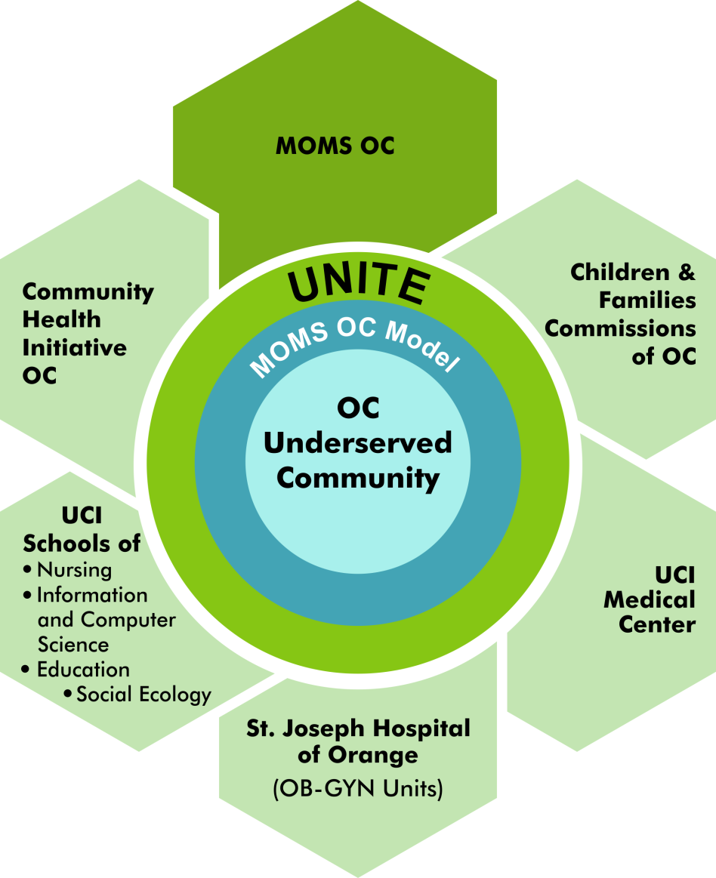
UNITE: Project Aims
Healthy Mothers, Healthy Babies, Healthy Communities!
Help underserved pregnant women through IoT-enabled self-management
Smart, personalized recommendations and interventions for maternal care
Community engagement with mothers, families, & community-oriented agencies

Slide 3
UNITE Project Update (Oct 18 – Mar 19)
Developing new RN-in-the-loop smart intervention model
Targeting underserved (primary Hispanic) mothers in Santa Ana
WIoT-enabled self-management for maternal care
Engaging multiple community partners:
MOMS Orange County; Childrens and Families Commission of OC; Community Health Initiative OC; UCI Medical Center; Sr. Joseph Hospital
Successful kickoff Community Advisory Board (CAB) Meeting in Feb 2019
Seeds of community building:
Expanding coverage beyond underserved mothers and families in OC
Interdisciplinary research community building at UCI: CS, Nursing, Social Ecology, Education, Medicine
International collaboration with Finland (Turku Nursing School and Hospital) with parallel research efforts
Notes:
Describe what you have done so far in terms of the science (technical and social), community engagement, and capacity building. You do not need to be exhaustive and anecdotes are highly encouraged.

Slide 4
UNITE: Anticipated outcomes and success measures in the next year
Complete Focus Group Study and Feasibility Analysis with underserved pregnant mothers
Success Measure: Approval of IRB for full-scale UNITE RCT
Expand Advisory Board to include additional community partners, nurse practitioners, exercise/nutrition specialists
Success Measure: Feedback from Annual CAB meeting on plans for RCT
Notes:
Describe at least two deliverables that you plan to accomplish over the next year that will significantly advance your project.

