Slide 1


2019 NSF SMART AND CONNECTED COMMUNITIES PI MEETING
FY 2018 IRG: SCC: Empowering Smart and Connecticut Communities through Programmable Community Microgrids, NSF Award 1831811
Peng Zhang¹, Peter Luh¹, Joel Rinebold², Baikun Li¹, Amir Herzberg¹, Fei Miao¹, Mark Wick³, Erin Steward⁴
¹ University of Connecticut ² Connecticut Center for Advanced Technology
³ Energy and Innovation Park, New Britain, CT ⁴ City of New Britain, CT
https://power.engr.uconn.edu/
Notes:
This is the transition slide. The lightning talk moderator will announce the name of your project and the name of the lead PI. Expect to begin your presentation from the next slide.

Slide 2
Project Aims
The main objective is to create smart programmable microgrids (SPMs) that enable software-defined, hardware-independent microgrid functions, particularly for resolving challenges that hinder microgrid adoptions
Architect a programmable microgrid
Pioneer a concept of “software-defined operation optimization”
for microgrids
Devise software-defined Distributed Formal Analysis

Slide 3
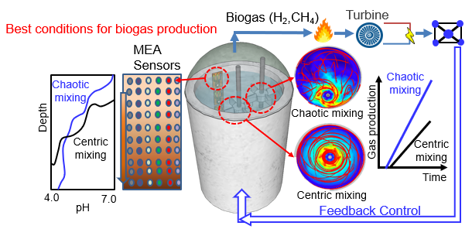
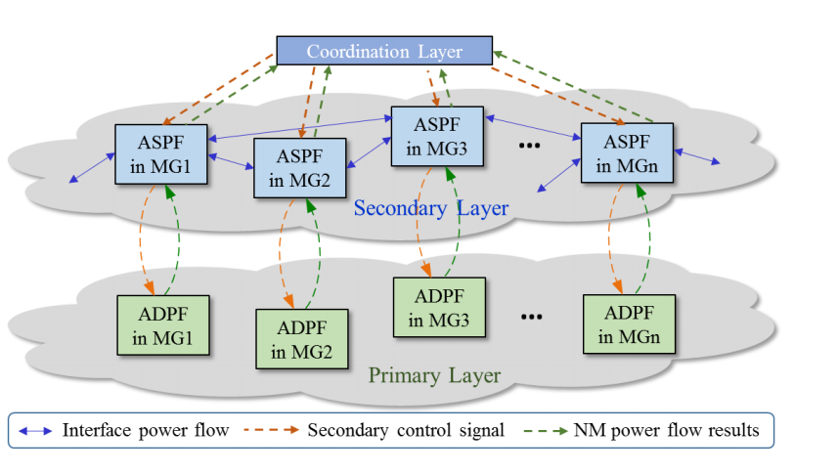
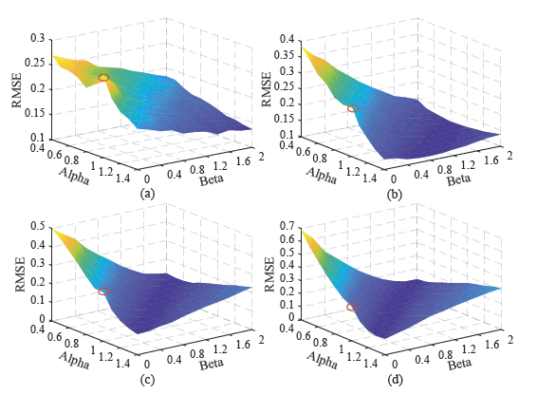
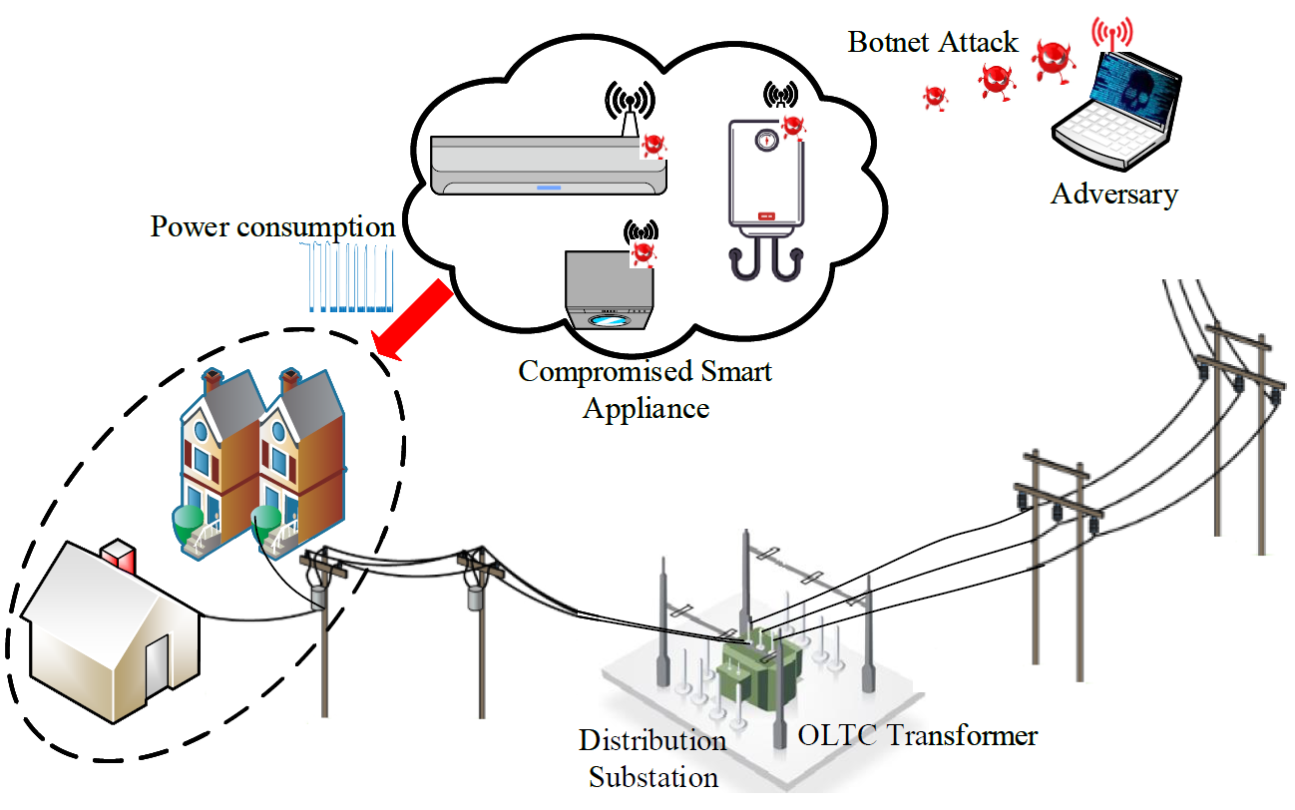
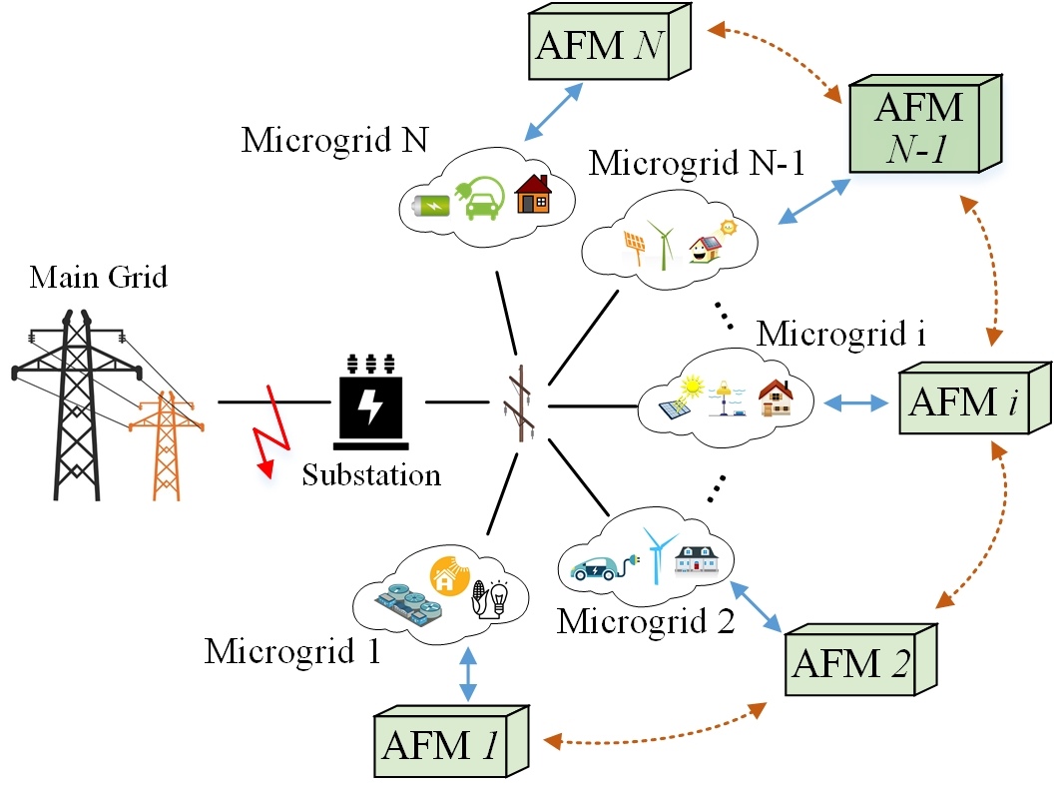
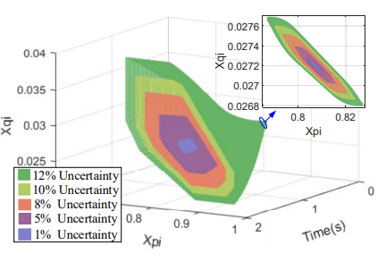
Update of the Project
New sociotechnical outcomes.
Visualization of the AD
A Compositional microgrids Power Flow
Cyberattack resilient load forecasting
SPM platform
x₂
x*
x₁
Distributed Formal Analysis for Power Networks
A systematic formulation approach for unit commitment
Securing Power Distribution Grid Against Power Botnet Attacks
A real-time Distributed Active Fault Management
Notes:
Describe what you have done so far in terms of the science (technical and social), community engagement, and capacity building. You do not need to be exhaustive and anecdotes are highly encouraged.

Slide 4
Update of the Project
New sociotechnical outcomes.
  Commencement of Community Based Development with Energy Innovation Park in an “Opportunity Zone” for Clean Energy, Computer Server Operation, and Technology Based Jobs and Economic Development;
  Collaboration with Community Leaders, Municipal Officials, State Representatives, and Utility Providers for Project Support;
  Modularized mathematical models for combined heat and power, and storage; a powerful decomposition and coordination method
Major community outcomes.
  Community Leadership Engagement and Integration of Leadership Management for Information, Energy, and System Control;
  Leveraging of Government and Private Investments for Development of the Energy Innovation Park;
Contribution to S&CC.
  Improved Connectivity with Technology, Community Needs, and Community Control with Documented Expectations for Lower Cost Energy and Information Management, Increased Environmental Performance, and Job Creation;
Notes:
Describe what you have done so far in terms of the science (technical and social), community engagement, and capacity building. You do not need to be exhaustive and anecdotes are highly encouraged.

Slide 5
Anticipated outcomes and success measures in the next year
Outcome 1.
  An SPM platform tested and validated on Eversource Energy Testbed
  Community Engagement to Document Progress, Outcomes, and Feedback for Application of the SPM Platform on the Emerging Energy Innovation Park
Outcome 2.
  A powerful distributed and asynchronous decomposition and coordination method;
  A systematic formulation tightening approach
  Develop a real-time-learning-based cybersecurity function to protect SPMs against power bot attacks
Notes:
Describe at least two deliverables that you plan to accomplish over the next year that will significantly advance your project.

