Slide 1
2019 NSF SMART AND CONNECTED COMMUNITIES PI MEETING
FY 2018 IRG: Building Safe and Secure Communities through Real-Time Edge Video Analytics, Award 1831795
Hamed Tabkhi, Electrical and Computer Engineering, Lead PI
Shannon Reid, Criminal Justice and Criminology
Douglas A. Shoemaker, Center for Applied GIScience
Robert Phocas, Sustainability Director, City of Charlotte
Arun Ravidran, Electrical and Computer Engineering
Srinivas Pulugurtha, Civil and Environmental Engineering
smartsafecharlotte.uncc.edu
Notes:
This is the transition slide. The lightning talk moderator will announce the name of your project and the name of the lead PI. Expect to begin your presentation from the next slide.

Slide 2
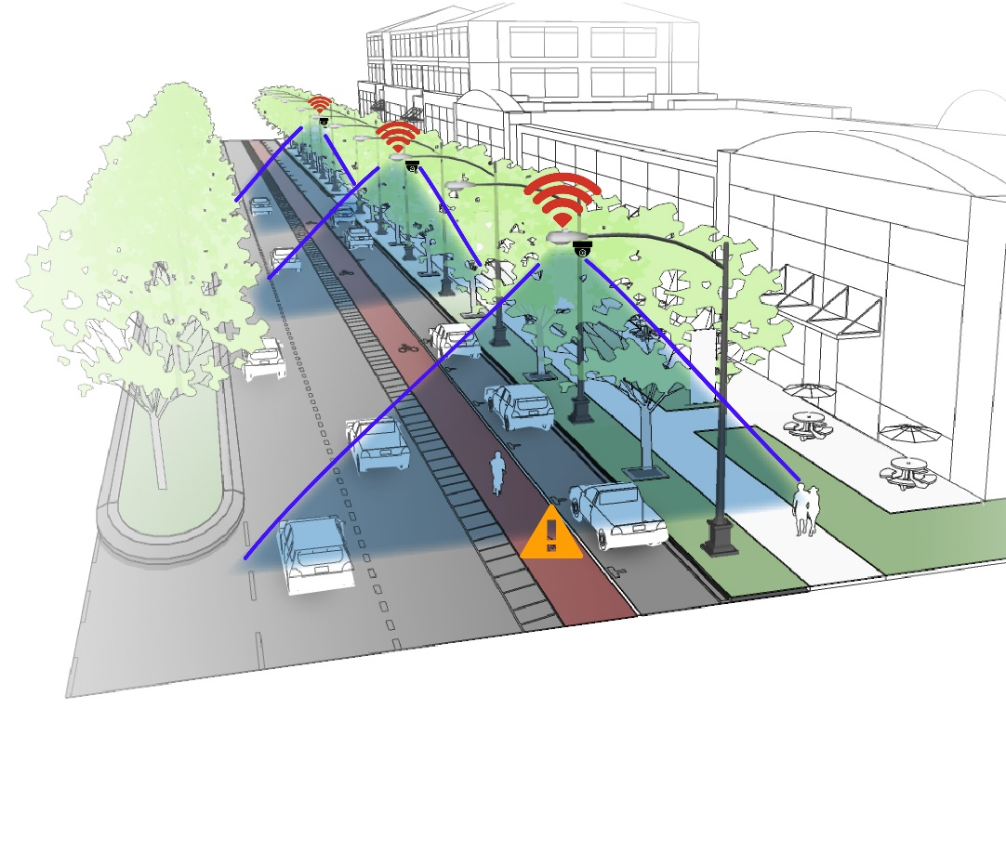
Project Aims
Artificial Intelligence in the Service of Public Safety: colorblind, “Intelligent” policing
Cost, labor savings by pushing computation to the network edge
Call-on multiple communities (police, neighborhoods, students) to co-design technology
Notes:
Describe the aims of this project and how you plan to address them in a specified community, in collaboration with your academic collaborators and community partners.

Slide 3
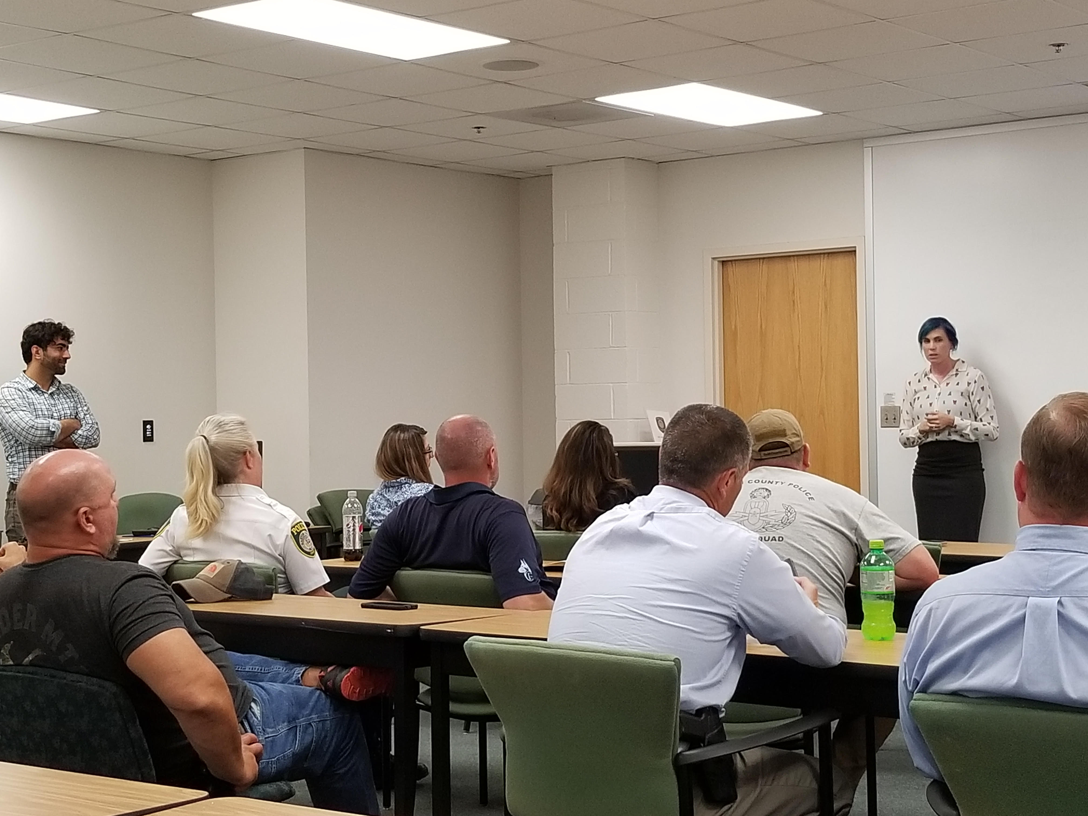
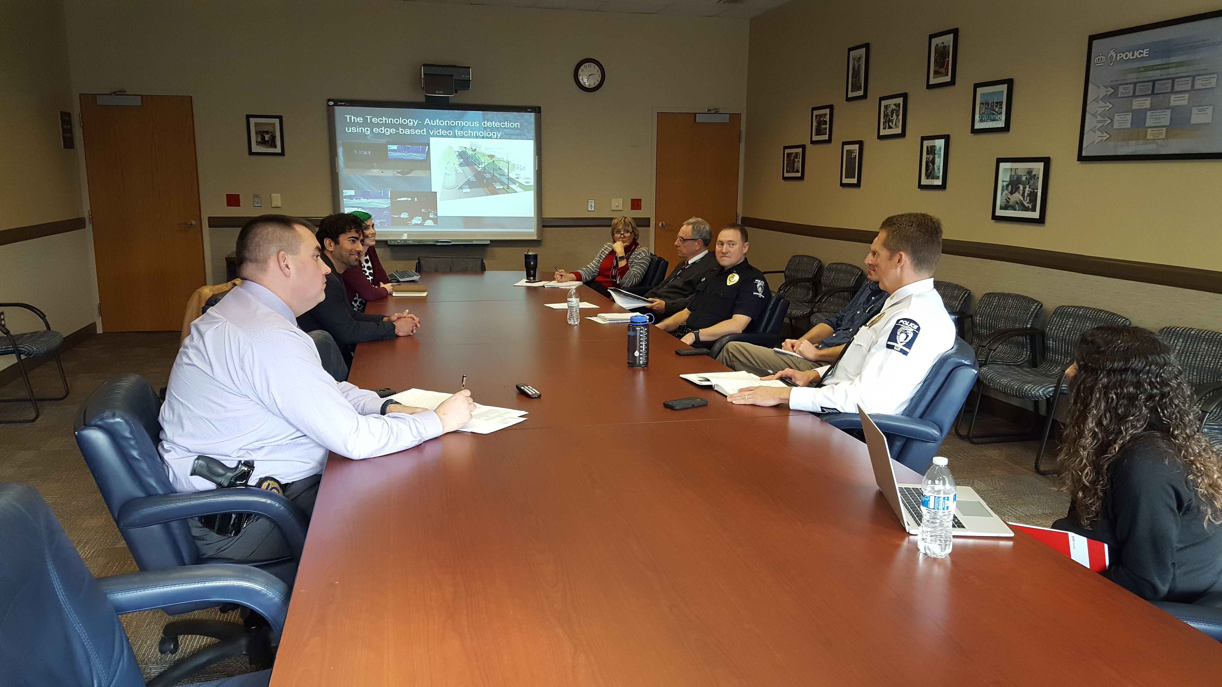
Update of the Project
Institutional Outreach: AI for public safety demonstrations
Training Data: Building law enforcement behavioral database
W/City of Charlotte: Developing extensive community outreach
Established Data Governance, Privacy Policy
Finding Balance between AI Research and Community Concerns
Notes:
Describe what you have done so far in terms of the science (technical and social), community engagement, and capacity building. You do not need to be exhaustive and anecdotes are highly encouraged.
** add pictures
** come see demos

Slide 4
Anticipated outcomes and success measures in the next year
Form Executive Oversight Council
First community codesign testbed
Hold SmartCity CLT Workshop
Notes:
Describe at least two deliverables that you plan to accomplish over the next year that will significantly advance your project.

