Slide 1


2019 NSF SMART AND CONNECTED COMMUNITIES PI MEETING
FY 2018 IRG: SCC:
Smart and Connected Churches for Promoting Health
in Disadvantaged Populations, NSF Award 1831755
Timothy Bickmore, Michael Paasche-Orlow, David Wright
Northeastern University, Boston University, Black Ministerial Alliance
http://relationalagents.com/projects/HealthMinistry.html
Notes:
This is the transition slide. The lightning talk moderator will announce the name of your project and the name of the lead PI. Expect to begin your presentation from the next slide.

Slide 2
Project Aims
Improve population health for underserved urban communities.
Leverage existing social support networks in a network of African American churches in the Boston area.
Leverage spiritual and religious beliefs and practices.

Slide 3
Black Ministerial Alliance of Boston
30 churches, > 20,000 members
Interdenominational
Provides spiritual nurture to clergy, advocacy and program services for the Black community
Decrease health disparities
Facilitate the growth of Health Ministry

Slide 4
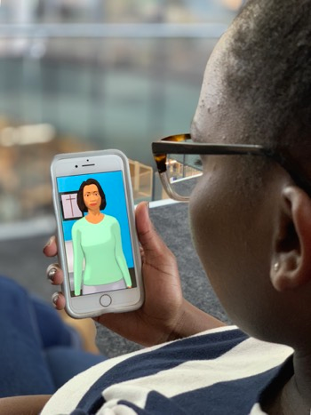
Update of the Project
13 focus groups involving 12 members of 2 churches.
Development of research infrastructure.
Contribution to S&CC: Understanding of how spirituality can be leveraged in population-level interventions.
Notes:
Describe what you have done so far in terms of the science (technical and social), community engagement, and capacity building. You do not need to be exhaustive and anecdotes are highly encouraged.
Six months into project.

Slide 5
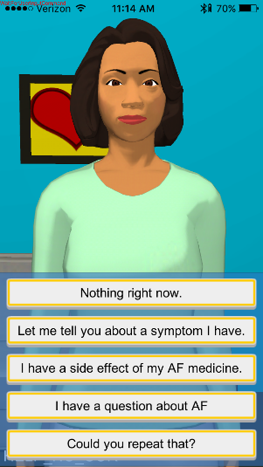
Anticipated outcomes and success measures in the next year
Complete requirements analysis from focus groups, surveys, and ethnographic research.
Technical infrastructure to support rapid deployment and evaluation of intervention prototypes.
Initial smartphone prototype for three health behaviors with integrated spiritual support for key informant field evaluation.
Notes:
Describe at least two deliverables that you plan to accomplish over the next year that will significantly advance your project.

