Slide 1
2019 NSF SMART AND CONNECTED COMMUNITIES PI MEETING
FY 2018 IRG: PuebloConnect: Expanding Internet Access and Content Relevance in Tribal Communities
NSF Award 1831698
Elizabeth Belding, PI, University of California, Santa Barbara
Marisa Duarte, Co-PI, Arizona State University
Jennifer Case Nevarez, Senior Personnel, Community Learning Network
Morgan Vigil-Hayes, Co-PI, Northern Arizona University
Ellen Zegura, Co-PI, Georgia Tech
Notes:
This is the transition slide. The lightning talk moderator will announce the name of your project and the name of the lead PI. Expect to begin your presentation from the next slide.

Slide 2
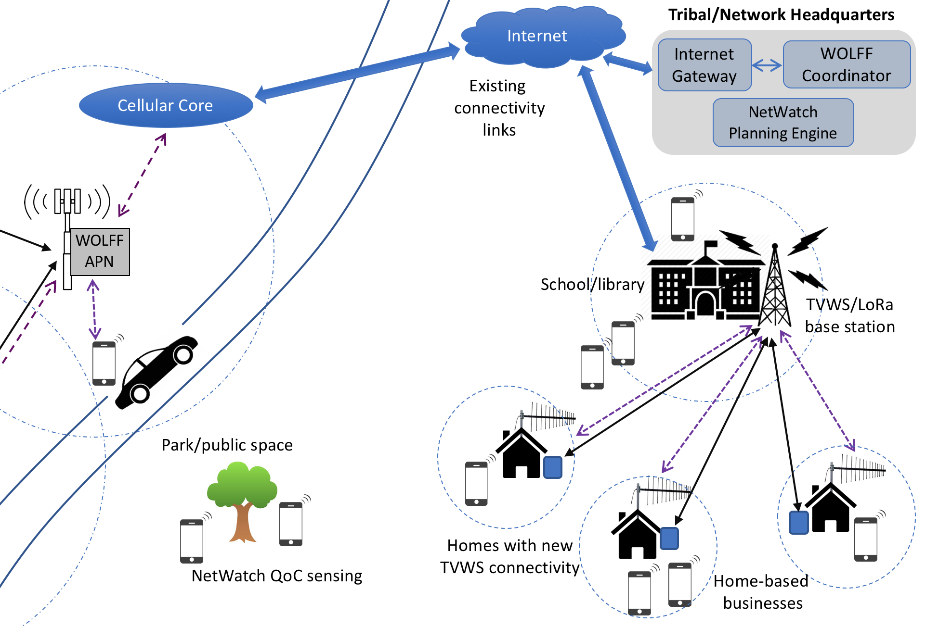
Project Aims
In partnership with Santa Clara, Ohkay Owingeh, Tesuque, and Pojoaque Pueblos of New Mexico, and REDINet:
Improve middle- and last-mile Internet connectivity and access
wireless network innovations: TV white space networks; network and spectrum availability assessments; LoRA
Grow community Web skills
participatory community-based learning
digital literacy courses: increase Tribal Web presence

Slide 3
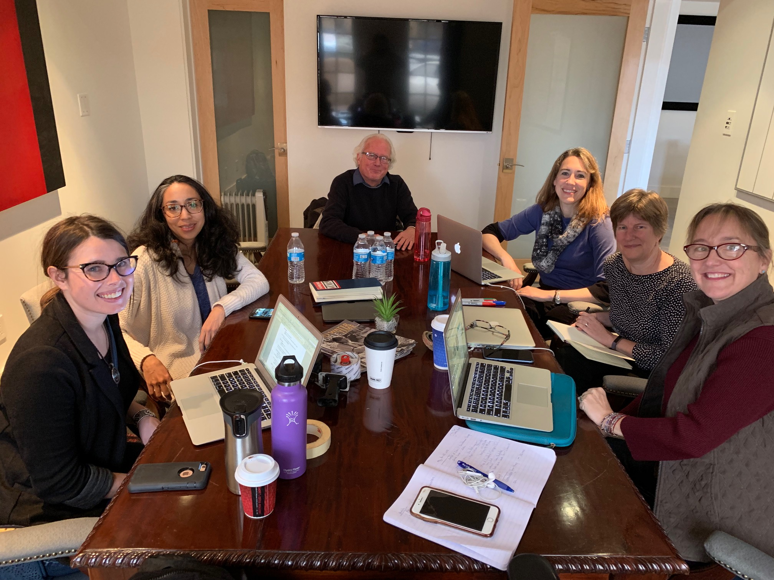
Update of the Project
Full team kick-off meeting held on-site in NM
Site for first TVWS installation identified; working with vendor on exact placement
Paper in preparation on inconsistency in cellular coverage data in rural areas
Completed cultural review
Establishment of initial interview guides and a survey instrument for beginning action research
Planning digital literacy courses
Work on expansion of partnerships and funding sources
Notes:
Describe what you have done so far in terms of the science (technical and social), community engagement, and capacity building. You do not need to be exhaustive and anecdotes are highly encouraged.

Slide 4
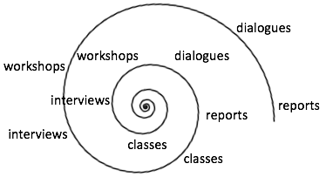
Anticipated outcomes and success measures in the next year
First TVWS installation complete; second one underway
Two papers submitted on technical innovations
Community trainings and participatory research progress
Regional IT education assessment completed and IT Education Plan in place
Regional IT audit completed
IRB processes and approvals completed
Notes:
Describe at least two deliverables that you plan to accomplish over the next year that will significantly advance your project.

