Slide 1
2019 NSF SMART AND CONNECTED COMMUNITIES PI MEETING
FY 2018 IRG: SCC: Smart Water Crowdsensing: Examining How Innovative Data Analytics and Citizen Science Can Ensure Safe Drinking Water in Rural Versus Suburban Communities, NSF Award 1831669
PI: Dong Wang, co-PIs: Na Wei, Jenifer Tank, Danielle Woods, Diogo Bolster; Community Partner: Environment Health Department in St. Joseph County Penn-Harris-Madison (PHM) School Corporation
University of Notre Dame
http://apollo.cse.nd.edu/sws
Notes:
This is the transition slide. The lightning talk moderator will announce the name of your project and the name of the lead PI. Expect to begin your presentation from the next slide.

Slide 2
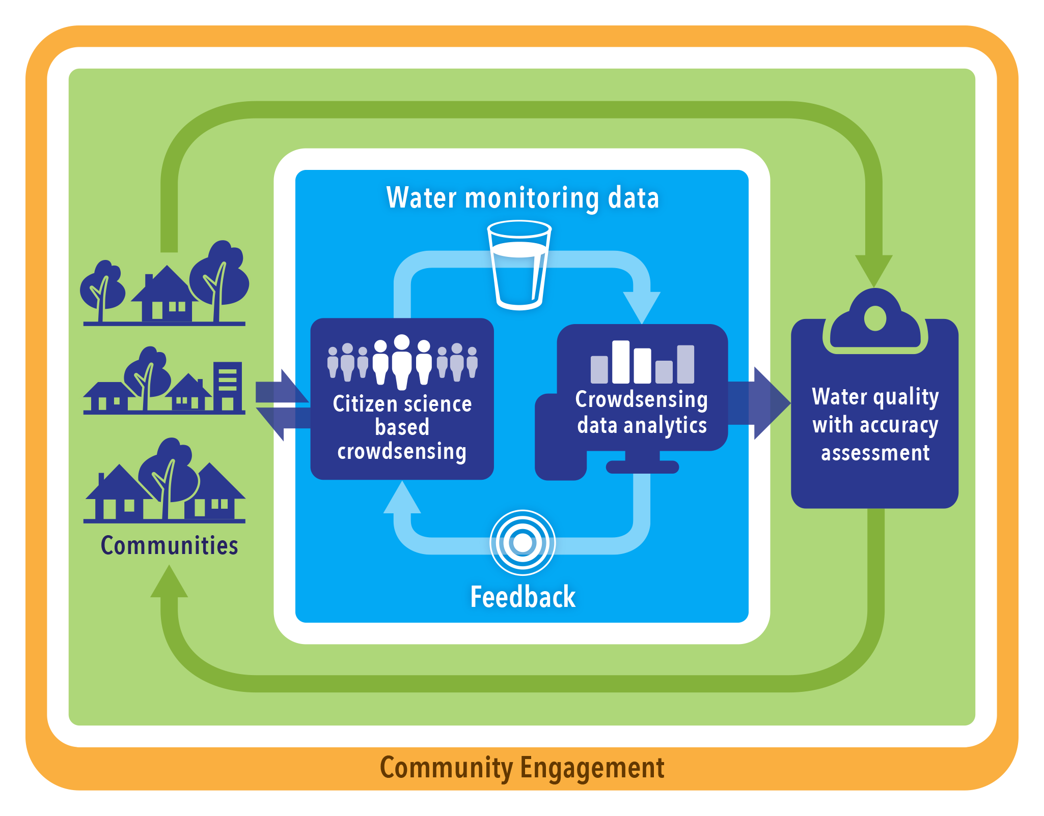
Project Aims
Develop a citizen science based Smart Water Crowdsensing (SWC) framework
Promote public health in private well dependent communities
Integrate highly interdisciplinary approaches to addressing both technological and social challenges
Notes:
For all of your slides, do not include more than three bullet points per slide and do not try to speak to the entirety of your project. We want to hear about the activities that you consider primary and most interesting.
Describe the aims of this project and how you plan to address them in a specified community, in collaboration with your academic collaborators and community partners.
REQUIRED Graphical representation
of your approach, its place within the broader application domain, and interaction with the community.

Slide 3
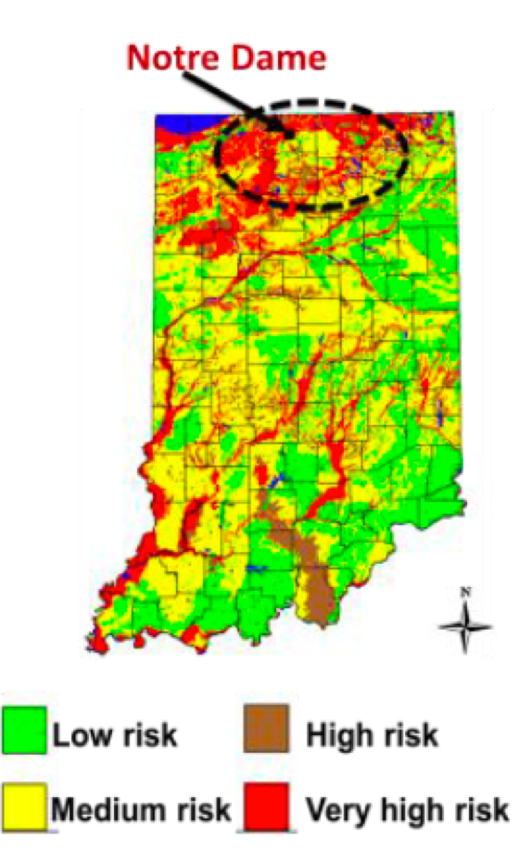
Update of the Project
Sociotechnical outcomes.
Technical: Develop new data analytic and inference models
Social: Design surveys and interviews to understand the key socio-demographic factors
Community outcomes.
Identify the target communities
Connect with local school systems
Contribution to S&CC.
Support a broad range of citizen science based S&CC applications
Science serving society
Notes:
Describe what you have done so far in terms of the science (technical and social), community engagement, and capacity building. You do not need to be exhaustive and anecdotes are highly encouraged.

Slide 4
Anticipated outcomes and success measures in the next year
Outcome 1: Implement the SWC in the target communities
Outcome 2: Collect and analyze baseline data for communities and participants
Outcome 3: Educate K-12 and general public through Notre Dame Linked Experiment Ecosystem Facility (ND-LEEF).
Notes:
Describe at least two deliverables that you plan to accomplish over the next year that will significantly advance your project.

