Slide 1
2019 NSF SMART AND CONNECTED COMMUNITIES PI MEETING
FY 2018 IRG:
Community-based Automated Information for Urban Flooding
(NSF Award #1831475)
¹Mikhail Chester (PI), Margaret Garcia, Guiseppe Mascaro
²Ben Ruddell, Eck Doerry (presenting today)
³Tom Meixner ; ⁴Rob Pastel ; ⁵Chris Lowry
¹Arizona State University, ²Northern Arizona University, ³University of Arizona, ⁴Michigan Technological University, ⁵University of Buffalo
http://www.floodaware.net/
Notes:
This is the transition slide. The lightning talk moderator will announce the name of your project and the name of the lead PI. Expect to begin your presentation from the next slide.

Slide 2
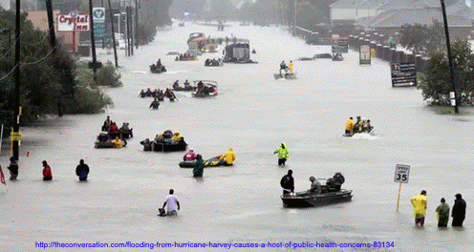
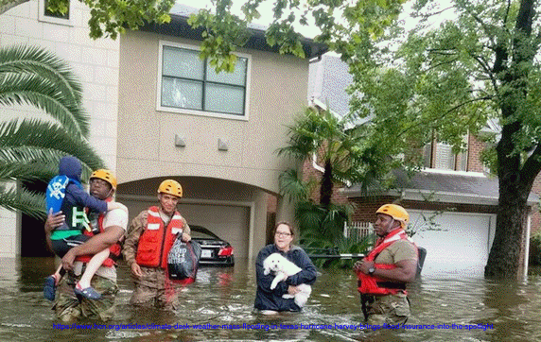
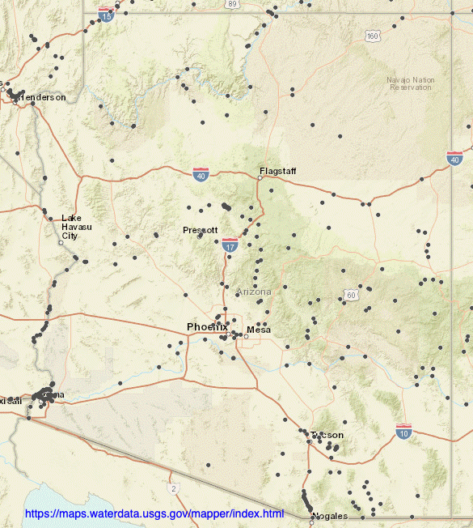
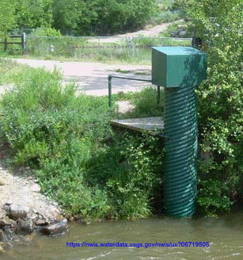
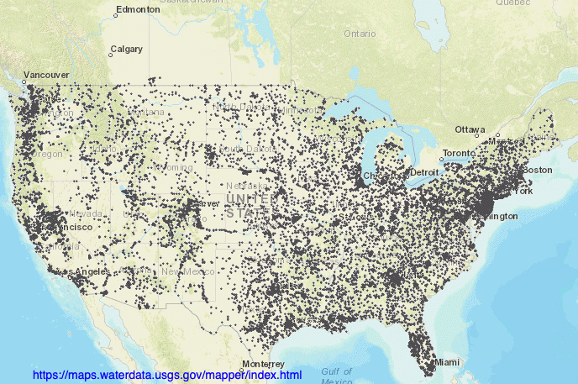
Project Context: Urban Flooding
Flooding is the most damaging natural hazard in the U.S. ; highest damage in cities.
Current flood stage observation is sparse:
focuses on larger lakes/rivers
Little to no focus on detailed urban landscapes
But this is where we need it most!
Notes:
According to NOAA: Hurricane Harvey cost $125 billion. In second place behind Katrina at $161 billion
USGS covers about 10k large and midsize lakes and streams. Almost no coverage of fine scale urban streams/basins.
Bottom line: we need smarter flood planning and management, and for that we need more data…. LOTS more data…in urban areas where floods have most impact.

Slide 3
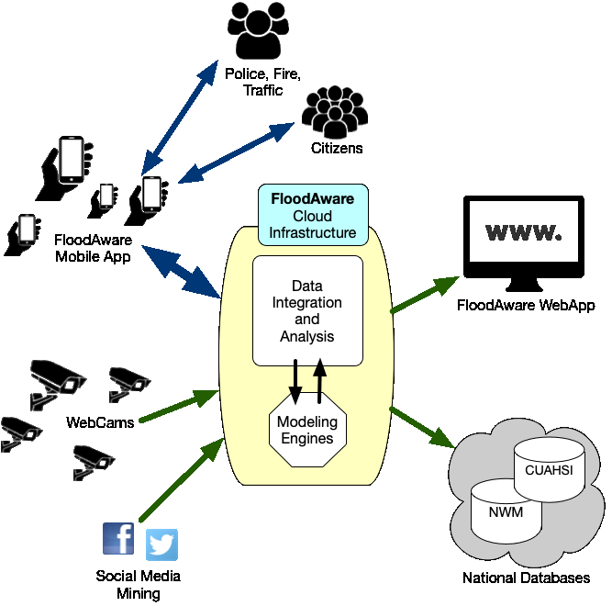
Project Aims: Smarter Flood Management
The FloodAware System
Concept: Automated real-time flood response
monitoring/prediction/response/planning
FloodAware aims:
”Smart” = hydrology + data + real-time network
Near-real-time flood status/prediction
Proof of crowd-sourcing potential in smart cities
Engage both authorities and citizens
Model for real nationwide FloodAware system
Key FloodAware challenges:
Collecting/integrating disparate data streams
Automated flood stage extraction from images
Modeling with variable data quality
Cost effectiveness for cities
Notes:
Real time monitoring: Focus on urban landscapes. Increase sensors density

Slide 4
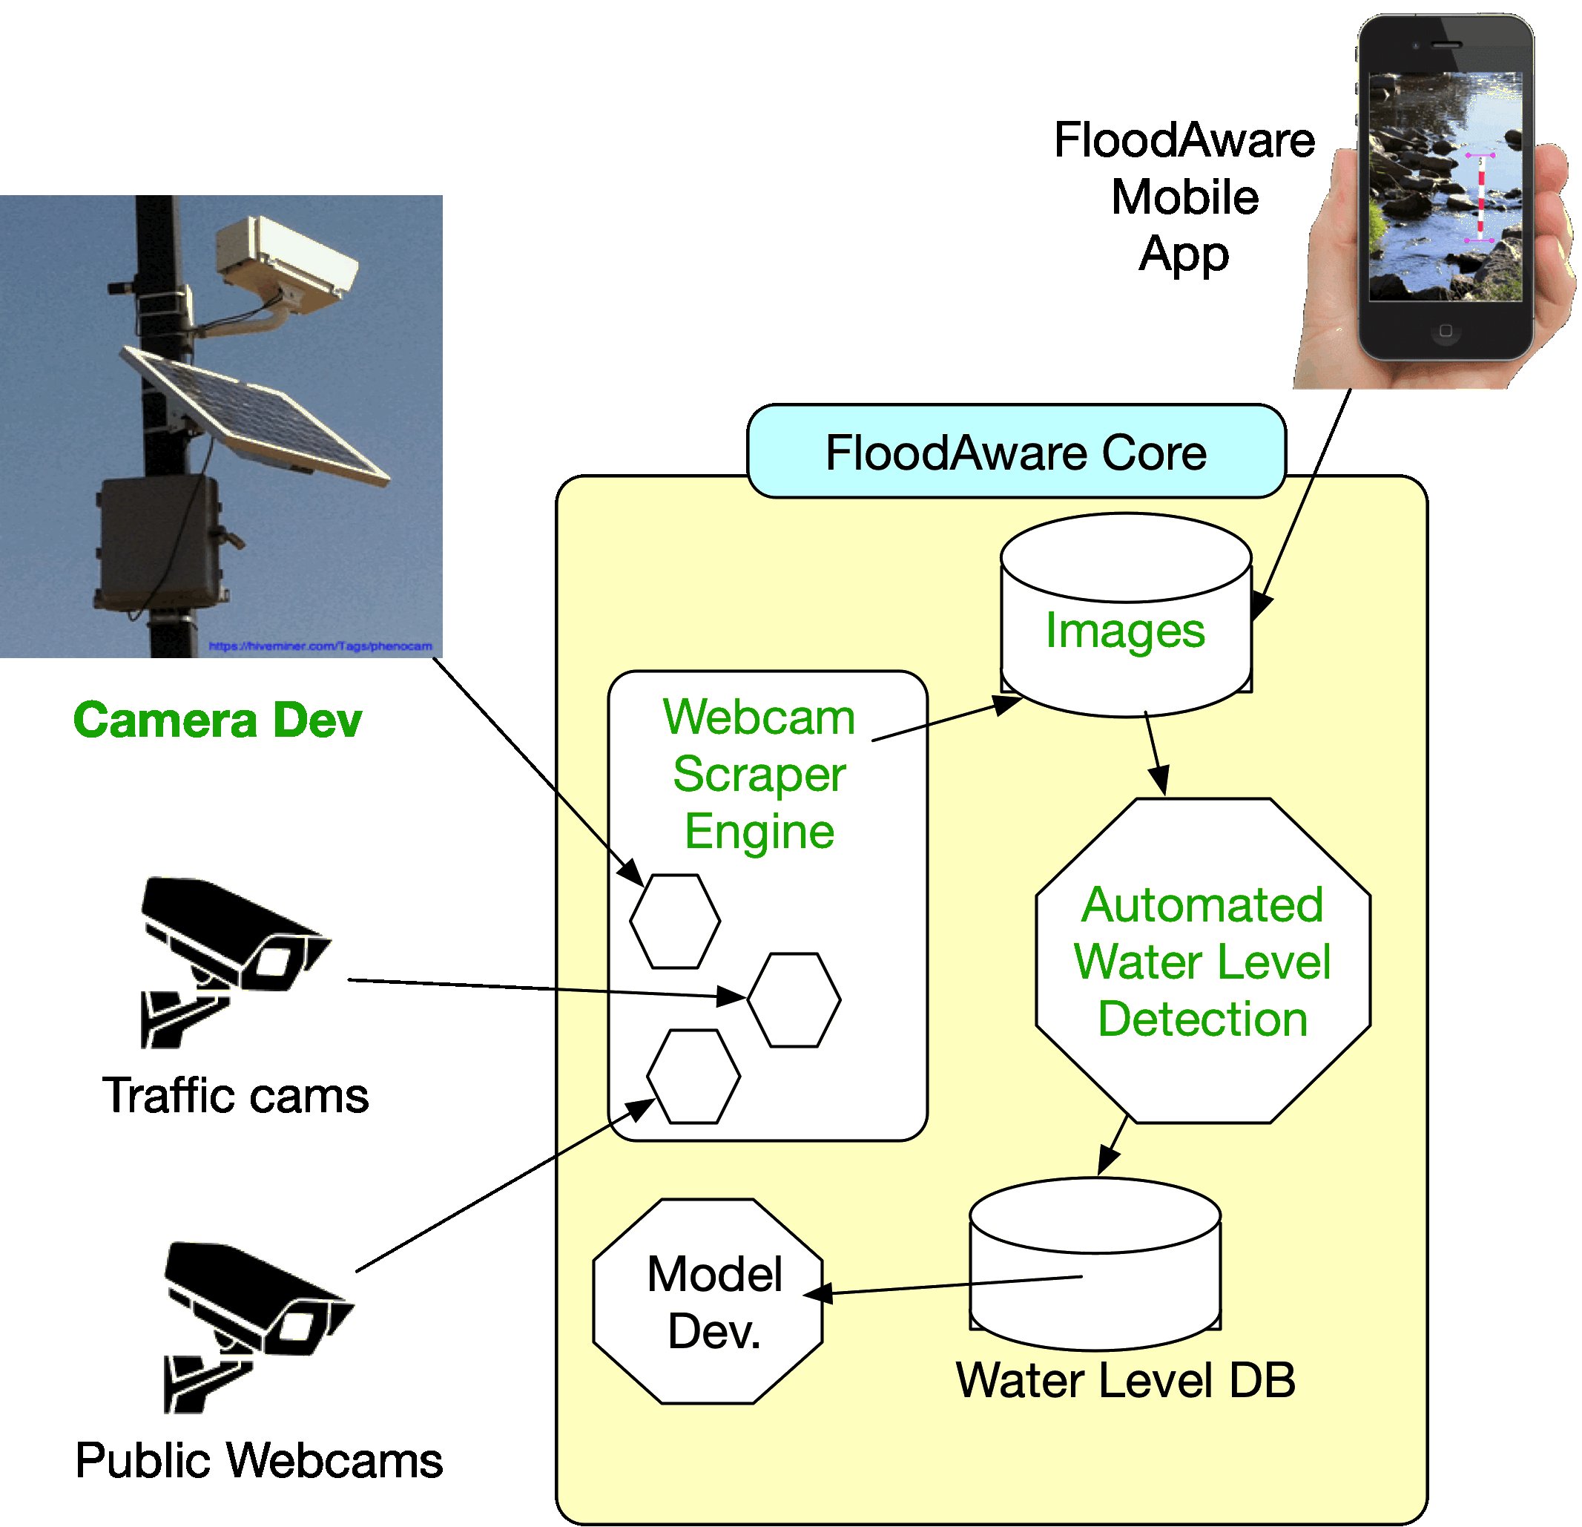
Year 1 Activities: Focus on webcams
Fall 2018
Project Launch
Planning, recruiting, hiring
Spring 2019
Inventory data sources
Site selection/permitting
Develop tech specs
Build/Invent Technology
Summer 2019
Refine/test webcam system
MONSOON SEASON!
Fall 2019
Complete FloodAware mobile app
Analyze data/system performance
Plan for round 2
Notes:
Real time monitoring: Focus on urban landscapes. Increase sensors density

Slide 5
Update of the Project (at this moment)
New sociotechnical outcomes
Inventory of potential data streams (volume, quality, reliability)
Surveyed target areas for test cam placements
Initial stormwater drainage models for FLG and PHX areas.
Prototype camera endpoint solution nearing testing
Operational smart webcam scraper
Functioning basic automated image analysis
Major community outcomes
Positive connections/discussion with city management (FLG and PHX)
Connections to AZ DOT traffic team
Specific plans for collecting traffic control webcam data during monsoon
Contribution to S&CC
Initial vision for post-project deployment
Notes:
Describe what you have done so far in terms of the science (technical and social), community engagement, and capacity building. You do not need to be exhaustive and anecdotes are highly encouraged.

Slide 6
Anticipated outcomes and success measures in the next year
Outcome 1: Functioning technical infrastructure (v1.0)
Measures:
Robust deployable camera endpoints
Continuous automated collection of webcam data
Reliable detection of water level from images
Basic mobile app: uploads images, receives alerts
Outcome 2: Proof of basic FloodAware concept
Measures:
Growing dataset of time-series flooding images and water level data
Ability to display near-real-time graphical maps of current flooding status
V1.0 prototypes of data-driven stormwater models (non-real-time)
Community partners eager to help with next steps
Notes:
Describe at least two deliverables that you plan to accomplish over the next year that will significantly advance your project.

Slide 7
Thank you!
Questions?
Eck Doerry, Professor
School of Informatics, Computing, and Cyber Systems
Northern Arizona University

