Slide 1






2019 NSF SMART AND CONNECTED COMMUNITIES PI MEETING
FY 2018 IRG: STEMports: Community Workforce Development through Augmented Reality STEM Learning Experiences, NSF #1831427
Scott Byrd, PI, Maine Mathematics and Science Alliance
Gary Lewis, Co-PI, Maine Mathematics and Science Alliance
David Gagnon, Co-PI, Field Day Lab, University of Wisconsin, Madison
https://stemports.org | https://fielddaylab.wisc.edu/ | https://mmsa.org
Notes:
This is the transition slide. The lightning talk moderator will announce the name of your project and the name of the lead PI. Expect to begin your presentation from the next slide.

Slide 2
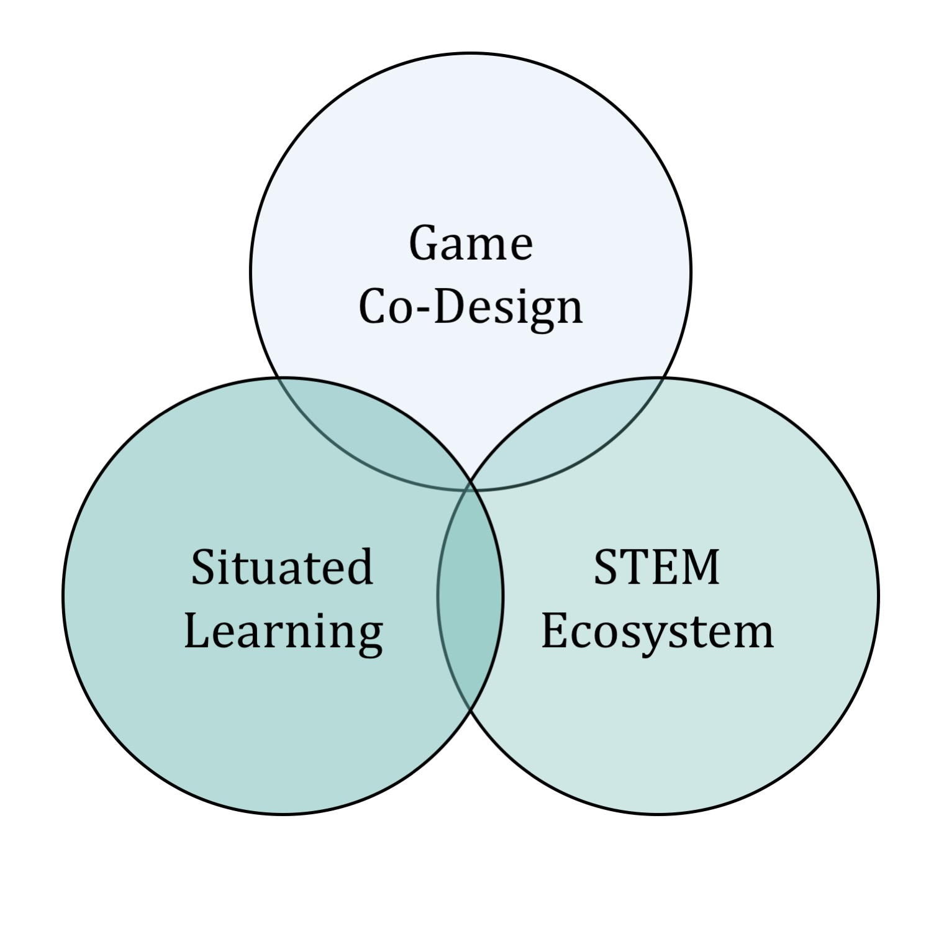
STEMports Project Aims
Engages communities in Maine around STEM situated learning and workforce development.
Involves youth in co-design of augmented-reality, STEM learning game.
Connects communities by youth collaborating with STEM professionals, organizations, and stakeholders in a learning ecosystem.

Slide 3

Update of the Project
Building systems for learning and
collaboration within and across communities.
Community partners & program staff
are working with co-design teams in
both hubs (Western Foothills and Central Midcoast).
Designing universal AR authoring tool,
system-of-systems, for community-based
learning, connecting, and solving.
Notes:
Describe what you have done so far in terms of the science (technical and social), community engagement, and capacity building. You do not need to be exhaustive and anecdotes are highly encouraged.

Slide 4
Anticipated outcomes and success measures in the next year
Facilitate co-design year 1 iteration across both hubs.
Develop and test STEMports application at 75% functionality.
Design and validate instruments to be deployed in Year 2.
Notes:
Describe at least two deliverables that you plan to accomplish over the next year that will significantly advance your project.

