Slide 1
2019 NSF SMART AND CONNECTED COMMUNITIES PI MEETING
FY 2018 IRG: SCC: Data-Informed Scenario Planning for Mobility Decision Making in Resource Constrained Communities
NSF Award 1831347
Jerome P. Lynch (PI) and Tierra Bills, Civil and Environmental Engineering, University of Michigan
Robert Goodspeed, Taubman College of Architecture and Urban Planning, University of Michigan
Curt Wolf, Todd Shurn, Urban Collaboratory, University of Michigan
Pascal Van Hentenryck, School of Industrial and Systems Engineering, Georgia Tech
Alex Little, Twin Cities Area Transit Authority (TCATA), Benton Harbor, Michigan
Ryan Thyfault, Kinexus, Benton Harbor, Michigan
John Egelhaaf, Southwest Michigan Planning Commission, Benton Harbor, Michigan
For more information:
http://urbanlab.umich.edu/
Notes:
This is the transition slide. The lightning talk moderator will announce the name of your project and the name of the lead PI. Expect to begin your presentation from the next slide.

Slide 2
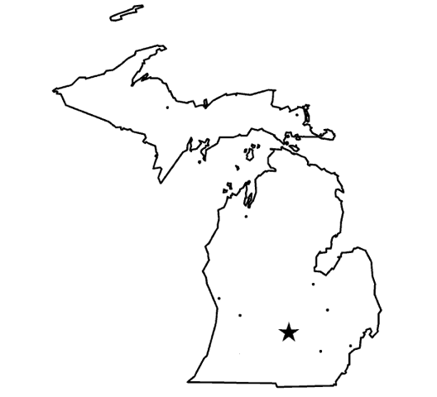
S&CC Mobility Empowerment
Goal
City of Benton Harbor:
4.68 square miles
10,000 residents
$8,965 income per capita
50% automobile ownership
Explore how under-resourced communities may implement accessible, low cost barrier S&CC technologies that improve transportation efficiency for all residents.
TCATA:
Community-funded public transit
Two fixed routes
On-demand service
Operates 27 buses
Context
Focus is non-automobile owners need for reliable, predictable transportation to/from employment, healthcare, education and retail in a low income community without shared ride services.
Introduction to Benton Harbor and TCATA
Approach
Collaborate with public transit, educational institutions, job training programs and regional planners to embed S&CC technologies to acquire data for community-based scenario planning leveraging predictive analytics.
Data-Driven Scenario Planning Process for Mobility

Slide 3
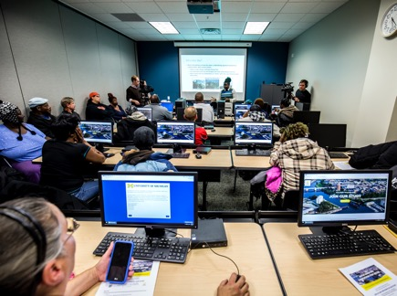
Project Progress
Major community outcomes:
Hosted workshops to acquire mobility perceptions from the transportation dependent community.
Distributed GPS trackers to citizens
Stakeholders identification underway for scenario planning
New socio-technical outcomes:
Deployed GPS vehicle trackers in TCATA fleet enabling a regional map overlay showing vehicle location real-time.
Contribution to S&CC:
Advancing computer vision methods for automated identification of public transit ridership origin-destination
Developing fine-grain discrete choice models of community based on survey data and OD data obtained from multiple sources
Community Workshop
GPS Trackers for Residents
Notes:
Describe what you have done so far in terms of the science (technical and social), community engagement, and capacity building. You do not need to be exhaustive and anecdotes are highly encouraged.

Slide 4
Anticipated Outcomes and Success Measures
Deployment of sensors to inform predictive analytics:
GPS tracking of residents and TCATA assets
OD pairs of existing ridership on fixed route transit
Employment, healthcare and education resource mapping
Offline optimization of TCATA service in Benton Harbor:
Based on community data collection, optimize TCATA resources to balance asset allocation between fixed route and on-demand service
Quantify performance of proposed optimal configurations
Create a framework for the use of S&CC data visualization and predictive modeling into scenario-based community planning process
Notes:
Describe what you have done so far in terms of the science (technical and social), community engagement, and capacity building. You do not need to be exhaustive and anecdotes are highly encouraged.

