Slide 1
2019 NSF SMART AND CONNECTED COMMUNITIES PI MEETING
How Can Investments In Smart Cities Technologies Improve The Lives Of Low-Income, Inner-City Residents?
FY 2017 PG: NSF Award [1737495]
Gerrit-Jan Knaap, Vanessa Frias Martinez, Seema Iyer, Willow Lung-Amam, Ariel Bierbuam, Sheri Parks, Katherine Klosek, Lauren Stamm, Gail Sunderman, Kevin Kornegay, Shonte Eldridge, Andre Robinson, Wanda Best, Azalee Fisher, Anthony Pressly, Bethany Swain
University of Maryland, College Park; University of Baltimore; Morgan State University; Johns Hopkins University; City of Baltimore; Upton Planning Committee; Mount Royal CDC; Druid Heights CDC
http://www.umdsmartgrowth.org/city/baltimore-smart-cities-project/
Notes:
This is the transition slide. The lightning talk moderator will announce the name of your project and the name of the lead PI. Expect to begin your presentation from the next slide.

Slide 2
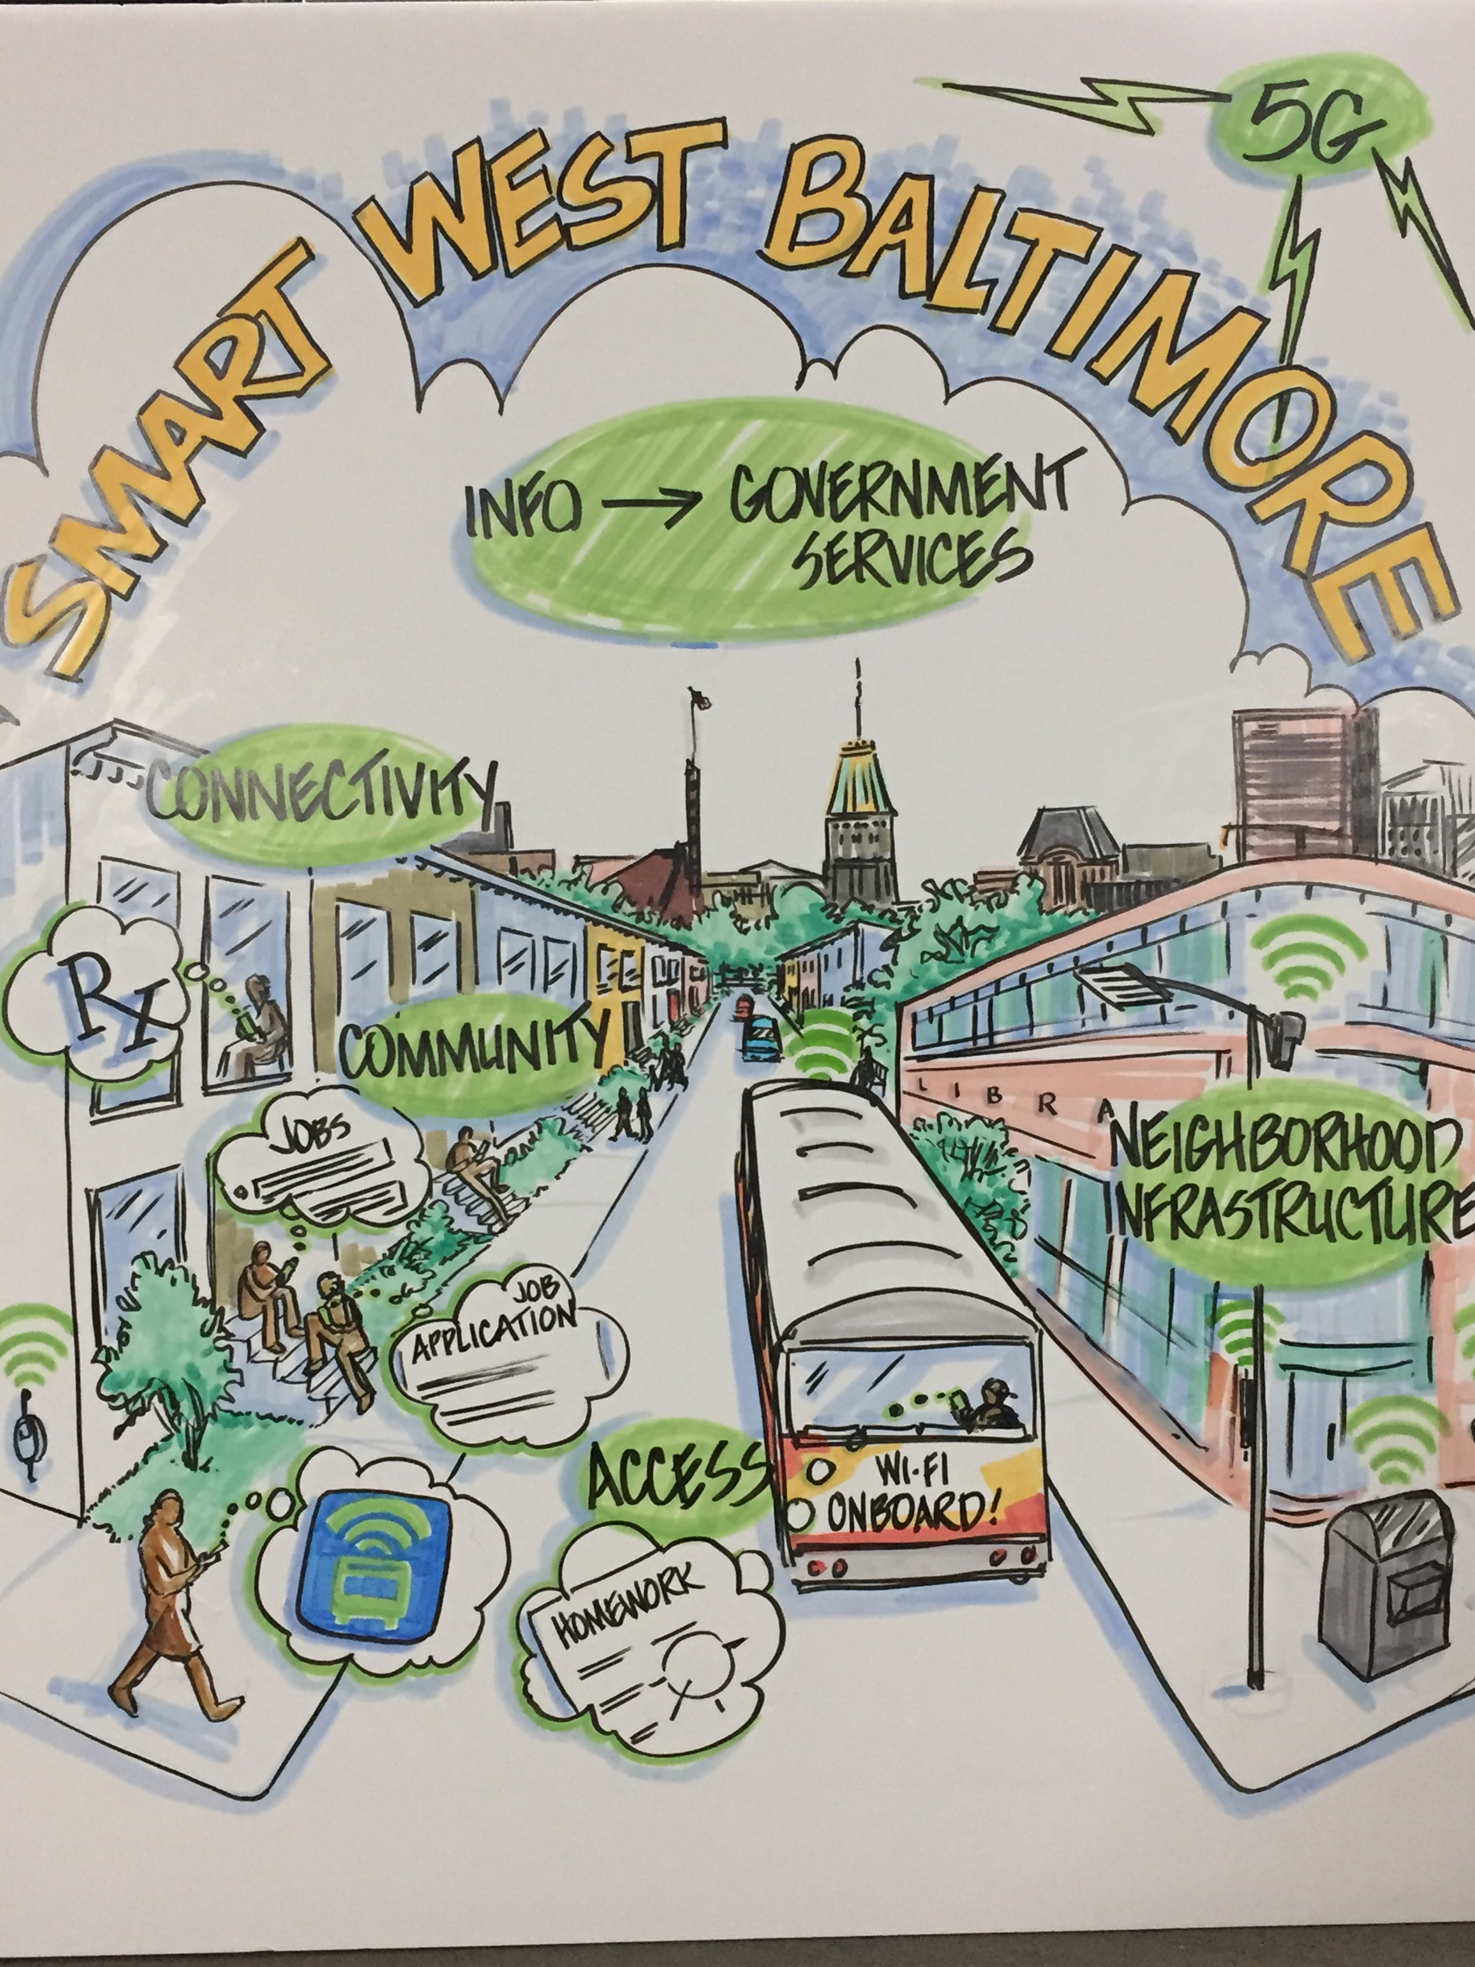
Project Aims
Community focused,
needs-based assessment
Create relationship matrix between neighborhoods, social scientists, technologists, City government, and community stakeholders

Slide 3
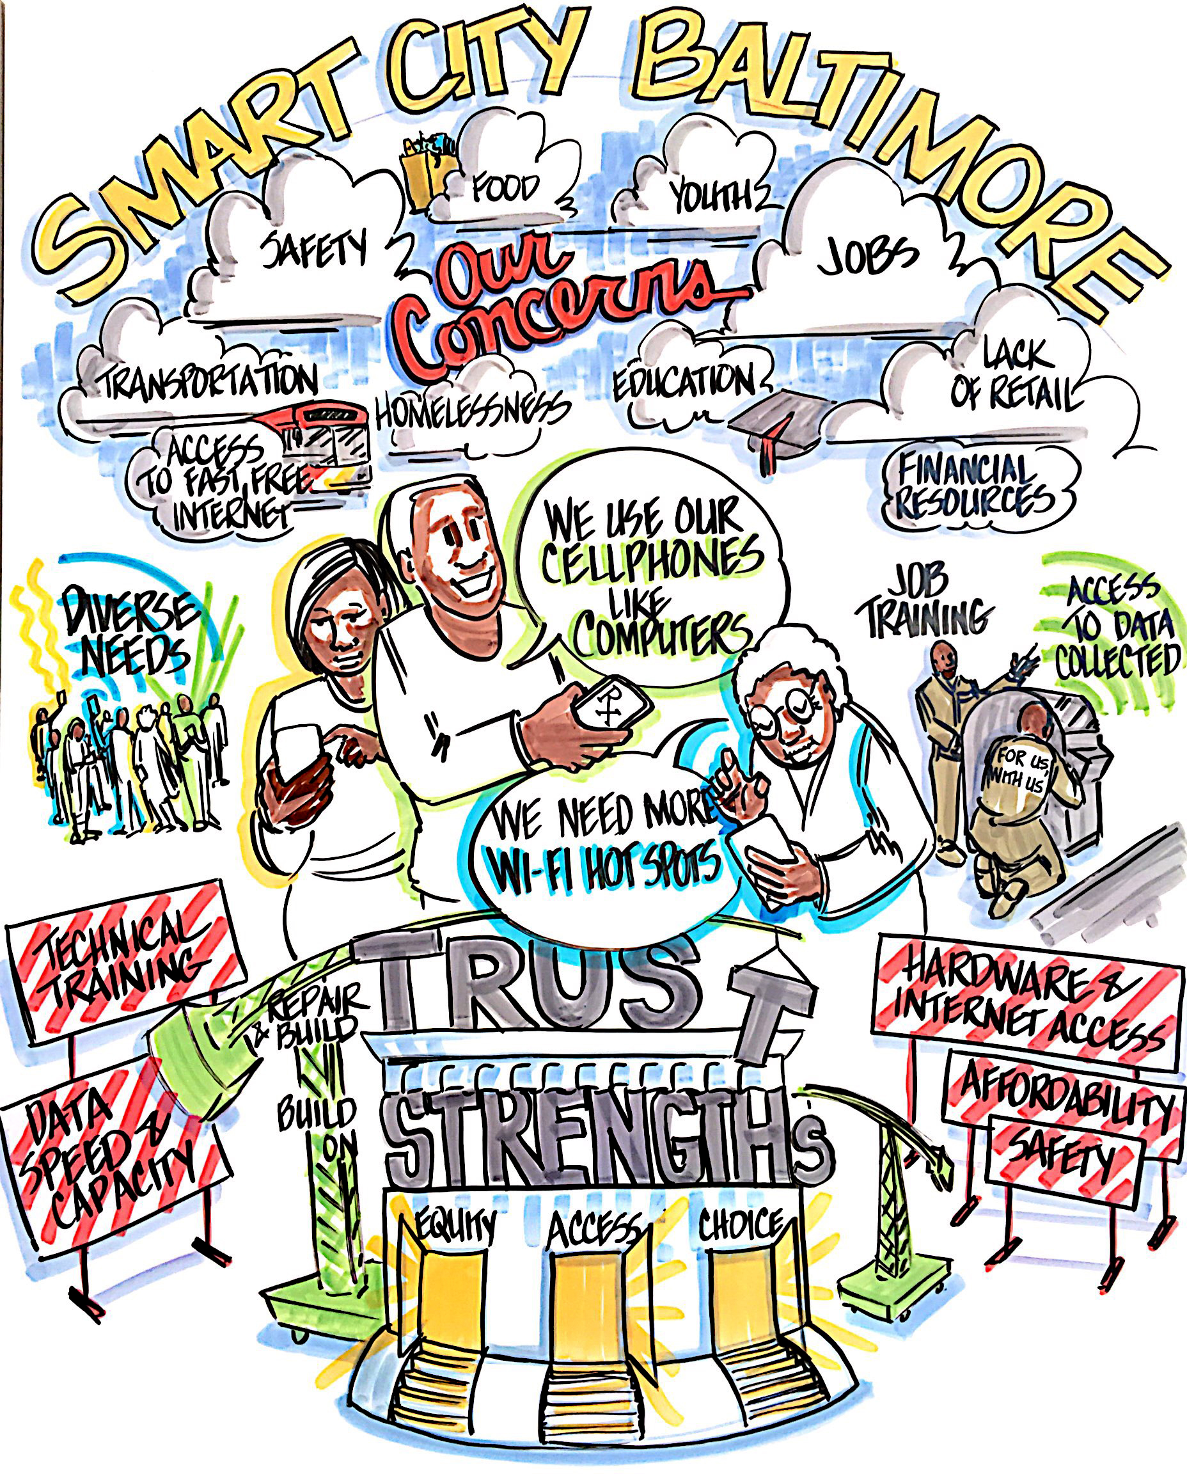
Updates
Deliverable:
10 focus groups; two sets of surveys
Outcome:
City engagement and leadership of stakeholder continuity through development of a Smart Cities Council
Notes:
Describe at least one deliverable that you accomplished together with your community partners and at least one outcome in terms of capacity building. Also describe something unexpected about working with your community partners. Anecdotes are highly encouraged. Include photos.
Emphasize activities that have been carried out after last year's PI meeting and how these activities along with what was accomplished last year fits within the overall vision of your project.
Deliverable
Documentaries
Technological innovation for jobs or access to job training
Access to data collected in and about the neighborhood
Improve access via free wifi
Improve safety through technology
Outcome
holding back on “digital kiosk” deployment

Slide 4
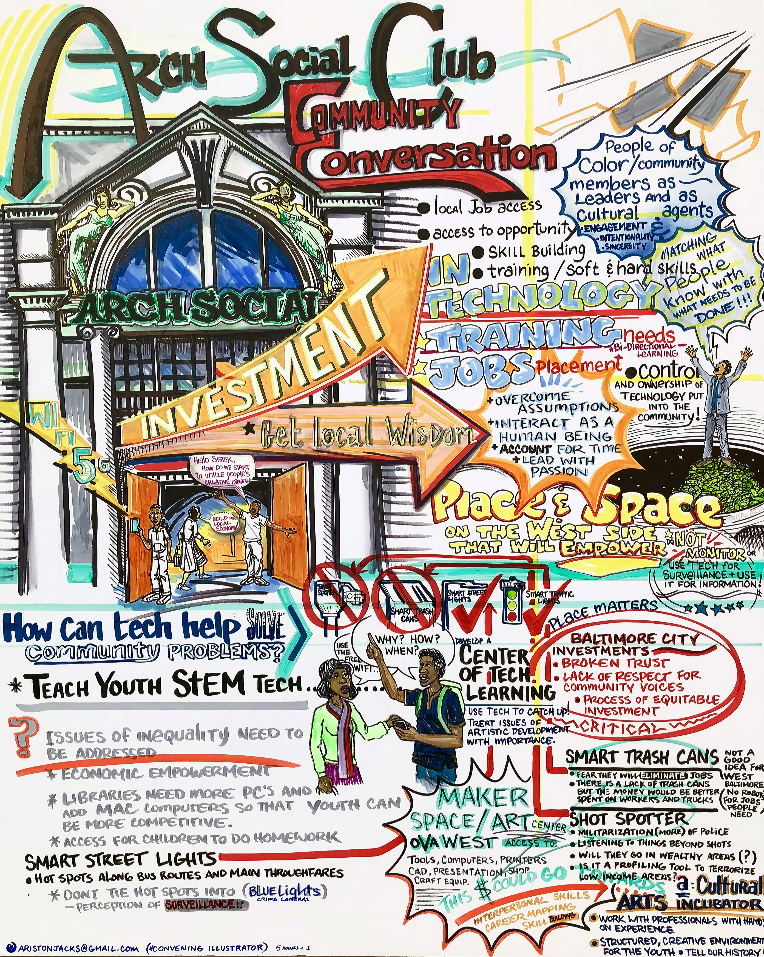
Updates
Sociotechnical outcome:
development of new technologies (like 5G or autonomous vehicles) belie neighborhood realities
Connectivity
Safety
Jobs
Notes:
Describe at least one deliverable in terms of the science (technical and social). Why is this deliverable significant/what did it accomplish or what will it allow? Include photos.
Emphasize activities that have been carried out after last year's PI meeting and how these activities along with what was accomplished last year fits within the overall vision of your project. Inclusion of photos are encouraged.
Belied realities: Hard to have a conversation about 5G when 49% of Sandtown-Winchester does not have residential internet access. Surveillance, driverless busses = no security on the bus; still need foundational economic development opportunities within these neighborhoods.

Slide 5
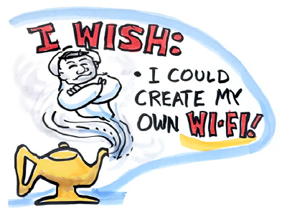
Planned Outcomes/Next Steps
Work with community engaged stakeholders and the City to leverage the smart cities movement:
Community internet access
Smart cities related job training programs
Prioritized City infrastructure
investments – Gov Ex
Data citizens – increase familiarity with existing data portals; improve the quality of the data and increase access to that data - BNIA

