Slide 1
2019 NSF SMART AND CONNECTED COMMUNITIES PI MEETING
S&CC-IRG Track 1: Connecting the Smart-City Paradigm with
a Sustainable Urban Infrastructure Systems Framework
to Advance Equity in Communities (NSF Award #1737633)
Team Composition
Community Partners
S. Shekhar & A. Ramaswami, Co-Leads, Univ. of Minnesota
J. Marshall, University of Washington
V. Merwade, Purdue University
R. Feiock, Florida State University
J. Brown, D. Dalbotten, R. Johns, J. Cao, F. Douma, L. Kne, University of Minnesota
M. Larson, St. Paul Mayor’s Office
B. Hjelle & K. Mayell, Minneapolis PWD
Carl Michaud, Hennepin County PWD
M. Ohlsen, Tallahassee (Utilities)
C. Ellingson & B. Stretch, Minneapolis Public Schools
A. Fyfie, ICLEI-USA
T. Macgalliard, Intl. City/County Management Association
B. Levine, MetroLab Network
Website: http://www.spatial.cs.umn.edu/Project/smart-city/index.html
Notes:
BRIEFLY INTRODUCE YOURSELF AND YOUR INVESTIGATORS (10 sec slide)

Slide 2
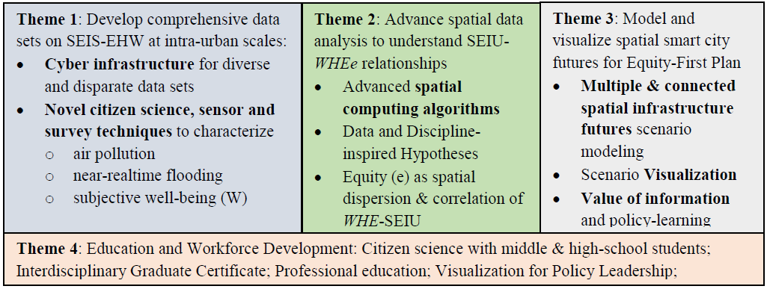
Project Aims
Objectives
Understand spatial equity (e) across infrastructures and outcomes (wellbeing (W), health (H), environment (E))
Advance WHEe outcomes using smart spatial infrastructure planning in cities.
Challenges:
Data Gaps: need intra-urban scale data on SEIU and WHE parameters (Theme 1)
Knowledge Gaps (Themes 2, 3):
Data science to understand spatial interactions among SEIU-WHEe parameters.
All-infrastructure models of spatial futures in changing climate, with disruptive infrastructures & technologies
Approach in collaboration of Community Partners
Notes:
A brief background: Please describe the problem you are addressing and why it is important (20sec slide)

Slide 3
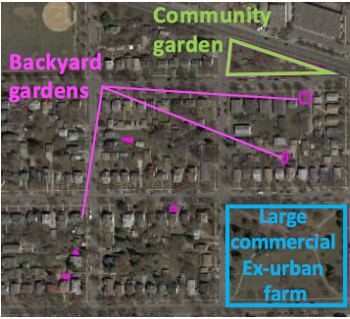
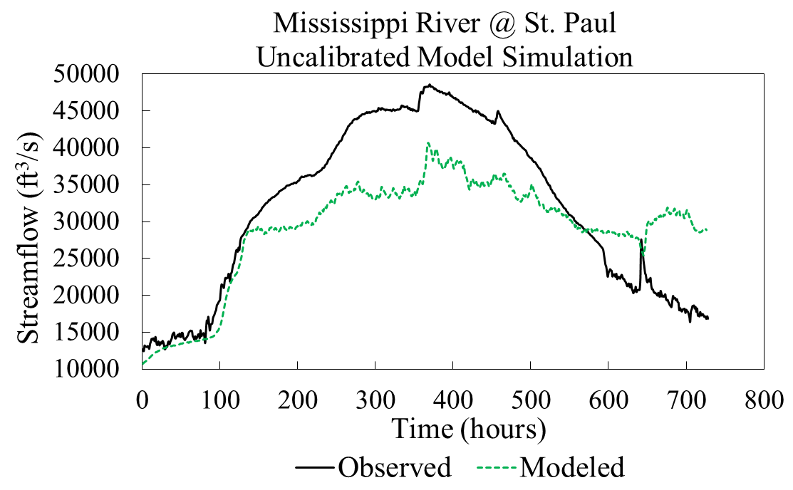
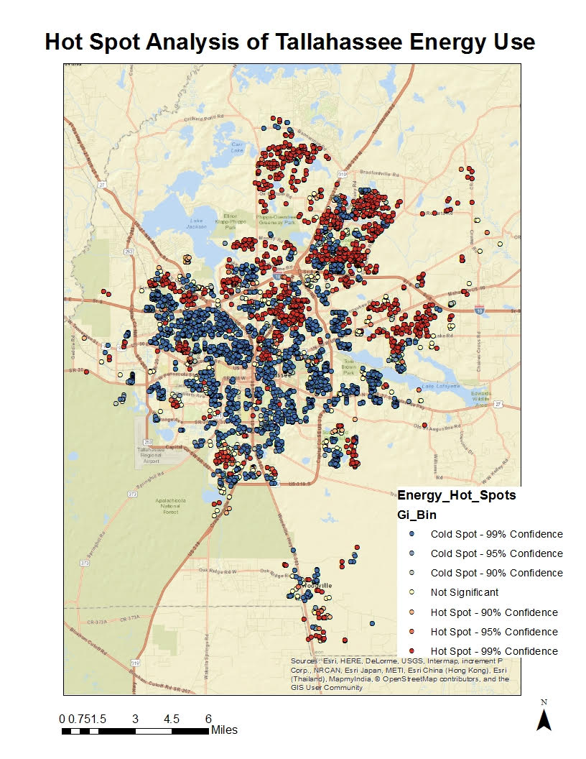
Project Update (since 2018 PI meeting)
New sociotechnical outcomes.
Theme-1:
Assessment of infrastructure & Well-being data (primary survey implementation)
Streamlined survey and analysis technique developed in S&CC.
On line survey developed (267 surveys completed).
Air pollution sensors
Improved sensor design, with tests being conducted in laboratory and in field.
Significance: Cost effective sensors to measure air pollution at a wider scale.
Citizen Science for near real-time urban flood simulations
Hyper-resolution physically-based distributed flood modeling (Minneapolis).
Significance: Analyze urban flooding for extreme weather conditions (e.g. Storms).
Theme-2:
Comparing consumption hotspots
Hotspot analysis of Energy consumption in Tallahassee.
Significance: Equity based analysis of rebate programs based on the consumption.
Mapping Trees for Green Infrastructure Equity
Aerial imagery based detection, and classification of individual trees, and urban gardens.
Significance: Ash Borer problem, Urban garden detection for urban farming potential
Theme-4
Responsive CS Curriculum website set up for 8-12 classroom use.
Support for individual school contexts i.e.: Grade level, course or program.
Finalize school implementation and teacher observation schedules.
Begin implementation of curriculum modules and lessons.
Notes:
Describe at least one deliverable in terms of the science (technical and social). Why is this deliverable significant/what did it accomplish or what will it allow? Include photos.
Emphasize activities that have been carried out after last year's PI meeting and how these activities along with what was accomplished last year fits within the overall vision of your project. Inclusion of photos are encouraged.

Slide 4
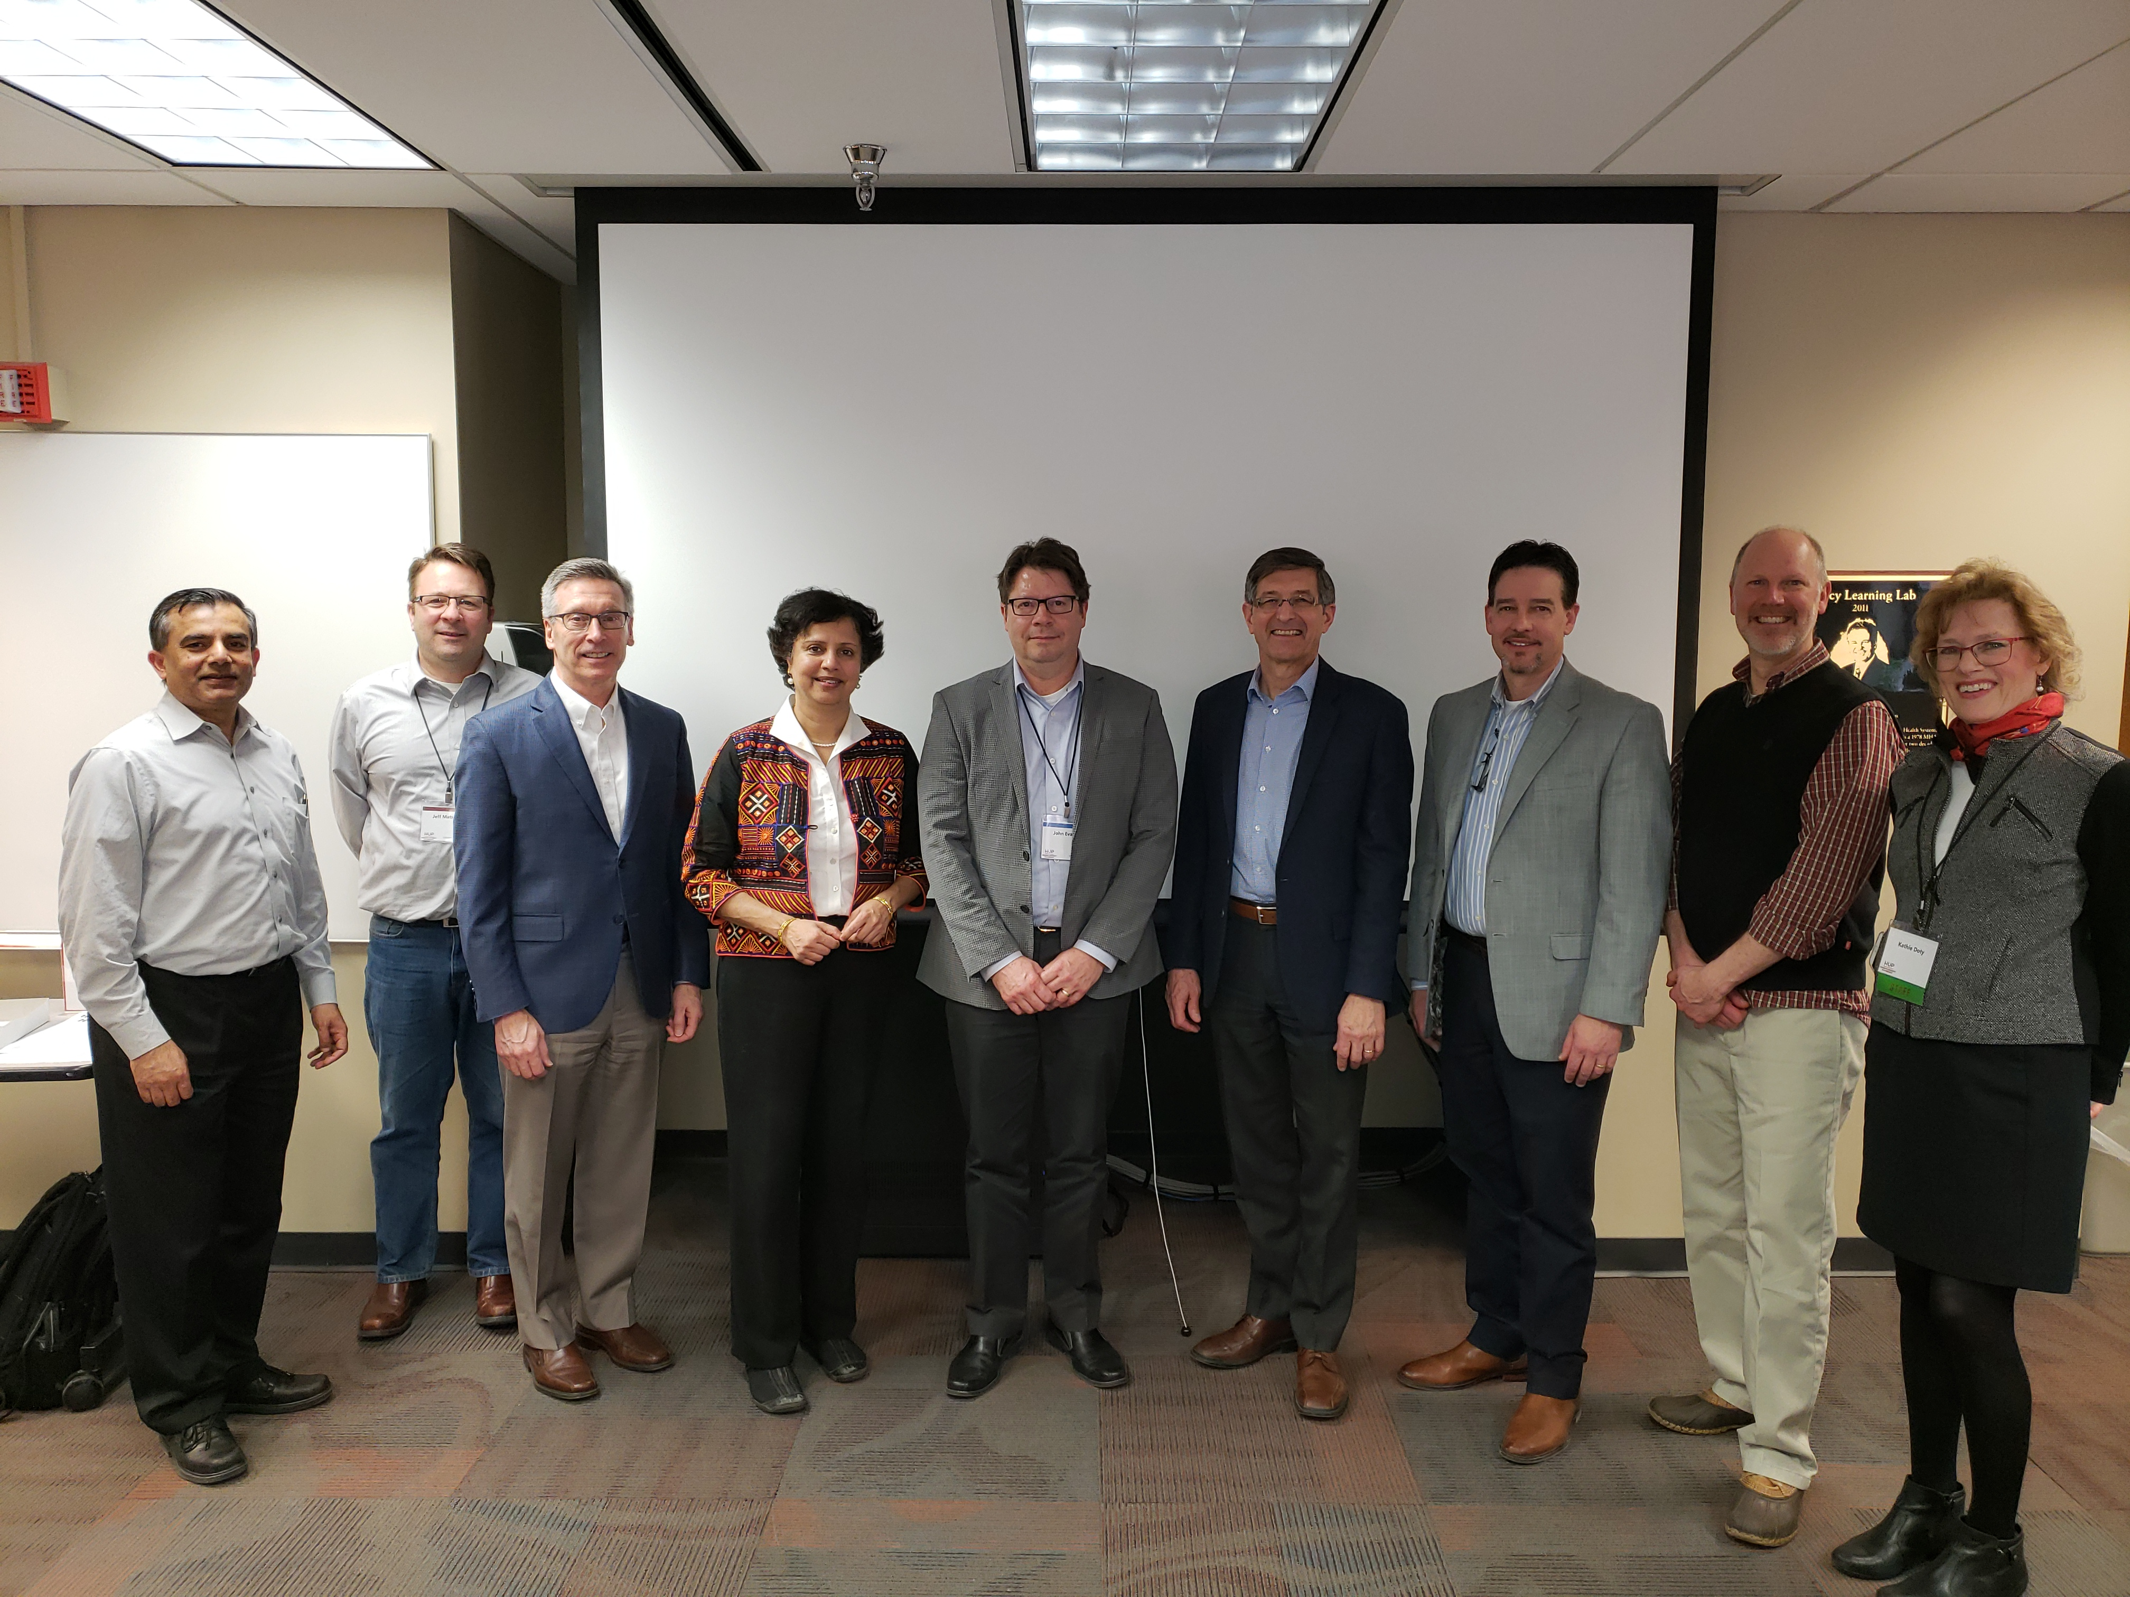
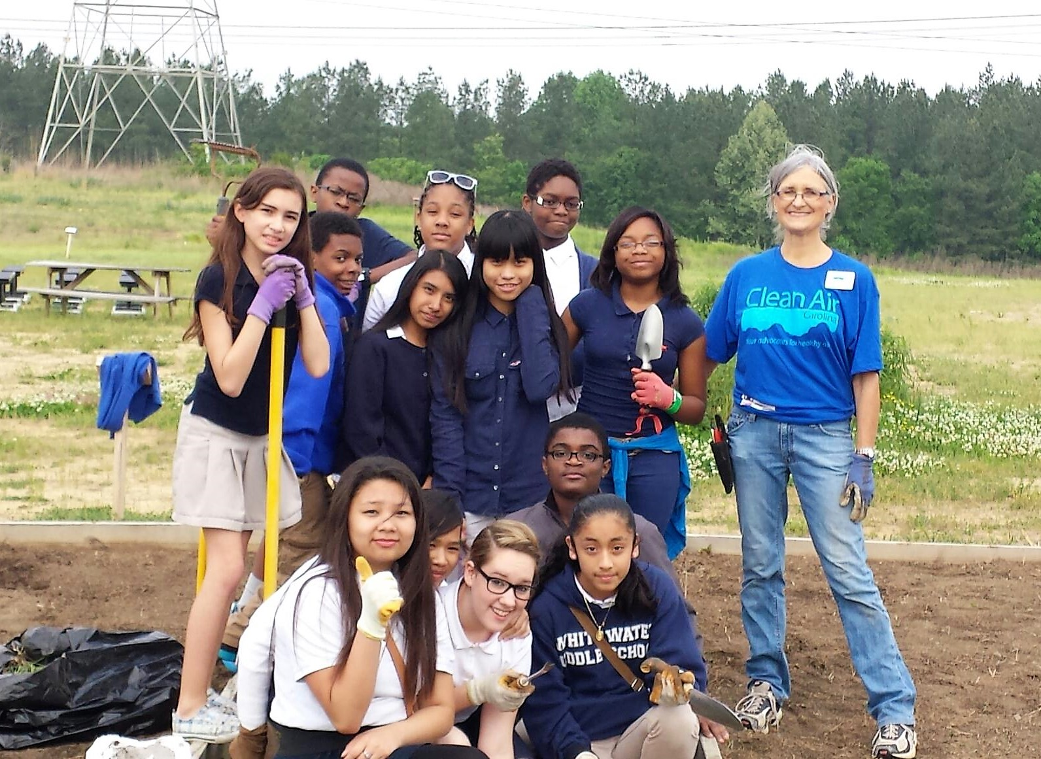
Project Update (since 2018 PI meeting)
Major community outcomes:
Theme 1: Minneapolis PWD and Public Schools
Long term tracking of inequality in wellbeing and relationship to infrastructure.
Neighborhood associations, (Seward, Prospect Park)
Contacted all 87 Neighborhoods Associations (via Newsletters, Facebook)
Dissemination in 8 MSP schools
Theme 2: Shared the results on Ash tree detection with Hennepin county PWD
Theme 4: Minneapolis School District: Developed initial curriculum materials, set up Air Pollution Monitors at all schools sites.
Major capacity outcomes:
Post Doctoral students supported
- Lin Zeng, Dana Boyer (University of Minnesota)
- Lara Clark (Env. Eng., University of Washington)
Ph.D. students supported
- Siddharth Saksena (Purdue University)
- Kewei Xu (Florida State University)
- Jayant Gupta, Matthew Vernon (University of Minnesota)
High school
Teachers: 13 high school teachers, Summer 2018 Professional Development
Summer Students: Samantha Detor, Abigail Roh (Breck High School)
Notes:
Describe at least one deliverable that you accomplished together with your community partners and at least one outcome in terms of capacity building. Also describe something unexpected about working with your community partners. Anecdotes are highly encouraged. Include photos.
Emphasize activities that have been carried out after last year's PI meeting and how these activities along with what was accomplished last year fits within the overall vision of your project.

Slide 5
Anticipated outcomes & success measures for next year
Theme-1:
Grow Fine scale data set SEIU & WHE parameters.
Air pollution sensors
Reproducibility and limits of detection in laboratory and in the field
Calibration curve using reference methods for black carbon concentration estimation
Near real-time urban flood simulations
Finalize W-RCMM outputs and embed bathymetry for entire network
Calibration and validation of model after bathymetry incorporation
Theme-2:
Map Urban Gardens and Trees for Green Infrastructure Equity
Algorithms for tree shadow enhancement and clipping.
Deep learning based algorithms for urban garden detection.
Ground truth of urban gardens to build models for urban garden detection.
Theme-3:
Model and visualize spatial smart-city futures for Equity-First plan (Starts in 2019).
Theme-4:
High School use curriculum developed recently
Notes:
Describe at least two deliverables that you plan to accomplish over the next year that will significantly advance your project.

