Slide 1
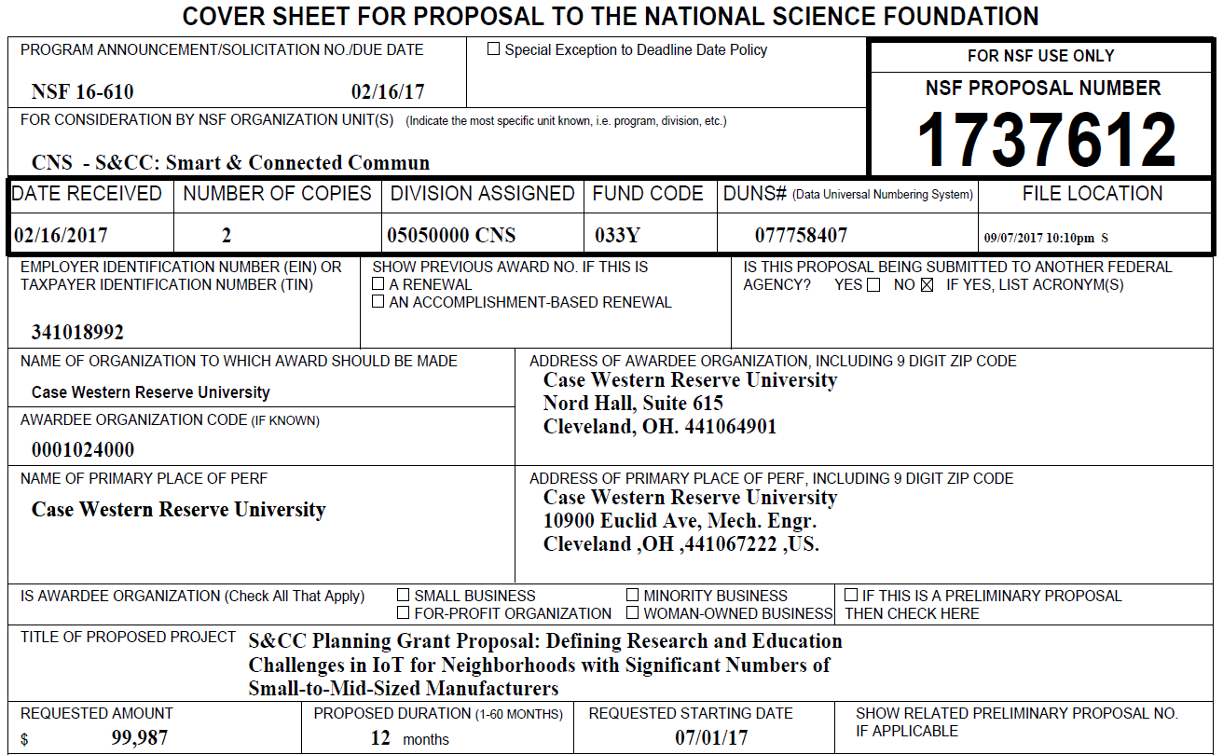
NSF CNS-1737612: Smart & Connected Community Planning Grant

Slide 2
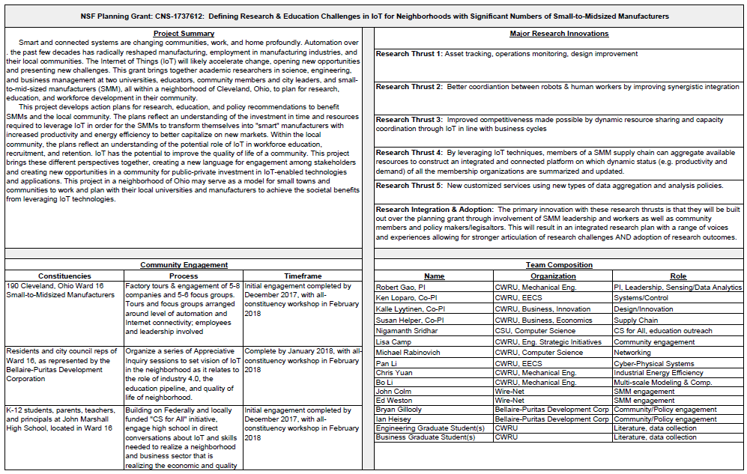
Project Chart

Slide 3
NSF Award Summary

Slide 4
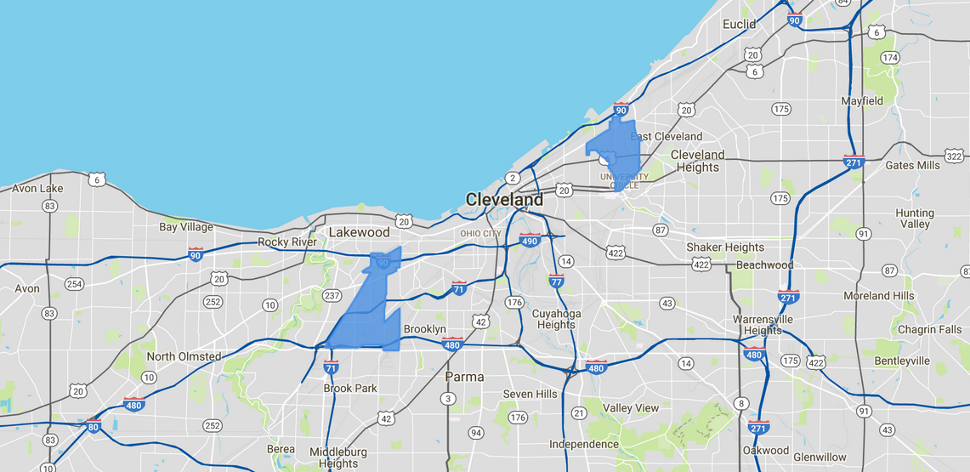
Geographic Target: Cleveland, Ward 16
http://www.clevelandcitycouncil.org/find-my-ward

Slide 5
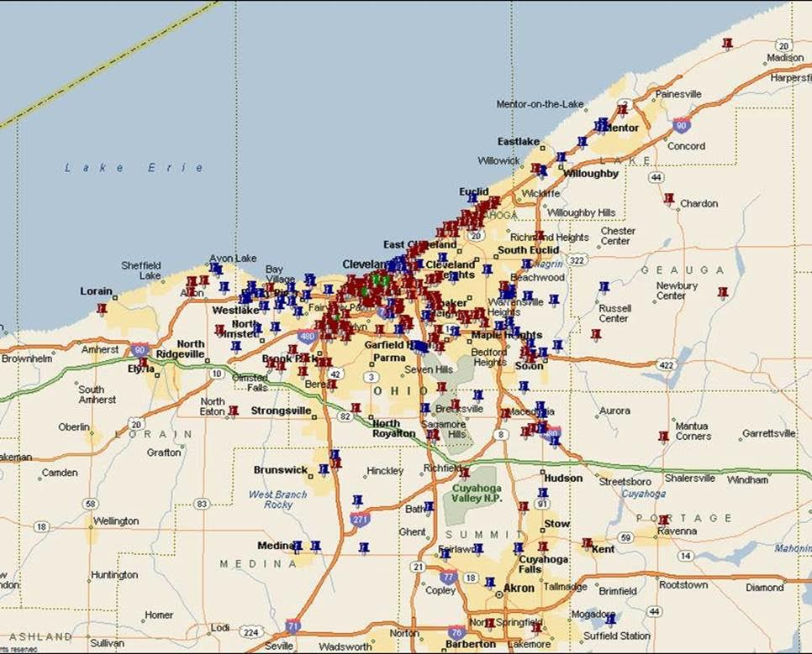
SMM Concentration in Ward 16
183 manufacturers, 7,600 employees, average employment 42
Metal machining, stamping, heat treatment, foundries, ovens, chemicals

Slide 6
S&CC Group Meeting: 04/1/2019
Community Engagement
Engaged 12 SMMs through 2 focus groups, using a formalized discussion process with transcripts developed.
Engaged 31 citizens through 3 focus groups for discussion, and developed transcripts. interacted with high school principals and teachers to determine how to integrate community interest and company needs around the challenge of workforce preparedness for SMMs.
Developed an experimental test bed with multiple sensors connected to an induction motor for monitoring its operation and diagnosing faulty conditions in real-time remotely observable through Internet,
Demonstrating how IoT technologies can help SMMs improve their daily operations on the factory floor
Project Milestones (Soliciting input on 3 fronts)
Citizen input (Lisa Camp)
Education input (Nigamanth Sridhar)
Research input (research topics for formal proposal in 2018, based on literature study by faculty, tie in with feedback from citizen and education)

Slide 7
Research findings
first-hand experience and a better understanding of the state-of-technology of the various SMMs and demands on the capital investments to become “smart”, and to successfully compete in the Industry 4.0 era.
concerns about the potential impact of IoT/Industry 4.0 on workforce, such as replacement of personnel due to increased level of automation, downsizing, and challenges in hiring qualified employees with computer skills that are consistent with the IoT needs.
better understanding and appreciation of the community culture that is critical to any discussion about technology.
residents are intrigued by the prospect of using smarter infrastructure enabled by IoT to help maintain and build relationships throughout the community.
Issues associated with the needs for leaving no one behind—language, race, ethnicity, age, class, etc.
The induction motor test bed presents a tangible demonstration for people to see how a commonly used, legacy type of “passive” machine system in the manufacturing production line can be equipped with low-cost electronics and computational capability that serves as a fundamental building block for an IoT-enabled smart factory of the future.

