Slide 1
2019 NSF SMART AND CONNECTED COMMUNITIES PI MEETING
Leveraging Shared Autonomous Vehicles for Greater Community Health, Equity, Livability and Prosperity (HELP)
NSF Award # 18-31140
Research Team: U. of Minnesota (UMN) & Worchester Polytechnic Institute (WPI)
Zhi-Li Zhang (lead PI), Saif Benjaafar, Frank Douma, Yingling Fan, Alireza Khani, Tom Fisher, & Yanhua Li (WPI)
Community Partners: MnDoT, Met Council, Cities of Minneapolis/St. Paul, Southwest Transit, TC Shared Mobility Equity Task Force/Urban Research Outreach-Engagement Center, Greater MSP, Destination Medicine Center, and Southeast MN Together
Present at PI meeting: Lisa Austin, Bill Dooley, Matt Flyten & Meredith Klekotka
Project Website: http://www.dtc.umn.edu/SCC/ [will be moved to: www.sccs.dtc.umn.edu ]
Notes:
This is the transition slide. The lightning talk moderator will announce the name of your project and the name of the lead PI. Expect to begin your presentation from the next slide.

Slide 2
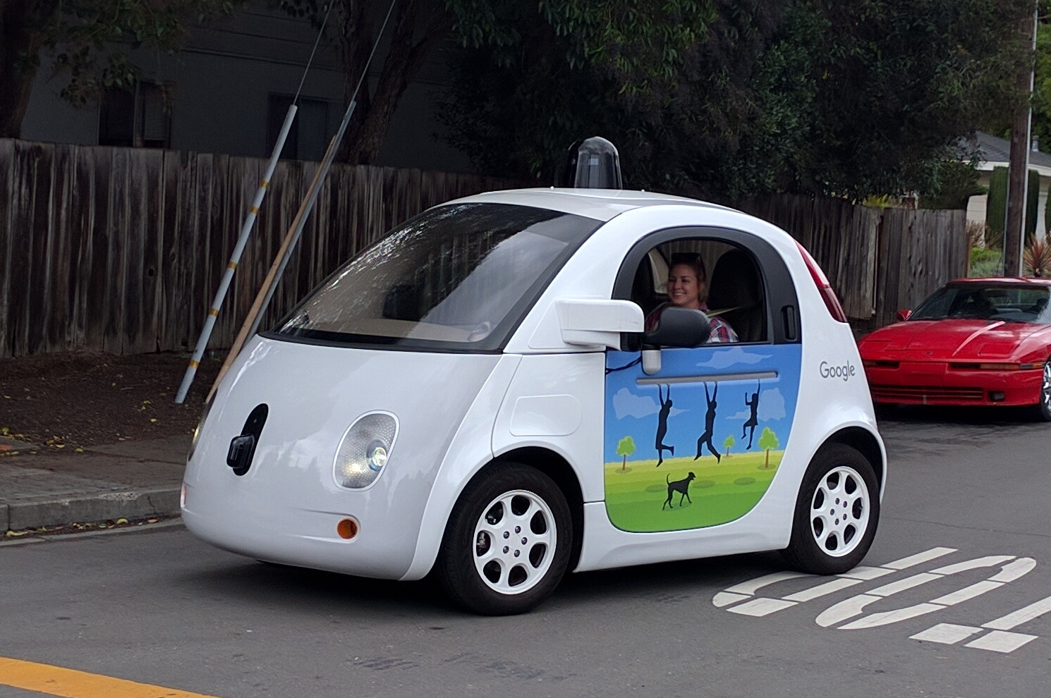
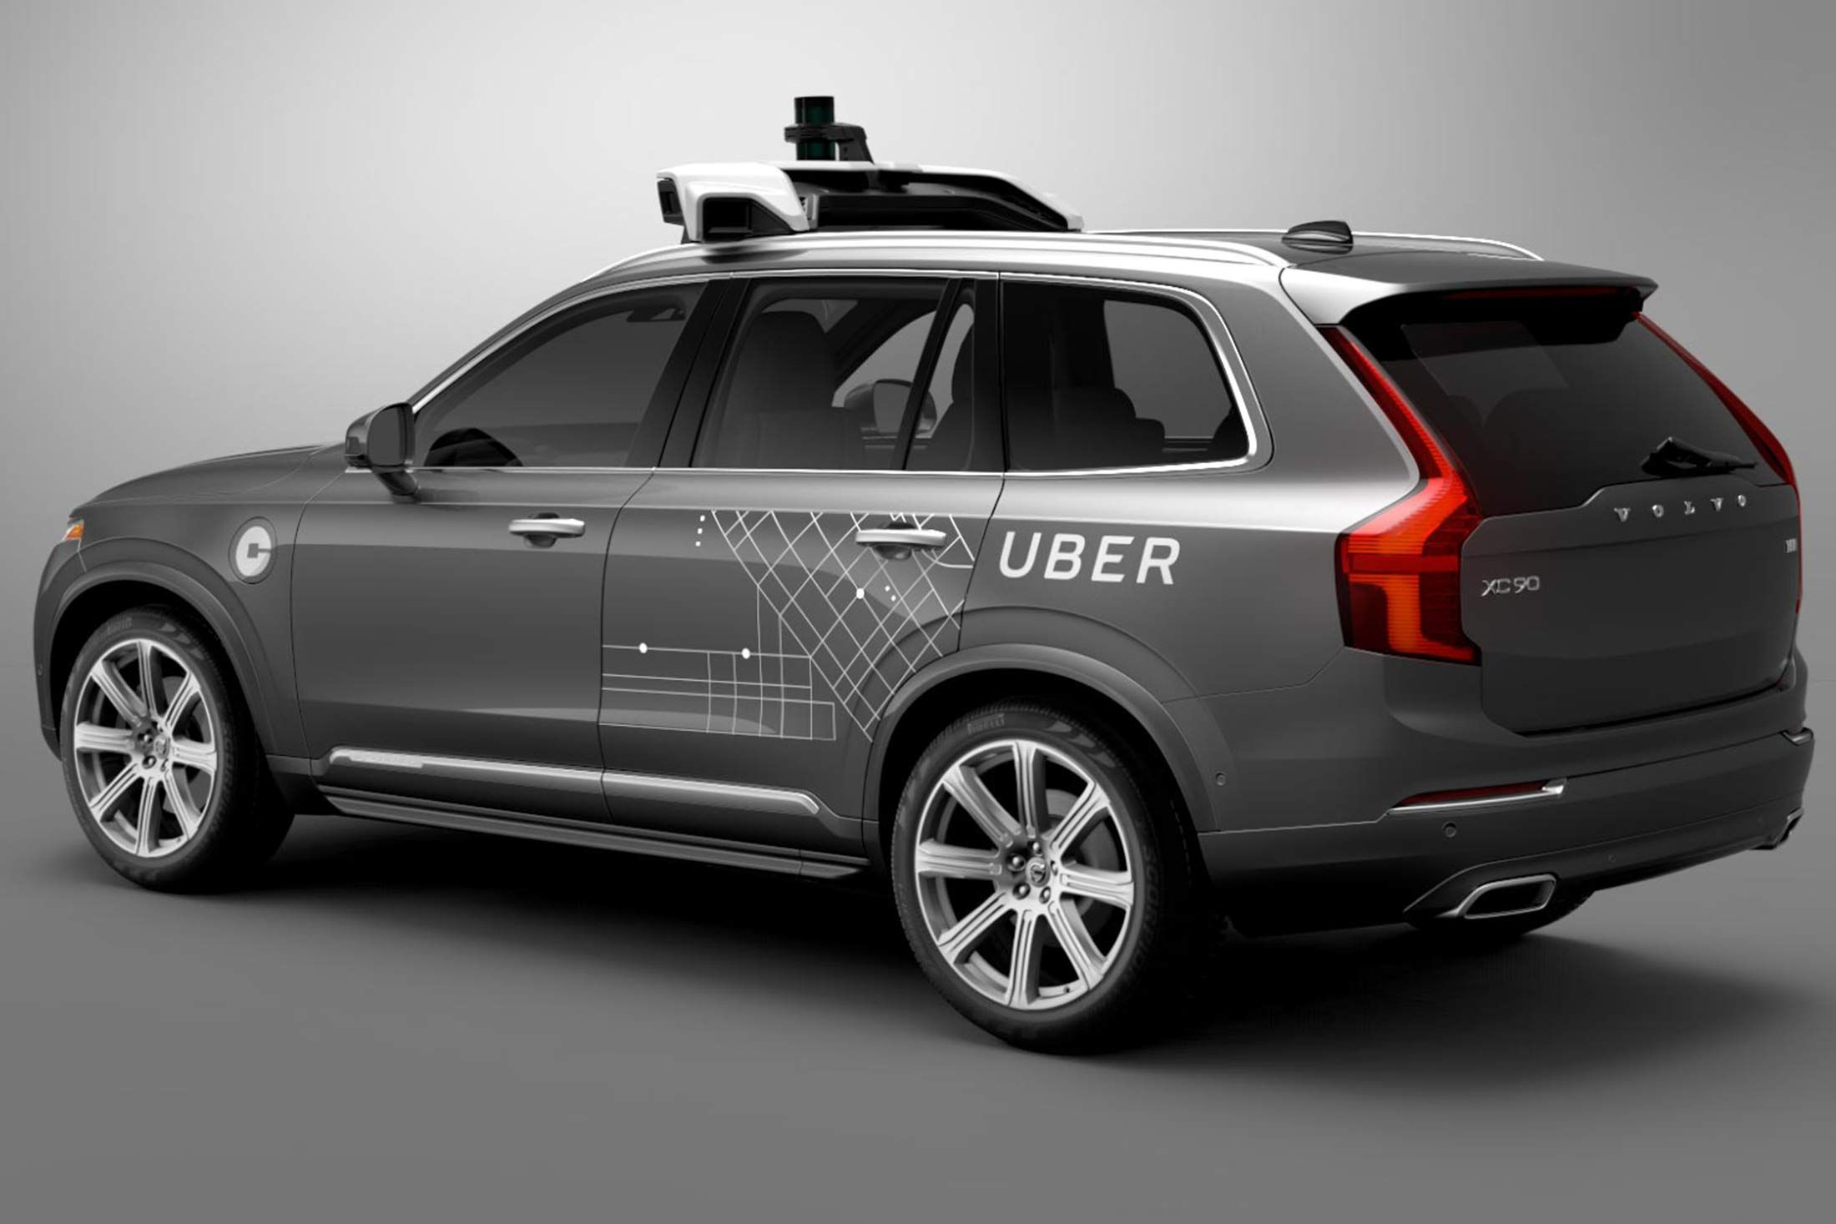
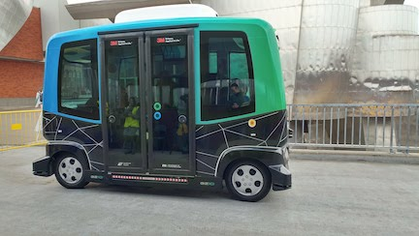
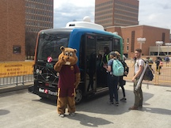
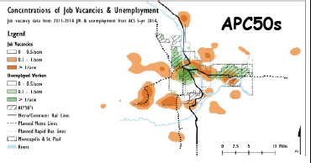
Project Aims
Driverless Cars are Coming – whether like it or not, will have huge impacts on many levels!
envisage and design a transformative transportation & mobility service based shared autonomous vehicles (SAVs) for future smart cities/communities
Smart Cloud Commuting Service
bridge technology/geographical divides, bringing benefits to diverse communities & addressing mobility-equity issues
work w/ stakeholders, policy makers & communities to identify & tackle various socio-economic challenges
urban re-design
better land use
bridge geographical divide
mobility and equity

Slide 3
Update of the Project
Developed initiative queueing theoretical models and conducted a feasibility study using real urban trip data
➔ can reduce # of cars by 7 fold w/ SAVs during peak hours
Explored impacts of AV's on road redesign, parking lot reuse, mobility hubs, land-use change, and multi-modal interactions
Working with community partners, developed an ambitious engagement strategy to identify risks and opportunities for AVs to reduce transportation disparities
Notes:
Describe what you have done so far in terms of the science (technical and social), community engagement, and capacity building. You do not need to be exhaustive and anecdotes are highly encouraged.

Slide 4
Anticipated outcomes and success measures in the next year
Outcome 1. Designing an activity-based travel demand model incorporating effects of AVs, and developing economic models for SCCS that account for efficiency-&-equity issues
Outcome 2. Deepening community engagement and developing recommendations for policies and programs to support more equitable transportation outcomes & better land use
Notes:
Describe at least two deliverables that you plan to accomplish over the next year that will significantly advance your project.

