Slide 1
2019 NSF SMART AND CONNECTED COMMUNITIES PI MEETING
Landslide Risk Management in Remote Communities:
Integrating Geoscience, Data Science,
and Social Science in Local Context
FY 2018 IRG: NSF Award 1831770
Lisa Busch, Sitka Sound Science Center and Robert Lempert, RAND
with Josh Roering, Univ of Oregon
Ryan Brown, RAND
Phebe Vayanos, USC
Sitkascience.org and www.rand.org
Notes:
This is the transition slide. The lightning talk moderator will announce the name of your project and the name of the lead PI. Expect to begin your presentation from the next slide.

Slide 2
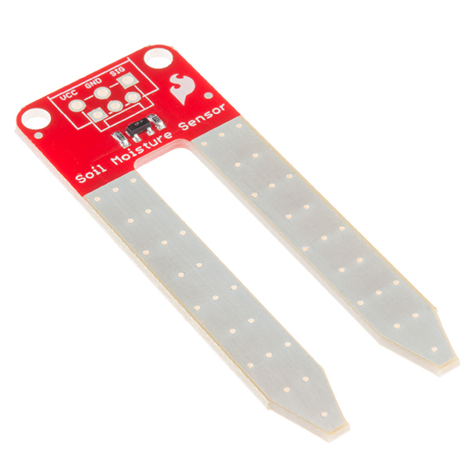
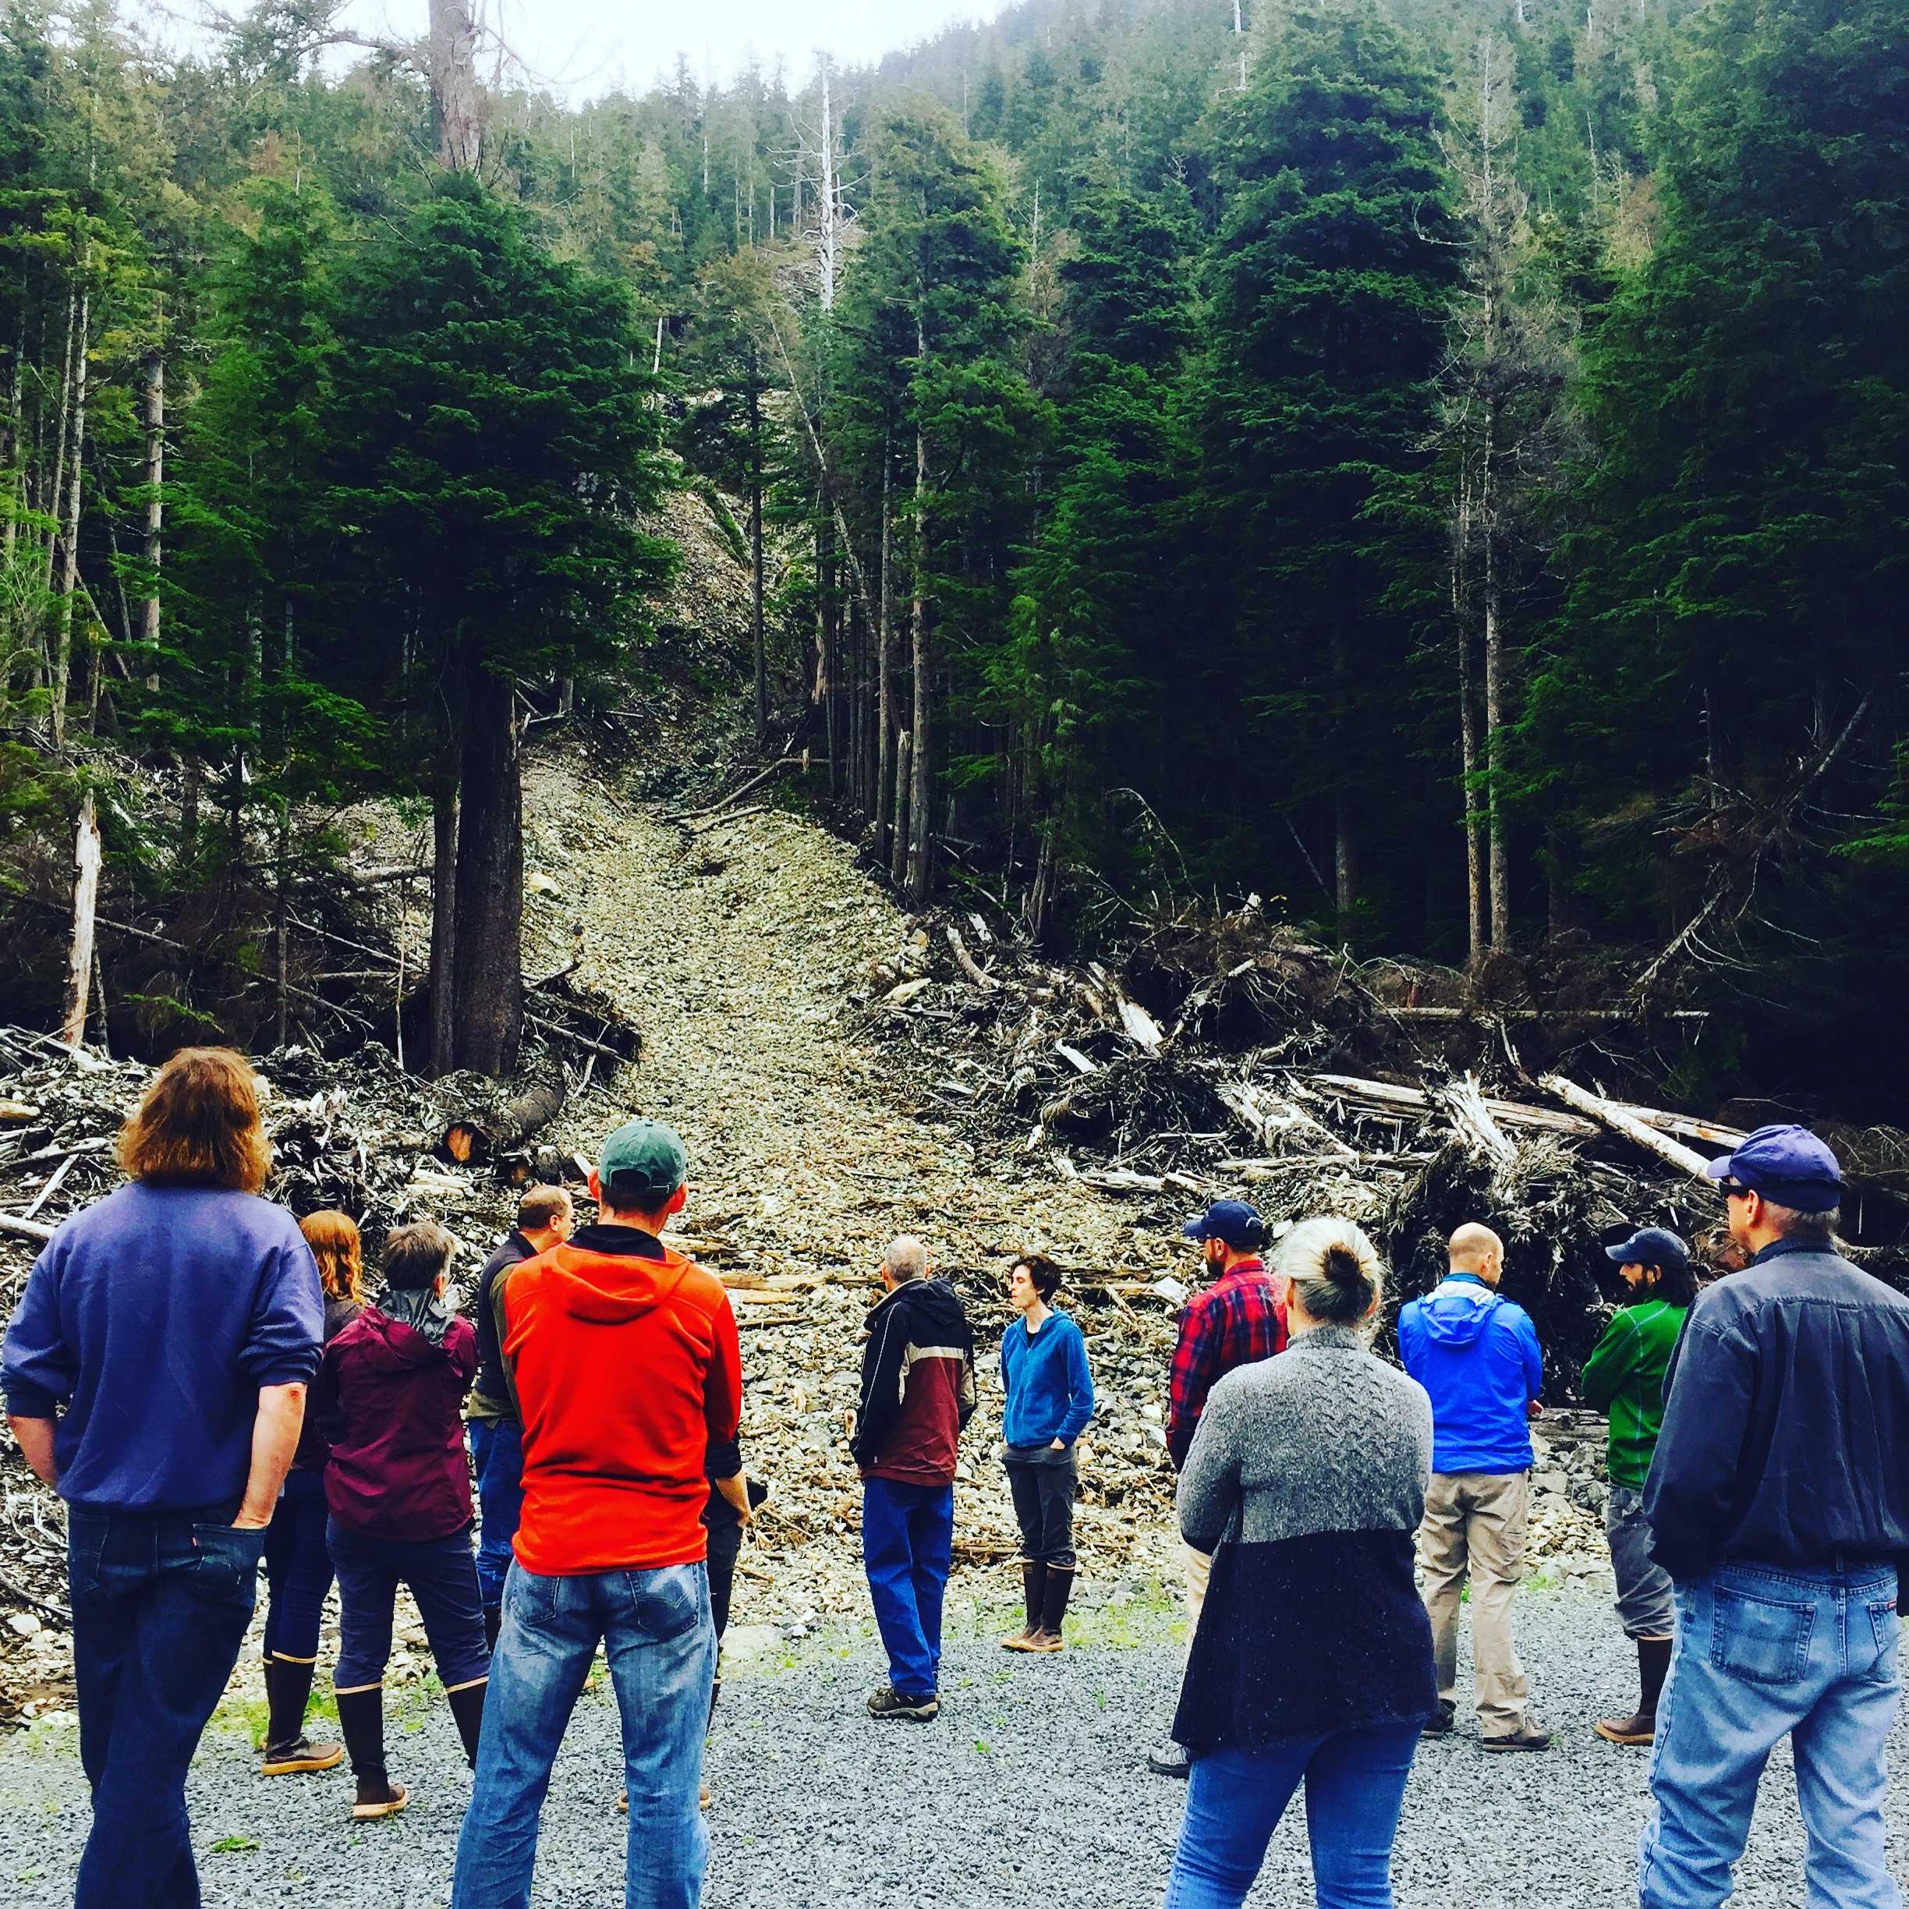
Intelligent and Networked Technologies Can Improve Landslide Warning for Small Communities
Effective warning systems have four components
Risk Knowledge
Network of small, inexpensive moisture sensors will improve real-time landslide prediction
In 2015, multiple landslides hit Sitka, Alaska with little warning
Monitoring
Social network influence maximization will improve risk communication and response
Communication
Participatory, computer-supported deliberations will help community inform system design
Response
Capability
Project aims to benefit Sitka and help disseminate approach nationwide

Slide 3
In this coming year we will…
Begin installing network of sensors for testing, calibration, and data collection
Map community’s social networks
Conduct scoping workshop to inform design of decision support tools
Launch project’s science in schools and other community education programs
Notes:
Describe at least two deliverables that you plan to accomplish over the next year that will significantly advance your project.

Slide 4
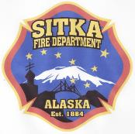
Project Provides Locus of Collaboration for Many Groups
Core team
Geoscience
Notes:
Through multiple visits to Sitka, we have developed a strong network of research and academic partners, federal/state/local government agencies, and community business and organizations. Every organization on this screen is a partner in our follow-on grant proposal.

