Slide 1
2019 NSF SMART AND CONNECTED COMMUNITIES PI MEETING
FY 2018 IRG: I4All: A Smart Sociotechnical Infrastructure to Identify, Cultivate and Sustain Youth STEM Interests [1831685]
Nichole Pinkard, Reed Stevens, & Tre Everette (Northwestern)
Soundarya Radhakrishnan (Evanston District 65 Public School)
http://el-3.org
Notes:
This is the transition slide. The lightning talk moderator will announce the name of your project and the name of the lead PI. Expect to begin your presentation from the next slide.

Slide 2
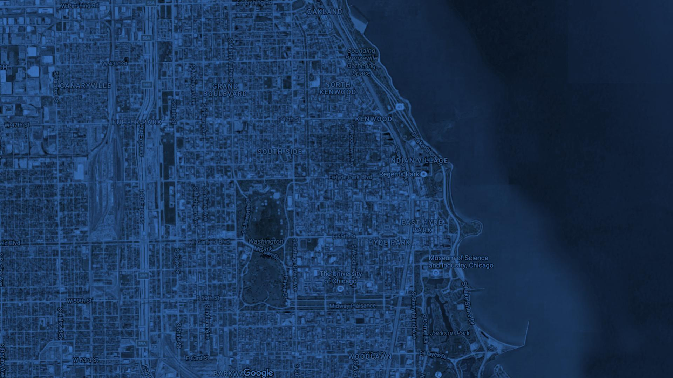
DESIGN³
CODING
MAKING
FUSE
EvanSTEM
How can we create an equitable interest-powered learning ecosystem for middle school-aged youth in Evanston?
EPL
EL3
YOU
District 65
MetaMedia

Slide 3
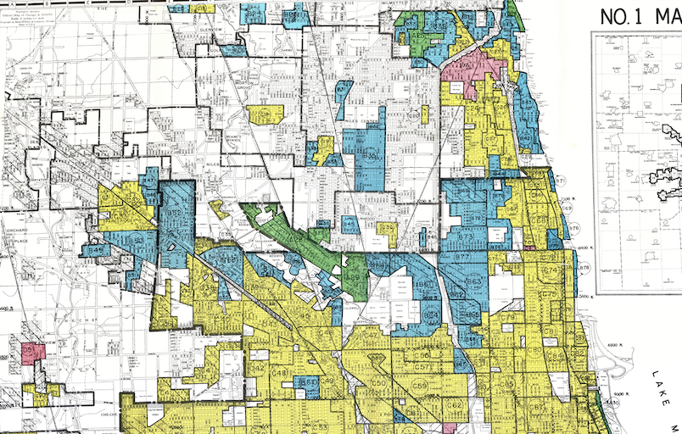
i4All Learning Infrastructure
Stakeholders
Inventory of Learning Locations
Web Portals
Local Government Leaders
Funders
University Partners
Youth Serving Organizations
Educators
Caring Adults & Youth
Parent Portal
Schools
Student Portal
Parks
Educator Portal
Experience Engine
Community Orgs
Community Showcasing
F2F Learning Workshops
Self-paced Online Modules
Online Affinity Groups
Open Studios
K-8 CS Curriculum
Businesses
Student Portfolios
Curated Computational Making Content
School District/EvanSTEM
Student Data
Family
Communications
Participation
Expectations
Platforms
& Technology
Learning
Campaigns
Research Partner
Notes:
Maybe also introduce this, another version of the previous slide, what are the players, and what can result? Or just use one or the other? Or say this is an example in Chicago?

Slide 4
Update of the Project
New sociotechnical outcomes
6th grade STEM citywide design challenge that requires students
to use formal and informal learning spaces
Integration of ArcGIS community analysis tools to visualize and quantify the unequal “cost of participation”
Revamped EL3 ecosystem platform with privacy policies, data sharing and research agreements necessary to enable educators to work together in support of student learning across formal and informal learning spaces
Major community outcomes
Establishing Trust and Social Capital
Opened and staffed new 3500 sq ft OST computational making learning hub in an area subjected to systematic disinvestment since the days of redlining
STEM shared-equipment program between school district, OST providers, and Evanston Public Library
Notes:
Describe what you have done so far in terms of the science (technical and social), community engagement, and capacity building. You do not need to be exhaustive and anecdotes are highly encouraged.

Slide 5
Anticipated outcomes and success measures in the next year
Mobile interactive maps that reveal the out-of-school learning ecosystem to drive decision-making about what is offered and facilitate families to curate and select opportunities
Shared language and understanding of the current STEAM interest exploration landscape across race and social economics in Evanston to inform community expectations and drive development of new programming
School district ownership of the goal to increase family understanding and participation in OST activities
Notes:
Describe at least two deliverables that you plan to accomplish over the next year that will significantly advance your project.

