Slide 1
2019 NSF SMART AND CONNECTED COMMUNITIES PI MEETING
FY 2017 PG: Agent-based Scenario Planning for a Smart & Connected Community against Sea Level Rise in Tampa Bay #1737598
Y. Yilmaz, M. Hafen, A. Bush
University of South Florida: College of Engineering/ School of Public Policy/ Honors College
https://sites.google.com/site/nsfsccsealevelrise
Notes:
This is the transition slide. The lightning talk moderator will announce the name of your project and the name of the lead PI. Expect to begin your presentation from the next slide.

Slide 2
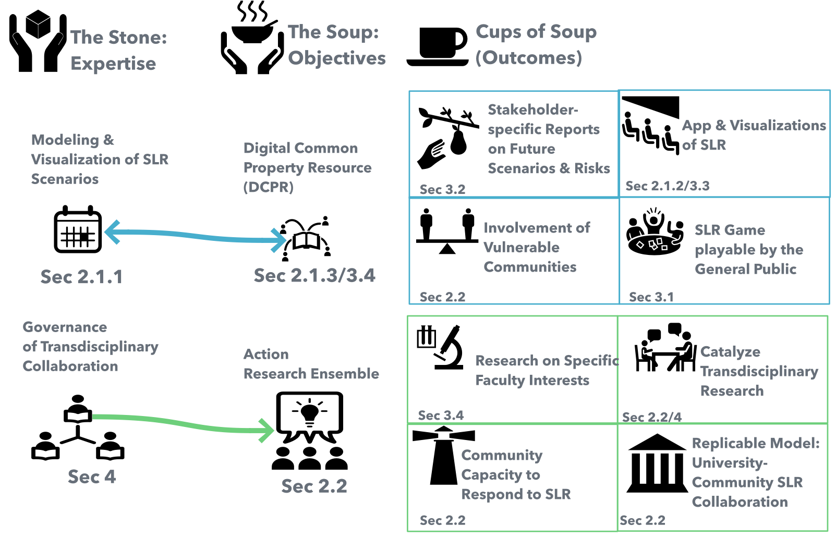
Project Aims
Objective:
to act as the “stone” to catalyze the
“soup”: development of the capacity of stakeholders and communities in the Tampa Bay region to collaborate, anticipate, and shape that future landscape in the best interests of Tampa Bay’s citizens.
Notes:
A brief background: Please describe the problem you are addressing and why it is important (20sec slide)

Slide 3
Lessons Learned
Collaborative Hub @ Resilience—Right ideas, too soon.
Solve Immediate Problems to build momentum for larger efforts.
Work where there is a Collaborative Culture: St. Petersburg > Tampa.
Notes:
Describe at least one deliverable that you accomplished together with your community partners and at least one outcome in terms of capacity building. Also describe something unexpected about working with your community partners. Anecdotes are highly encouraged. Include photos.
Emphasize activities that have been carried out after last year's PI meeting and how these activities along with what was accomplished last year fits within the overall vision of your project.

Slide 4
Update of the Project since last PI meeting
Proof of Concept— 56th Annual Allerton Conference on Communication, Control, and Computing (Allerton) October 2-5, 2018
Contribution to Local efforts— CORE Proposal to State of Florida, University of South Florida Center for Coastal Resiliency (CORE), College of Marine Science USF@St. Petersburg.
Notes:
Describe at least one deliverable in terms of the science (technical and social). Why is this deliverable significant/what did it accomplish or what will it allow? Include photos.
Emphasize activities that have been carried out after last year's PI meeting and how these activities along with what was accomplished last year fits within the overall vision of your project. Inclusion of photos are encouraged.

Slide 5
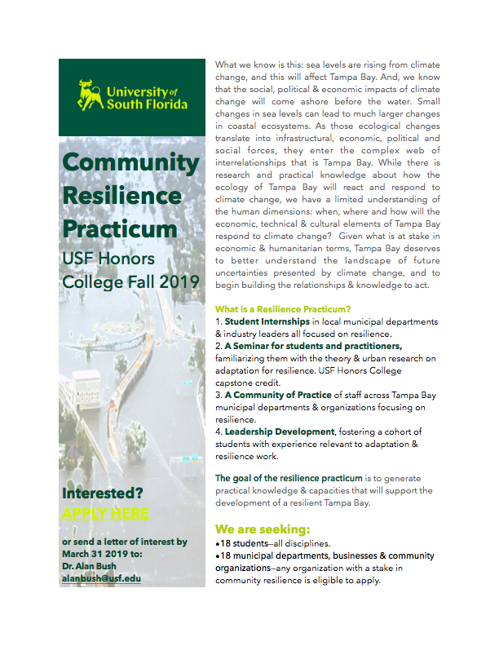
Planned Outcomes/Next Steps
Foster Collaborative Capacity
USF Resilience Practicum, Tampa & St. Petersburg—Fall 2019
Solve Immediate Problems
Modeling Revenue Vulnerability to SLR Exploring Partnerships—Now

