Slide 1
2019 NSF SMART AND CONNECTED COMMUNITIES PI MEETING: FY 2017 IRG Track 2
1. Total Time = 3 minutes MAXIMUM for your content.
2. Must be a ppt/pptx file. Please rename the file SCC.IRGTrack2.[Award#].[PI_LastName].ppt/pptx
3. Slides must be uploaded at https://nsfsccpimeeting.ee.washington.edu/presentation/
4. Please address all the content in this template, but you may do so in more than four slides, if needed. Be sure to also read the additional instructions listed in the ”notes” section below the slides.
5. All slides must auto-advance (set under “Transitions”). We set a duration for these suggested template slides. You can change the duration on these slides, but the total must equal 3 minutes. If you do not use this template, be sure to set the duration for each slide and to make sure that the total presentation time is 3 minutes. Otherwise, we will set equal duration for each slide.
6. Other suggestions
Keynote users, export to .pptx format; LaTeX users, make images to add to a .pptx; Please check your slides on a PC platform.
Animation should not be used
Use images for any content with special characters.
7. Please practice using the timing established here! The total time allotted is nonnegotiable.
8. DELETE THIS SLIDE WHEN YOU ARE DONE!

Slide 2
2019 NSF SMART AND CONNECTED COMMUNITIES PI MEETING
FY 2019; CPS TTP #1837244
Smoothing Traffic via Energy-efficient Autonomous Driving
STEAD; NSF Award [#]
PI: Alexandre Bayen, UC Berkeley
George Pappas, Univ. of Pennsylvania
Benedetto Piccoli, Rutgers Univ.
Dan Work, Vanderbilt Univ.
Notes:
This is the transition slide. The lightning talk moderator will announce the name of your project and the name of the lead PI. Expect to begin your presentation from the next slide.

Slide 3
Project Aims
The project will achieve the following aims:
Provide theoretical framework for mobile control of traffic
Control via mean field games and deep-RL
Theoretical bounds on algorithms performance (both PDE and Neural nets)

Slide 4
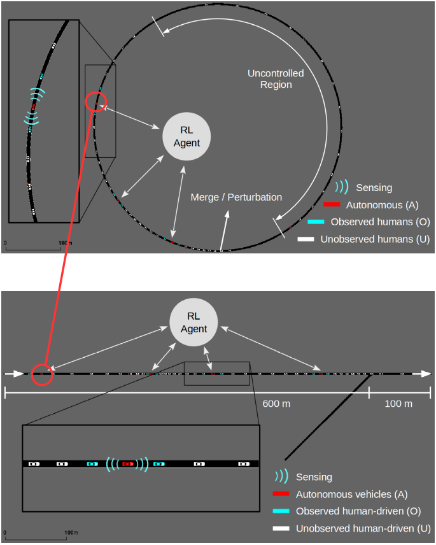
Update of the Project since last PI meeting
Project started in Jan. 2019. In progress milestones
Neural net calibration for CAV and non CAV models
Mean field game formulation of Lagrangian control
Provably efficient NN
Toughest Challenge: transfer learning
Notes:
Most significant accomplishment: Describe at least one deliverable that you accomplished together with your community partner(s) in terms of capacity building and/or the science. Anecdotes and photos are highly encouraged.
Toughest challenge: Describe something challenging or unexpected about working with your community partners in terms of capacity building and/or the science (technical and/or social). How did you overcome this challenge? Anecdotes and photos are highly encouraged. Consider limiting your text.

Slide 5
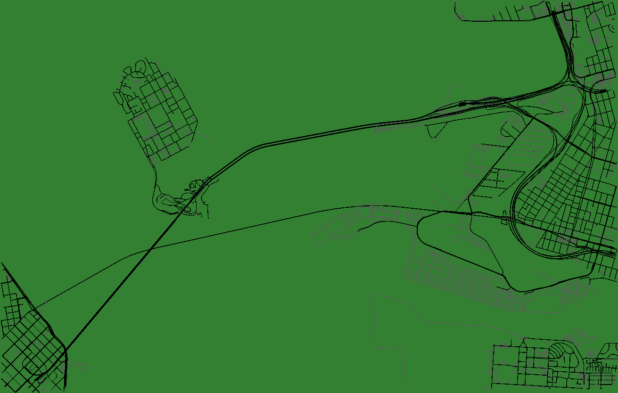
Anticipated outcomes and success measures in the next year
PDE mean field games formulation of Lagrangian control
Computationally tractable NN mobile control
Provably efficient NN approach to mobile control
Experimental validation (experimental vehicles and model city)
Notes:
Describe at least two deliverables that you plan to accomplish over the next year that will significantly advance your project.

