Slide 1
2019 NSF SMART AND CONNECTED COMMUNITIES PI MEETING
FY 2017 IRG Track 2: Towards Quality Aware Crowdsourced Road Sensing for Smart Cities, NSF Award 1737590
Lu Su* (PI), Chunming Qiao* (Co-PI), Jing Gao* (Co-PI), Adel W. Sadek* (Co-PI), Alex Anas* (Co-PI), Athena Hutchins† (Partner), William Geary‡ (Partner), and Thomas George§ (Partner)
* State University of New York at Buffalo
† Niagara International Transportation Technology Coalition (NITTEC)
‡ Erie County Department of Public Works
§ Niagara Frontier Transportation Authority (NFTA)
https://www.cse.buffalo.edu/~lusu/scc.html

Slide 2
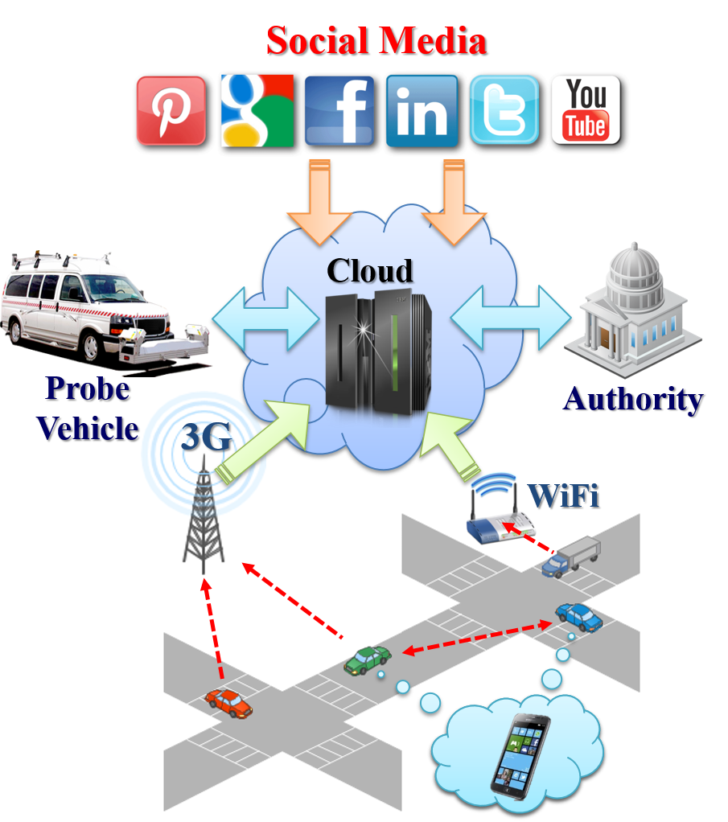
Project Aims
Goal: To make the acquisition and dissemination of road/traffic condition information (traffic congestion, road surface defects, malfunctioning traffic regulation infrastructures) accurate, efficient, and timely.
Traditional road and traffic monitoring
Stationary Sensors (e.g., inductive loop detectors, closed-circuit cameras)
Specialized probe vehicles equipped with dedicated sensors (e.g., ground penetrating radar (GPR), 3D laser scanner).
Prohibitively high deployment cost
Impossible to achieve largescale deployment
Limited road coverage
Delayed information update
QuicRoad: a Quality-of-information aware crowdsourced road sensing system.
Smartphones (GPS, accelerometer, compass, camera, etc).
Social media.
Specialized sensor/vehicle/authority.
Figure 1: QuicRoad System Design

Slide 3
Update of the Project since last PI meeting
Most Significant Accomplishments
Develop a Quality of Information Aware Information Integration Framework
The proposed framework can jointly estimate the QoI of each information source and aggregate the information from different sources weighted by the estimated QoI.
Develop a Smartphone App to collect phone sensor data and display road and traffic information.
Working with our community partners, i.e., Niagara Frontier Transportation Authority (NFTA) and University at Buffalo Parking & Transportation Services department for the deployment of our road sensing systems on their operated buses and shuttles.
We have tested our system on the application of pothole detection and slippery road detection.
Toughest Challenge
Our partners do not allow the drivers of their operated buses/shuttles to use smartphone when driving.
Have to purchase and install dedicated smartphone on each bus/shuttle.
Make the system running in a fully unattended and automatic manner.

Slide 4
Anticipated outcomes and success measures in the next year
System deployment
Deploy more NFTA and UB buses and shuttles.
Distribute developed smartphone app.
Applications
Crowdsourced traffic congestion estimation
Crowdsourced map inference
Crowdsourced parking availability inference
User behavior analysis
Explore whether and to what degree the road sensing information provided by the proposed system would change the social behavior of the crowd.
Engage new local community and industry partners
HERE Technologies
Buffalo Niagara Medical Campus (BNMC)
University at Buffalo parking & transportation services department

