Slide 1
2018 NSF SMART AND CONNECTED COMMUNITIES PI MEETING
IRG Track 2: Community on Multimodality: Participatory Action, Service, and Support (COMPASS), NSF Award 1737443
Daphney–Stavroula Zois¹ (PI), Wonhyung Lee² (co–PI), Charalampos Chelmis³ (co–PI), Rushka Tcholakova⁴, Natasha Pernicka⁵, Brian Hawley⁶, Anthony Capece⁷, Nancy Chiarella⁸, Dahlia Herring⁹, Jill Peckenpaugh⁹
¹Electrical and Computer Engineering Department, University at Albany, SUNY; ²School of Social Welfare, University at Albany, SUNY; ³Computer Science Department, University at Albany, SUNY; ⁴United Way of the Greater Capital Region; ⁵The Food Pantries for the Capital District; ⁶Neighborhood Engagement Unit, Albany Police Department; ⁷Central Avenue Business Improvement District; ⁸Capital Region Coalition to End Homelessness; ⁹U.S. Committee for Refugees and Immigrants
https://www.albany.edu/~dz973423/projects/nsf-scc-2017/index.html

Slide 2
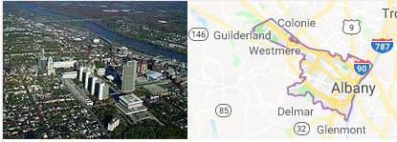
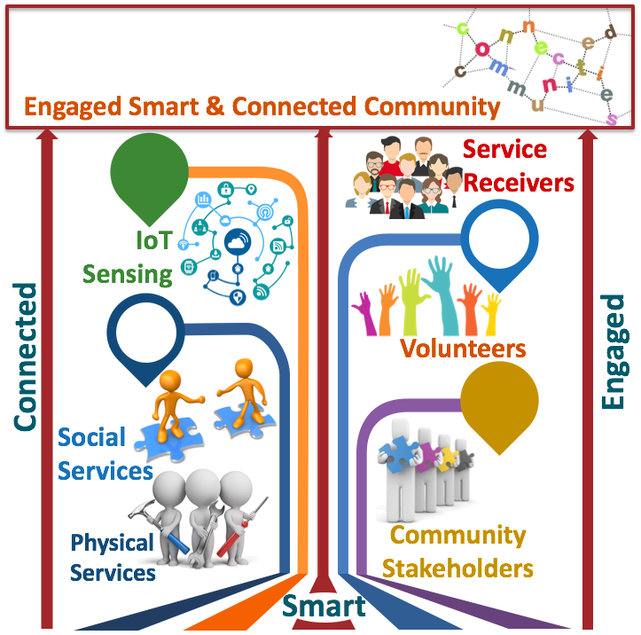
Project Aims
City of Albany, NY
Community Partners
Build relationships and trust with the community.
Understand needs and concerns of the community.
Identify and Share data and expertise instrumental for developing proposed approach.
Refine conceptual framework of research.
Assist in evaluation of proposed approach.
Enable two–way communication between residents and service providers.
Simplify discovery and use of services.
Deploy resources more efficiently.
Promote participatory action.
Improve the wellbeing of communities.

Slide 3
Status of the Project
Collected and analyzed physical service requests in Albany County from SeeClickFix
Designed optimization framework to automatically and quickly classify two-type requests
Automatically constructed a network of service providers from organizations’ websites
Received IRB approval for interviewing service providers
Assessed the quality of online presence of service organizations
Developed questionnaires for service providers
COMPASS
Conducted interviews with Albany Police, Central Business Improvement District, United Way of the Greater Capital Region, The Food Pantries of the Capital Region
Outreached and engaged new community partners: Homeless Coalition, ServeAlbany, Refugees RoundTable
Incorporated suggestions from interviewed community partners into initial research design
Hired, trained, and mentored 9 students (2 PhD ECE, 1 PhD CS, 1 MS CS, 3 MS SSW, 1 BS CS, 1 BS ECE)
A talk “Maximizing service delivery: integrating human behaviors, data analytics, and engineering” given at the UAlbany Advanced Data Analytics Seminar Series
Created project website for continuing dissemination of results and community engagement

Slide 4
What’s next
Obtain data from human service providers
Extend optimization framework to classify multiple-type requests
Devise machine learning algorithms to prioritize service requests
Integrate heterogeneous service–related data into a cognitive representation
Computationally analyze trajectories of service–seeking individuals
Sample service organizations for next interviews
Develop survey questionnaire on service–navigating behaviors
Apply and obtain IRB approval
Conduct interviews and surveys
Analyze interviews and surveys
COMPASS
Identify and collaborate with other service coordination efforts (e.g., 360º Community Information Exchange, Communications Portal, “Food Connect” Digital Food Pantry System)
Seek individual-level insights through surveys and focus groups
Bring together service providers to discuss research findings and refine the conceptual research framework
Hire 1 SSW, 1 CS, 1 ECE student for 2018-2019
Disseminate research findings via conference and journal publications
Incorporate research outcomes to courses taught by the project team
Give seminar talks to initiate new research collaborations
Provide students with the opportunity to interact with our community partners
Pair students from CS/ECE/SW to work together on the project

