Slide 1
2018 NSF SMART AND CONNECTED COMMUNITIES PI MEETING
PG: Towards Smart and Accessible Transportation Hub [1737533]
Leads: Zhigang Zhu, The City College of New York (CCNY), Jie Gong (Rutgers University)
Co-PIs: Camille Kamga (CCNY), Cecilia Feeley (Rutgers), William H. Seiple (Lighthouse Guild)
Community Partners: Mike Lysicatos (NJ Passaic County), as well as partners from Bentley, NYC MPOD, NYSCB, Goodwill, NJ Transit
Notes:
Smart and Accessible Transportation Hub – A Poem (10 sec slide)
By the SAT-Hub Team at CUNY, Rutgers and Lighthouse Guild
With our partners in NYC and NJ

Slide 2
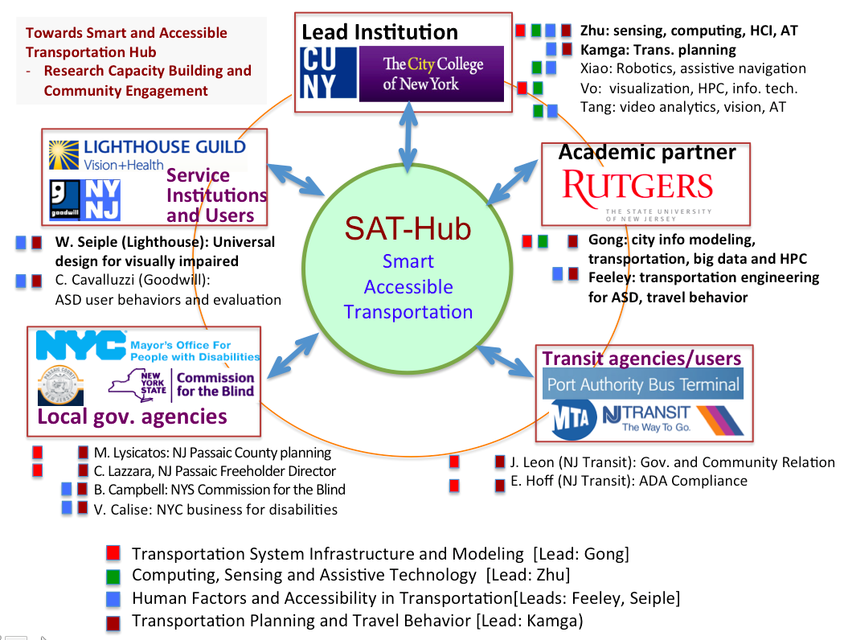
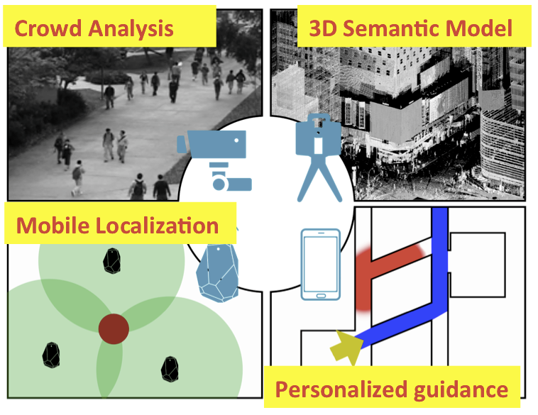
Project Aims
Challenge:
An integrated framework to transform large existing transportation hubs into smart facilities
Integrative Research:
SAT-Hub integrates machine intelligence, accessibility and transportation
Community Engagement:
Refine partnerships with three sectors representing local governments, and transit agencies, and service institutions
Impact:
Project-inspired integrative research in Smart Infrastructure, Sensing & Computing, Accessibility & Mobility, Transportation Planning, leading to direct benefits for people with disabilities
SAT Hub Vision: Provide better location-aware services to underserved populations with minimal infrastructure changes
Notes:
Project Aims (35sec slide)
Publication transportation is vital in big cities, and IT really changes the landscape of ITS.
However this creates more challenges for disabled, making digital divide even more obvious.
Smart and Accessible Transportation Hub, is a collaboration between CUNY, Rutgers and Lighthouse Guild,
Security, Transportation and Services, three are in one to serve all citizens.
公共交通便都市，信息技術更添色；
可惜殘障遇挑戰，數字分化更明顯。
交通智能又可及，城市若歌雙聯合；
安全交通兼服務，集成一體利全民。

Slide 3
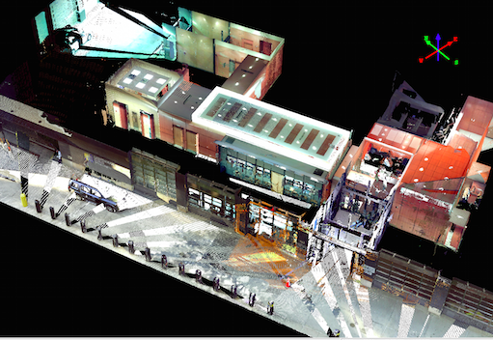
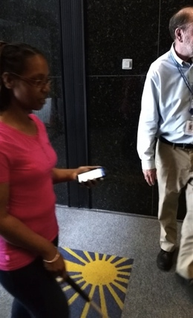
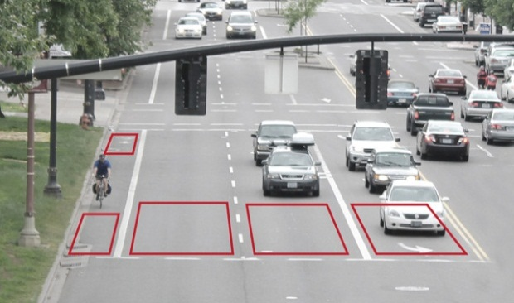
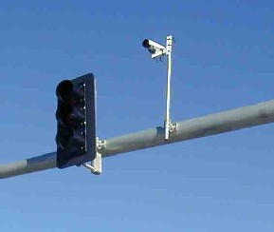
Status of the Project
A Test Site at Lighthouse Guild
3D Semantic, Beacon and Tango Models
Deep-Net Crowd Analysis
Human Subject Evaluation with 11 Blind Users
An Internal Workshop for Community Engagement
Three Sectors and Users
Industrial Partnership: PFI with Bentley
Real-World Deployment
NYC WiFi and Beacons (MOPD)
NJ Smart Corridor Project (Passaic County)
3D Model of Facility
BVI user test
15-mile corridor
Notes:
Status of the Project (35sec slide)
Digital 3D modeling is for the environment, deep-net crowd analysis for pedestrian dynamics.
Multi-sensors are used for localization, and personalized guidance is provided both in & out the Hub.
Partnerships are built among government, industry & academia, service institutions are also involved.
User engagement is an indispensible part, and Smart Cities apply to anywhere in the world.
數字模型識環境，人群分析知動態；
多種傳感定方位，戶內室外均便行。
聯手政府和公司，服務機構亦加入；
用戶積極來參與，智能城市遍全球。

Slide 4
Planned Outcomes
(1). Design of a SAT-Hub framework for experimenting and refining smart service (SAT framework)
(2). Strengthened partnerships with community stakeholders and explore unique needs of the user community through a workshop, site visits, and regular interactions (SAT community engagement)
(3). Refined cross-disciplinary, integrative research themes to enable the successful deployment of solutions (SAT research capacity building)
=> A SCC IRG Proposal in 2018/2019
Notes:
Planned Outcomes (20sec slide)
Framework, Community Engagement, and Research Capacity Building are Three in One,
An Integrative Research Grant proposal to SCC is on our radar screen!
框架、參與並研究，三者合一坐樞紐；
集成研究是計劃，明年年會在相逢！

