Slide 1


2018 NSF SMART AND CONNECTED COMMUNITIES PI MEETING
PG: Agent-based Scenario Planning for a Smart & Connected Community against Sea Level Rise in Tampa Bay, NSF Award 1737598
Yasin Yilmaz (PI), Alan Bush (co-PI), Mark Hafen (co-PI)
University of South Florida
https://sites.google.com/site/nsfsccsealevelrise/
Notes:
BRIEFLY INTRODUCE YOURSELF AND YOUR INVESTIGATORS (10 sec slide)

Slide 2
Project Aims
Objective:
to act as the “stone” to catalyze the
“soup”: development of the capacity of stakeholders and communities in the Tampa Bay region to collaborate, anticipate, and shape that future landscape in the best interests of Tampa Bay’s citizens.
Stone 1: assembled expertise of the PI team on computational modeling and visualization of SLR scenarios to catalyze the “soup” of a Digital Common Property Resource (DCPR).
Stone 2: expertise of the PI team on governance of transdisciplinary projects to catalyze the “soup” of an Action Research Ensemble.
Notes:
A brief background: Please describe the problem you are addressing and why it is important (20sec slide)

Slide 3
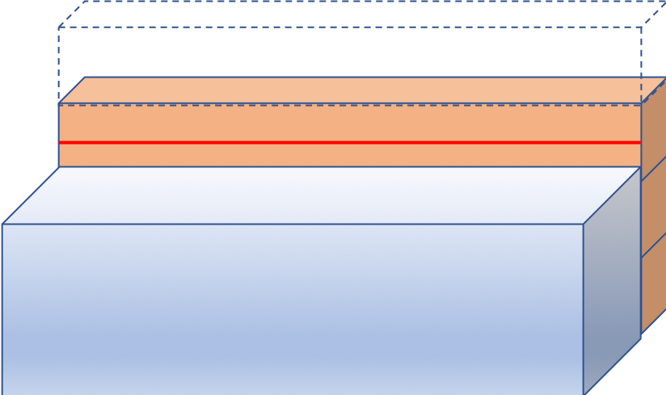
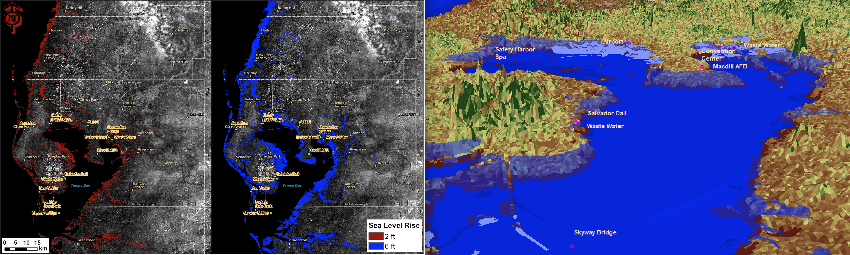
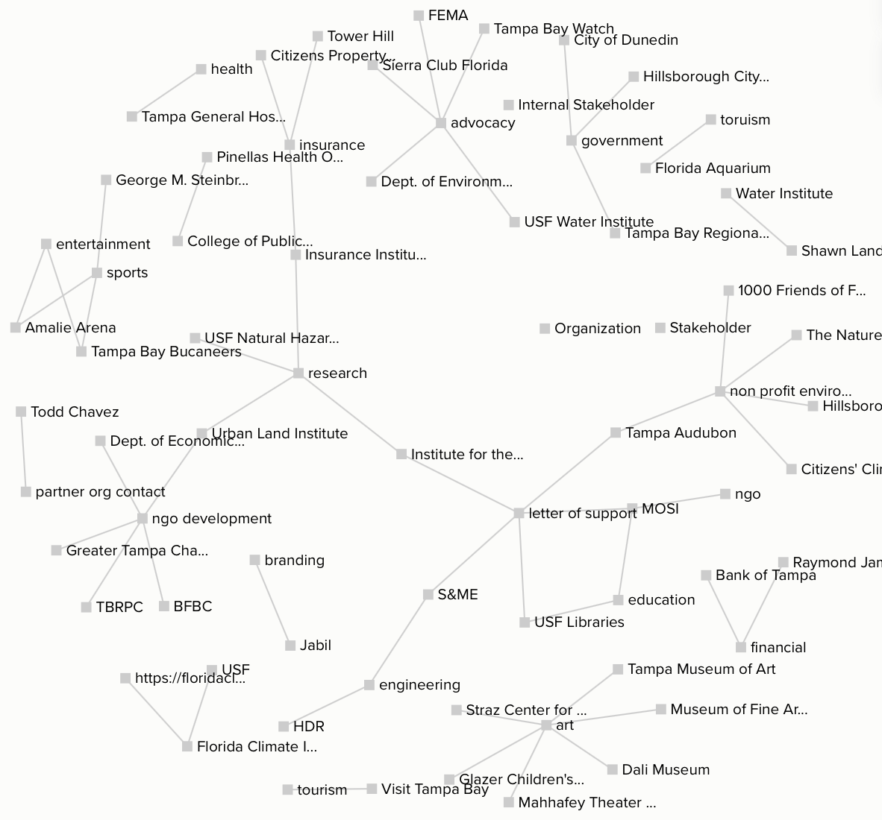
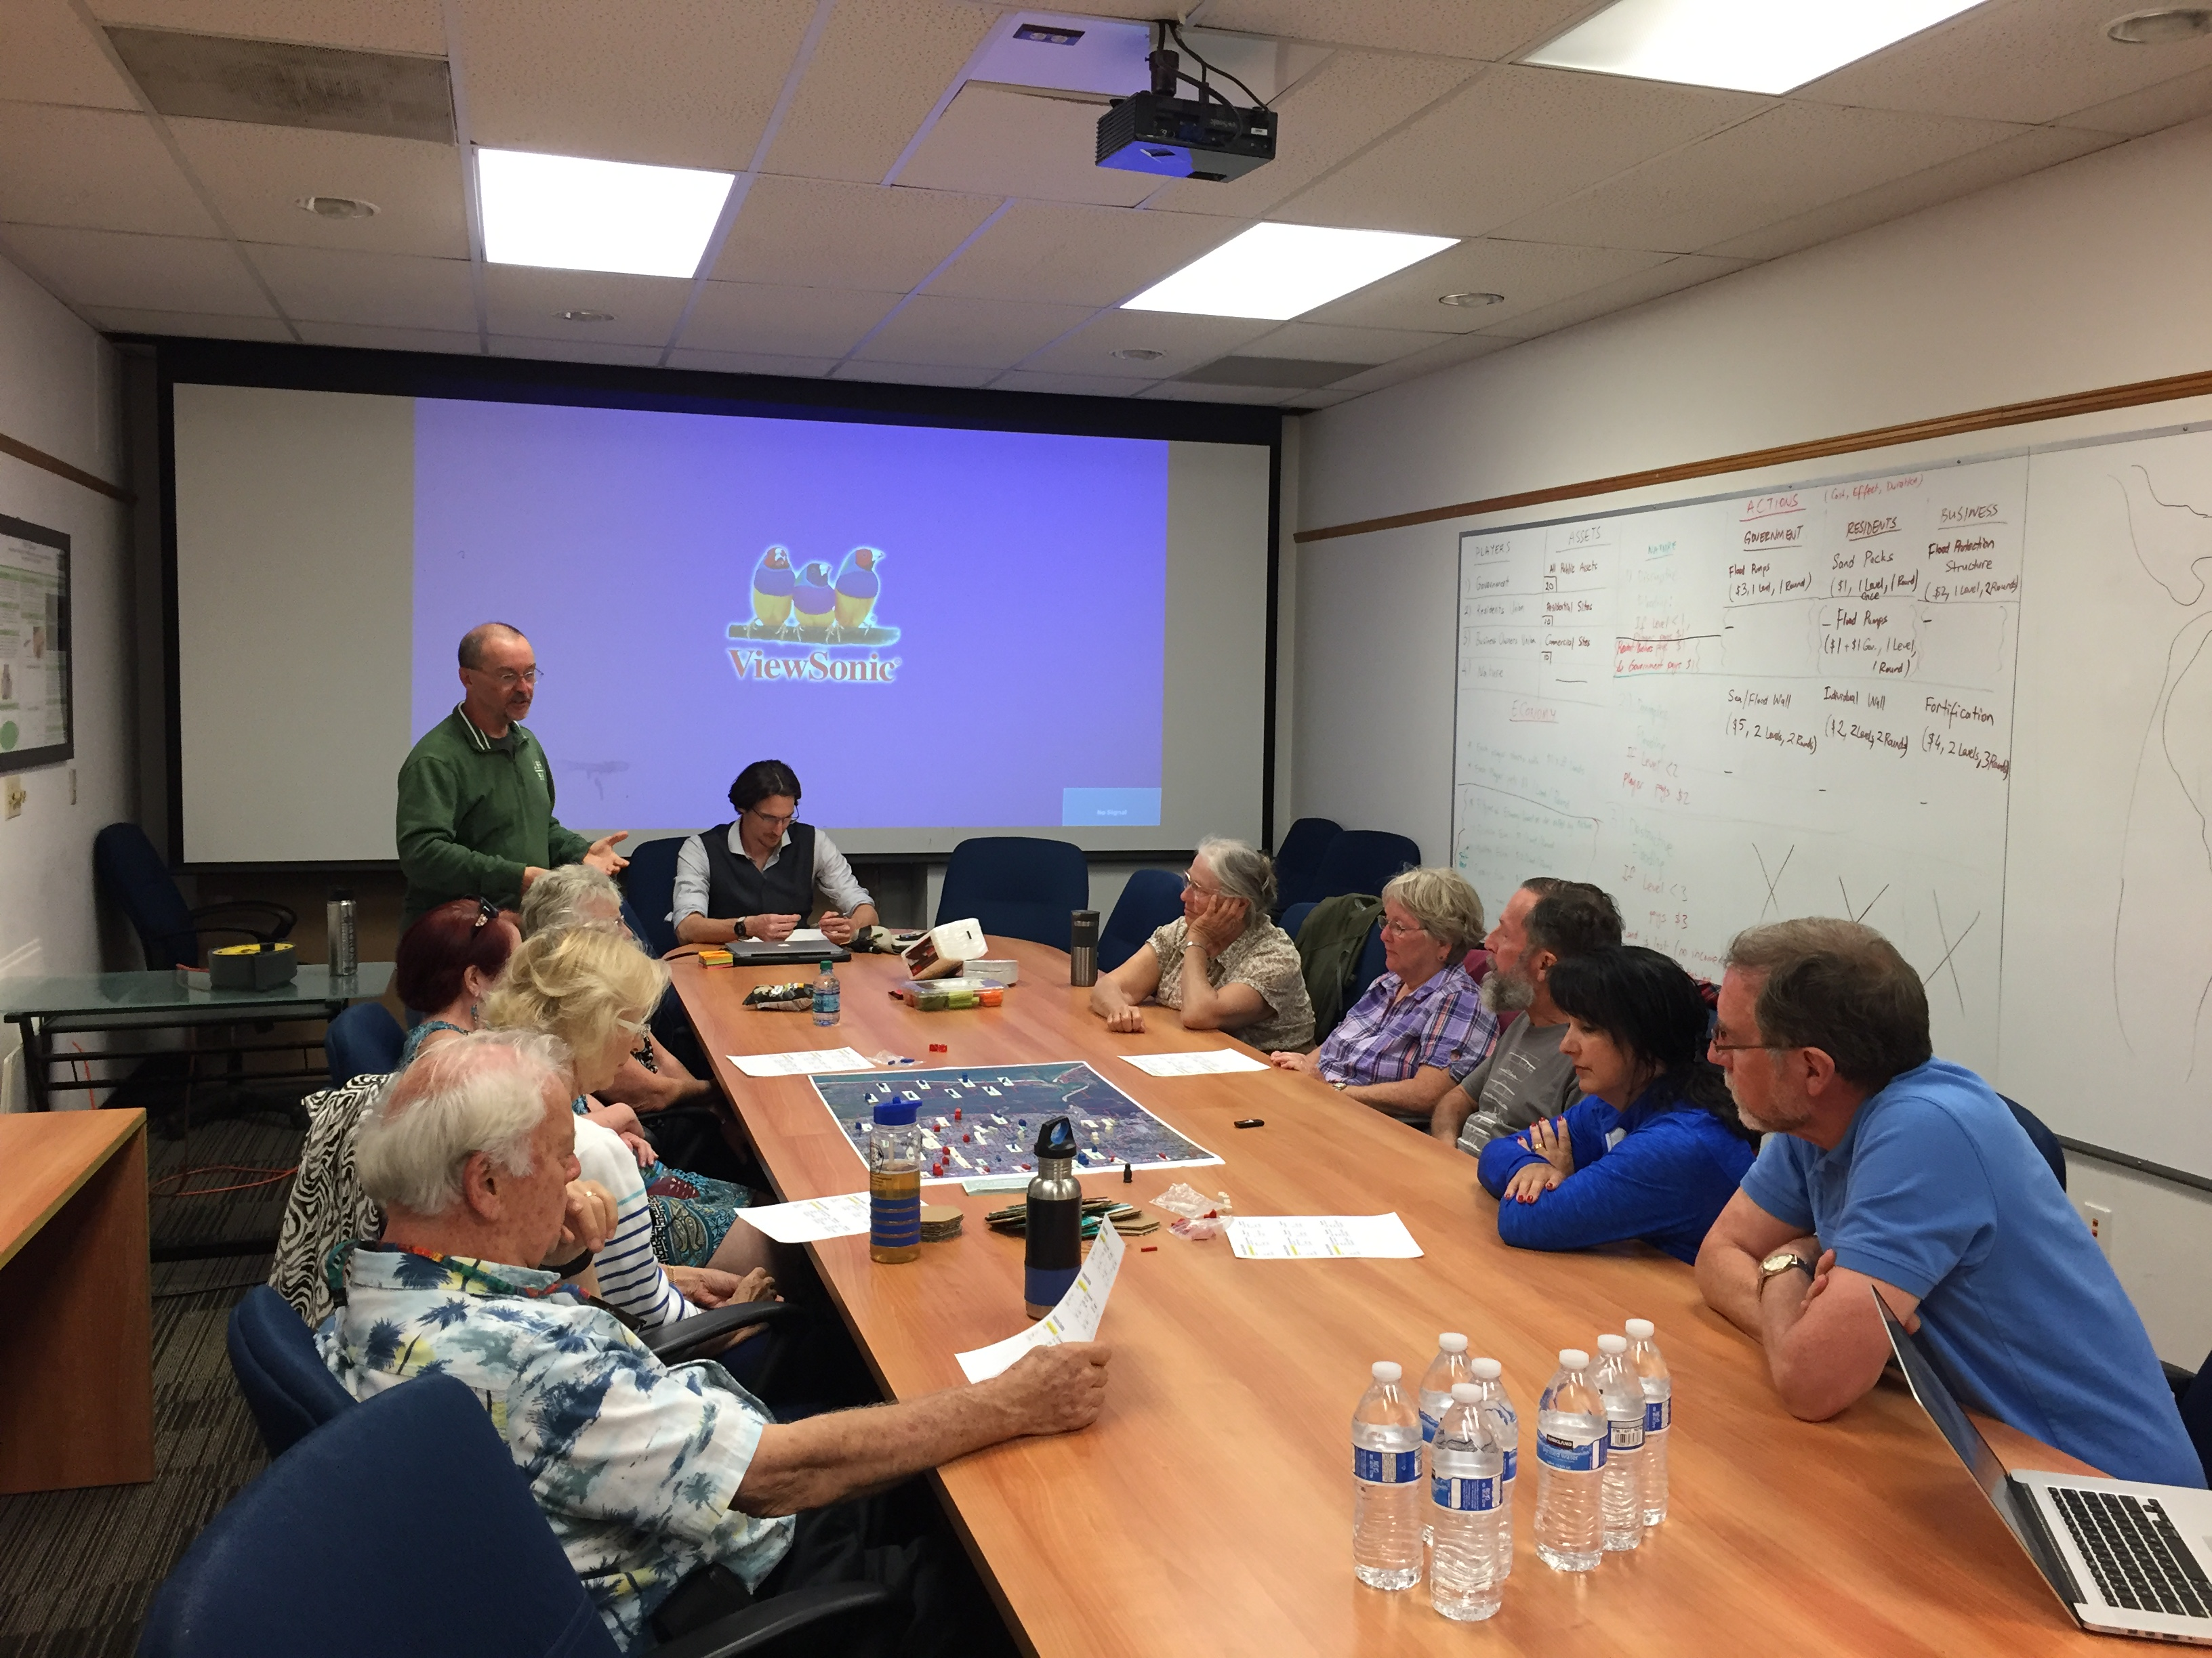
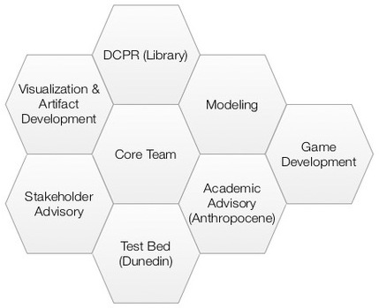
Status of the Project
Computational Scenario Planning: 3-agent scenario, Markov decision process, dynamic programming
Visualization: Proof-of-concept GIS maps and DEM model of SLR projections
Community Engagement: Game of SLR, Game meetings
Management:
Dynamic governance,
Complexity Leadership Theory
Notes:
A brief background: Please describe the problem you are addressing and why it is important (20sec slide)

Slide 4
Planned Outcomes
Tampa Bay region “Cups of Soup”
Cup 1: stakeholder-specific reports to foster actionable knowledge on SLR
Cup 2: generate an app interface and other visualizations of SLR
Cup 3: keep marginalized and vulnerable populations central to SLR responses
Cup 4: develop a playable game as a means of engaging the public around SLR.
Within USF “Cups of Soup”
Cup 1: use DCPR to enable disciplinary research related to SLR
Cup 2: catalyze spin-off transdisciplinary scholarship on emergent topics
Cup 3: enhance ability of stakeholders affected by SLR to work together
Cup 4: prototype and refine an organizational model of university-community collaboration around SLR.
Notes:
A brief background: Please describe the problem you are addressing and why it is important (20sec slide)

