Slide 1
2018 NSF SMART AND CONNECTED COMMUNITIES PI MEETING
RCN: One Bridge at a Time: Bridging the Digital Divide for the Well-Being of Aging Populations in Smart and Connected Communities (#1737483)
Project Team
Anil Yazici (PI), Assistant Professor, Civil Engineering, Stony Brook University, Email: Anil.Yazici@stonybrook.edu
Eren Erman Ozguven (Co-PI), Assistant Professor, Civil & Environmental Engineering, Florida A&M University-Florida State University College of Engineering, Email: eozguven@eng.famu.fsu.edu
David Eby (Co-PI), Research Professor, University of Michigan Transportation Research Institute, Email: eby@umich.edu
Jacqueline Mondros (Co-PI), Professor/Dean, School of Social Welfare, Stony Brook University, Email: jacqueline.mondros@stonybrook.edu
Walter Boot (Co-PI), Assistant Professor, Psychology, Florida State University, Email: boot@psy.fsu.edu
Project webpage: https://you.stonybrook.edu/agingpopulationrcn
Notes:
BRIEFLY INTRODUCE YOURSELF AND YOUR INVESTIGATORS (10 sec slide)

Slide 2
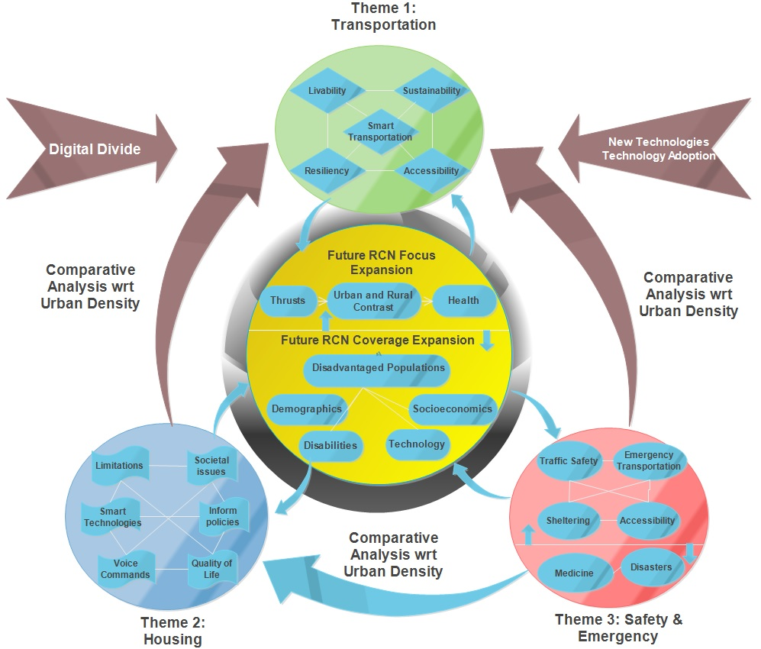
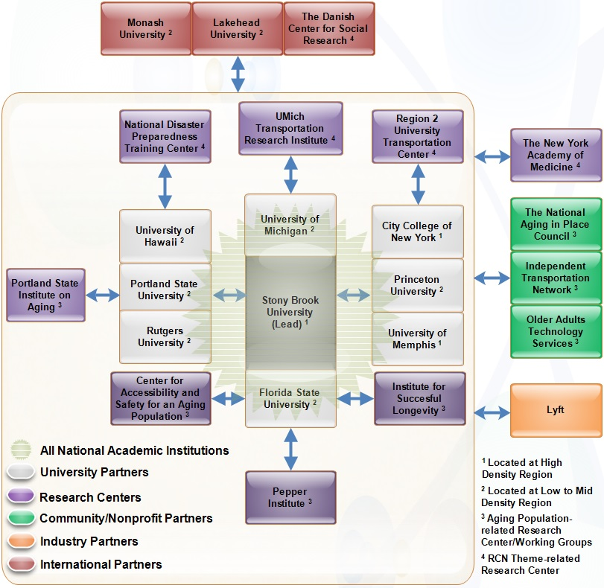
Project Scope and RCN Structure
Integrative Research:
A diverse group of researchers from 11 disciplines at 12 academic institutions, 4 community/non-profit/government organizations, and one industry partner as well as three international collaborators.
Workshops, special conference sessions and journal issues to promote, support, and strategize new directions in S&CC research
Notes:
A brief background: Please describe the problem you are addressing and why it is important (20sec slide)

Slide 3
Objectives and Status of the Project
Objectives and Challenges
Creating all-inclusive S&CC with all segments of the society regardless of different socioeconomic and demographic characteristics, declining physical and cognitive abilities, and varying urban densities and land patterns
Transferability and scalability of approaches and practices between regions
Development of strategies and policies that will optimize successful and all-inclusive S&CC approaches
Community Engagement:
Non-profit and community organizations, and industry partners to efficiently reach out to the target population and engage community members to embrace the RCN’s research goals
→ Older Adults Technology Services (OATS); Independent Transportation Network of America (ITNAmerica); The National Aging in Place Council (NAIPC); The New York Academy of Medicine; Lyft
Introducing the discussion of urban density impacts on S&CC with a geographically diverse group of institutions and communities
Current Status:
Two community-focused presentations have been made so far: 1) Florida State University Institute for Successful Longevity Brown Bag Series, December 6, 2017, Tallahassee, FL, and 2) Center for Accessibility and Safety for an Aging Population, FAMU-FSU College of Engineering, Transportation Day, December 8, 2017, Tallahassee, FL.
First international workshop to be held at Stony Brook University, April 19-20, 2018, Stony Brook, NY.
IEEE ITSC2018 Special Session to be held in November, 2018, Maui, HI: “Intelligent Transportation Systems and Disadvantaged Populations: Technology Adoption Challenges and Bridging the Digital Divide”
Notes:
A brief background: Please describe the problem you are addressing and why it is important (20sec slide)

Slide 4
Timeline and Broader Impacts
April 2018: First workshop at Stony Brook University
Anticipated Outcomes: White papers, Literature reviews, Research needs statement
2019-2020: Mid-project workshop at University of Michigan
Anticipated Outcomes: Workshop presentations; Summary on on-going RCN research
2021: Synthesis Workshop at Florida State-Florida A&M University
Anticipated Outcomes: RCN activity assessment; Future vision statement
Project Duration (2017-2021): Community Gatherings, Papers/Projects through RCN Collaborations, Journal/Conference Special Issues/Sessions, Conference Travel Support for RCN related research.
Broader Impacts:
* An interdisciplinary collaborative environment which advances S&CC research as a whole along multiple frontiers
* Help maintain social equity and livability for the communities including aging population and other various disadvantaged groups
* Inform policy makers and city governments with best practices and strategies for the adoption and integration of emerging S&CC technologies
Notes:
A brief background: Please describe the problem you are addressing and why it is important (20sec slide)

