Slide 1


2018 NSF SMART AND CONNECTED COMMUNITIES PI MEETING
SCC-Planning: Smart, Connected, Engaged Senior Communities, CNS#1737454
Team: Wu (PI), Knopf, Talmage, Mirchandani, Candan, O’Neill and Sazonov, Wen.
Affiliations: Arizona State University, Drexel University, University of Alabama
Community Partners: Westminster, Friendship Village, Vi at Silverstone, Royal Oaks.
Notes:
BRIEFLY INTRODUCE YOURSELF AND YOUR INVESTIGATORS (10 sec slide)

Slide 2
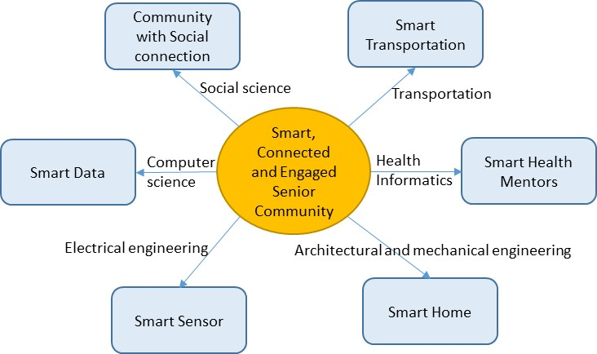
Project Aims
Understand challenges facing continuing care retirement facility residents via multi-disciplinary efforts across social science, computer science, and engineering
Develop facility guidelines incorporating progressive ideas from social engagement, transportation, health, smart buildings, and sensor technologies
Develop novel sensor and data management solutions embedded into the community cyberinfrastructure
Notes:
A brief background: Please describe the problem you are addressing and why it is important (20sec slide)

Slide 3

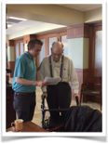
Status of the Project
Outreached 4 communities
Developed 33-questions questionnaire (delivered as online and on-ground)
Conducted 8 onsite survey (2 for each community)
Collected over 200+ questionnaires (still in process)
Notes:
A brief background: Please describe the problem you are addressing and why it is important (20sec slide)

Slide 4
Planned Outcomes
Identify the social and technological issues existing in continuing care retirement facility
Develop social/engineering solutions (in Track I application) to achieve going from “aging in place” to “aging well with smart technology”
Potential impacts
  Improving the quality of life of senior residents while decreasing costs
  Imbedding technological innovations (e.g., health monitoring sensors) broadly in continuing care retirement facilities
Notes:
A brief background: Please describe the problem you are addressing and why it is important (20sec slide)

