Slide 1
2018 NSF SMART AND CONNECTED COMMUNITIES PI MEETING
RCN: Developing an Informational Infrastructure for Building Smart Regional Foodsheds, NSF Award 1737573
University of California, Davis: Thomas Tomich (PI; Agricultural Sustainability Institute (ASI), Matthew Lange (co-PI; Food Science & Technology), Nina Amenta (Computer Science), Jim Quinn (Environmental Science & Policy), Nick Anderson (School of Medicine), Allan Hollander (ESP), Courtney Riggle (ASI)
The Ohio State University: Casey Hoy (co-PI; Food & AgriCultural Transformation), Ayaz Hyder (co-PI; Translational Data Analytics), Dorota Grejner-Brzezinska (Engineering), Jill Clark (Public Affairs) , Ingrid Adams (College of Medicine)
PI’s & Steering Committee Members/Other institutions: Suzanna Lewis (co-PI; Lawrence Berkeley National Laboratory), Robyn Krock (Valley Vision), Aparna Dial (Smart Columbus), Sarah O’Brien (Nationwide Children’s Hospital)
Notes:
BRIEFLY INTRODUCE YOURSELF AND YOUR INVESTIGATORS (30 sec to 1 min slide)

Slide 2
Project Aims
Develop an informatics framework for understanding and optimizing regional food systems (“foodsheds”)
• host meetings with researchers and community stakeholders to discuss strategies for network development and data curation
• collect and curate cross-disciplinary data resources within and across two foodsheds (Sacramento and Columbus) and tackle specific informational gaps/challenges to be addressed by researchers in the network
• facilitate a global analytics system for food, health and agriculture by hosting two foodshed informatics research network conferences
Notes:
A brief background: Please describe the problem you are addressing and why it is important (2 min slide)

Slide 3
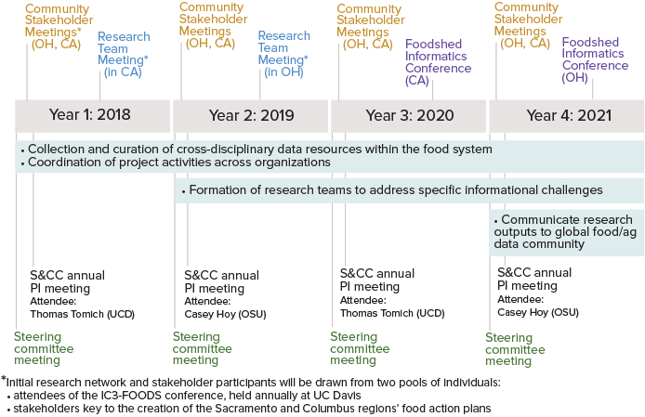
Timeline
Notes:
Project Timeline (1 min slide)

Slide 4
Status of the Project
Project launch: January 2018
Weekly/Bi-weekly project team meetings: Beginning January 2018 Regular discussion of strategy and progress on RCN structure, data management, and partner engagement.
2-day project strategy workshop: February 2018 Convened intensive 2-day workshop with PI’s and project team to detail project framing, goals, and workplans. Workplans and teams in place for implementation of: RCN data structure and curation strategies (open linked data, with IP considerations), engagement (steering committee, research partners, stakeholders), project management (tracking provenance, activities, tasks). Pending: development of detailed external communication strategy.
Collaborating with related activities to interact with research partners and food system stakeholders: Starting in March 2018 Leveraging complementary activities to engage with partners and collect information on existing data and data gaps for our 2 regional foodsheds. E.G.: Networking and harvesting information from: a series of stakeholder meetings in OH, a series of domain expert meetings in CA in March, CA extension community’s annual gathering in April, etc. This will continue as opportunities arise.
Notes:
Status of Project (1 min slide)

