Slide 1
2018 NSF SMART AND CONNECTED COMMUNITIES PI MEETING
PG: Pedestrian Safe and Secure Communities with Ambient Machine Vision, 1737586
Hamed Tabkhi, Shannon Reid, Arun Ravindran, Srinivas Pulugurtha, Doug Shoemaker, and Robert Phocas
University of North Carolina Charlotte (UNC Charlotte), Charlotte City Manager's Office
https://coefs.uncc.edu/htabkhiv/
Notes:
BRIEFLY INTRODUCE YOURSELF AND YOUR INVESTIGATORS (10 sec slide)

Slide 2
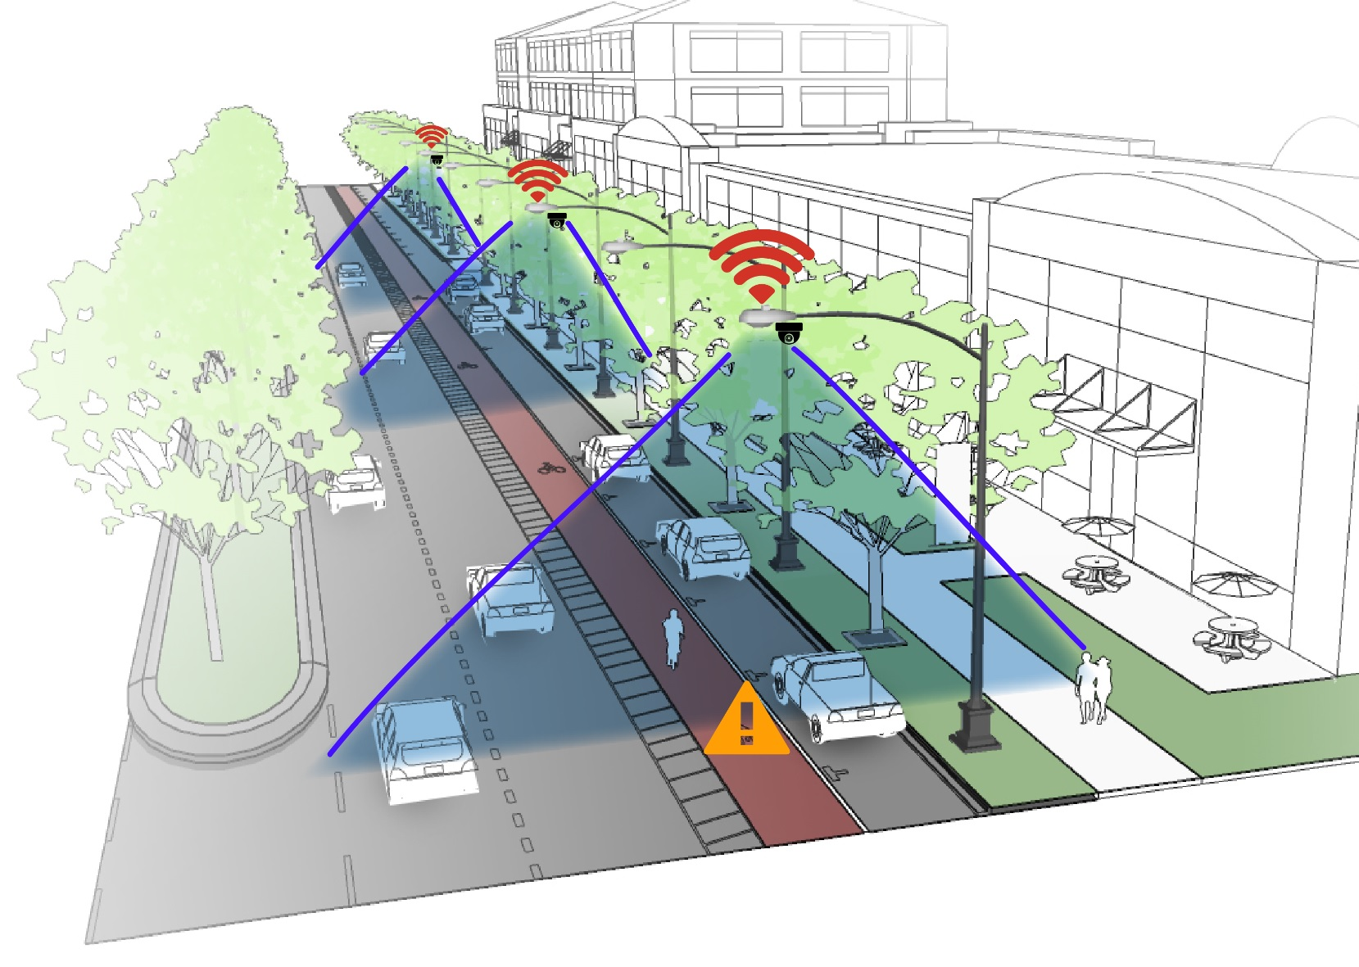
Project Aims
Edge Video Analytics integrated to the community
For autonomous real-time detection and notification of hazardous behaviors
Targeted applications:
Pedestrian Safety
Intelligent Policing
No strict requirement for video data storage
-> Maintain privacy
-> Color-blind monitoring
Notes:
A brief background: Please describe the problem you are addressing and why it is important (20sec slide)

Slide 3
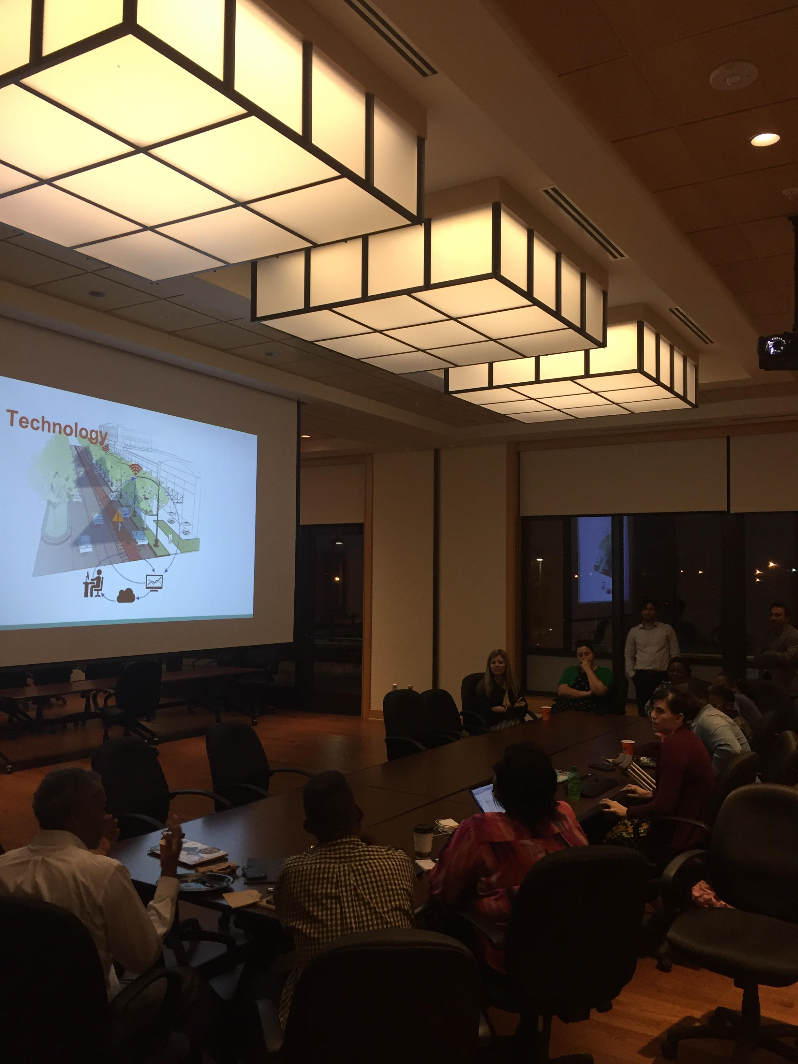
Status of the Project
Community engagement:
Engaged a broad range of community partners:
City office
Local police departments
Transportation managers
General public
Social:
Developed community presentations and survey questions
Presented and surveyed neighborhood leaders
Technology:
Studied the algorithmic requirements
Developed early prototypes of the technology
Notes:
A brief background: Please describe the problem you are addressing and why it is important (20sec slide)

Slide 4
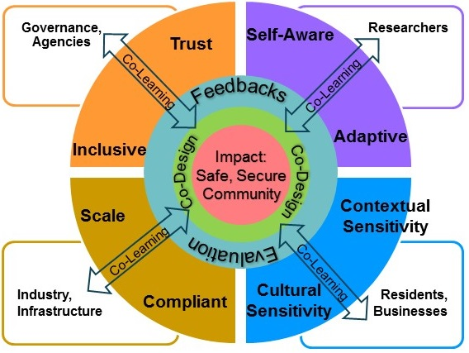
Planned Outcomes
Understand and formalize community preferences for the proposed technology
Identifying the community testbeds
Establish multi-dimensional sustainable integrative research
UNCC, City office, local industry and business owners, residents
Early prototypes and demos
Deep learning for distributed edge video analytics
Early prototypes of the edge technology at UNCC campus
Notes:
A brief background: Please describe the problem you are addressing and why it is important (20sec slide)

