Slide 1


2018 NSF SMART AND CONNECTED COMMUNITIES PI MEETING
Science of Design for Societal-Scale CPS: 1743772
Janos Sztipanovits, Xenofon Koutsoukos, David Hess, Vanderbilt University
Shankar Sastry, Claire Tomlin, University of California Berkley
Werner Damm, University of Oldenburg, Germany
Alexander Pretschner, Technical University of Munich, Germany
https://cps-vo.org/group/sdss-cps
Notes:
BRIEFLY INTRODUCE YOURSELF AND YOUR INVESTIGATORS (10 sec slide)

Slide 2
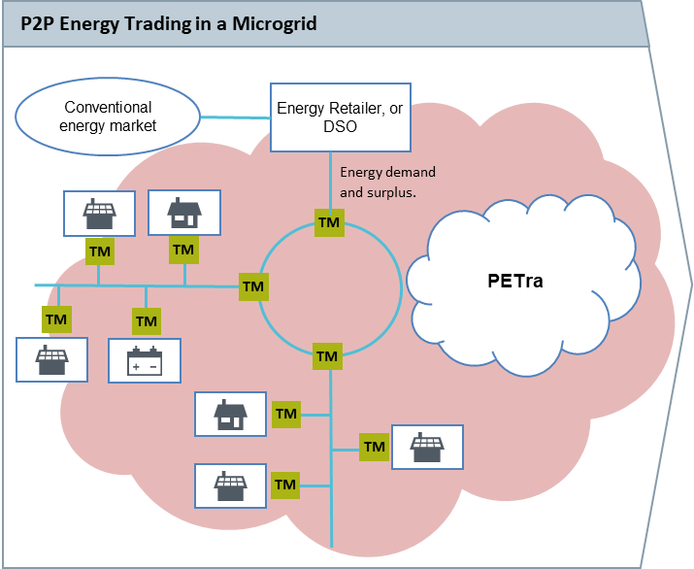
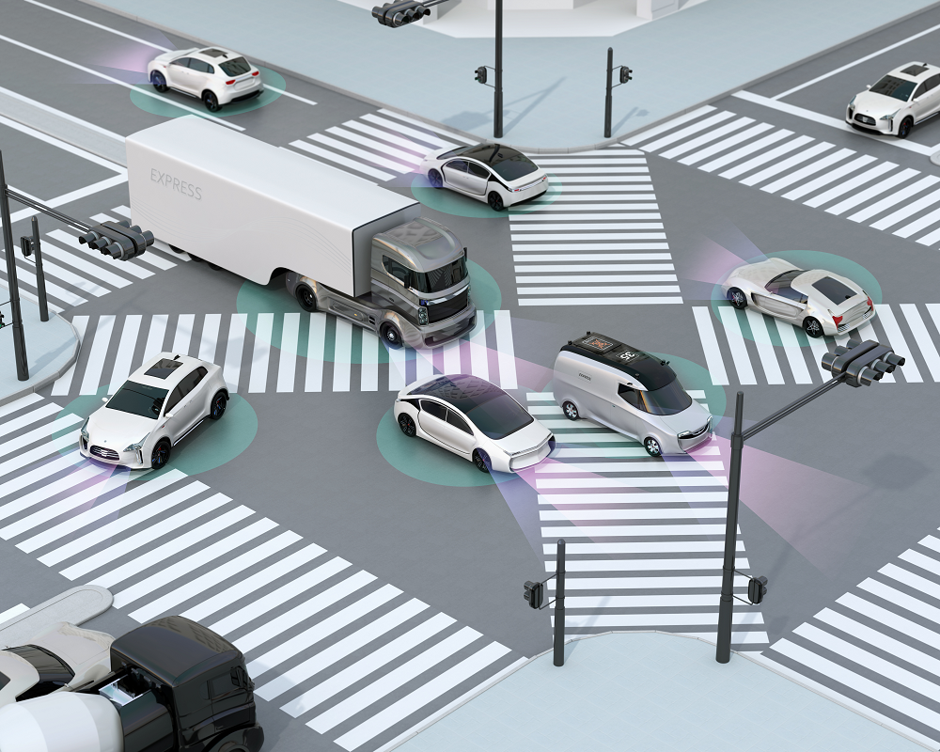

Project Aims
  Understand and compare the nature, scope, and evolution of policies and societal expectations in the operation of societal-scale H-CPS in the US and in Europe
  Investigate methods for the explicit and formal representation of societal context (operational, privacy, safety, security policies, incentives, pricing and market policies) that are machine interpretable and impact the structure and behavior of H-CPS
  Develop policy-aware architectures that guarantee the enforcement of policy requirements during the operation of a new generation of H-CPS.
Notes:
A brief background: Please describe the problem you are addressing and why it is important (20sec slide)

Slide 3
Project Aims
  Understand and compare the nature, scope, and evolution of policies and societal expectations in the operation of societal-scale H-CPS in the US and in Europe
  Investigate methods for the explicit and formal representation of societal context (operational, privacy, safety, security policies, incentives, pricing and market policies) that are machine interpretable and impact the structure and behavior of H-CPS
  Develop policy-aware architectures that guarantee the enforcement of policy requirements during the operation of a new generation of H-CPS.
Notes:
A brief background: Please describe the problem you are addressing and why it is important (20sec slide)

Slide 4
Project Aims
  Understand and compare the nature, scope, and evolution of policies and societal expectations in the operation of societal-scale H-CPS in the US and in Europe
  Investigate methods for the explicit and formal representation of societal context (operational, privacy, safety, security policies, incentives, pricing and market policies) that are machine interpretable and impact the structure and behavior of H-CPS
  Develop policy-aware architectures that guarantee the enforcement of policy requirements during the operation of a new generation of H-CPS.
Notes:
A brief background: Please describe the problem you are addressing and why it is important (20sec slide)

Slide 5
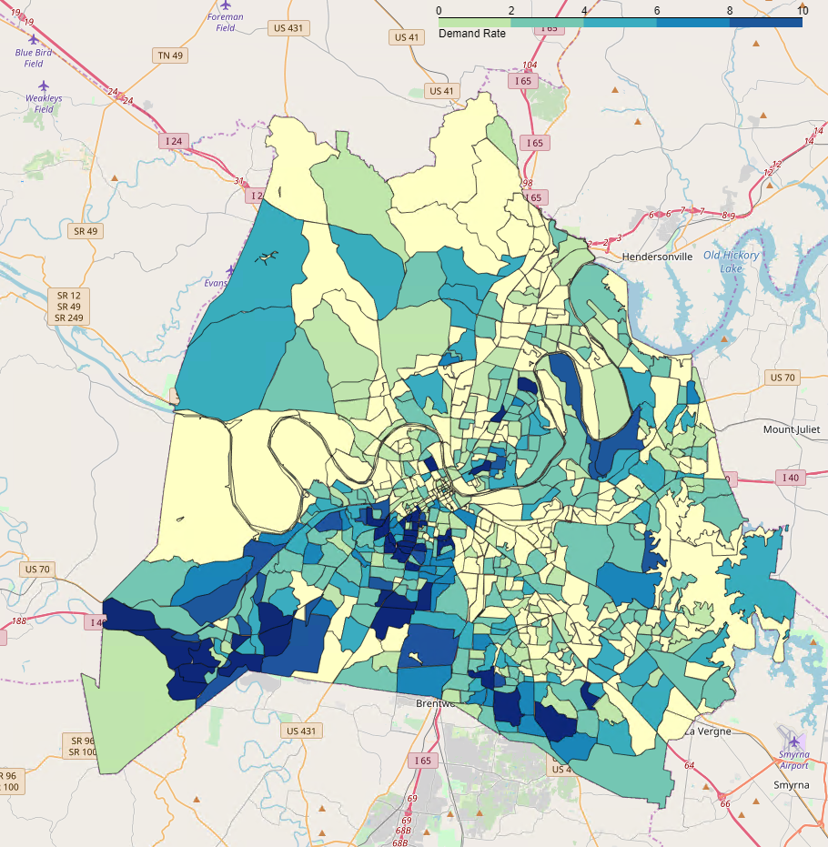
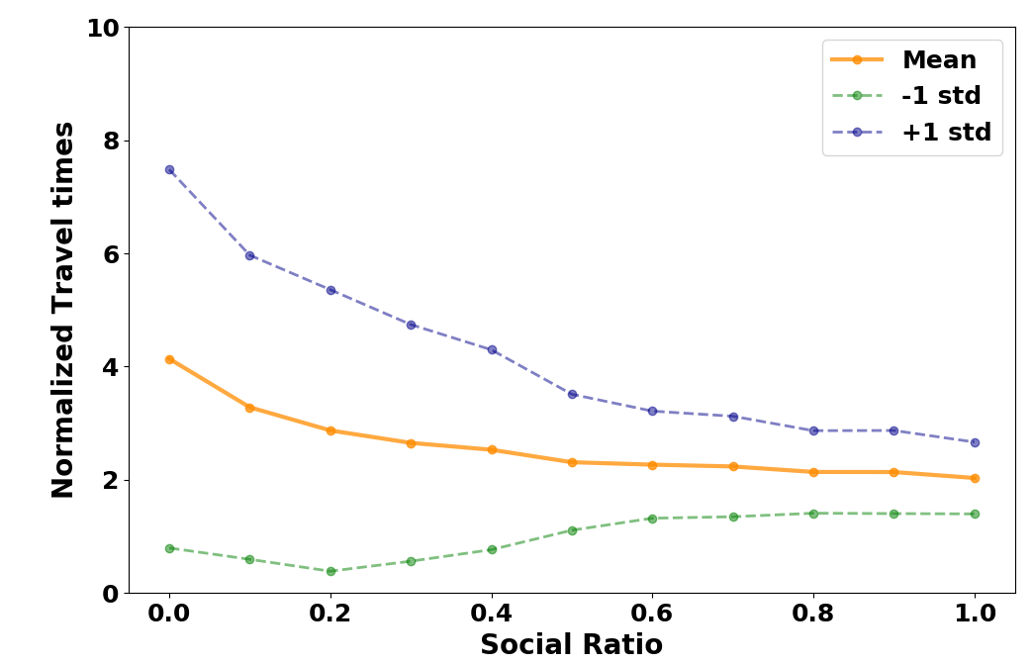
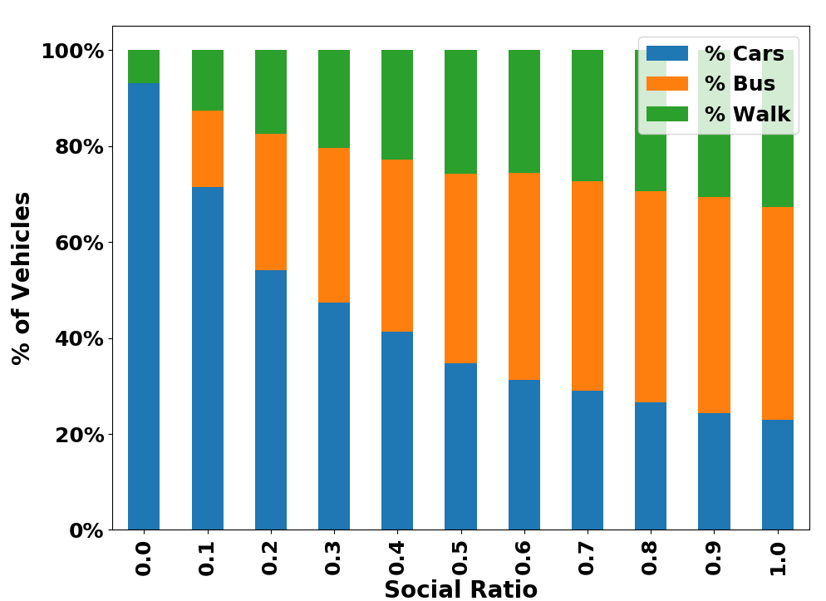
Example of Societal Scale CPS Project: Transit Hub
Simulation Example
  Agent-based simulation
  Vanderbilt employees trip distribution
  Background traffic
  Agents choose random time between 7.30am-10am for onward journey.
Impact & Future Work
  Modular, scalable platform and incentive design framework that can easily be adopted by cities and supports mode integration
  Validated simulation platform to evaluate policies prior to deployment (e.g., new bus routes or incentives for ride-sharing)
  Decentralized virtual commons, connecting cities with citizens (opportunities for engagement)
Social Optimal Router
  Takes a proactive approach to avoid congestion by suggesting route choices that are more socially optimal
  Considerate of the choices made by other users and work towards improving system-level performance.
CNS-1528799, CNS-1647015
Dubey, Ratliff, Zhang

Slide 6



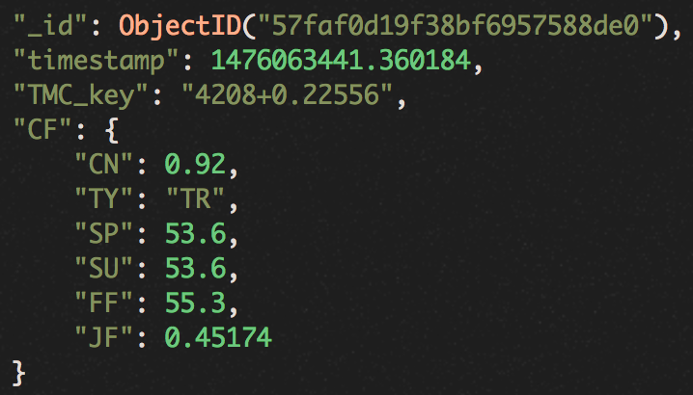

Example of Societal Scale CPS Project: Transit Hub
Data Aggregation
Contextual Anomaly Detection
Applications and Services
Smart
Phones
Data Formatting
Converting to the same format
Long-term Model
Stacked Convolutional Neural Networks
Explaining non-recurrent traffic patterns for large areas
Real-time Delay Prediction
For visitors and travelers
Data Cleaning
Get rid of errors and noises
Augmented Traffic Dataset
For third party applications
Roadside
Sensors
Data Processing
Normalization
Balancing
Aggregation
Short-term Model
Stacked LSTM encoder decoder
Identifying traffic anomaly due to events, e.g., accidents
Predicting traffic conditions
Service Alerts
For visitors and travelers
On-vehicle
Devices
Service Analysis and Optimization
For city planners
Traffic
Data APIs
CNS-1528799, CNS-1647015

Slide 7
Example of Societal Scale CPS Project: Transit Hub
Data Aggregation
Contextual Anomaly Detection
Applications and Services
Smart
Phones
Data Formatting
Converting to the same format
Long-term Model
Stacked Convolutional Neural Networks
Explaining non-recurrent traffic patterns for large areas
Real-time Delay Prediction
For visitors and travelers
Data Cleaning
Get rid of errors and noises
Augmented Traffic Dataset
For third party applications
Roadside
Sensors
Data Processing
Normalization
Balancing
Aggregation
Short-term Model
Stacked LSTM encoder decoder
Identifying traffic anomaly due to events, e.g., accidents
Predicting traffic conditions
Service Alerts
For visitors and travelers
On-vehicle
Devices
Service Analysis and Optimization
For city planners
Traffic
Data APIs
CNS-1528799, CNS-1647015

Slide 8
Example of Societal Scale CPS Project: Transit Hub
Data Aggregation
Contextual Anomaly Detection
Applications and Services
Smart
Phones
Data Formatting
Converting to the same format
Long-term Model
Stacked Convolutional Neural Networks
Explaining non-recurrent traffic patterns for large areas
Real-time Delay Prediction
For visitors and travelers
Data Cleaning
Get rid of errors and noises
Augmented Traffic Dataset
For third party applications
Roadside
Sensors
Data Processing
Normalization
Balancing
Aggregation
Short-term Model
Stacked LSTM encoder decoder
Identifying traffic anomaly due to events, e.g., accidents
Predicting traffic conditions
Service Alerts
For visitors and travelers
On-vehicle
Devices
Service Analysis and Optimization
For city planners
Traffic
Data APIs
CNS-1528799, CNS-1647015

Slide 9
Example of Societal Scale CPS Project: Transit Hub
Data Aggregation
Contextual Anomaly Detection
Applications and Services
Smart
Phones
Data Formatting
Converting to the same format
Long-term Model
Stacked Convolutional Neural Networks
Explaining non-recurrent traffic patterns for large areas
Real-time Delay Prediction
For visitors and travelers
Data Cleaning
Get rid of errors and noises
Augmented Traffic Dataset
For third party applications
Roadside
Sensors
Data Processing
Normalization
Balancing
Aggregation
Short-term Model
Stacked LSTM encoder decoder
Identifying traffic anomaly due to events, e.g., accidents
Predicting traffic conditions
Service Alerts
For visitors and travelers
On-vehicle
Devices
Service Analysis and Optimization
For city planners
Traffic
Data APIs
CNS-1528799, CNS-1647015

Slide 10
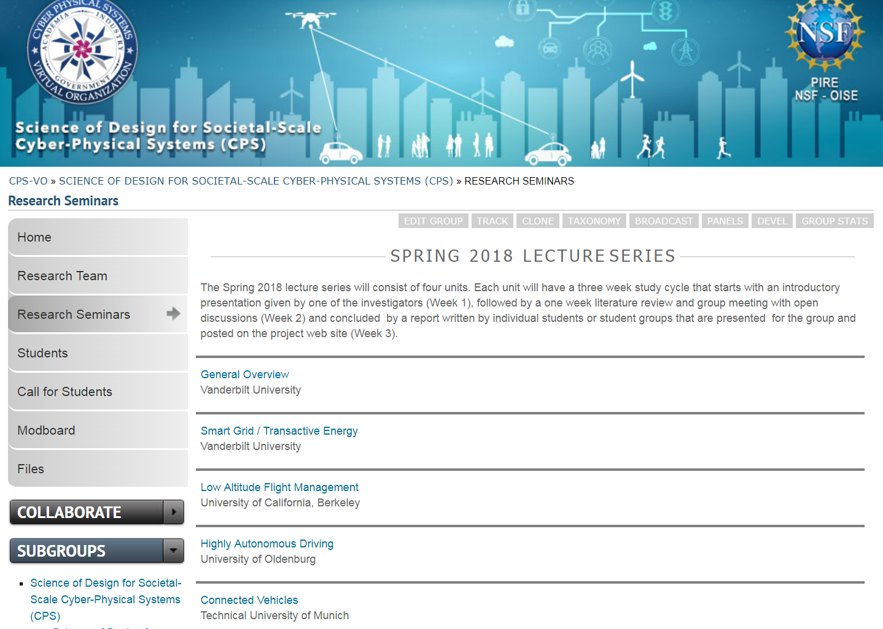
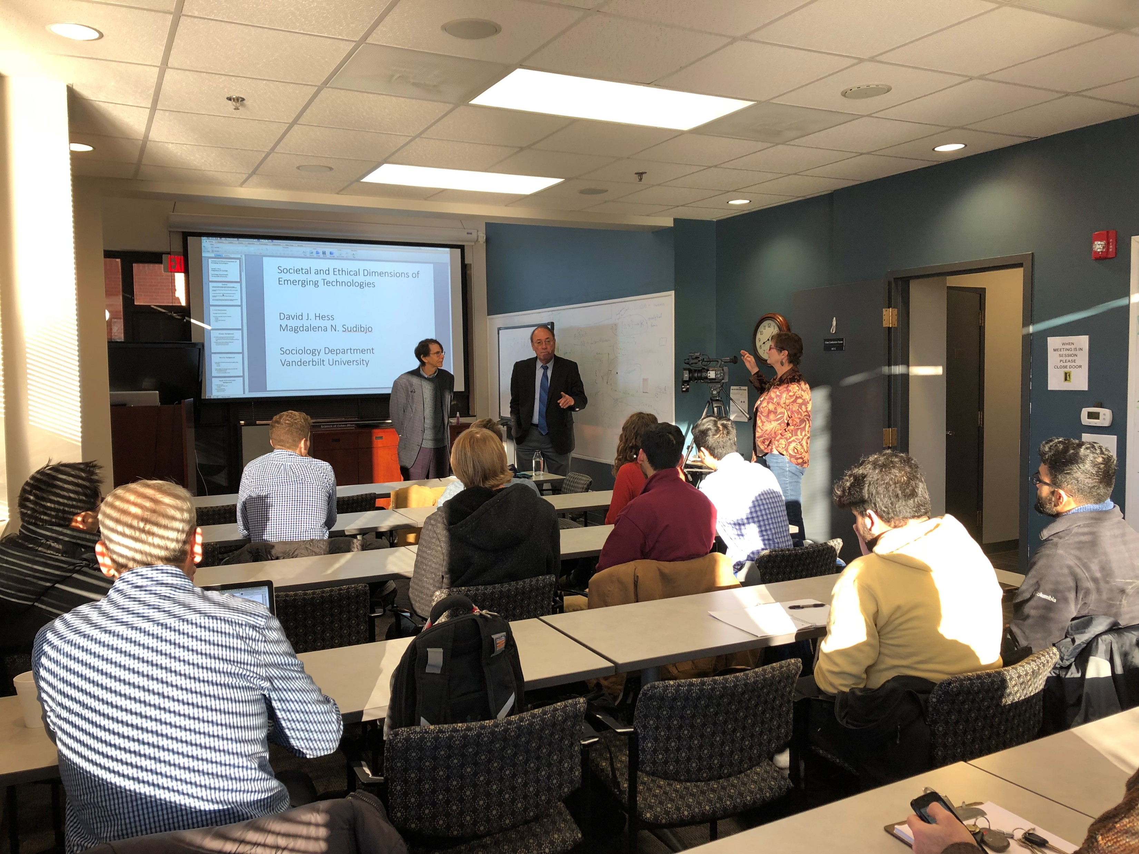
Snapshot from the Project
Seminar sequence for undergraduate students coordinated across campuses
https://cps-vo.org/group/sdss-cps/seminars
Notes:
A brief background: Please describe the problem you are addressing and why it is important (20sec slide)

Slide 11
Planned Actions and Outcomes in Year 1
US – German Workshop on current approaches towards regulations for type homologation of highly autonomous vehicles. Washington DC, October 17-19, 2018
Creating and operating live test beds
Germany: Providentia/A9 test field is deployed along parts of the A9 Autobahn north of Munich
USA: Simulation platforms for highway traffic control, transactive energy and UAV traffic control
Experimental scenarios for decision makers
  New traffic system concepts for urban living
  Car sharing and car pooling concepts
  Handling mixed traffic (autonomous and manually driven cars)
Exchange of 10-10 undergraduate students for 8 weeks summer research internship between US and German partner universities
Notes:
A brief background: Please describe the problem you are addressing and why it is important (20sec slide)

