Slide 1
2018 NSF SMART AND CONNECTED COMMUNITIES PI MEETING
IRG Track 2: Towards Quality Aware Crowdsourced Road Sensing for Smart Cities, NSF Award 1737590
Lu Su* (PI), Chunming Qiao* (Co-PI), Jing Gao* (Co-PI), Adel W. Sadek* (Co-PI), Alex Anas* (Co-PI), Athena Hutchins† (Partner), William Geary‡ (Partner), and Thomas George§ (Partner)
* State University of New York at Buffalo
† Niagara International Transportation Technology Coalition (NITTEC)
‡ Erie County Department of Public Works
§ Niagara Frontier Transportation Authority (NFTA)
https://www.cse.buffalo.edu/~lusu/scc.html

Slide 2
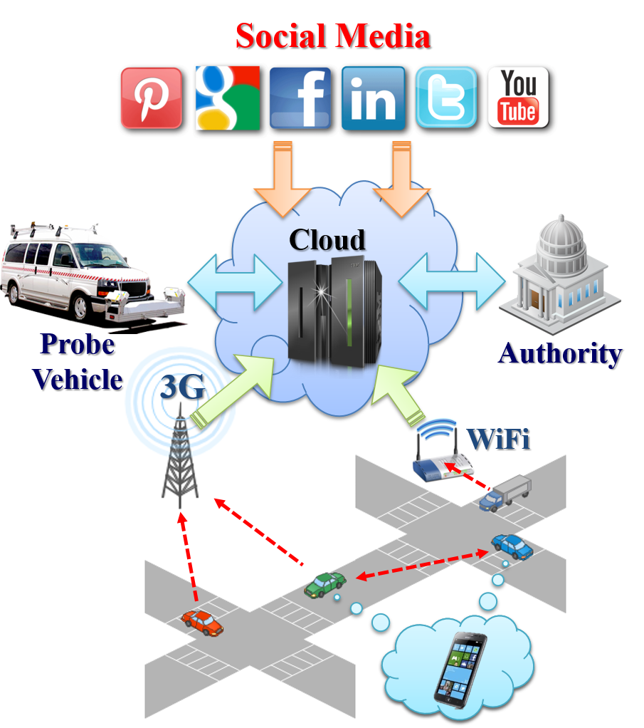
Project Aims
Goal: To make the acquisition and dissemination of road/traffic condition information (traffic congestion, road surface defects, malfunctioning traffic regulation infrastructures) accurate, efficient, and timely.
Traditional road and traffic monitoring
Stationary Sensors (e.g., inductive loop detectors, closed-circuit cameras)
Specialized probe vehicles equipped with dedicated sensors (e.g., ground penetrating radar (GPR), 3D laser scanner).
Prohibitively high deployment cost
Impossible to achieve largescale deployment
Limited road coverage
Delayed information update
QuicRoad: a Quality-of-information aware crowdsourced road sensing system.
Smartphones (GPS, accelerometer, compass, camera, etc).
Social media.
Specialized sensor/vehicle/authority.
Figure 1: QuicRoad System Design

Slide 3
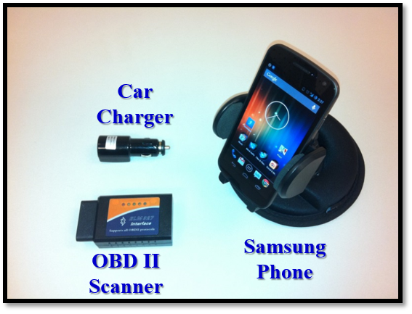
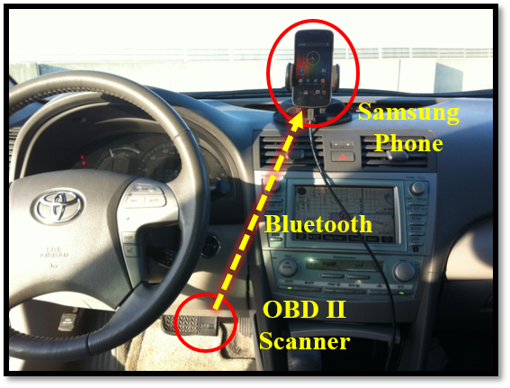
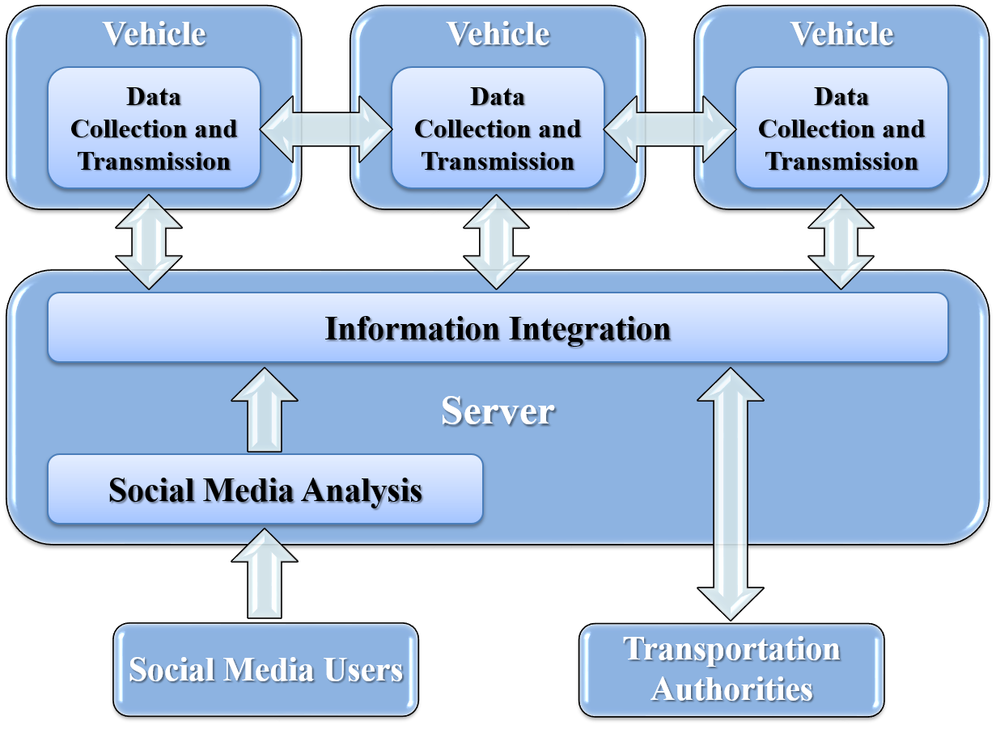
Overview of the Proposed Research
Task 1: QoI-Aware Information Integration Infer true values of the observed objects or events from the noisy information provided by the unreliable human-carried smart devices or social media users.
Task 2: Integrating Social Media Information with Mobile Sensing Data Integrate social media information with mobile sensing data to construct a more complete and accurate view of road condition.
Task 3: Socioeconomic Impact of the Proposed Research Explore whether and to what degree the road sensing information provided by the proposed system would change the social behavior of the crowd.
Task 4: System Deployment with Local Community Engagement.

Slide 4
Status of the Project and Next Steps
Status: Develop a Quality of Information Aware Information Integration Framework
Motivation: Individual sensors are unreliable (poor sensor quality, incomplete view, environment noise), so aggregating observations from multiple sensors that observe the same entity can help find the true value.
Challenge: The reliability of each sensor should be taken into account when aggregating the observations. however, the reliability information is usually unknown a priori.
Principle: Infer both truth and sensor reliability simultaneously.
A sensor is reliable if it provides many pieces of true information.
A piece of information is likely to be true if it is provided by many reliable sensors.
Next Steps
Build and deploy road sensing systems to collect data.
Apply the proposed framework to the collected data.

