Slide 1
2018 NSF SMART AND CONNECTED COMMUNITIES PI MEETING
S&CC-IRG Track 1: Connecting the Smart-City Paradigm with
a Sustainable Urban Infrastructure Systems Framework
to Advance Equity in Communities
NSF Award #1737633
Team Composition
S. Shekhar & A. Ramaswami, Co-Leads, Univ. of Minnesota
J. Marshall, University of Washington
V. Merwade, Purdue University
R. Feiock, Florida State University
J. Brown, D. Dalbotten, R. Johns, J. Cao, F. Douma, L. Kne, University of Minnesota
Website: http://www.spatial.cs.umn.edu/Project/smart-city/index.html
Notes:
BRIEFLY INTRODUCE YOURSELF AND YOUR INVESTIGATORS (10 sec slide)

Slide 2
2018 NSF SMART AND CONNECTED COMMUNITIES PI MEETING
S&CC-IRG Track 1: Connecting the Smart-City Paradigm with
a Sustainable Urban Infrastructure Systems Framework
to Advance Equity in Communities
NSF Award #1737633
Team Composition
Community Partners
S. Shekhar & A. Ramaswami, Co-Leads, Univ. of Minnesota
J. Marshall, University of Washington
V. Merwade, Purdue University
R. Feiock, Florida State University
J. Brown, D. Dalbotten, R. Johns, J. Cao, F. Douma, L. Kne, University of Minnesota
B. Hjelle & K. Mayell, Minneapolis (Public Works)
M. Ohlsen, Tallahassee (Utilities)
Carl Michaud, Hennepin county (Public Works)
Matt Larson, St. Paul
C. Ellingson & B. Stretch, Minneapolis Public Schools
A. Fyfie, ICLEI-USA
T. Macgalliard, Intl. City/County Management Association
B. Levine, MetroLab Network
Website: http://www.spatial.cs.umn.edu/Project/smart-city/index.html
Notes:
BRIEFLY INTRODUCE YOURSELF AND YOUR INVESTIGATORS (10 sec slide)

Slide 3
Objectives & Overarching Questions
Objectives
Understand spatial equity (e) in the context of 7 basic infrastructure provisioning and related wellbeing (W), health (H), and environment (E) outcomes in cities (WHE)
Advance all four WHEe outcomes using smart spatial infrastructure planning in cities.
Address two inter-connected overarching research questions (RQs)
Notes:
A brief background: Please describe the problem you are addressing and why it is important (20sec slide)

Slide 4
Objectives & Overarching Questions
Objectives
Understand spatial equity (e) in the context of 7 basic infrastructure provisioning and related wellbeing (W), health (H), and environment (E) outcomes in cities (WHE)
Advance all four WHEe outcomes using smart spatial infrastructure planning in cities.
Address two inter-connected overarching research questions (RQs)
RQ1: How can we better understand spatial equity (including inequality and fairness) in the context of 7 basic infrastructure provisioning and related wellbeing (W), health (H), environment (E) outcomes in cities (WHE)? (Note: Equity, e, is explored as the spatial distribution of the WHE outcomes and their correlates with SEIU parameters)
Notes:
A brief background: Please describe the problem you are addressing and why it is important (20sec slide)

Slide 5
Objectives & Overarching Questions
Objectives
Understand spatial equity (e) in the context of 7 basic infrastructure provisioning and related wellbeing (W), health (H), and environment (E) outcomes in cities (WHE)
Advance all four WHEe outcomes using smart spatial infrastructure planning in cities.
Address two inter-connected overarching research questions (RQs)
RQ1: How can we better understand spatial equity (including inequality and fairness) in the context of 7 basic infrastructure provisioning and related wellbeing (W), health (H), environment (E) outcomes in cities (WHE)? (Note: Equity, e, is explored as the spatial distribution of the WHE outcomes and their correlates with SEIU parameters)
RQ2: Given the opportunity of transformative smart infrastructures on-horizon (e.g. smart electricity grid, autonomous vehicles) and their interactions with land use, buildings, solar PV deployment, urban farming and green infrastructure to manage climate risks, can smart spatial infrastructure planning in cities, initiated today, encompassing all 7 physical infrastructure sectors, advance all four WHEe outcomes? In particular, how does an equity first approach differ from conventional approaches that focus on “average” outcomes?
Notes:
A brief background: Please describe the problem you are addressing and why it is important (20sec slide)

Slide 6
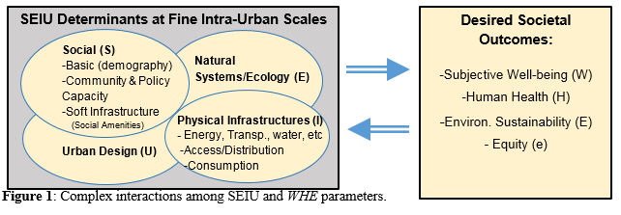
Project Approach
Approach in collaboration of Community Partners
Comprehensive fine intra-urban scale data (SEIU-EHW parameters in Figure 1)
Figure 1. Complex Interactions among SEIU and EHW parameters
Notes:
A brief background: Please describe the problem you are addressing and why it is important (20sec slide)

Slide 7
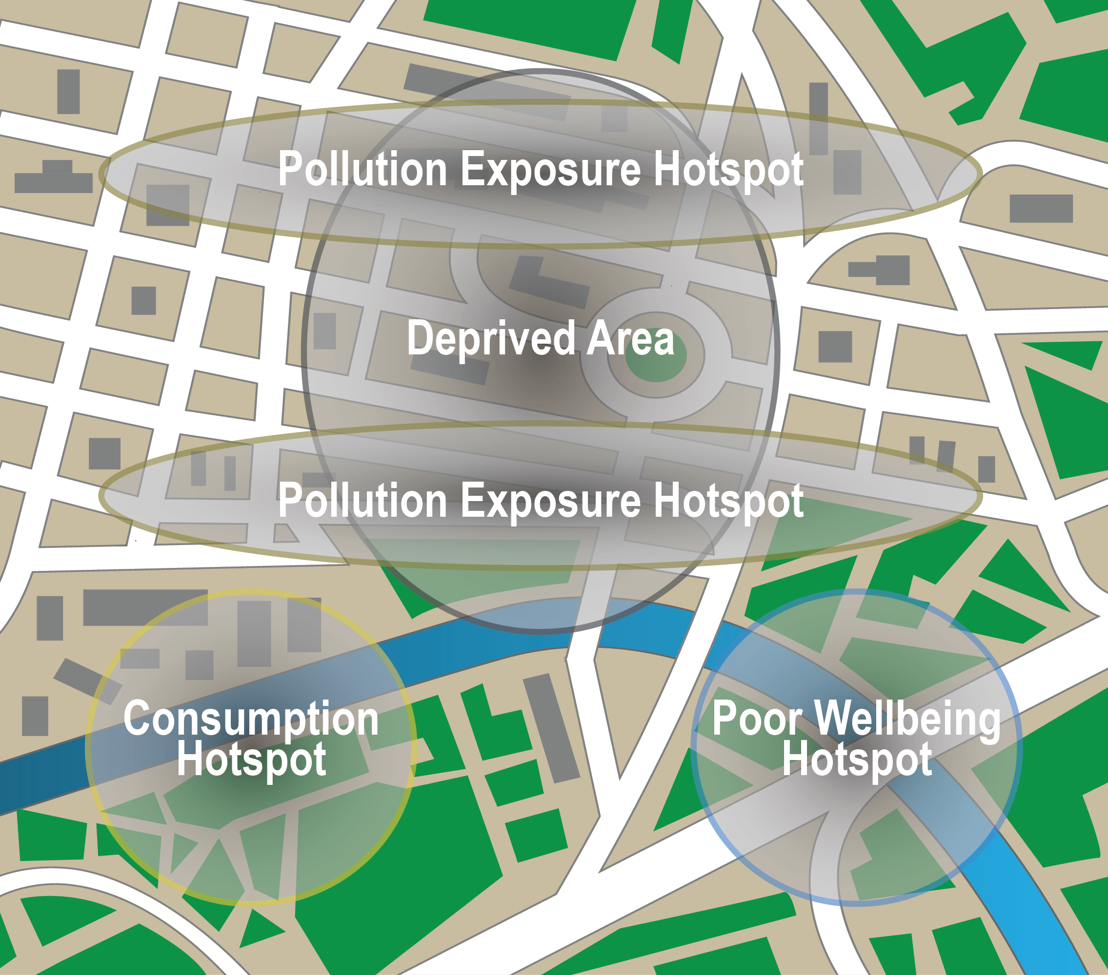
Project Approach
Approach in collaboration of Community Partners
Comprehensive fine intra-urban scale data (SEIU-EHW parameters in Figure 1)
Spatial Data Science to understand relationships (Figure 2).
Model & visualize multi-infrastructure spatial smart city futures
Knowledge co-production theories, science and practice
Figure 1. Complex Interactions among SEIU and EHW parameters
Figure 2. Spatial Patterns
Notes:
A brief background: Please describe the problem you are addressing and why it is important (20sec slide)

Slide 8
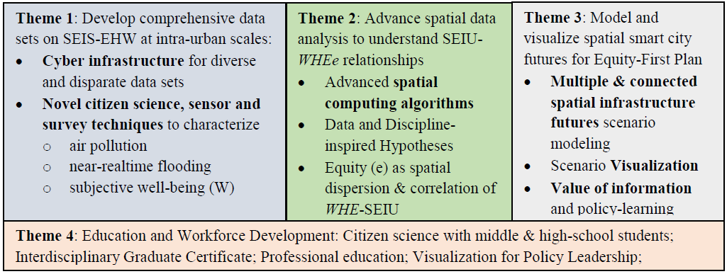
Four Themes
Leverages the SHC SRN
Leverages the SHC SRN
Note: SHC = Sustainable Healthy Cities
SRN = Sustainability Research Network
Notes:
A brief background: Please describe the problem you are addressing and why it is important (20sec slide)
ANU COMMENT TO SHASHI: The multi-infrastructure modeling is coming from the SRN, and I will lead that effort as I am leading that in the SRN. There are very few people who have breadth and depth on all 7 infrastructrue sectors – that Theme 3 will be led by me, with various faculty providing scenarios..
This is the major intersection of SRN & SCC. The SCC budget alone would not enable any of the data in Theme 1 or the Modeling in Theme 3 to be done. SCC is leveraging significantly on SRN as NSF also knows, and I suspect appreciates a lot.

Slide 9
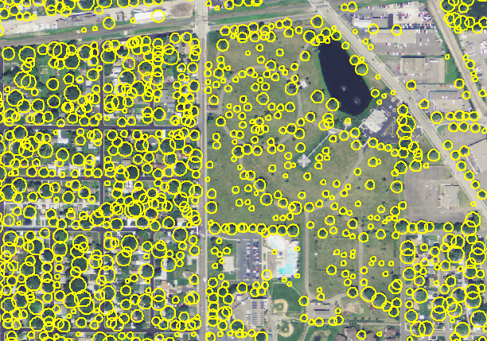
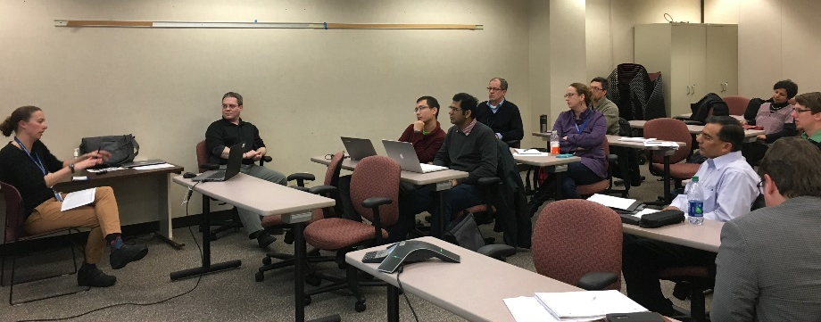
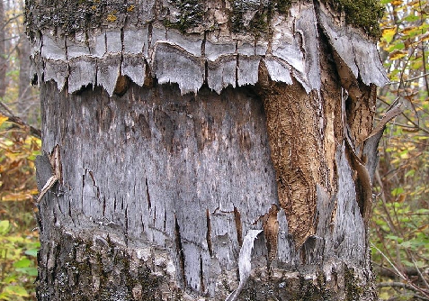
Status of the Project : Accomplishments
Kick-off meetings with community partners: Minneapolis, Hennepin County, and Tallahassee (Theme 1 & 4).
Worked with Minneapolis & SHC SRN to design a neighborhood level well-being survey (Theme 1)
Developed framework for SEIU-WHEe database, added public & community partner data (Theme 1).
Assembled a network of partners to implement the Citizen Science curriculum modules (Theme 4)
Advertised Citizen Science summer teacher workshop (Minneapolis Public Schools; Theme 4)
Legend
Tree canopy
Source: MPR News, Roanoke Times
Notes:
A brief background: Please describe the problem you are addressing and why it is important (20sec slide)

Slide 10
Status of the Project : Accomplishments
Kick-off meetings with community partners: Minneapolis, Hennepin County, and Tallahassee (Theme 1 & 4).
Worked with Minneapolis & SHC SRN to design a neighborhood level well-being survey (Theme 1)
Developed framework for SEIU-WHEe database, added public & community partner data (Theme 1).
Collected 80% of the data needed for the surface-groundwater flood prediction model (Theme 1 & 4).
Obtained tree inventory for the City of St. Paul and the University of Minnesota.
Acquired parcel level housing characteristic, sales information, natural gas consumption, water consumption, spatial/land use, and voting characteristics data for Tallahassee/Leon County (Theme 1).
Assembled a network of partners to implement the Citizen Science curriculum modules (Theme 4)
Advertised Citizen Science summer teacher workshop (Minneapolis Public Schools; Theme 4)
Legend
Tree canopy
Source: MPR News, Roanoke Times
Notes:
A brief background: Please describe the problem you are addressing and why it is important (20sec slide)

Slide 11
What is Next ?
Complete the SEIU-WHEe database
Work with community Partners to finish populating the database
Near-real time flood modelling
Parameterize the model, Acquire streamflow and rainfall data, Calibrate model using observed data
Spatial green infrastructure analysis
Process high spatial resolution LiDAR and high temporal resolution satellite imagery
Incorporate ash tree features
Effect of spatial partitioning on statistical measures of inequality
Evaluate statistical measures, metrics with real data and assess point data and aggregate data.
Identify real world relevant use-cases for real-time spatial patterns and mine identified spatial patterns.
Equity-first planning
Develop instruments for baseline measures of policy planning stakeholders
Organize a Tallahassee stakeholder meeting with workshop on measuring livability at FSU in October
Citizen science curriculum development
Complete curriculum development, Further website development for Citizen Science component
Strengthen connections with schools, Minneapolis Public Schools teachers
Finalize logistics for Citizen Science summer teacher workshop
Notes:
A brief background: Please describe the problem you are addressing and why it is important (20sec slide)

