Slide 1
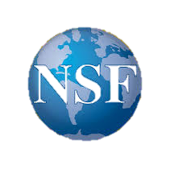
2018 NSF SMART AND CONNECTED COMMUNITIES PI MEETING
PG: Smart Connections for Conserving & Catalyzing Cultural Community Resources,
NSF Award: 1737587
Donna Rizzo¹, Mandar Dewoolkar¹, Dryver Huston², Douglas Porter^{1,3}, Asim Zia⁴
¹Civil & Environmental Engineering, ²Mechanical Engineering, ³HistoricPreservation, and ⁴Community Development & Applied Economics
go.uvm.edu/rizzoscc2018
Notes:
BRIEFLY INTRODUCE YOURSELF AND YOUR INVESTIGATORS (10 sec slide)
32115

Slide 2
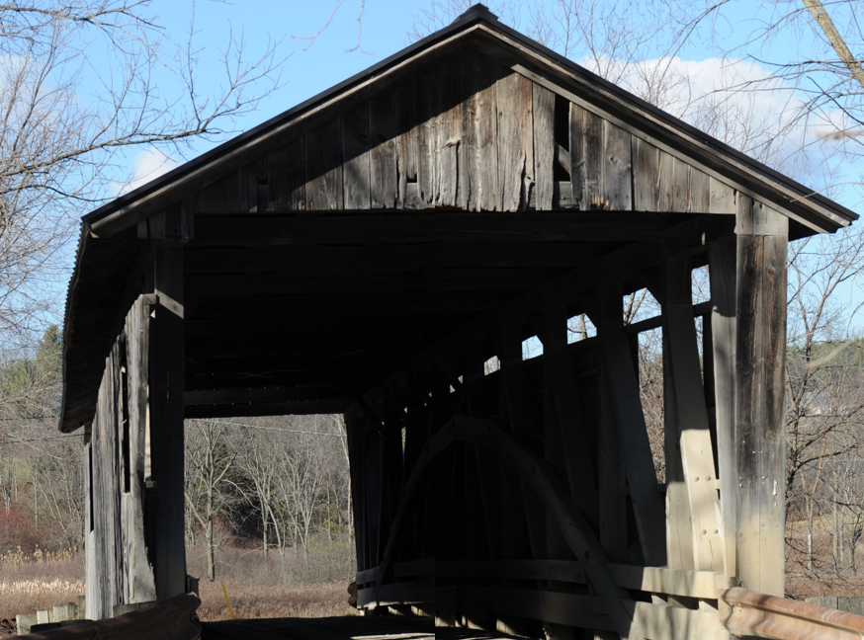
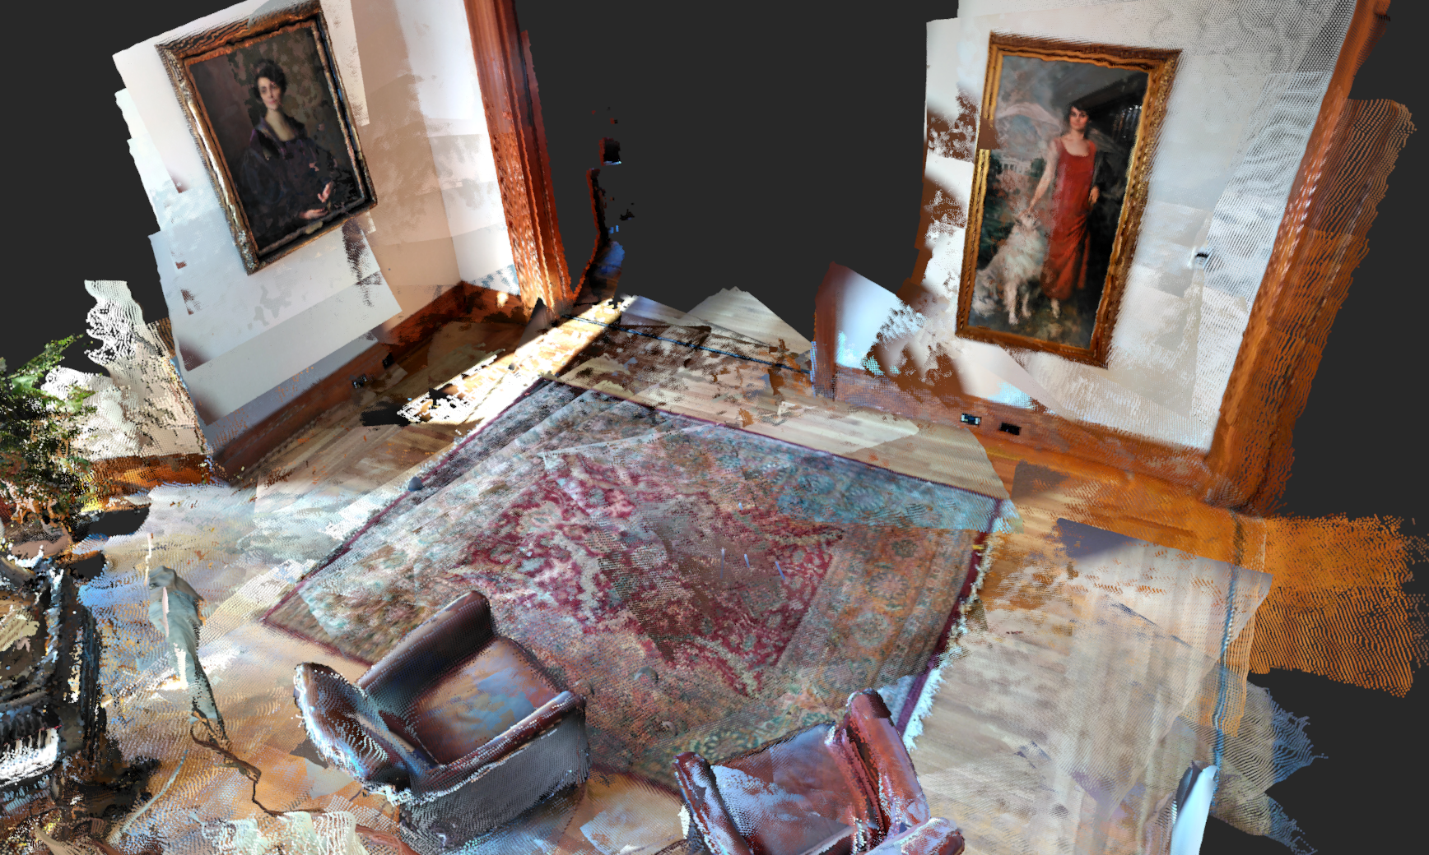
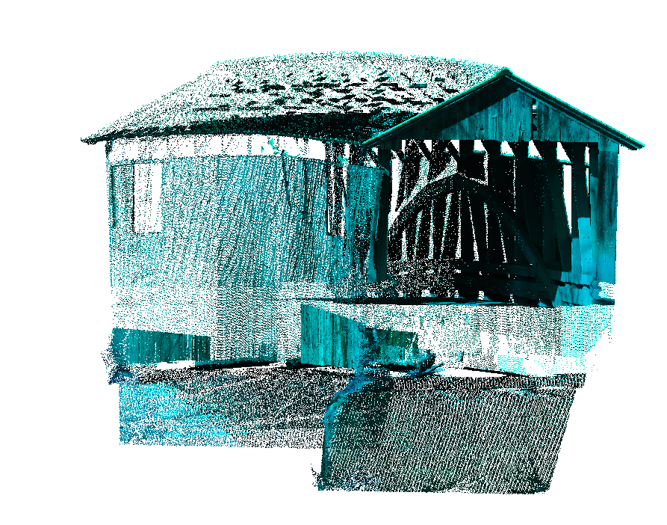
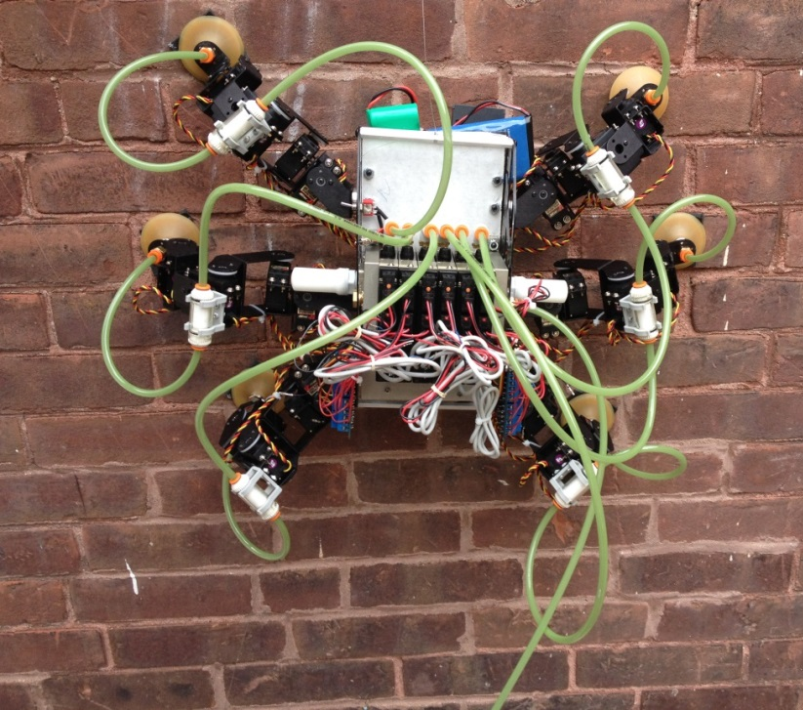
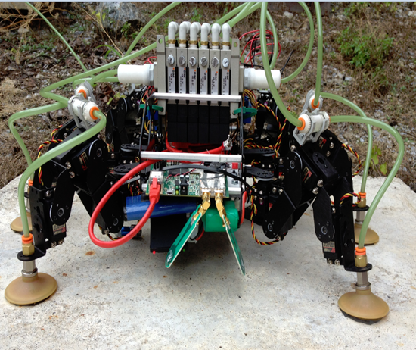
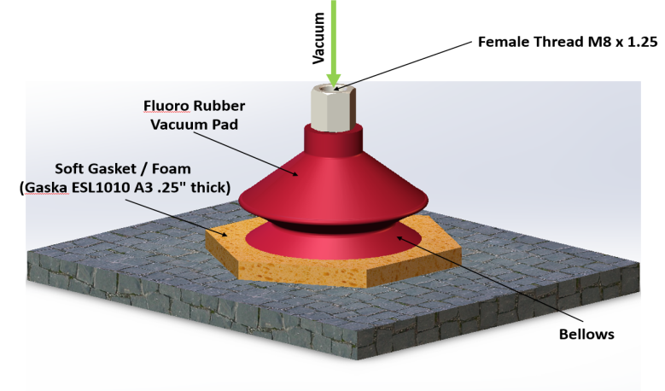
Project Aims: Bring engineering research to bear on specific problems in the preservation of Vermont’s cultural resources
Lidar Scan of Covered Bridge into BIM Model
3D Mapping Using Photogrammetry (Structure from Motion) on smart phone with Tango/Unity
Robots Soft foot climber

Slide 3
Project Aims: Use Cultural Resources Network (CRN) to delivery systems & make the technologies available to VT communities
Community Partners
Name | Organization
Kathy Beyer | Housing Vermont
Luce Hillman | UVM Facilities
Laura Trieschmann | State Historic Preservation Officer
Tom Visser | Historic Preservation
Andrea Wright | Project Delivery Bureau, Environmental Section
Judith Ehrlich | VTrans - Historic Preservation
Jamie Duggan | Division of Historic Preservation Dept of Housing & Community Development
John Crock | UVM - Anthropology
Bob McCullough | UVM - Historic Preservation
Paul Bruhn | Preservation Trust of Vermont
Michael Desrochers | Dept of Public Safety, Division of Fire Safety - State of Vermont
Karl Goetze | Efficiency Vermont
Deb Sachs | Netzero of Vermont
Karen Freeman | VT Housing and Conservation Board
Carolyn Carlson | VTrans - Bridges
Bob Neeld | Engineering Ventures
Nick Artim | Heritage Preservation Group
Jerry Francis | Shelburne Farms

Slide 4
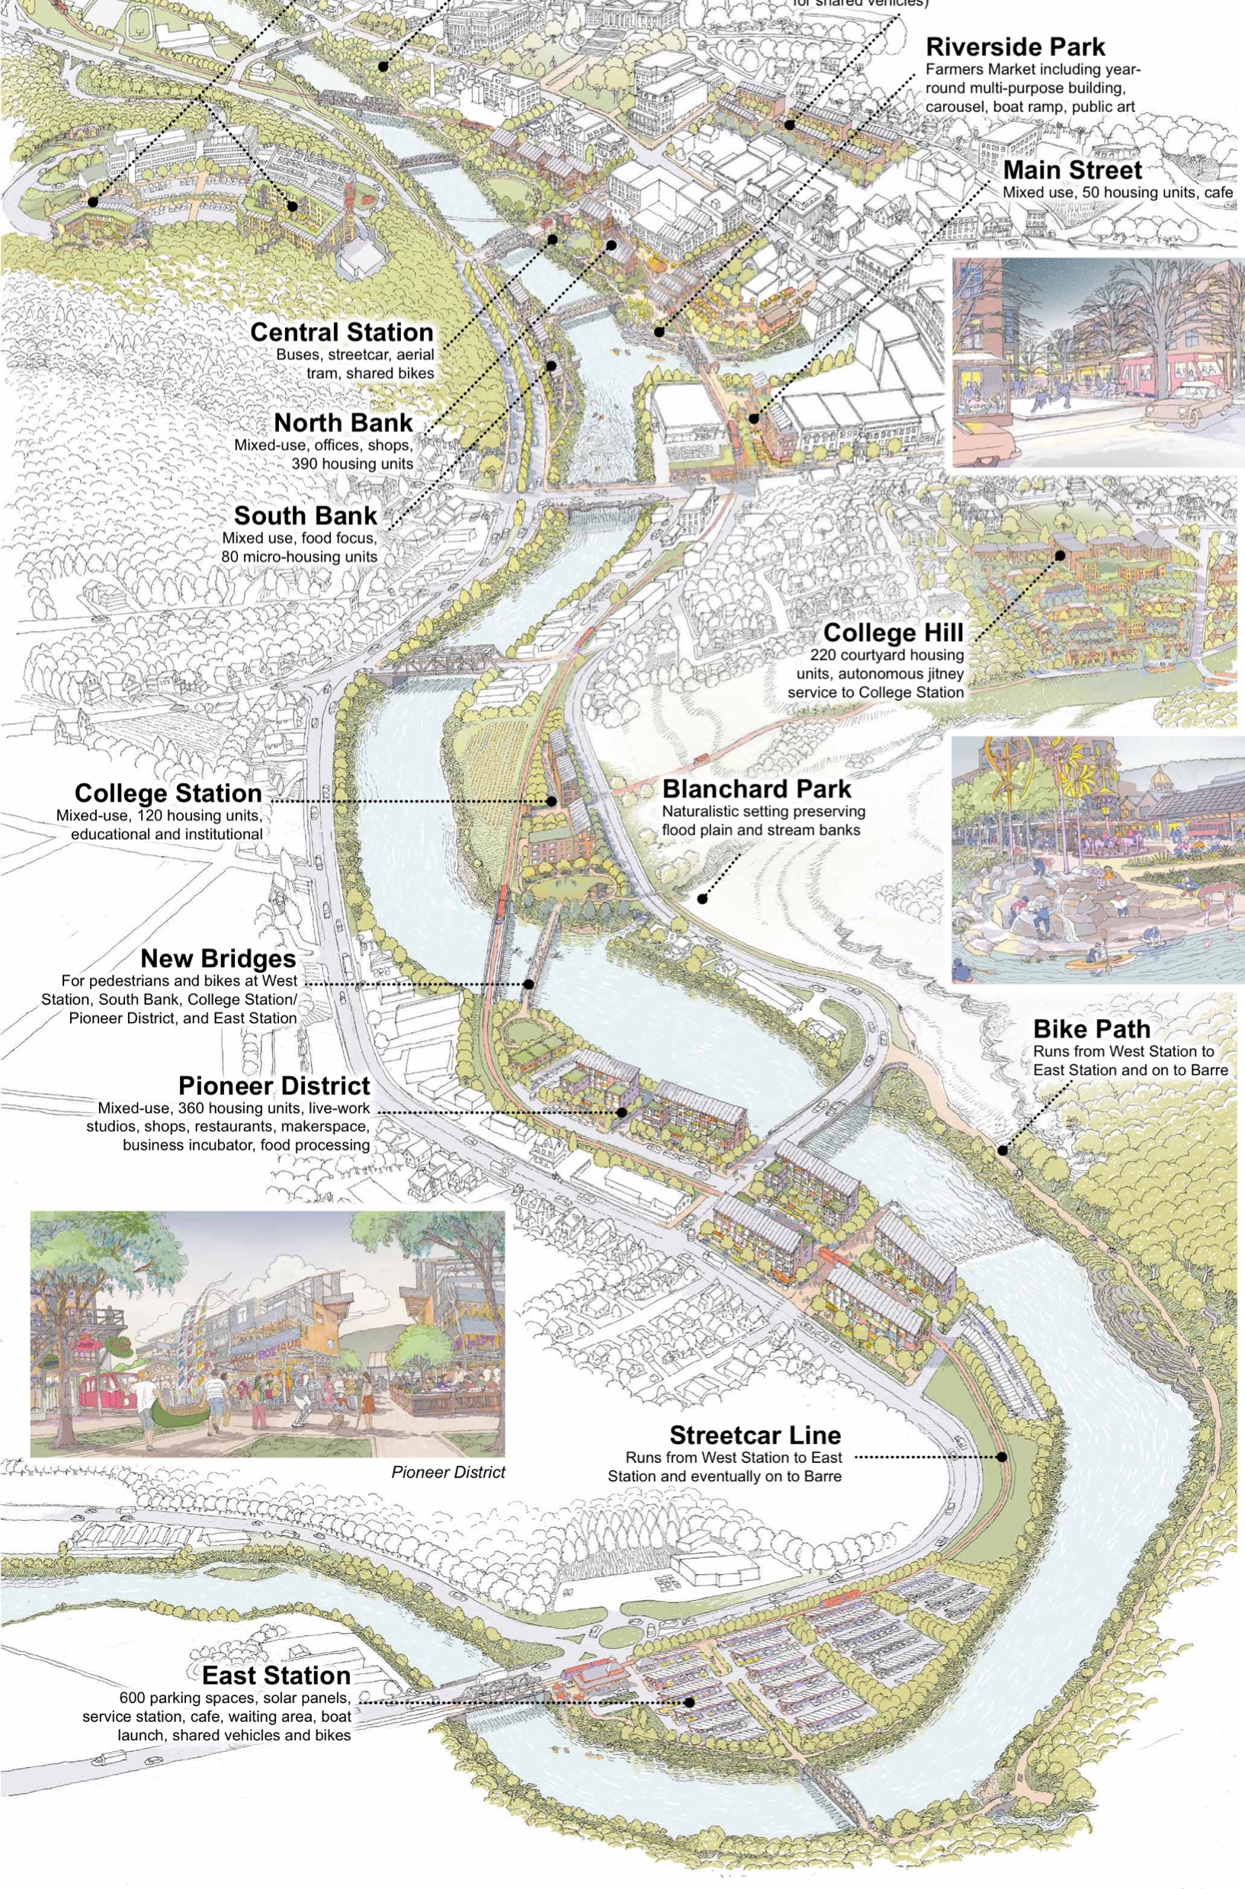
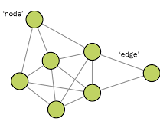
Project Aims: Use network analysis to ID existing community network connections, key features, and ways to enhance network functioning

Slide 5
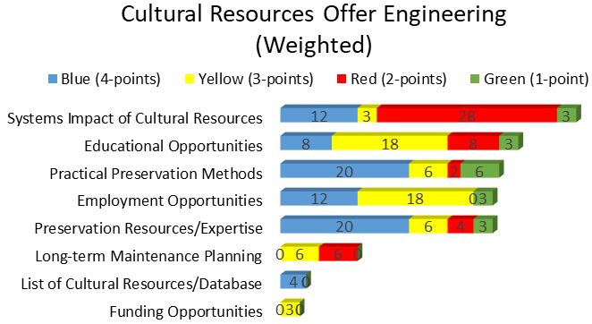
Status of the Project:
Workshop 1: (Jan. 4, 2018) helped ID research & work tasks most interesting and useful to the cultural resource and engineering communities

Slide 6
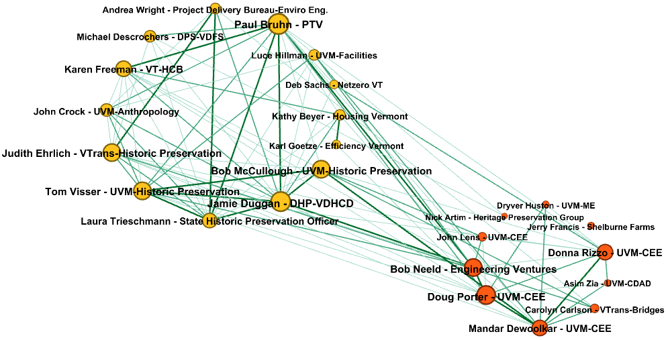
Analysis will likely:
1) enhance appreciation of challenges facing both sectors,
2) ID structural features of successful preservation networks,
3) provide measures of community connectedness leveraged by local preservation activities,
4) promote connections between CRN and engineering networks mutually beneficial to both.
Cultural Resources Network (CRN)
Engineering Network
Cultural Resources (Node)
Engineering (Node)
Connection (Edge)
Note: Edges and Nodes are scaled based on strength of adjacency

